Slide 1



Trends and Testimonies: 10 Years of Sexual and Gender-Based Violence in Haiti
Diana Manilla Arroyo, MSF
Conflict of interest: the author has declared no conflict of interest.

Slide 2
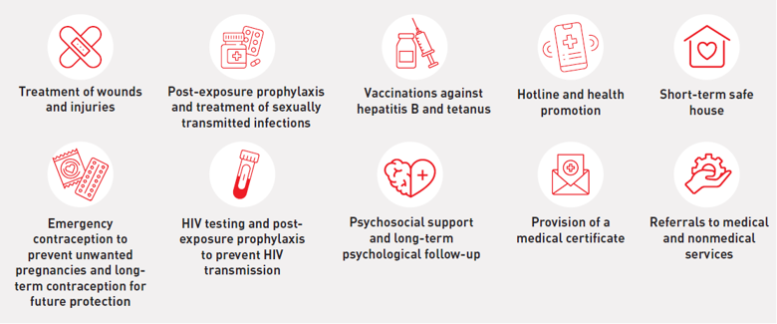
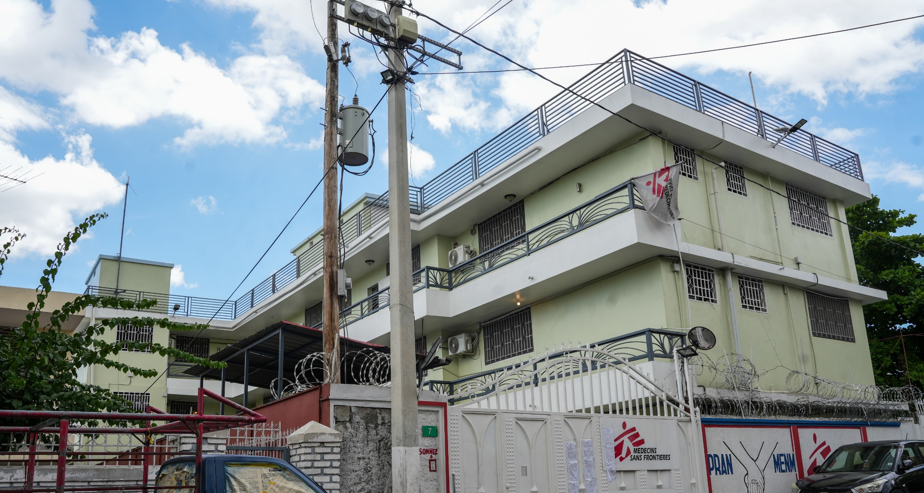
Context
Pran Menm clinic - 2015

Slide 3

Why did we collect this data?
Measure and document the gendered consequences of the crisis
Amplify survivors’ voices and experiences
2021
Assassination of President Jovenel Moise
2022
Increase of G9 vs GPEP violence
2023
Multinational Support Forces
2024
Viv Ansam Coalition
2025
Gang Suppression Force
+1.4 m. displaced

Slide 4
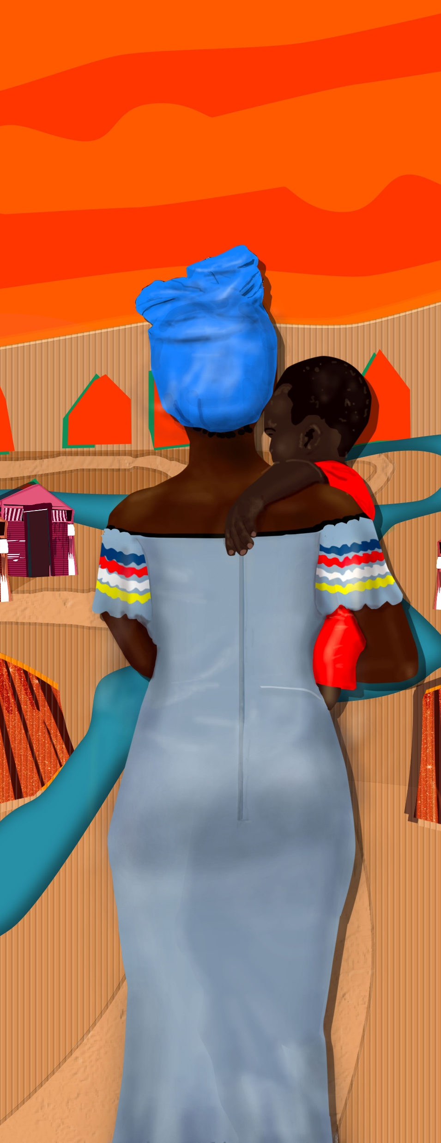
Methods
  Anonymised database May 2015 –Sept. 2025
    Before and after 2022 (crisis)
  Survivors’ testimonies (service priorities)
  Interviews with survivors who used services of other organisations
  FGD with MSF staff and external partners
  Review of secondary literature
Key limitation: Only survivors who accessed services are represented

Slide 5
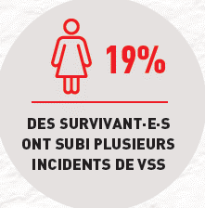



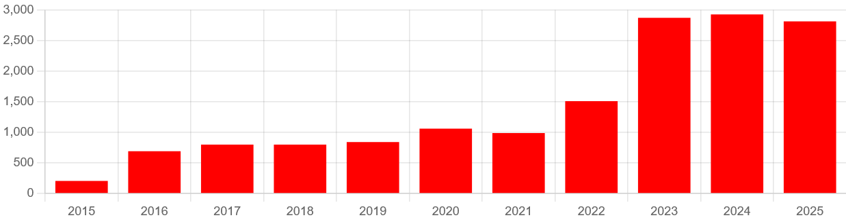
Evolution of trends
x
NUMBER OF PATIENTS SINCE 2022
Number of patients that received care at Pran Men’n since 2015
USE GRAPHS/CHART HERE

Slide 6
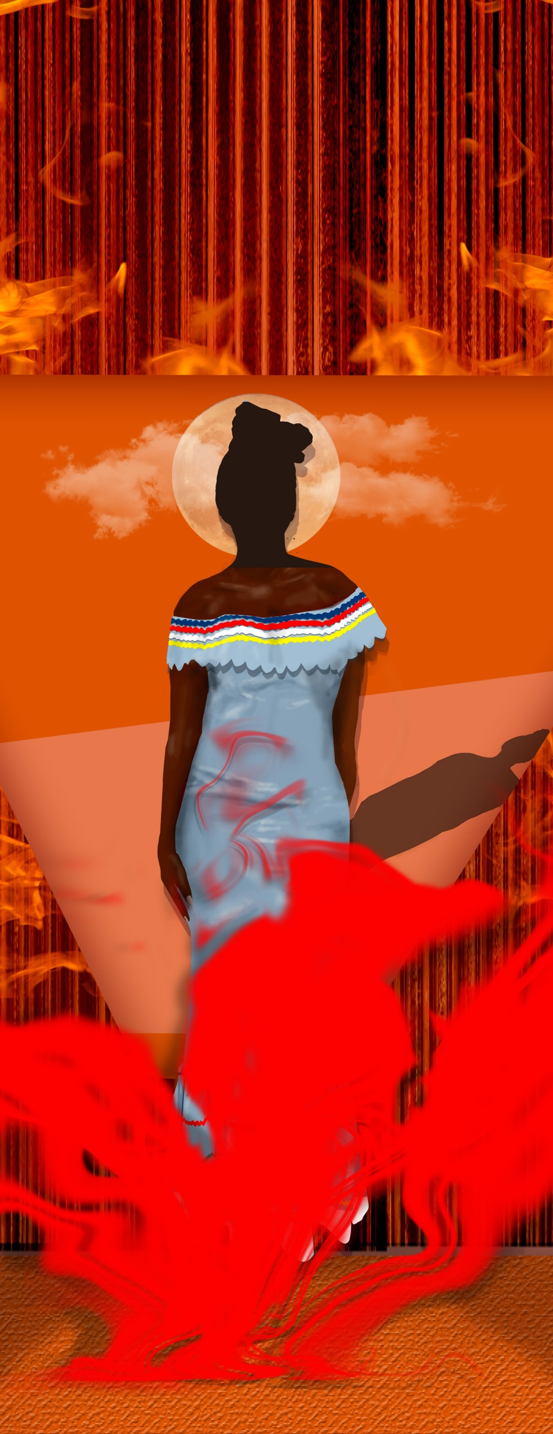
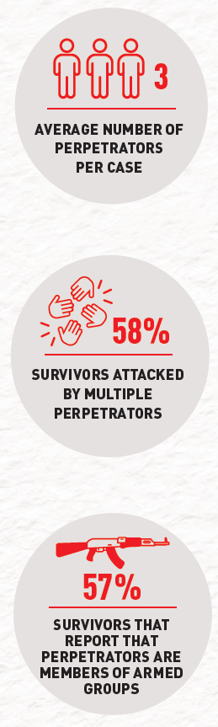
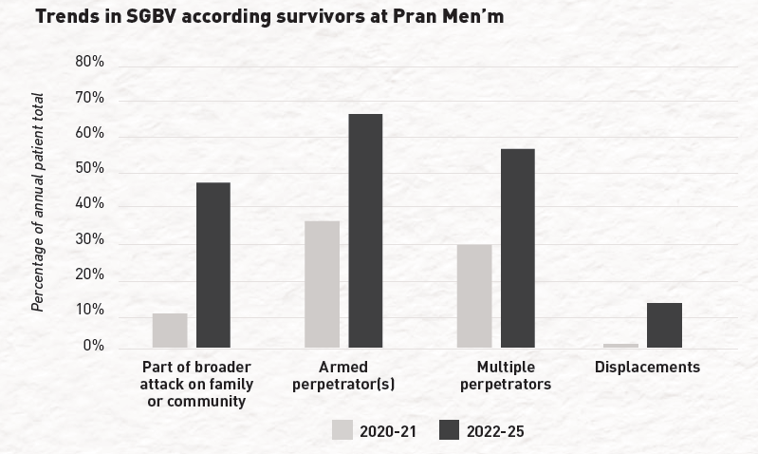
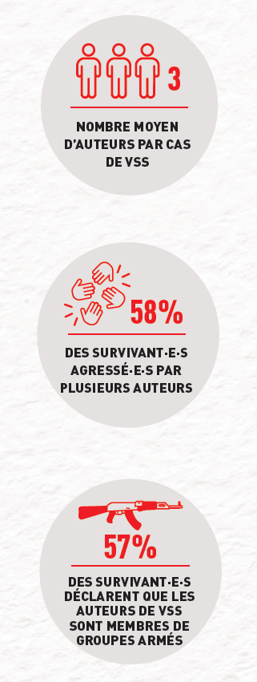
Increasing brutality
NUMBER OF PATIENTS DISPLACED
COMPARED TO BEFORE
2022
x
20

Slide 7
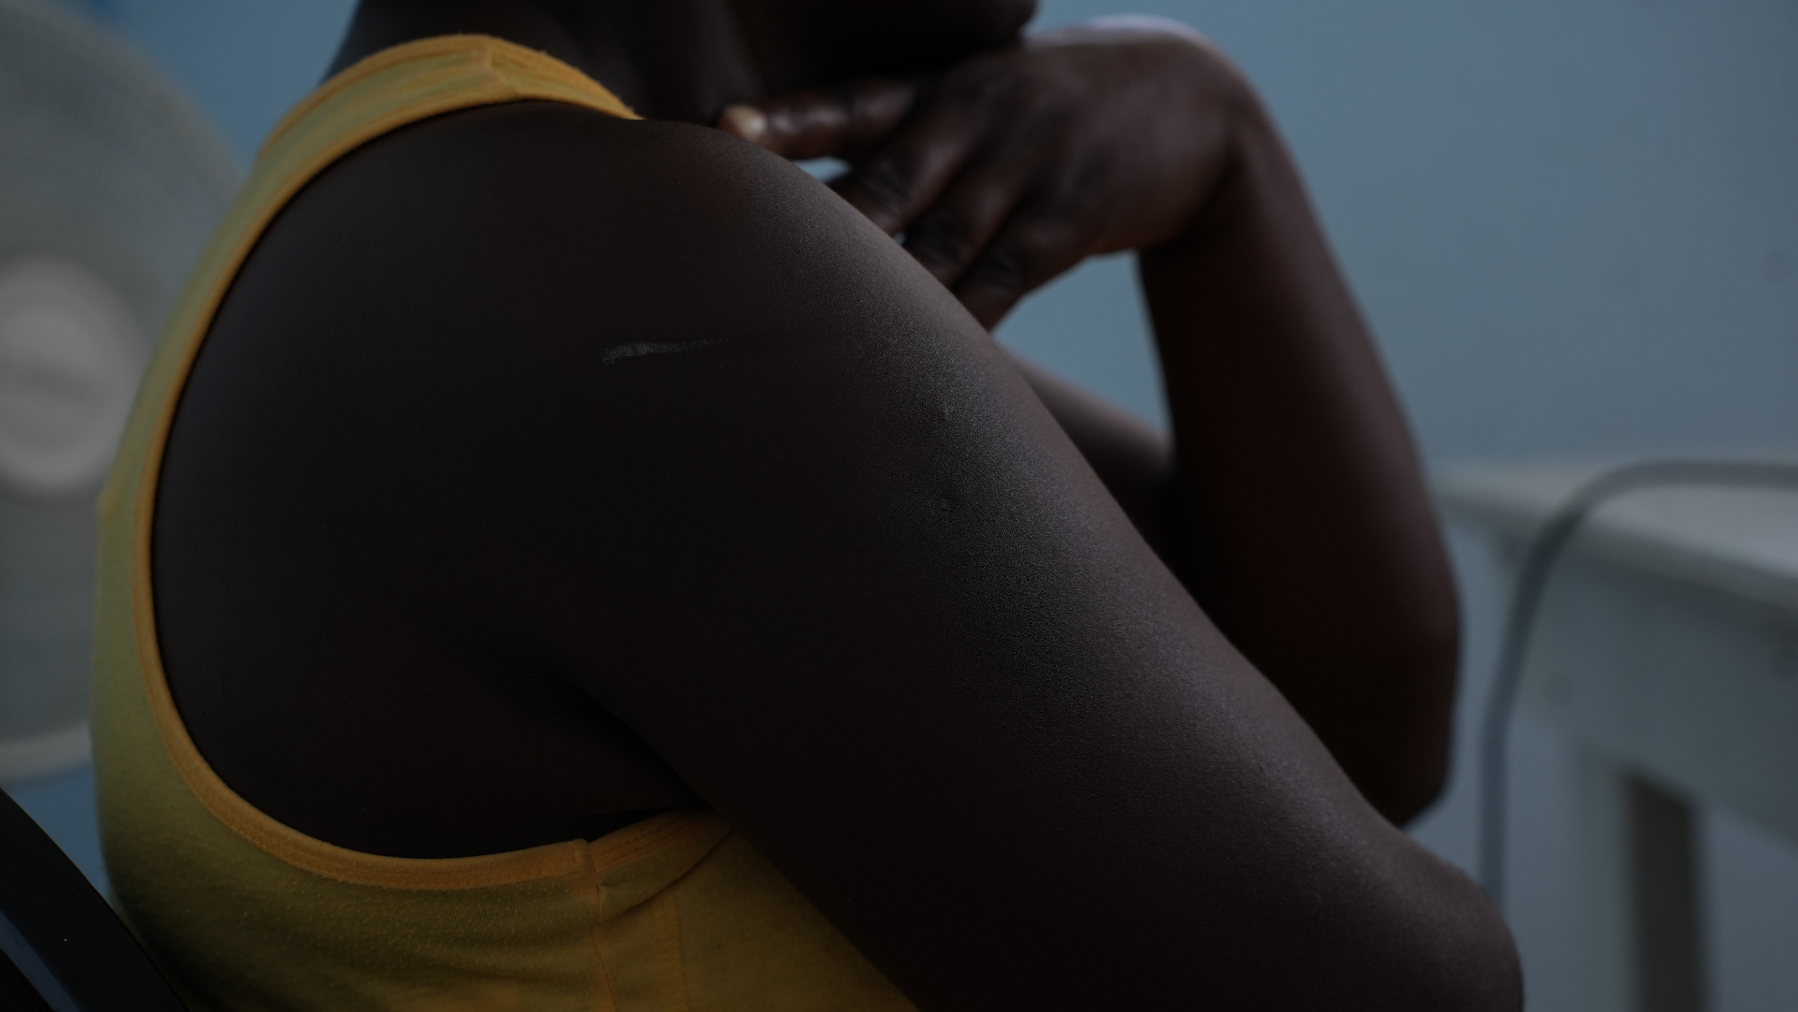
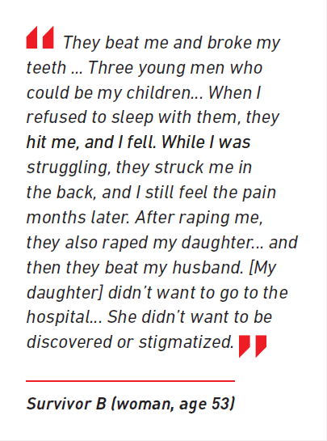

Slide 8
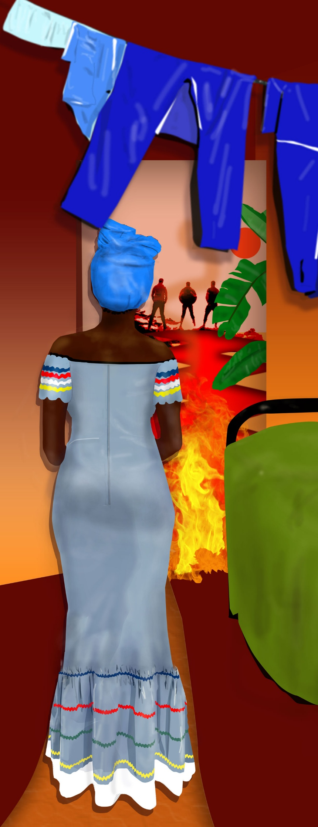



What did we advocate for and why?
Recognise that sexual violence is pervasive and used to control, and subjugate women and girls.
By focusing on recognition and resourcing, the advocacy aims to drive concrete change aligned with their expressed needs.
Expand comprehensive medical and psychological care to all areas (gang-controlled and state-controlled).
Increase of funding for safe shelters (survivors’ top priority).

Slide 9

Thank you
Diana Manilla Arroyo
d.manilla.a@gmail.com

