Slide 1

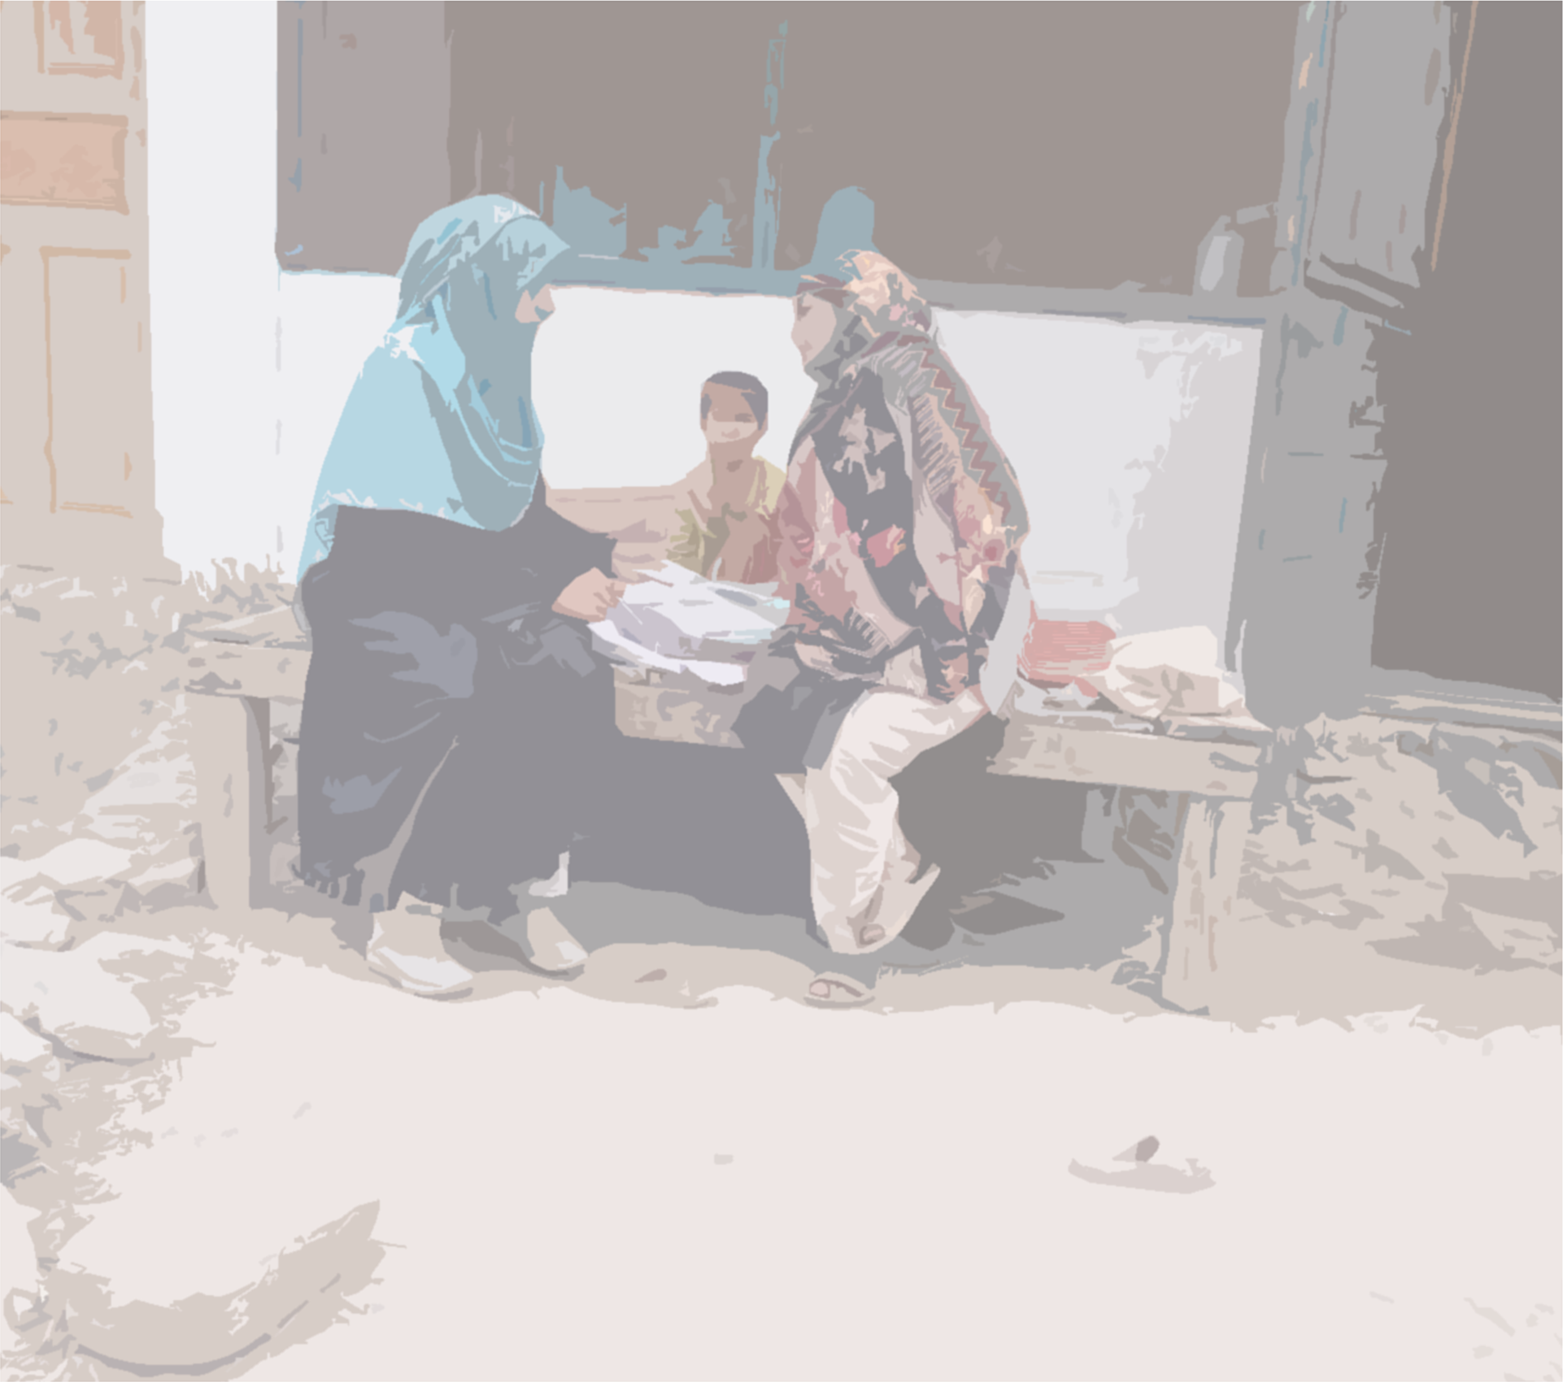







An integrated newborn care kit (iNCK) to save newborn lives and improve health outcomes in Gilgit-Baltistan, Pakistan:
An open-label cluster-randomised controlled trial
Daniel S. Farrar for the GB iNCK Study Team
COI: The author has declared no conflict of interest.
Notes:
Hi everyone – my name is Danny Farrar and I am an epidemiologist based at The Hospital for Sick Children in Toronto, Canada. I’d like to thank the Scientific Days organizers for the opportunity to present here today. I am sharing this work on behalf of our study team in Canada and Pakistan, titled “An integrated newborn care kit to save newborn lives and improve health outcomes in Gilgit-Baltistan, Pakistan: An open-label cluster-randomised controlled trial”. I have no conflicts of interest to declare.

Slide 2
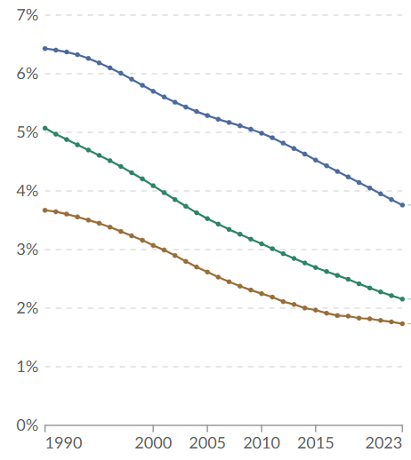

Neonatal Mortality
Since 2000, global declines in neonatal mortality (↓44%) lag behind progress for under-5 mortality (↓51%)
Pakistan experiences high neonatal mortality, around 38–40 newborn deaths per 1000 live births
Most newborn deaths are from preventable causes (e.g., birth asphyxia, complications of prematurity, infection)
Neonatal mortality rate, %
Neonatal mortality, 1990–2023
(Our World in Data)
(https://ourworldindata.org/grapher/neonatal-mortality-wdi)
Notes:
Despite declines in childhood mortality in recent decades, there has been relatively less progress in reducing neonatal mortality (or death within the first 28 days after delivery).
Pakistan experiences a high neonatal mortality rate, estimated at 38–40 newborn deaths per 1000 live births. The Pakistani context is particularly challenging, given fewer healthcare facilities relative to other low-middle income countries, and limited access to both antenatal and postnatal care in rural areas.
Critically, most newborn deaths are from potentially preventable causes including birth asphyxia, complications of prematurity, and infection.
As such, there remains a need for interventions which are low-cost, and able to be delivered through community-based healthcare models.

Slide 3
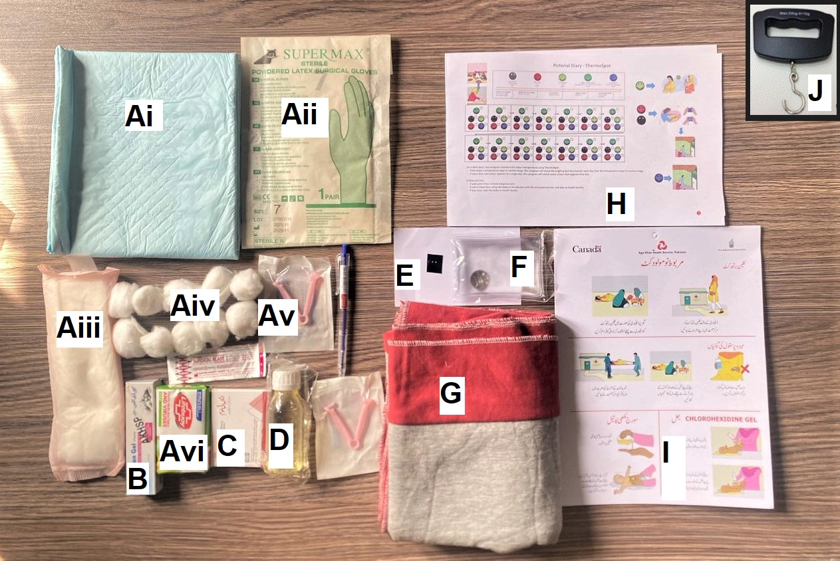
Integrated Newborn Care Kit (iNCK)
  Portable Easy-to-Use Low-Cost
  Integrated Evidence-Based
Clean birth kit
(B) Chlorhexidine 4% gel
(C) Three misoprostol tablets
(D) Sunflower oil emollient
(E) ThermoSpotTM thermoindicator sticker
(F) Click-to-heat warmer
(G) Fleece blanket
(H/I) Pictorial diary and guide
(J) Weighing scale
Clean birth kit:
Used at time of delivery regardless of location of delivery. Includes plastic sheet, sterile blade, sterile cord clamp, gloves, and soap.
Delivered to pregnant women by Lady Health Workers during the third trimester of pregnancy
Notes:
In response to this need, our team has developed what we call the “integrated newborn care kit”, or iNCK. The iNCK contains low-cost and evidence-based items including a clean birth kit to encourage a sterile delivery, 4% chlorhexidine gel to prevent omphalitis (or infection of the umbilical cord stump), and three 200 microgram misoprostol tablets to prevent postpartum hemorrhage (which is the leading cause of maternal mortality).
The iNCK also includes sunflower oil emollient to strengthen the skin barrier and prevent infection, a ThermoSpot temperature indicator sticker to identify newborn fever and hypothermia, a fleece blanket and click-to-heat warmer to address hypothermia, and a pictorial guide demonstrating the appropriate usage of each component.

Slide 4
Integrated Newborn Care Kit (iNCK)
  Portable Easy-to-Use Low-Cost
  Integrated Evidence-Based
Clean birth kit
(B) Chlorhexidine 4% gel
(C) Three misoprostol tablets
(D) Sunflower oil emollient
(E) ThermoSpotTM thermoindicator sticker
(F) Click-to-heat warmer
(G) Fleece blanket
(H/I) Pictorial diary and guide
(J) Weighing scale
(B) Chlorhexidine 4% gel:
Applied to umbilical stump once daily from days 1–10 after delivery.
Delivered to pregnant women by Lady Health Workers during the third trimester of pregnancy
Notes:
In response to this need, our team has developed what we call the “integrated newborn care kit”, or iNCK. The iNCK contains low-cost and evidence-based items including a clean birth kit to encourage a sterile delivery, 4% chlorhexidine gel to prevent omphalitis (or infection of the umbilical cord stump), and three 200 microgram misoprostol tablets to prevent postpartum hemorrhage (which is the leading cause of maternal mortality).
The iNCK also includes sunflower oil emollient to strengthen the skin barrier and prevent infection, a ThermoSpot temperature indicator sticker to identify newborn fever and hypothermia, a fleece blanket and click-to-heat warmer to address hypothermia, and a pictorial guide demonstrating the appropriate usage of each component.

Slide 5
Integrated Newborn Care Kit (iNCK)
  Portable Easy-to-Use Low-Cost
  Integrated Evidence-Based
Clean birth kit
(B) Chlorhexidine 4% gel
(C) Three misoprostol tablets
(D) Sunflower oil emollient
(E) ThermoSpotTM thermoindicator sticker
(F) Click-to-heat warmer
(G) Fleece blanket
(H/I) Pictorial diary and guide
(J) Weighing scale
(C) Three misoprostol tablets:
Taken by the woman after delivery of the newborn but before delivery of the placenta.
Delivered to pregnant women by Lady Health Workers during the third trimester of pregnancy
Notes:
In response to this need, our team has developed what we call the “integrated newborn care kit”, or iNCK. The iNCK contains low-cost and evidence-based items including a clean birth kit to encourage a sterile delivery, 4% chlorhexidine gel to prevent omphalitis (or infection of the umbilical cord stump), and three 200 microgram misoprostol tablets to prevent postpartum hemorrhage (which is the leading cause of maternal mortality).
The iNCK also includes sunflower oil emollient to strengthen the skin barrier and prevent infection, a ThermoSpot temperature indicator sticker to identify newborn fever and hypothermia, a fleece blanket and click-to-heat warmer to address hypothermia, and a pictorial guide demonstrating the appropriate usage of each component.

Slide 6
Integrated Newborn Care Kit (iNCK)
  Portable Easy-to-Use Low-Cost
  Integrated Evidence-Based
Clean birth kit
(B) Chlorhexidine 4% gel
(C) Three misoprostol tablets
(D) Sunflower oil emollient
(E) ThermoSpotTM thermoindicator sticker
(F) Click-to-heat warmer
(G) Fleece blanket
(H/I) Pictorial diary and guide
(J) Weighing scale
(D) Sunflower oil emollient:
Applied to the newborn’s body once daily from days 1–28 after delivery.
Delivered to pregnant women by Lady Health Workers during the third trimester of pregnancy
Notes:
In response to this need, our team has developed what we call the “integrated newborn care kit”, or iNCK. The iNCK contains low-cost and evidence-based items including a clean birth kit to encourage a sterile delivery, 4% chlorhexidine gel to prevent omphalitis (or infection of the umbilical cord stump), and three 200 microgram misoprostol tablets to prevent postpartum hemorrhage (which is the leading cause of maternal mortality).
The iNCK also includes sunflower oil emollient to strengthen the skin barrier and prevent infection, a ThermoSpot temperature indicator sticker to identify newborn fever and hypothermia, a fleece blanket and click-to-heat warmer to address hypothermia, and a pictorial guide demonstrating the appropriate usage of each component.

Slide 7
Integrated Newborn Care Kit (iNCK)
  Portable Easy-to-Use Low-Cost
  Integrated Evidence-Based
Clean birth kit
(B) Chlorhexidine 4% gel
(C) Three misoprostol tablets
(D) Sunflower oil emollient
(E) ThermoSpotTM thermoindicator sticker
(F) Click-to-heat warmer
(G) Fleece blanket
(H/I) Pictorial diary and guide
(J) Weighing scale
(E) ThermoSpotTM:
Applied to the newborn’s carotid artery and monitored from days 1–14 after delivery.
Delivered to pregnant women by Lady Health Workers during the third trimester of pregnancy
Notes:
In response to this need, our team has developed what we call the “integrated newborn care kit”, or iNCK. The iNCK contains low-cost and evidence-based items including a clean birth kit to encourage a sterile delivery, 4% chlorhexidine gel to prevent omphalitis (or infection of the umbilical cord stump), and three 200 microgram misoprostol tablets to prevent postpartum hemorrhage (which is the leading cause of maternal mortality).
The iNCK also includes sunflower oil emollient to strengthen the skin barrier and prevent infection, a ThermoSpot temperature indicator sticker to identify newborn fever and hypothermia, a fleece blanket and click-to-heat warmer to address hypothermia, and a pictorial guide demonstrating the appropriate usage of each component.

Slide 8
Integrated Newborn Care Kit (iNCK)
  Portable Easy-to-Use Low-Cost
  Integrated Evidence-Based
Clean birth kit
(B) Chlorhexidine 4% gel
(C) Three misoprostol tablets
(D) Sunflower oil emollient
(E) ThermoSpotTM thermoindicator sticker
(F) Click-to-heat warmer
(G) Fleece blanket
(H/I) Pictorial diary and guide
(J) Weighing scale
(F/G) Fleece blanket and
click-to-heat warmer:
Used if ThermoSpotTM indicates moderate or severe hypothermia.
Delivered to pregnant women by Lady Health Workers during the third trimester of pregnancy
Notes:
In response to this need, our team has developed what we call the “integrated newborn care kit”, or iNCK. The iNCK contains low-cost and evidence-based items including a clean birth kit to encourage a sterile delivery, 4% chlorhexidine gel to prevent omphalitis (or infection of the umbilical cord stump), and three 200 microgram misoprostol tablets to prevent postpartum hemorrhage (which is the leading cause of maternal mortality).
The iNCK also includes sunflower oil emollient to strengthen the skin barrier and prevent infection, a ThermoSpot temperature indicator sticker to identify newborn fever and hypothermia, a fleece blanket and click-to-heat warmer to address hypothermia, and a pictorial guide demonstrating the appropriate usage of each component.

Slide 9
Integrated Newborn Care Kit (iNCK)
  Portable Easy-to-Use Low-Cost
  Integrated Evidence-Based
Clean birth kit
(B) Chlorhexidine 4% gel
(C) Three misoprostol tablets
(D) Sunflower oil emollient
(E) ThermoSpotTM thermoindicator sticker
(F) Click-to-heat warmer
(G) Fleece blanket
(H/I) Pictorial diary and guide
(J) Weighing scale
(H/I) Pictorial diary and guide:
Guide demonstrating the usage and timing for each component.
Delivered to pregnant women by Lady Health Workers during the third trimester of pregnancy
Notes:
In response to this need, our team has developed what we call the “integrated newborn care kit”, or iNCK. The iNCK contains low-cost and evidence-based items including a clean birth kit to encourage a sterile delivery, 4% chlorhexidine gel to prevent omphalitis (or infection of the umbilical cord stump), and three 200 microgram misoprostol tablets to prevent postpartum hemorrhage (which is the leading cause of maternal mortality).
The iNCK also includes sunflower oil emollient to strengthen the skin barrier and prevent infection, a ThermoSpot temperature indicator sticker to identify newborn fever and hypothermia, a fleece blanket and click-to-heat warmer to address hypothermia, and a pictorial guide demonstrating the appropriate usage of each component.

Slide 10
Integrated Newborn Care Kit (iNCK)
  Portable Easy-to-Use Low-Cost
  Integrated Evidence-Based
Clean birth kit
(B) Chlorhexidine 4% gel
(C) Three misoprostol tablets
(D) Sunflower oil emollient
(E) ThermoSpotTM thermoindicator sticker
(F) Click-to-heat warmer
(G) Fleece blanket
(H/I) Pictorial diary and guide
(J) Weighing scale
(J) Weighing scale:
Used by Lady Health Workers to measure newborn birthweight.
Delivered to pregnant women by Lady Health Workers during the third trimester of pregnancy
Notes:
The iNCK is delivered to pregnant women in their homes during the third trimester by Lady Health Workers (or LHWs), who educate women on usage of the kit. LHWs are government-sponsored community health workers in Pakistan, who are trained to provide maternal and child health education and care.
As part of the iNCK, LHWs were also given a handheld weighing scale to measure newborn birthweight.
Importantly, our team previously piloted an initial version of the iNCK in Rahim Yar Khan, Pakistan from 2014–2015, and found a non-significant 17% reduction in neonatal mortality among those receiving the iNCK.

Slide 11
Integrated Newborn Care Kit (iNCK)
  Portable Easy-to-Use Low-Cost
  Integrated Evidence-Based
Clean birth kit
(B) Chlorhexidine 4% gel
(C) Three misoprostol tablets
(D) Sunflower oil emollient
(E) ThermoSpotTM thermoindicator sticker
(F) Click-to-heat warmer
(G) Fleece blanket
(H/I) Pictorial diary and guide
(J) Weighing scale
In a pilot trial from 2014–15,
the iNCK was associated with a
17% reduction in neonatal mortality
(not significant).
Pell et al. 2019. BMJ Global Health.
Delivered to pregnant women by Lady Health Workers during the third trimester of pregnancy
Notes:
The iNCK is delivered to pregnant women in their homes during the third trimester by Lady Health Workers (or LHWs), who educate women on usage of the kit. LHWs are government-sponsored community health workers in Pakistan, who are trained to provide maternal and child health education and care.
As part of the iNCK, LHWs were also given a handheld weighing scale to measure newborn birthweight.
Importantly, our team previously piloted an initial version of the iNCK in Rahim Yar Khan, Pakistan from 2014–2015, and found a non-significant 17% reduction in neonatal mortality among those receiving the iNCK.

Slide 12

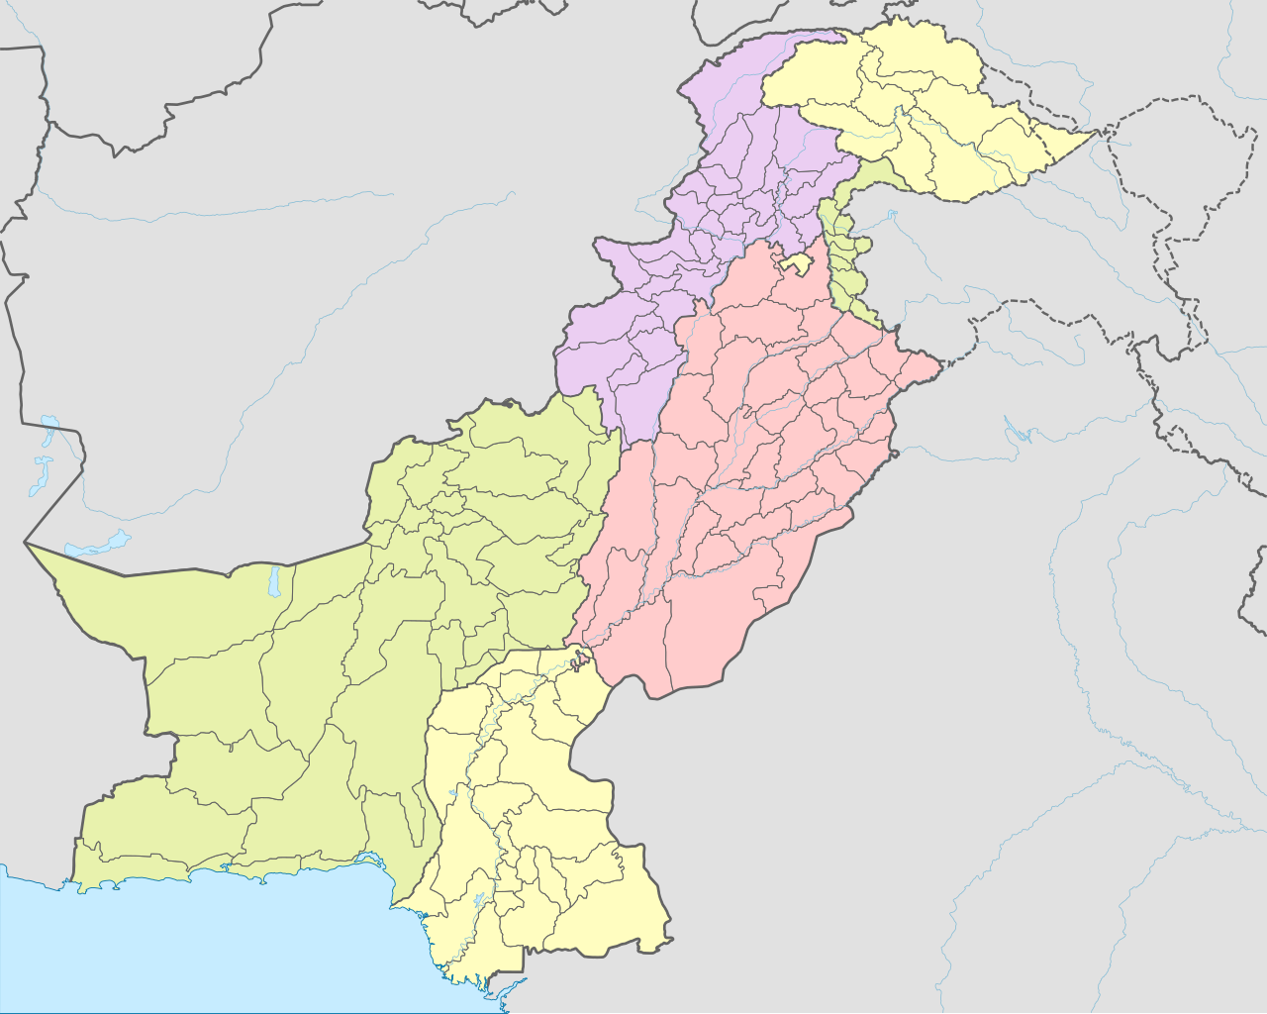
Methods – Trial Design
Objective: Estimate the effect of the iNCK on neonatal mortality, newborn omphalitis, birthweight measurement, and maternal postpartum haemorrhage when delivered to pregnant women by Lady Health Workers during the third trimester.
Study Design
Open-label, cluster randomised controlled trial
Study Setting
Seven district of Gilgit-Baltistan, Pakistan
77 clusters (Union Councils) randomised 1:1
38 control vs. 39 iNCK clusters
Study Period
March 2022–June 2024
Sample Size
Target of 27,448 pregnant women
Map of Pakistan (Milenioscuro, CC BY-SA 4.0)
Notes:
This brings me to our present trial’s objective, which was to estimate the effect of the iNCK vs. local standard of care on neonatal mortality and other newborn and maternal health outcomes, when delivered to pregnant women during the third trimester. To achieve this, we conducted an open-label, community-based, cluster randomized controlled trial in seventy-seven Union Councils of Gilgit-Baltistan, Pakistan.
Union Councils are geographic subdivisions involved in local health administration, and were randomized 1:1 to either the iNCK or standard of care arm as the cluster unit for this trial. The trial intervention period was conducted from March 2022 to June 2024, and we aimed to enroll more than 27 thousand pregnant women.
The trial was implemented in partnership with the Aga Khan Health Service, Pakistan and Aga Khan University; whom had critical relationships with local departments of health, the Lady Health Worker programme, and community leaders in Gilgit-Baltistan.

Slide 13



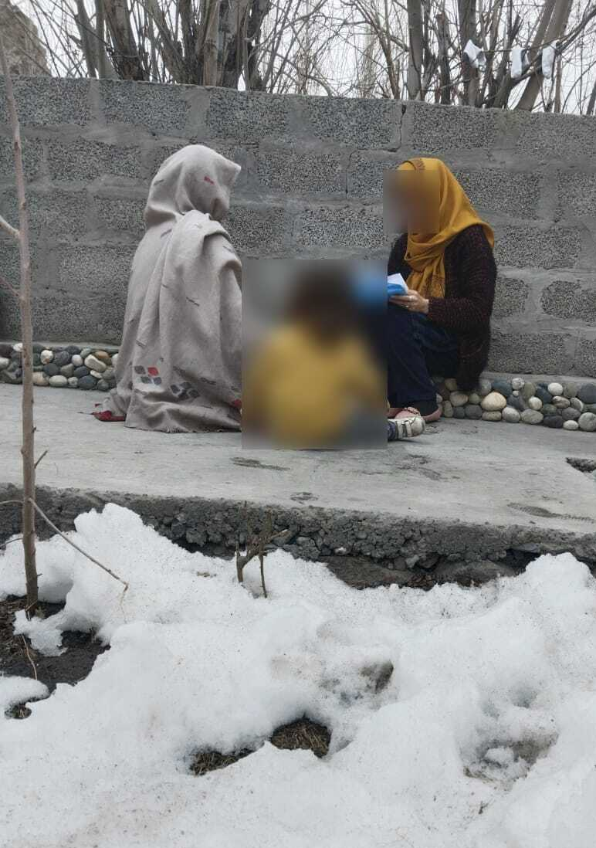

Methods – Procedures
Third trimester:
Pregnancy identification by LHWs
Soon after delivery:
Birth notification to study team
Third trimester:
Enrollment & intervention delivery
Days 8 and 29 after delivery:
Data collection visits
Notes:
In the trial, LHWs identified pregnant women as part of their routine duties. Study data collectors then joined LHWs during routine home visits in the third trimester to enroll pregnant women, where LHWs then delivered the iNCK and/or local standard of care.
Once the study team was notified of a newborn’s birth, data collection visits were timed on days 8 and 29 after delivery to collect trial outcomes, as well as uptake and acceptability of the iNCK.
Data collectors often originated from the same villages as participants, and were fluent in the local languages.
I also want to briefly highlight the study setting of Gilgit-Baltistan. This region is characterized by mountains and deep valleys, extreme seasonal fluctuations in temperature and precipitation, and frequent landslides. Many villages become completely isolated during winter months, and therefore rely heavily on primary community-based healthcare. Study data collectors often went to tremendous efforts to enroll women who are not commonly engaged in research settings.

Slide 14
Methods – Outcomes & Analysis
1
Neonatal mortality rate (NMR): Deaths of live-born children within 28 days after delivery, per 1,000 live births
2
Omphalitis (umbilical cord stump infection): Proportion of live births with redness or pus on the umbilical stump or surrounding skin within 28 days after delivery
3
Postpartum haemorrhage: Proportion of women who deliver vaginally with excessive vaginal bleeding within 24 hours after delivery
4
LHW-measured birthweight: Proportion of live births who are weighed by a Lady Health Worker within three days after delivery
Multivariable robust Poisson regression with generalized estimating equations to estimate the effect of the iNCK on primary and secondary outcomes, adjusting for reproductive, child, and cluster characteristics.
*Findings may be subject to minor changes given ongoing data reconciliation.
Notes:
The primary outcome of the study was the neonatal mortality rate, defined as the number of deaths of live-born children from any cause within the first 28 days after delivery, per 1000 live births.
Secondary outcomes included omphalitis or infection of the umbilical cord stump, and maternal postpartum hemorrhage, defined as experiencing excessive vaginal bleeding within 24 hours of delivery (among women who delivered vaginally).
We also assessed the proportion of newborns who were weighed by a Lady Health Worker within the first three days after delivery.
Effectiveness analyses were conducted using robust Poisson regression, with generalized estimating equations to account for the clustered trial design. These analyses adjusted for various sociodemographic, reproductive, and cluster-specific baseline covariates.

Slide 15
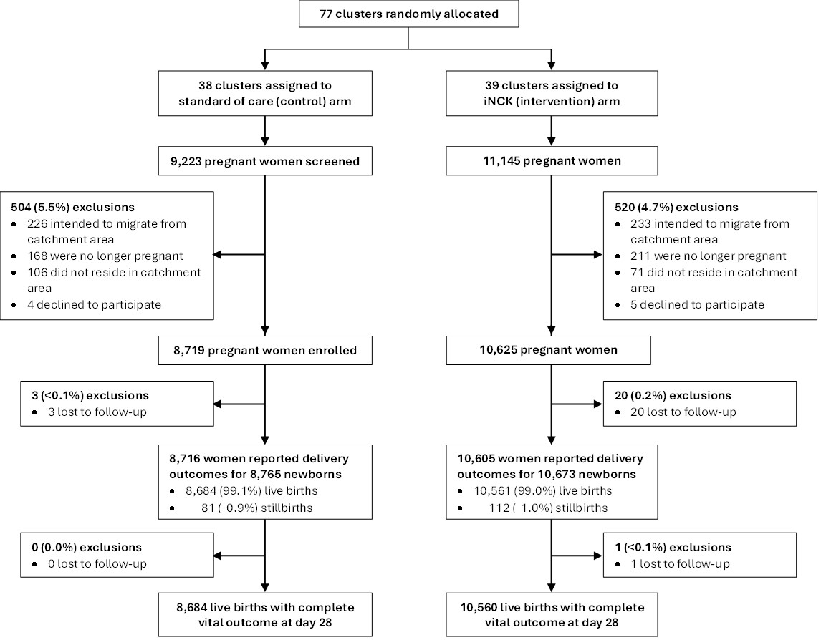
Results – Participants
19,344 women enrolled
Median age 28 years
Median 8 years of school
Median household income = 142 USD/month
70% delivered at health facilities
24% delivered their first child
Control
iNCK (intervention)
Notes:
Moving onto our results, the trial enrolled 19,344 pregnant women from March 2022–June 2024.
We observed a very low rate of loss to follow-up, ending up with 8,684 newborns in the control arm and 10,560 in the iNCK arm with complete data on the primary outcome.
For some background on our trial population, mothers were on average 28 years old and had 8 years of education, though one quarter had no education at all. The median household income was 142 USD per month, and about 70% of women delivered their baby in a health facility.

Slide 16
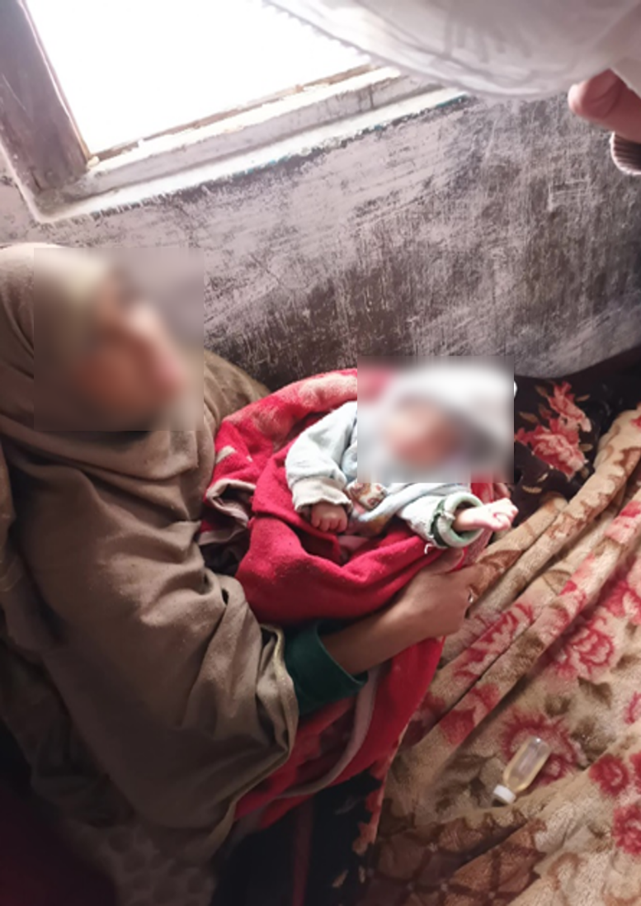

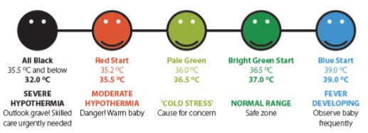
Uptake & Acceptance
Among iNCK arm participants…
99.7% used the clean birth kit
99.5% used chlorhexidine – 97% on day 1
99.5% used sunflower oil – 94% on day 1
95% used ThermoSpot – 92% on day 1
86% took all three misoprostol tablets
ThermoSpot identified neonates with…
Cold stress (n=1372), hypothermia (n=539), and fever (n=258)
Misoprostol…
Was never incorrectly used prior to delivery
Caused mild side effects in 5% of users
99.9% of iNCK arm participants thought the iNCK was safe and easy to use.
ThermoSpot indications (Maternova)
https://www.engineeringforchange.org/solutions/product/thermospot/
Notes:
We observed high uptake of the iNCK among intervention arm participants, with 95–99% using the clean birth kit, chlorhexidine, sunflower oil emollient, and ThermoSpot.
Importantly, there was also excellent adherence to pre-specified timing of usage, with >90% initiating usage of these components on the first day of the newborn’s life as directed.
Among users of ThermoSpot, roughly 1400 cases of cold stress, 500 cases of moderate or severe hypothermia, and 250 cases of fever were identified.
86% of women took all three misoprostol tablets, and there were zero instances where women incorrectly took misoprostol prior to delivery of the newborn. Among misoprostol users, 5% experienced mild side effects such as fever, sweating, or nausea.
Critically, from our acceptance survey among almost 10,000 women, >99% of respondents reported that they thought the iNCK was both safe and easy to use.

Slide 17
Effect of the iNCK on Secondary Outcomes
Omphalitis, Postpartum Hemorrhage, and LHW-Measured Birthweight
Control: 1681 cases / 8185 newborns (20.5%)
iNCK: 431 cases / 9919 newborns (4.4%)
aRR = 0.20, 95% CI 0.12–0.36, p<0.001
↓80% in
iNCK clusters
Omphalitis
Control : 586 cases / 7605 women (7.7%)
iNCK: 370 cases / 9231 women (4.0%)
aRR = 0.43, 95% CI 0.20–0.92, p=0.026
Postpartum
haemorrhage
↓57% in
iNCK clusters
Control : 1211 weighed / 8144 newborns (14.9%)
iNCK: 4108 weighed / 9974 newborns (41.2%)
aRR = 2.86, 95% CI 2.20–3.71, p<0.001
LHW-measured
birthweight
↑186% in iNCK clusters
Notes:
Sharing first the effectiveness results of our secondary outcomes, roughly 21% of newborns in the control arm experienced omphalitis vs. 4% in the iNCK arm. This corresponded to a significant 80% reduction after adjusting for demographic and reproductive characteristics.
Among women delivering vaginally, 8% of control participants experienced postpartum hemorrhage vs. 4% of iNCK participants. This was also a significant reduction of 57%.
Finally, the proportion of newborns whose birthweight was measured by a LHW in iNCK clusters was nearly triple that of control clusters.

Slide 18
Results – Neonatal Mortality
Control arm: 88 deaths from 8,682 live births
NMR 10.1 deaths per 1000 live births
iNCK arm: 86 deaths from 10,555 live births
NMR 8.1 deaths per 1000 live births
Risk of neonatal mortality was 8–23% lower in iNCK vs. control clusters
Unadjusted RR 0.77, 95% CI 0.52–1.112, p=0.172
Adjusted RR 0.92, 95% CI 0.67–1.27, p=0.611
  Adjusting for ANC, district, sex, time, baseline NMR, and baseline % of facility deliveries
*Is lower than expected mortality causing model instability?
Notes:
For the primary neonatal mortality outcome, we observed 174 total newborn deaths, corresponding to an NMR of 10.1 per 1000 live births in the control arm vs. 8.1 per 1000 live births in the iNCK arm.
While unadjusted analyses showed a non-significant 23% decline in mortality in iNCK vs. control clusters, this decline was just 8% when adjusting for covariates pre-specified during planning stage of the trial.
Notably, mortality was much less common across both arms than hypothesized – for instance, our trial sample size calculations assumed an NMR of 35 per 1000. Accordingly, we believe our a priori model may suffer from instability, in particular through adjustment of a 7-category study district variable.

Slide 19
Results – Neonatal Mortality
Substantial heterogeneity of effect by district:
District | Control |  |  | iNCK |  |  | aRR (95% CI)
 | Deaths / Live births | NMR |  | Deaths / Live births | NMR
Astore | 4 / 945 | 4.2 |  | 14 / 1598 | 8.8 |  | 2.16 (0.36–12.79)
Diamer | 6 / 755 | 7.9 |  | 12 / 1476 | 8.1 |  | 2.77 (0.52–14.73)
Ghanche | 14 / 1763 | 7.9 |  | 13 / 2402 | 5.4 |  | 0.69 (0.38–1.26)
Kharmang | 25 / 946 | 26.4 |  | 11 / 702 | 15.7 |  | 0.69 (0.27–1.73)
Nagar | 12 / 1347 | 8.9 |  | 7 / 497 | 14.1 |  | 1.29 (0.25–6.68)
Shigar | 2 / 809 | 2.5 |  | 13 / 1915 | 6.8 |  | 2.24 (0.65–7.72)
Skardu | 26 / 2119 | 12.3 |  | 13 / 1969 | 6.6 |  | 0.44 (0.25–0.78)
Excluding district, neonatal mortality was 24% lower in iNCK vs. control clusters
aRR 0.76, 95% CI 0.52–1.11, p=0.151
  Adjusting for ANC, sex, time, baseline NMR, and baseline % of facility deliveries
Notes:
To investigate the potential for model instability, we conducted an analysis stratifying the effect of the iNCK by study district.
Each district contains a smaller number of deaths, and we find substantial heterogeneity in the effect of the iNCK by district.
We therefore conducted a post-hoc analysis removing the adjustment for study district, and this analysis showed mortality was 24% lower in iNCK vs. control clusters, though this association was not statistically significant.

Slide 20


Limitations
NMR in both arms was rarer than expected:
  NMR may truly be lower than prior estimates
  NMR may be lower in areas covered by the LHW programme
  Our study may not have reached the most remote populations
Imbalance in participants between arms:
  Randomisation did not account for cluster birth rates
  Potential for lower LHW engagement in control clusters?
Notes:
The low observed NMR is a notable limitation in our study, and may have several explanations.
NMR may truly be lower than described by other sources, or may have declined over time. Our trial was also conducted in areas covered by the LHW program, and these areas may plausibly be less remote or have lower mortality than uncovered areas.
We also note an imbalance in sample size between arms, which may have affected our study power, and may be indicative of lower engagement by LHWs in control clusters.

Slide 21

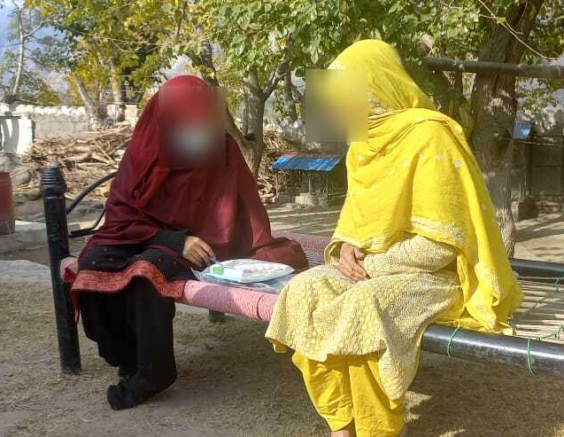
Implications & Impact
The iNCK might reduce neonatal mortality, did prevent omphalitis and postpartum hemorrhage, and improved newborn birthweight measurements
Delivery of the iNCK by LHWs achieved high uptake, knowledge, and acceptance of iNCK components
The iNCK platform may be useful for delivery of other MCH interventions, and in humanitarian settings
Ongoing cost-effectiveness analysis and partnerships to scale-up iNCK programme in Pakistan
Notes:
However, we note several strengths of our study. This was the first trial of this size and scope conducted in Gilgit-Baltistan, and successfully operated despite challenging environmental conditions.
The study achieved high uptake and acceptance of the iNCK, suggesting that community-based programs can be effective to teach perinatal women on healthcare interventions, even weeks to months ahead of time.
As an integrated intervention, the iNCK could also plausibly be supplemented with additional components such as for nutrition or responsive stimulation.
Finally, the iNCK’s portable nature means it may have utility in a variety of low-resource, humanitarian, and emergency settings.
Ultimately, the iNCK did reduce omphalitis and postpartum hemorrhage, improved newborn birthweight measurement, and may have reduced neonatal mortality.
Our team is also currently working on cost-effectiveness analyses of the iNCK, in an effort to inform potential future scale-up of the iNCK in Pakistan.

Slide 22


Acknowledgements
Research Team
Funders
Dr. Shaun Morris (co-PI)
Dr. Lisa Pell (co-PI)
Dr. Zulfiqar Bhutta
Dr. Diego Bassani
Dr. Adria Rose
Dr. Rachel Spitzer
Muhammad Yasin
Falak Madhani
Shariq Paracha
Dr. Sher Hafiz Khan
Nazia Jabeen
Faisal Ali
Masood Ali Khan
Dr. Sifat Wali
Partners
Lady Health Worker Programme
Gilgit-Baltistan Department of Health
(Dr. Saleem-Ud-Din and Dr. Syed Sadiq Shah)
Aga Khan Foundation, Pakistan
Dr. Sajid Soofi
Imran Chauhadry
Karim Muhammad
All participants, data collectors, supervisors, and drivers
Dr. Monica Taljaard
(University of Ottawa)
Notes:
This work would not have been possible without the incredible work of our study team, both at SickKids and our amazing partners in Pakistan at Aga Khan Health Service and Aga Khan University.

Slide 23
An integrated newborn care kit to save newborn lives and improve health outcomes in Gilgit-Baltistan, Pakistan: An open-label cluster-randomised controlled trial
Daniel S. Farrar for the GB iNCK Study Team
daniel.farrar@sickkids.ca, shaun.morris@sickkids.ca
Notes:
Thank you for listening.

