Slide 1
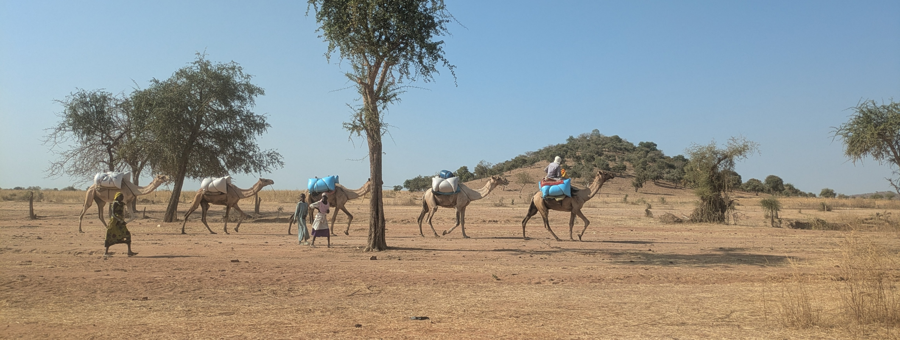


"Just sit with us. Hear our problems. Take them to people who will do something about it. And be sure they do something about it."
USE IMAGE HERE
©Nell Gray, MSF
Health, climate change, and humanitarian response in eastern
Chad: a multiphase, multi-sited ethnographic study
Nell Gray, MSF OCA and Kings College, London
Conflict of interest: the author has declared no conflict of interest.
Notes:
"Just sit with us. Hear our problems. Take them to people who will do something about it. And be sure they do something about it."
Talking with communities in Dar Sila, eastern Chad, about Climate change, this is what they asked of us. And this presentation is our attempt to do that.

Slide 2
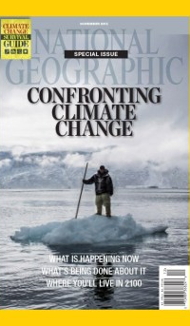
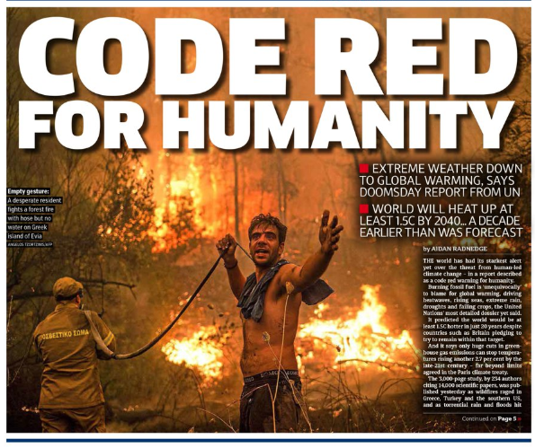
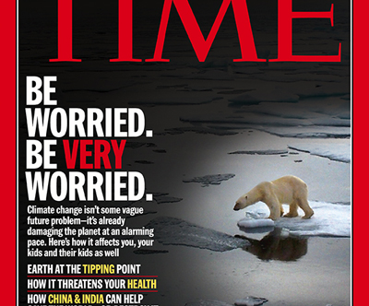
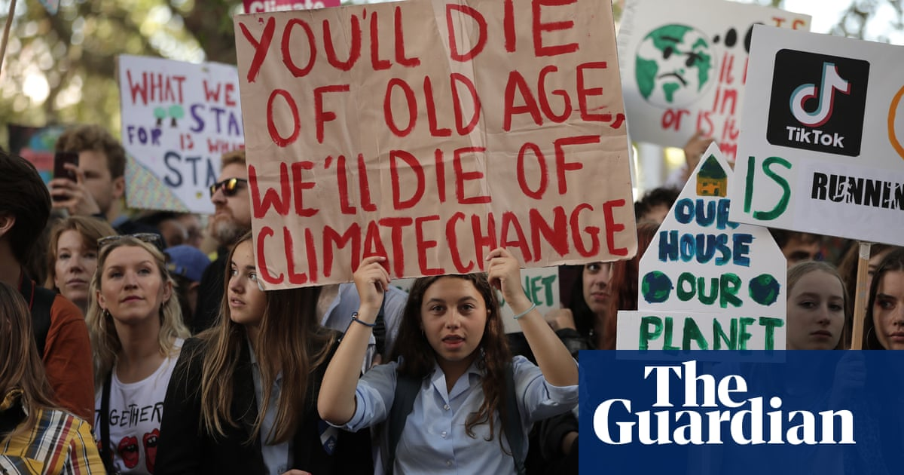
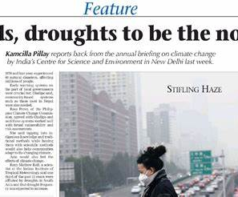
Notes:
We are all familiar with headlines like these.
Climate change is now widely recognised as both a health and humanitarian crisis, disproportionately affecting the people MSF aims to support.
We know it is increasing disease, conflict, displacement, and pressure on fragile systems.
We know that in 2020, MSF publicly committed to adapting its programming – and to working with communities and local actors in doing so.
The question is no longer whether climate change matters but how it matters – and on whose terms.
This study steps out of the headlines to explore how climate change is showing up in practice for both MSF and the communities it aims to support.

Slide 3
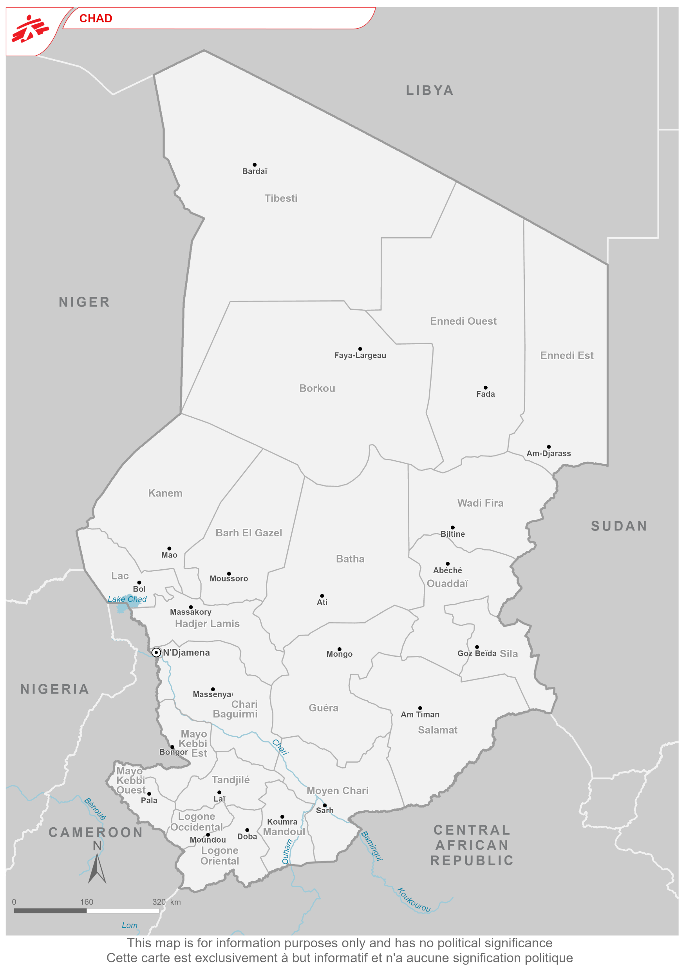
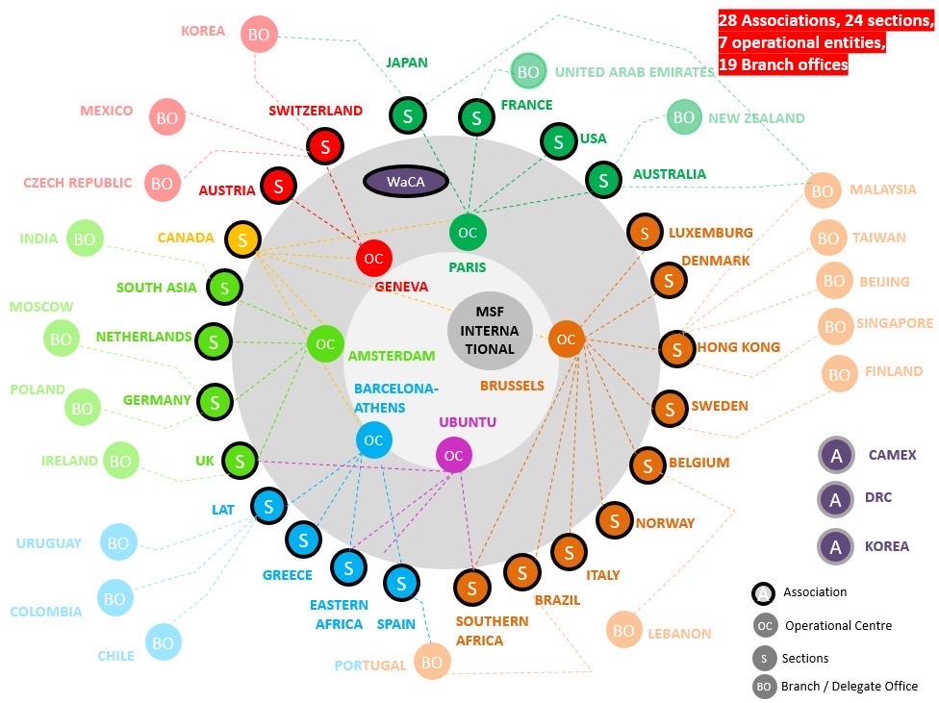
Context:
Notes:
This study has two interconnected sites.
The first takes us to Chad, the country both most vulnerable and least prepared to face the impacts of climate change.
More specifically it takes us to Dar Sila, in the east, bordering Sudan — the red circle here.
A place where people mainly live from the land, farming and raising livestock. Where people are already living the realities of a changing climate, alongside conflict, displacement, repeated epidemics, and limited infrastructure.
It is also where MSF has been implementing a co-designed community-based care project since 2021.
The second site holds a mirror up to MSF itself— for those of you who aren’t familiar with this possibly baffling image of MSF’s organizational structure. It asks how - at both headquarters and project level – MSF is engaging with climate change in practice.

Slide 4
Aims & methods:
How are MSF and people living in Dar Sila understanding, experiencing and acting upon climate change?
Multisited ethnography
MSF- Organisational perspective
(HQ + project)
Communities’ perspective
Integrated analysis for future humanitarian response
In-depth interviews
Observation
Document review
Collaborative
Group discussions
Interviews
Observation
Multiscalar analysis
Notes:
This study asks how MSF and communities living in Dar Sila understanding, experiencing and acting upon climate change
PRESS
It aims to hold both of these perspectives equally.
On one hand that of MSF – a medical humanitarian organisnsation with the intention of adapting its programming in the face of climate change, and on the other - communities living on its frontline in eastern Chad.
It then aims to brings these perspectives together
to identify gaps, tensions, and possibilities for future adaptation.
PRESS
To do this we used a multi-phase ethnographic approach, with methods adapted to each site.
Within MSF we did interviews, observations and document review
Interviews included a range of staff at headquarters, country and project level including both what one colleagues referred to as MSF’s climate advocates and climate skeptics.
In Dar Sila we did a collaborative ethnography, combining group discussions, interviews, observation – and document review.
Just to pause for a moment on the collaborative element of this study (which could be a presentation in itself) – We started with a participatory intention. It didn’t go as planned. It was quickly reframed by the communities we were working with – who, rather than being involved in a time consuming research project, asked (as I quoted at the outset): ‘just sit with us. Hear our problems. Take them to people who will do something about it. And be sure they do something about it.’

Slide 5
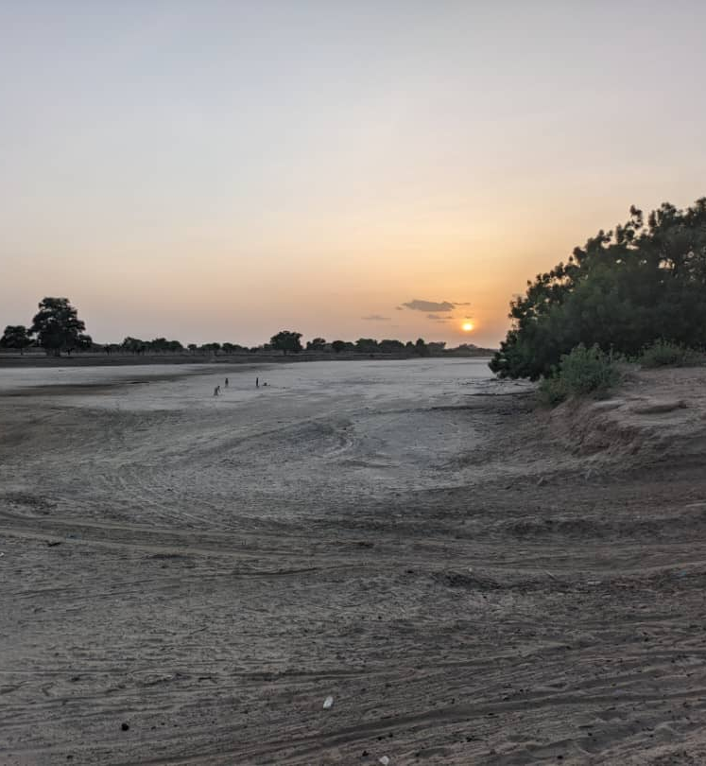
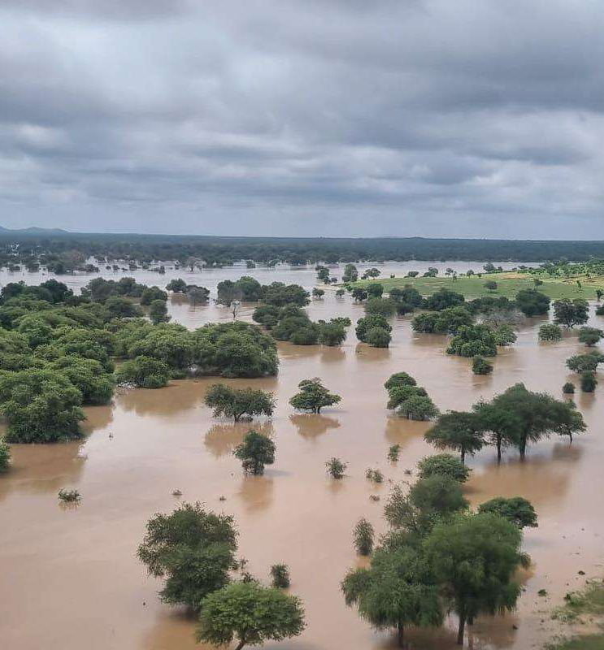
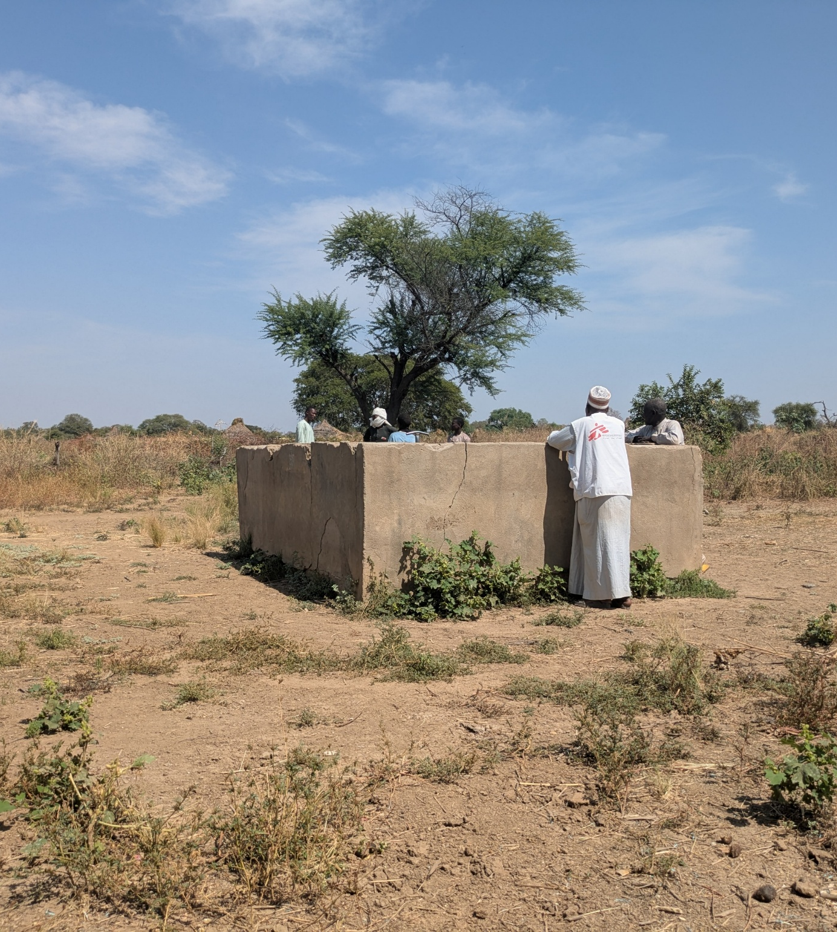
Results:
The drought
The flood
The Well
Climate change as slow degradation
Climate change as emergency
Climate change, infrastructural neglect, and the futures water reshapes
Notes:
So onto the results –
What emerges is a story of how climate change unfolds over time – a story though which water - unexpectedly - emerged as the central thread.
PRESS
From drought: climate change as slow degradation,
PRESS
To flood, climate change as emergency,
PRESS
To the well, where climate change overlaps with longer histories of infrastructural neglect and reshapes future possibilities.
Together, they show how knowledge and action look different depending on where you stand — and how understanding that gap is precisely where the future of humanitarian response needs to take shape.

Slide 6
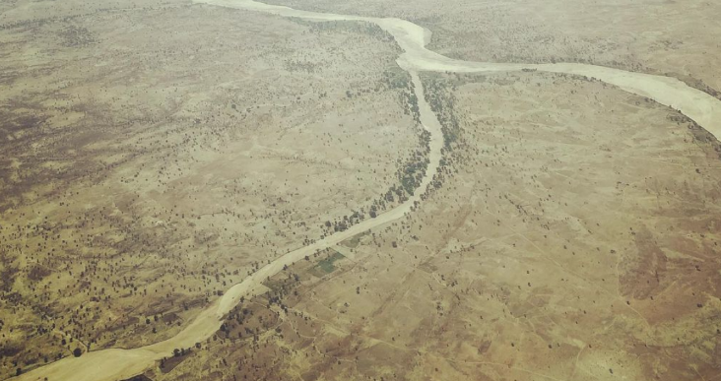
The drought - la sécheresse - لجفاف
Chart or table slide
Slide to use for graphs or tabs
‘This is a difficult year.
This year there is the heat and the drought. But its more than just one difficult year; its not normal.
It was never like this before.’
- Abdoulaye, village leader
USE GRAPHS/CHART HERE
©Nell Gray, MSF
Notes:
This story begins in June, the rains are late: ‘this is a difficult year.’ Abdoulaye a village leader tells us. ‘This year there is the heat and the drought’ ‘but its not just one difficult year. Its not normal’ ‘it was never like this before’
Drought shows us climate change as a slow, cumulative crisis.
Like Abdoulaye, many people told us how rainfall shifts gradually erode their livelihoods,
deepening precarity and producing layered forms of suffering. But they also told us it’s not just about climate change. Regional conflict, fragile local economies, changing NGO presence, and even the arrival of a new caterpillar devastating crops - all combine to impact health, as well as economic, mental and social wellbeing.
This type of ‘suffering’ doesn’t look like the suffering MSF usually looks out for. In fact its almost impossible for us to see. It doesn't cross our thresholds. It doesn't look like an emergency. When we asked what support people needed, they didn't ask for clinical care. They asked for livelihood support and safe drinking water. Solutions to the causes, not the symptoms.
And this slow crisis is mirrored within MSF.
Climate change has emerged slowly as an operational concern, initially seen as ‘not an MSF problem’ –even ‘polar bears on icecaps’ and – once taken up – difficult to map onto the existing operational model – a problem that is too big, too blurry; a crisis that is too slow to demand attention amidst a huge number of competing priorities.

Slide 7
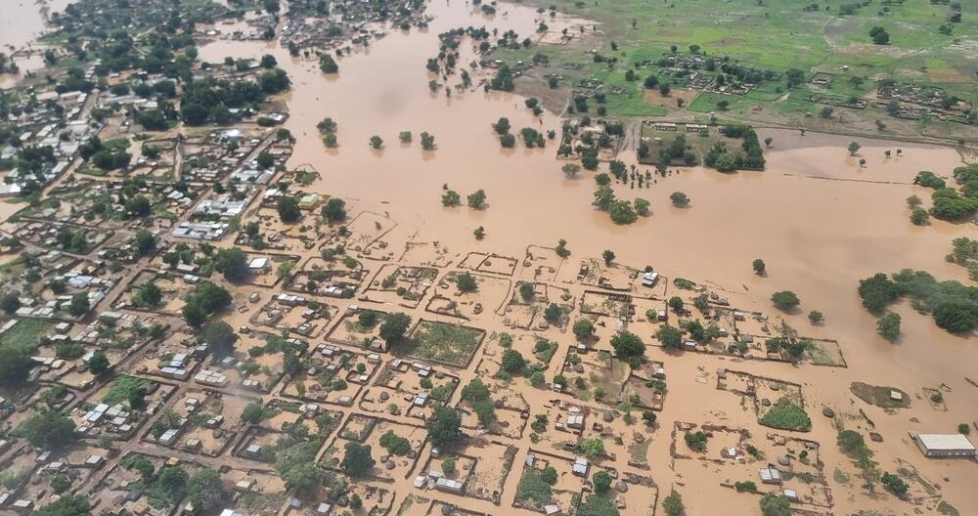
The flood - l’innondation - الفيضان
‘C’est du jamais vu
– never seen before.
Water so high it was never seen by our grandparents’ granparents’ grandparents.’
- Maryam, farmer
USE GRAPHS/CHART HERE
©MSF
Notes:
Flooding tells a different story.
In August 2024, unprecedented floods hit Dar Sila – to scale neither communities nor MSF were prepared for.
"C'est du jamais vu," Maryam told us. "Never seen before. Water so high it has never been seen by our grandparents' grandparents' grandparents"
Climate change is suddenly visible as an emergency. Suddenly, suffering looks more familiar to MSF, displacing the whole town and its surrounding villages (as well as the MSF team) onto areas of higher ground.
Both MSF and communities responded — and in that response, there were moments of alignment. MSF's motorboat, for example, became an unexpected central figure in people’s narratives, understood to have saved hundreds of lives – and an important gesture of solidarity.
But there were also moments of disconnect, in how risk is understood, solidarity is expressed, and response is organised.
The mental health response is an example. Its limited uptake was understood by MSF as 'cultural barriers to care,’ but communities had a different explanation. As one person told me bluntly:’C’est un truc des blancs.’ – it’s a white people thing.“
The same emergency. The same good intentions. But different framings of what support looks like.

Slide 8
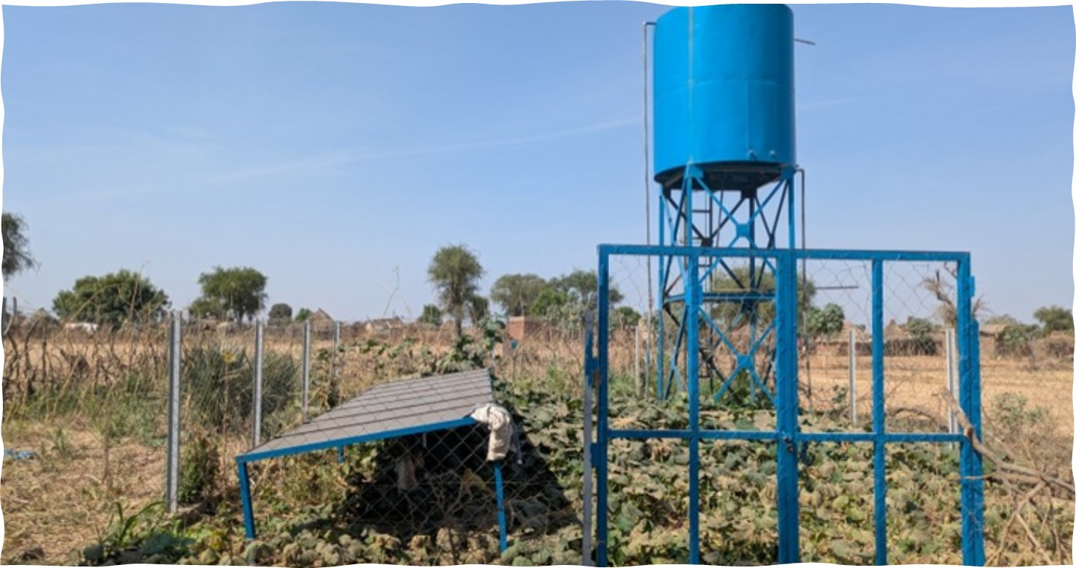
The well - le forage - الحفر
USE GRAPHS/CHART HERE
‘We’re caught between a rock and a hard place.
We cannot go back — it has become the path of the wadi [seasonal river].
But we cannot live here without water.
We are human beings, after all.’
- Sadam, farmer
©Nell Gray, MSF
Notes:
The well brings us to what happens after the flood.
So here, before all this - people were already facing serious water scarcity – a lack of basic water infrastructure.
Now, the flood has transformed the landscape. Some villages were totally destroyed by flood water, so residents have moved to new places, creating new villages. Some people want to relocate - the whole town where MSF is based for example - wants to move because people think it’s no longer safe from future floods. But there is a problem: the places that are safe from floods don’t have access to safe drinking water. A well.
Sadam explains: 'we are caught between a rock and a hard place. We cannot go back to where we came from — it has become the path of the wadi. But we cannot live here without water. Now there is intense heat, and if there is no water, we cannot live. We are human beings, after all.'
So here - MSF’s water intervention - where MSF chooses to dig – or not dig – a well - Isn’t just ‘response’. It determines where people can and can’t live. Where they are and aren’t safe. And so it has the possibility to make, or even break, futures.

Slide 9
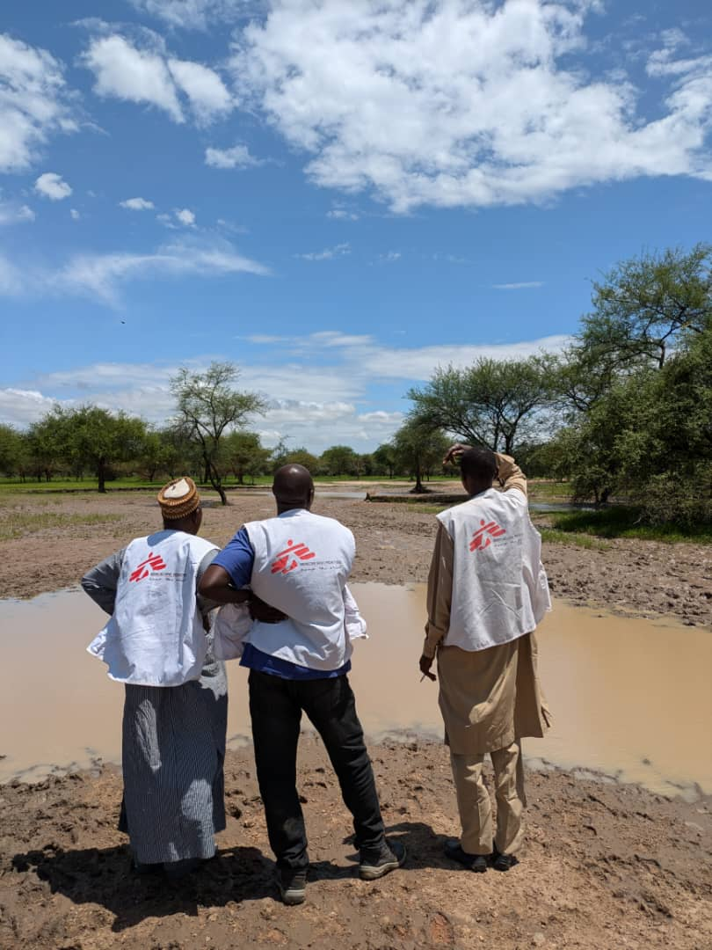
Conclusions:
Recommendations within MSF’s current frame:
See the slow crisis
Prepare from communities’ scenarios as a starting point
Strengthen water interventions : social and future dimensions
…but do we need to change the frame?
©Nell Gray, MSF
Notes:
So this study shows how MSF and the communities of Dar Sila are both confronting a crisis that exceeds their existing frameworks for understanding and action — but in fundamentally different ways.
For communities: climate change is climate change is understood through lived experience — changes visible in daily life: in the land, in the body. Its impacts cascade across health, economic and social life. People adapt – they have no choice but to. Critically they know how they want to adapt, but often lack the resources to be able to do so.
For MSF, climate change is primarily understood through data and scientific evidence — framed as a global, technical problem to be measured and managed. That framing shapes what MSF can see, and what it can act on. But climate change keeps throwing up realities that exceed it: health and care that are more than biomedical; communities needs that are beyond MSF’s mandate; crises that are slow as well as sudden, futures that need anticipating rather than emergencies that need containing. Moments where solidarity may matter more than managing and mitigating risk. MSF struggles to read these realities — not for lack of commitment or good intentions, but because the frame itself wasn't built for them.
So concretely, what does this mean in practice? Within our current frame, to pick three things
First, see the slow crisis. Integrate climate into routine analysis of health determinants so that gradual degradation becomes visible before it crosses emergency thresholds. And where communities need more than MSF can provide — livelihoods, water, food security — build deliberate partnerships with actors who can.
Second, build preparedness with communities — not just inform MSF's plans with communities’ knowledge, but start from communities’ scenarios. What they are most worried about, how they prepare and respond, and what adequate support actually looks like.
Third, strengthen water interventions to address not just technical but social and future-oriented dimensions — supporting communities' own decisions about long-term water management.
But these three things only go so far. And the key takeaway is this:
The real challenge isn't adding climate to what we already do, in the ways we already do it. Climate change pushes us to recognise that MSF — built to respond to emergencies, on our terms, on our timeline, through our knowledge systems — wasn't designed for this.
People in Dar Sila value what MSF brings. But they're asking for something both simple yet radically different — that their knowledge about what is happening, and what needs to happen, is not just context for MSF's decisions, but the basis for them.
This session asks whose voices shape our programmes. This study pushes us towards a harder, more uncomfortable version of that question — one I'd like to leave you with:
What if listening means not just rethinking what we do, but fundamentally transforming how we know, how we decide, and whose knowledge counts in the first place?

Slide 10

Limitations:
Positionality within MSF
Long history of ‘beneficiary – aid provider’ dynamics in Dar Sila
One country context, one moment in time
©Nell Gray, MSF
Notes:
And this study of course comes with its limitations.
The research is inevitably shaped by its positionality – and my positionality – embedded within MSF – which may shape how people engage with it. This is particularly important in a context like Dar Sila where there is a long history of entrenched aid provider – beneficiary dynamics.
It is an ethnographic study in one country context at one moment in time, and primarily housed within one MSF operational directorate - both regional and institutional contexts are evolving rapidly. Findings are not generalizable, but can offer insights relevant to similar contexts.

Slide 11
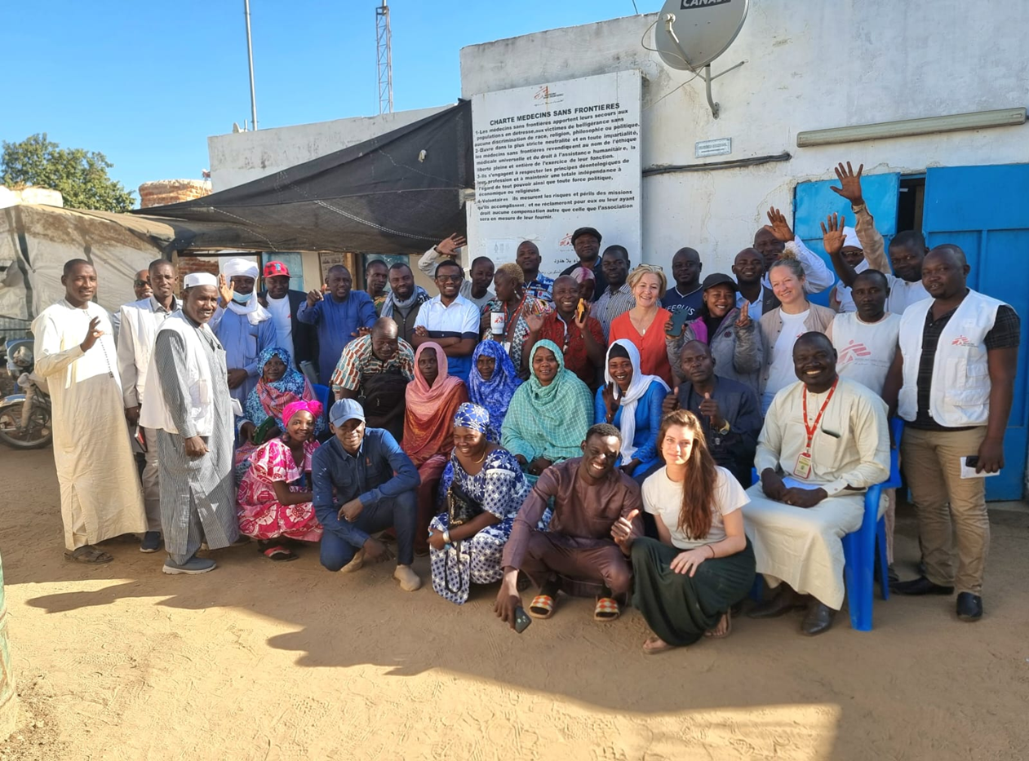

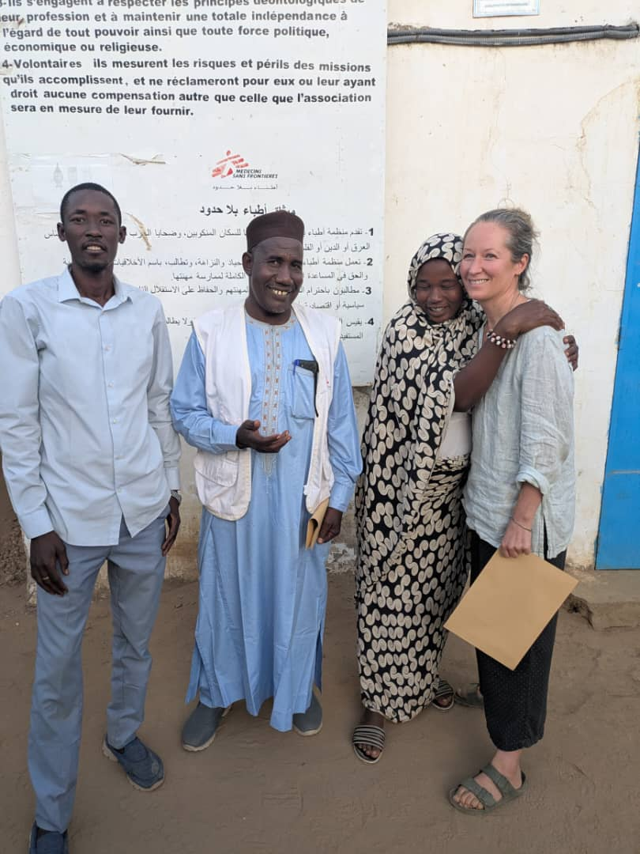
Thank you!
USE IMAGE HERE
USE IMAGE HERE
Study team:
MSF OCA, Chad: Moussa Hassan Daoud, Abdoulaye Hassan Moursal, Bintou Adam & Jacob Maikere
MSF OCA London, Berlin: Beverley Stringer, Caroline Voute & Prince Alfani
Kings College, London: Ann Kelly & Clare Herrick
Centre de Recherche en Anthropologie et Sciences Humaines, Ndjamena: Neneck Allah-Kauis
nell.gray@london.msf.org
This study was approved by Médecins Sans Frontières Ethical Review Board, King's College London Research Ethics Committee, and the Comité National de Bioéthique au Tchad.
Notes:
Finally, a huge thank you to all collaborators and colleagues – MSF, KCL, Centre de Recherche en Anthropologie et Sciences Humaines - CRASH and the team who worked on this study
and especially to people in Dar Sila
for sharing their time, knowledge, and experiences.
Here, today – I hope we are taking their concerns to people who will do something about it.
Thank you.

