Slide 1
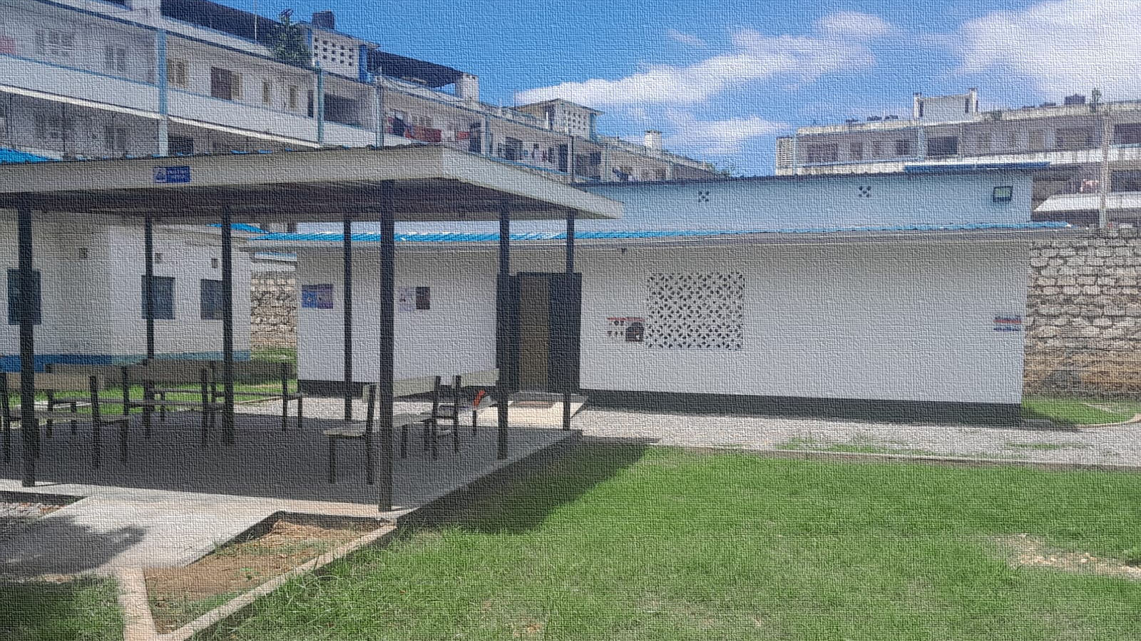

Advancing population health research to improve intervention
Final results from the
Mombasa Youth and Key Pop Study

Slide 2
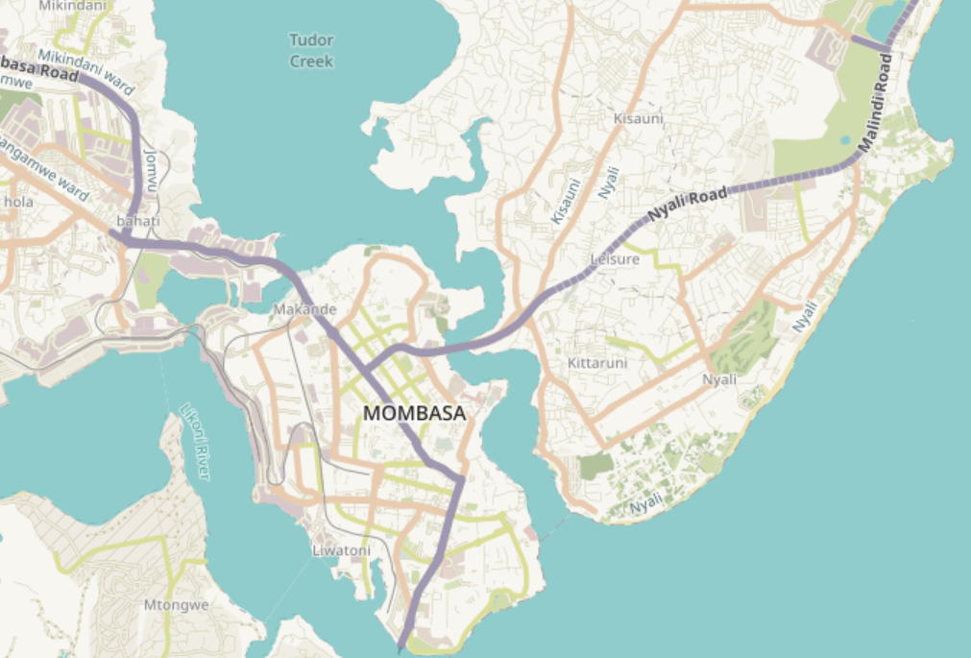
Youth friendly healthcare
Clinical outreaches
Health talks
Anti-stigma education
Community building
Training & mentorship
Fun!
Adolescents and youth aged 10-24 years
Key populations: sex workers, people who use drugs, LGBTQ+

Slide 3



Slide 4
Population health survey
Qualitative cohorts
Healthcare worker study
Key population survey
(2 waves: n=873)
Adolescent & youth survey
(2 waves: n=3,862)
Key population cohort
(15 waves: n=6)
Youth cohort
(15 waves: n=10)
Healthcare worker survey
(7 waves: n=1,443)
Healthcare worker interviews
(1 wave: n=24)

Slide 5
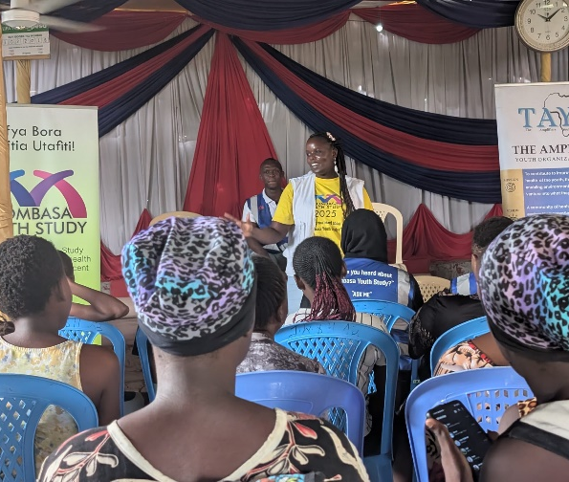

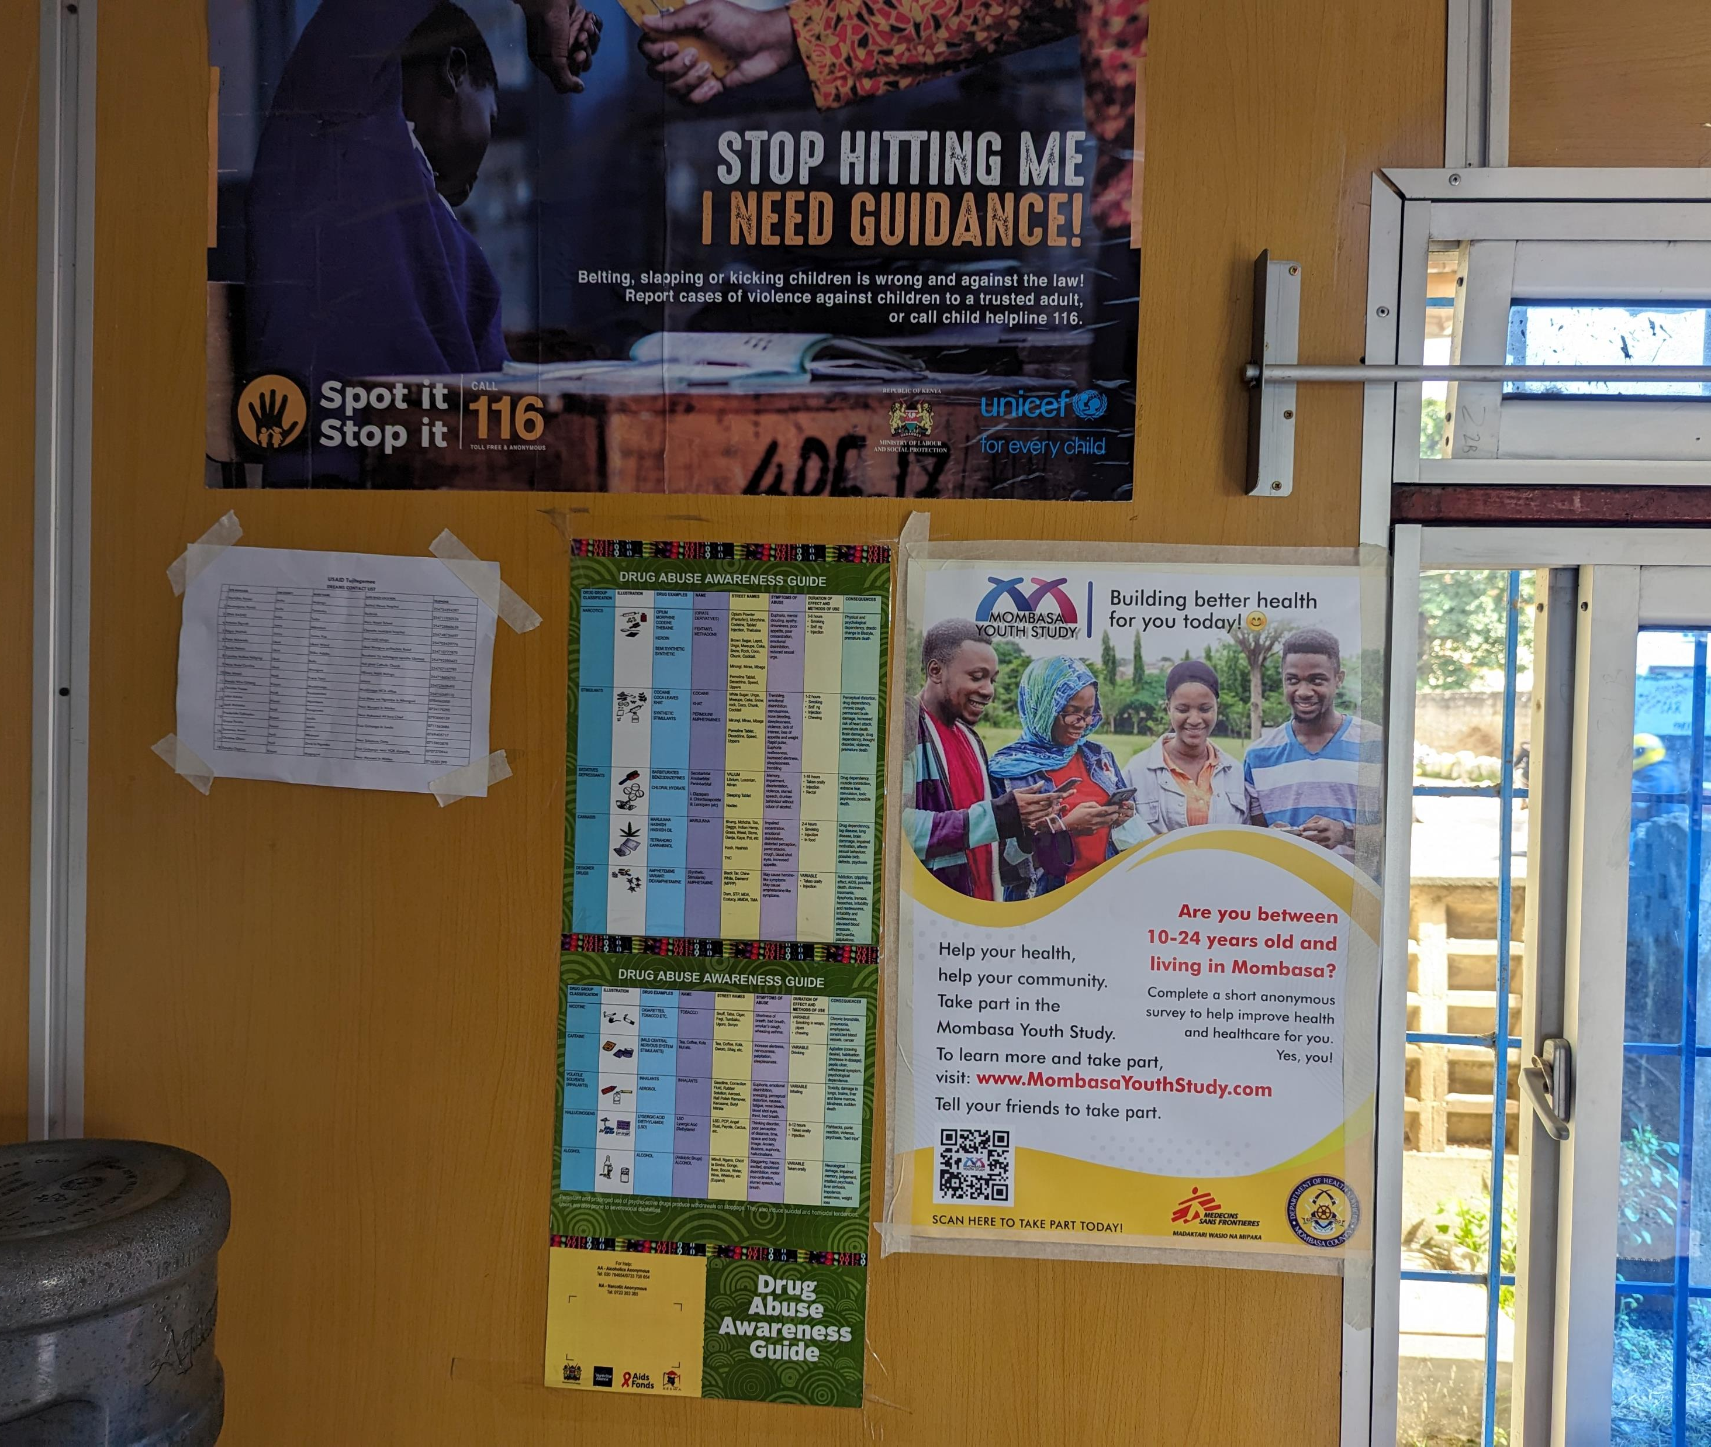
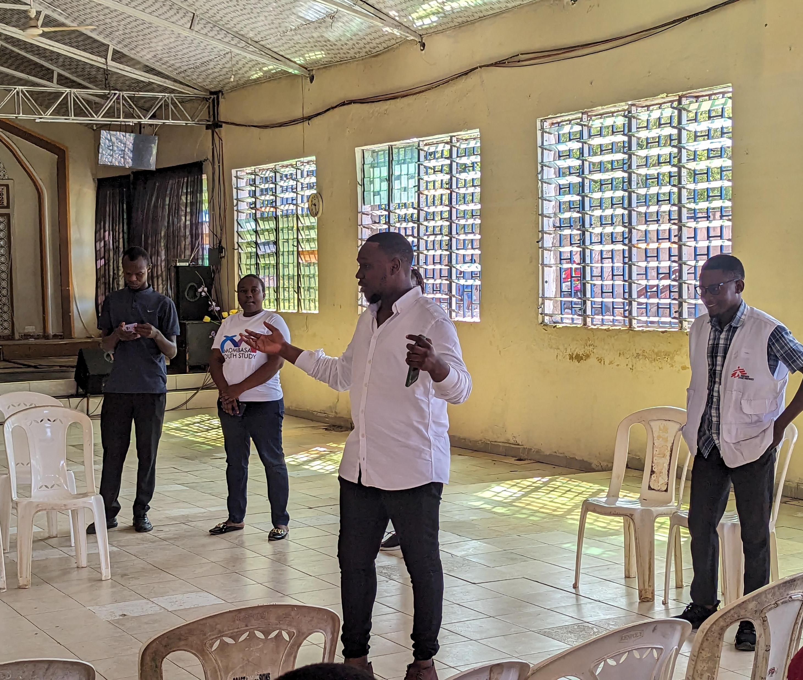
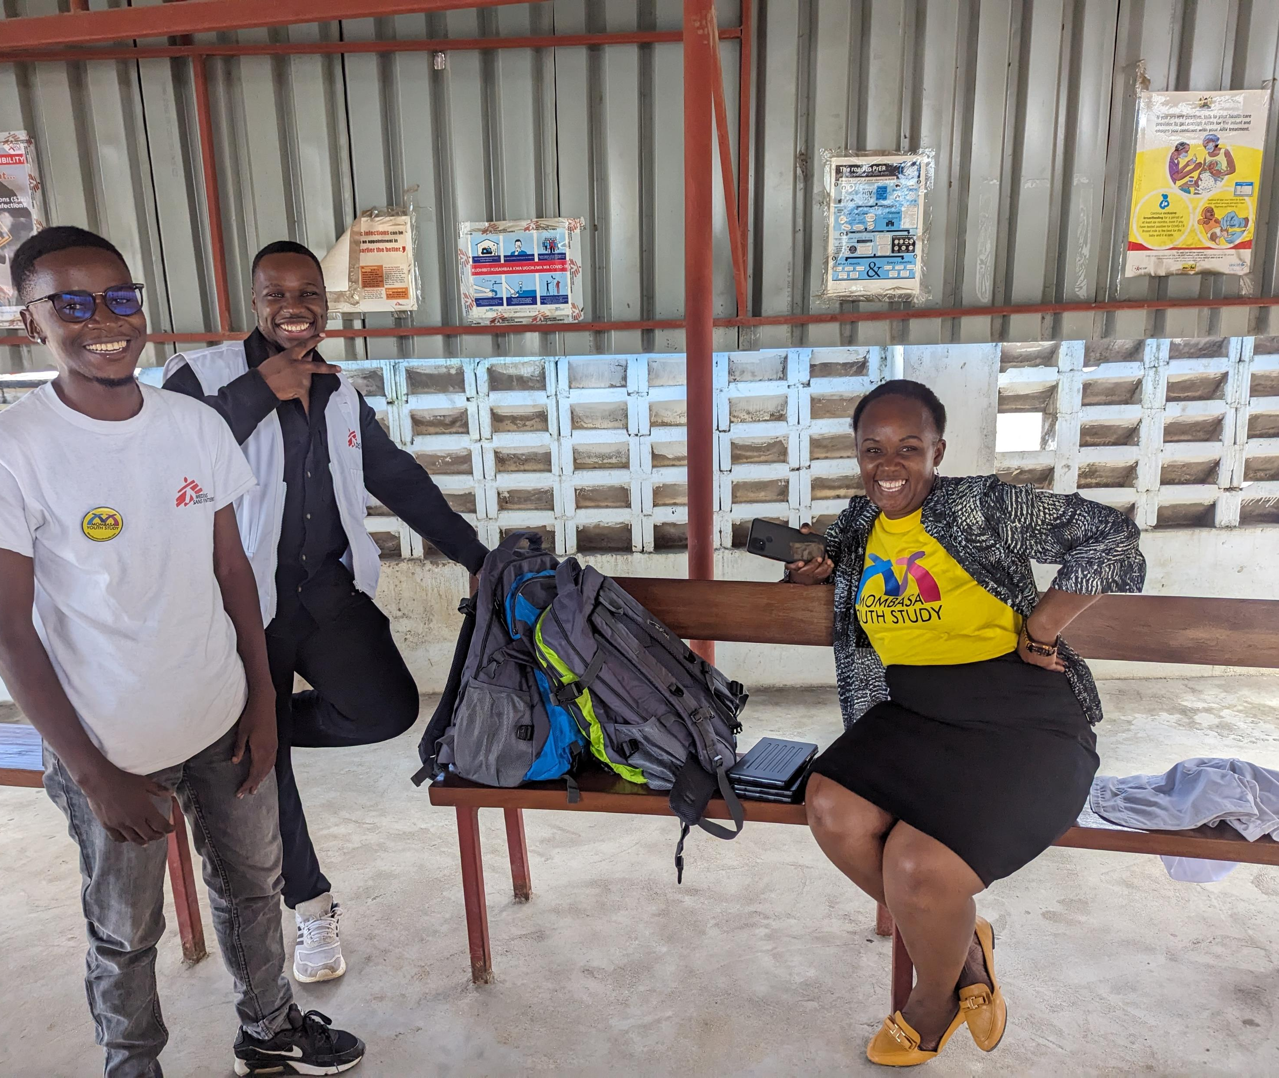
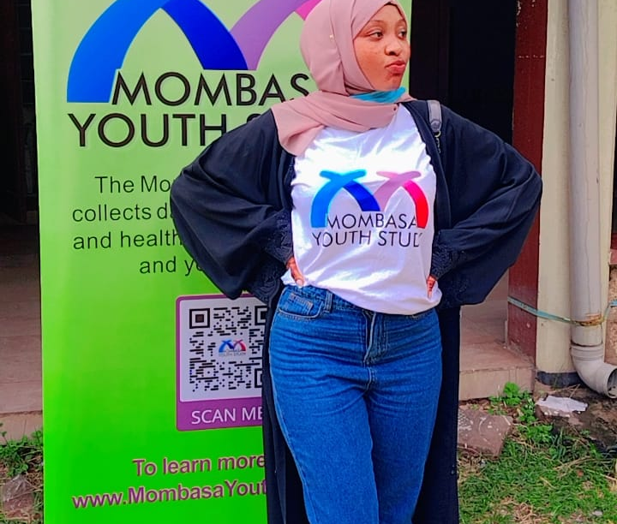

Slide 6
Our study’s purpose
Provide empirical insights to guide evidence-based decision making
Evaluate the intervention’s impact on health and healthcare among adolescents and young people

Slide 7
Intervention integration

Slide 8
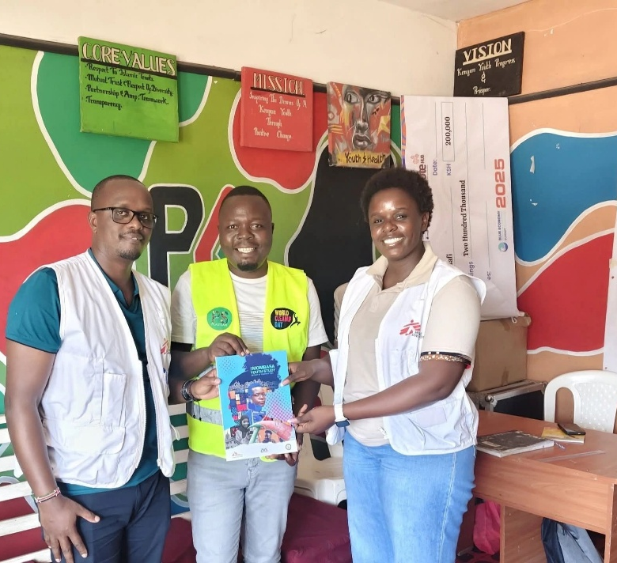
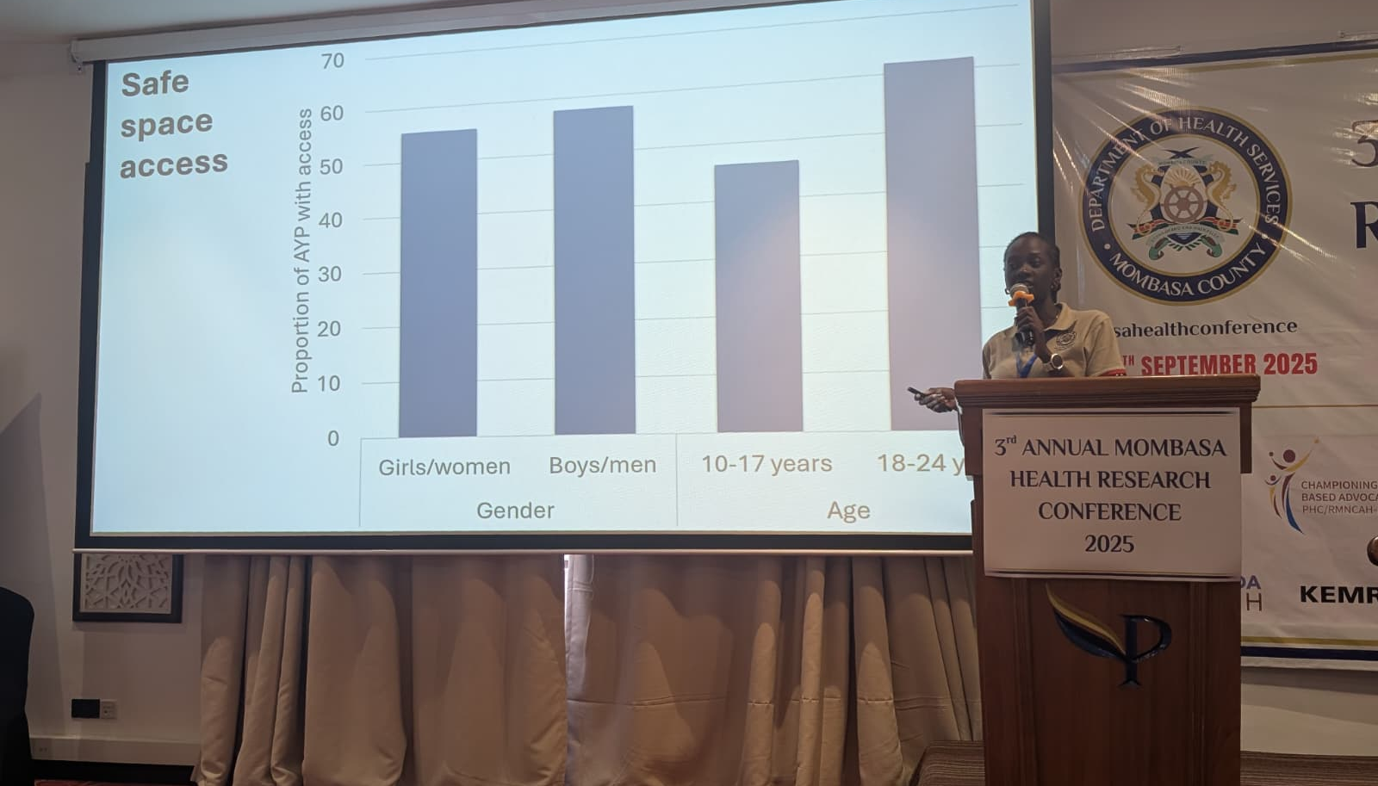


Slide 9




















Slide 10
Our study’s purpose
Provide empirical insights to guide evidence-based decision making
Evaluate the intervention’s impact on health and healthcare among adolescents and young people

Slide 11
Youth friendly services Intervention impact framework
n=989
2023
Wave 1
No YFS attendance
(‘baseline group’)
Relative difference:
(intervention−baseline) − (control−baseline)
2025
Wave 2
No YFS attendance
(‘control group’)
YFS attendance
(‘intervention group’)
n=948
n=689

Slide 12
Analysis
Generalised linear models constructed
‘Difference in difference’ approach (linear combinations of parameters) with robust variance
Clustering at level of sub-county
  Models accounted for variations in gender, age, and key population status
Wild cluster bootstrap (Rademacher weights)

Slide 13
Outcome measures
Access to healthcare →
  Five-point Likert scale of overall access (none > excellent)
Mental health & well-being →
  Patient Health Questionnaire 9 (PHQ9), indications of depression
Physical health →
  Seven-item self-rated health measure (terrible > excellent)
Uptake of HIV pre-exposure prophylaxis

Slide 14
Access to healthcare
(good-excellent)
Coef=0.10
95%CI:0.07,0.13
Coef=0.13
95%CI:-0.02,0.05
Relative difference
Coef=0.088
95%CI: 0.06,0.11
Notes:
The intervention group had an 8.8 percentage point higher outcome than would be expected based on baseline levels and the change observed in the control group.

Slide 15
Access to healthcare
(good-excellent)
Relative difference
General AYP
Coef=0.04
95%CI: -0.03,0.11
General
Key Populations
General
General
Key Populations
Key Populations

Slide 16
Access to healthcare
(good-excellent)
Relative difference
General
Key Populations
General
General
Key Populations
Key Populations
Key Population AYP
Coef=0.17
95%CI: 0.08,0.27

Slide 17
Depression
Coef= -0.04
95%CI: -0.06, -0.01
Coef=-0.28
95%CI:-0.08,0.02
Relative difference
Coef= -0.04
95%CI: -0.06, -0.01

Slide 18
Physical health
Coef=0.13
95%CI:-0.08,0.35
Coef=0.05
95%CI:-0.05,0.15

Slide 19
PrEP uptake
(recent/current)
Coef= 0.05
95%CI:0.01, 0.09
Coef= -0.01
95%CI:-0.04,0.02
Relative difference
Coef=0.059
95%CI: 0.16, 0.10

Slide 20
PrEP uptake
(recent/current)
Relative difference
Key Populations
Key Populations
Key Populations
Coef=0.1374
95%CI: 0.05, 0.23

Slide 21


Slide 22

Denton Callander
Patricia Owira
Ahmed Adam
Celina Kithinji
Radoslav Antonov
Kimani Makobu
Adrian Guadarrama
Hakima Masud
Kelvin Wangari
Masha Pastrana
Kelly Khabala
Iza Ciglenecki
Blessings Imani
David Kirongo
Vallary Winchester
Grace Mwendar
www.MombasaYouthStudy.com
www.MombasaKeyPopStudy.com

