Slide 1


HIV prevention for the community and with the community
Peer-driven delivery of long-acting injectable cabotegravir for key populations: preliminary findings from Beira, Mozambique
A. Flores, M. Barrios, R. Sabuni, Z. Seni, V. Carlos, N. Mulieca, S.J. Steele, L. O'Connell, T. Ellman, P. Isaakidis, A. Couto
[Diversity / Choice / Advocacy]
Notes:
- I am…
- I am pleased to talk to you about how MSF worked alongside the community to introduce HIV prevention choice in Beira, Mozambique

Slide 2
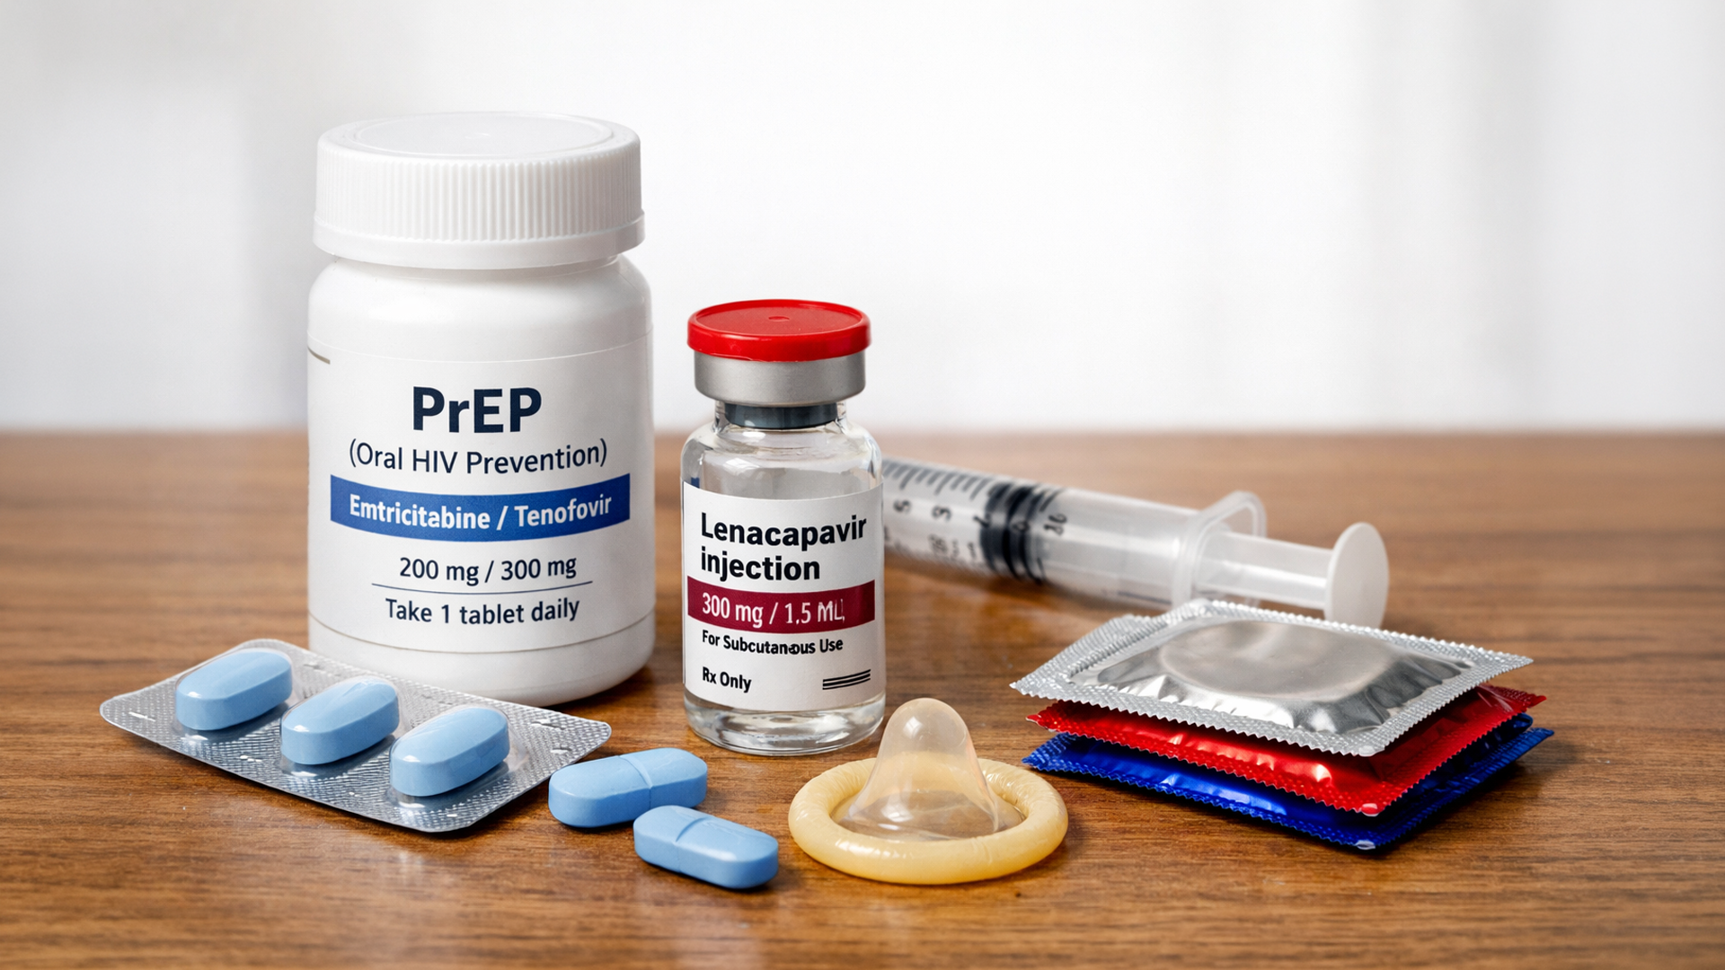
PrEP: From Daily Pill to Long-Acting Protection
WHAT IS PrEP?
Pre-Exposure Prophylaxis (PrEP)
- Antiretroviral medication taken before potential HIV exposure
- Prevents HIV from establishing infection in the body
- Evidence-based strategy for populations at heightened risk
ORAL PrEP (TDF/FTC): THE CHALLENGE
[ INSERT IMAGE ]
Right-click > Change Picture
Adherence-Dependent Efficacy
- Daily pill burden demands strict, uninterrupted adherence
- Visible pill bottle: stigma and disclosure risk for key populations
- Missed doses create real-world protection gaps
LONG-ACTING PrEP: NEW OPTIONS
Beyond the Pill: Two Approved Modalities
- CAB-LA (cabotegravir): bimonthly injection: adherence-independent, discreet
- Dapivirine vaginal ring: monthly insert, user-controlled, private
Both modalities WHO-prequalified and recommended for key populations at substantial HIV risk
CAB-LA Choice Study . Beira, Mozambique . MSF Scientific Day 2026
A. Flores et al.
Notes:
PrEP standands for…
It has been around for over a decade
Oral pills can be difficult to adhere to – missing doses may reduce protection
New methods: long-acting + create a menu of options

Slide 3
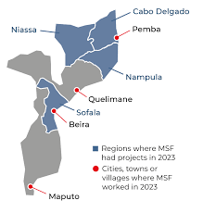
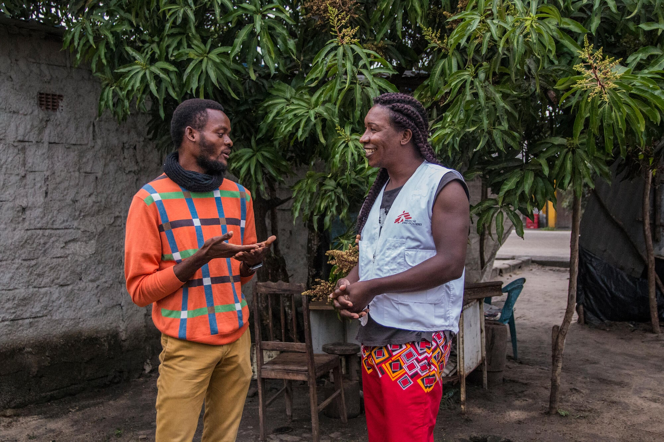
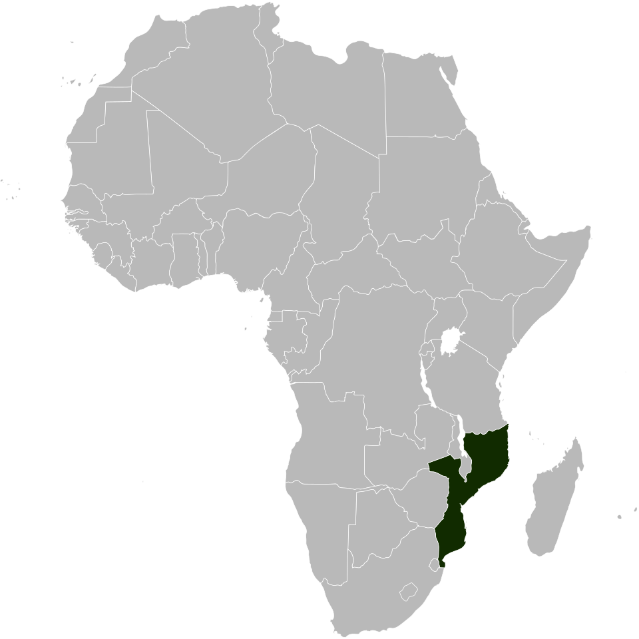
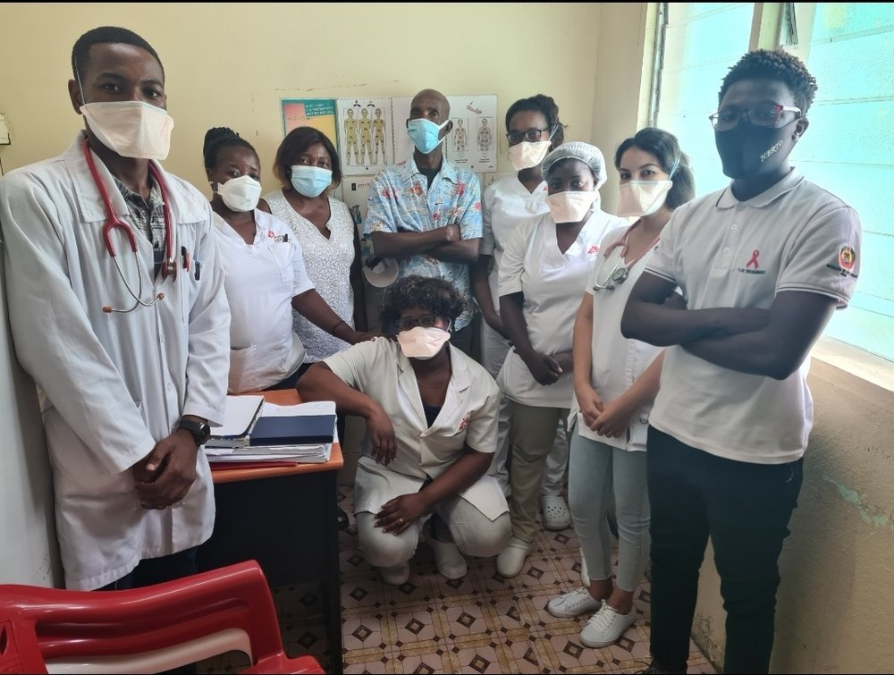
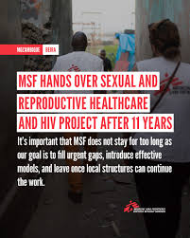
Background
Setting & Context
– Setting: Beira District, an urban, high‑HIV‑burden corridor city; MSF‑supported community clinics and outreach sites using a peer‑driven, (2014)
– Epidemiological context:
Mozambique
~2.1M people living with HIV | 12.5% national adult prevalence (INSIDA 2022)
Sofala province
Prevalence >15%
Key populations:
stigma, criminalisation, gender‑based violence
→ low prevention access
Notes:
Beira: central, Moz | high HIV prevalence
MSF has been present there since 2014, supporting and creating services for and with key populations: FSW, MSM, TG
KP: stigmatized -> lower access to healthcare -> higher HIV prevalence

Slide 4
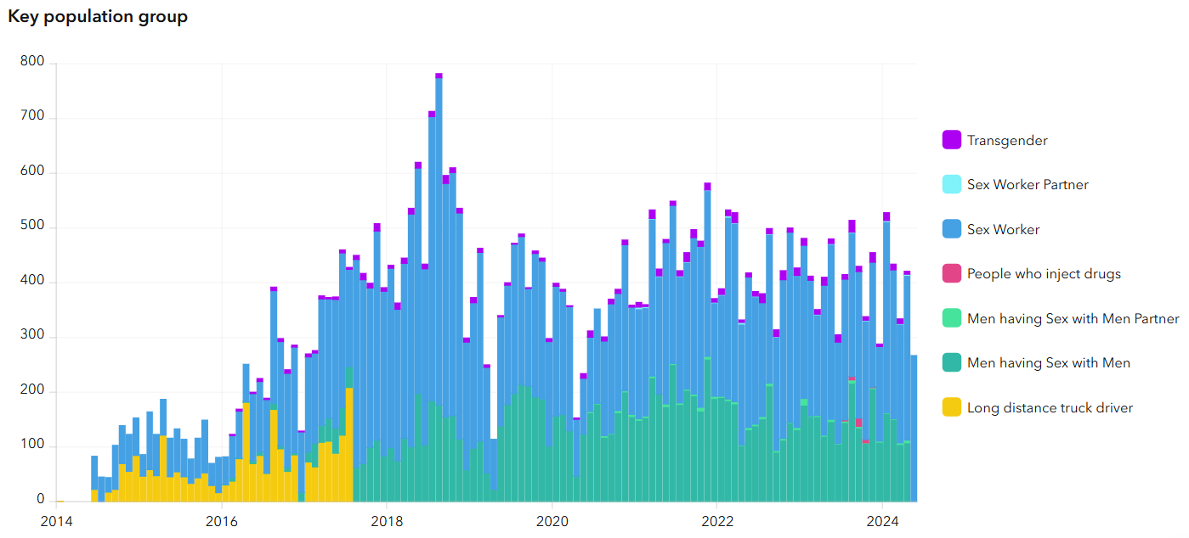
MSF Beira: Peer-Driven HIV Prevention for Key Populations (2014-2025)
Launched in 2014 as part of a multi-country corridor response to HIV: MSF delivered peer-driven, community-led prevention and care to key populations in Beira for 11 years, transitioning all services to the Ministry of Health in 2025.
Corridor Project
First in Mozambique
600+ trained
Launch
PrEP Study
Mentorship
2014
2015
2016
2019
2021
2025
[ INSERT PHOTO ]
Right-click > Change Picture
Night Clinics
Cyclone Idai
Handover
Peer-led outreach
HIV services restored
MoH transition
8,000+
600+
encounters
health workers trained
Peer Educators
Mobile Outreach
System Building
KP members as health advocates, building trust through shared experience and community networks
Night clinics meeting FSW and MSM on location, when they are safest
Mentorship of 600+ health workers; full handover to MoH and local organisations in 2025
KEY POPULATIONS SERVED
Female sex workers
Men who have sex with men
Transgender people
CAB-LA Choice Study . Beira, Mozambique . MSF Scientific Day 2026
A. Flores et al.
Notes:
Diverse model over the years: aiming to reach KP groups and improve access
Mobile clinics, door-to-door approaches, community clinics and drop-in centre

Slide 5
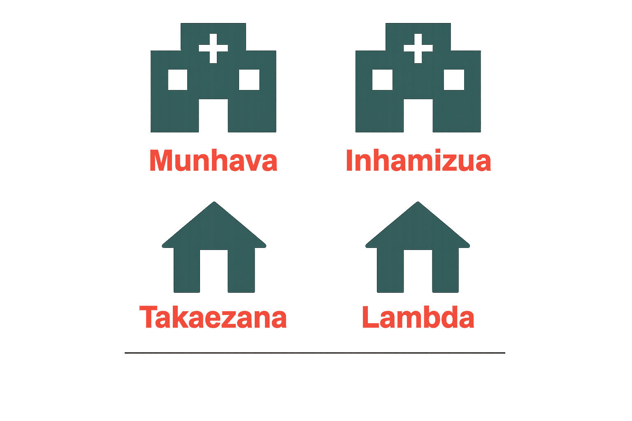
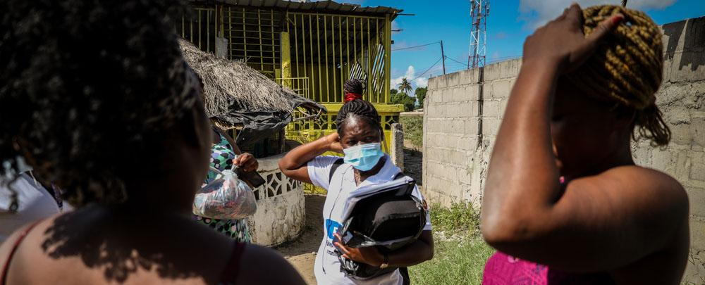
Study Design
Objectives
Methodology
Prospective mixed-methods cohort
embedded in a choice-based PrEP programme
Primary objective
Evaluate the feasibility and acceptability of integrating CAB-LA into peer-driven PrEP outreach for key populations.
Study period: July 2025 - June 2026
Sample: N=200 (CABLA study)`
H
H
Outcome measures
Uptake: Timing and rates of CAB-LA adoption.
Quantitative Component
- Prospective cohort in HIV-negative KPs (>= 18 years)
- Drop-in centres (DICs) and primary healthcare
- Outcomes: uptake, persistence, clinical safety
Persistence: Usage patterns and PrEP continuation.
Qualitative Component
- Methods: In-depth interviews (IDI), n=16
- Sampling: Purposive
- Analysis: Thematic
Clinical: Safety, adverse events, and seroconversions.
Feasibility: Acceptability and process efficiency.
[ INSERT PHOTO ]
Right-click > Change Picture
CAB-LA Choice Study . Beira, Mozambique . MSF Scientific Day 2026
A. Flores et al.
Notes:
We developed an implementation study to understand how feasible and acceptable expanding the menu of prevention options would be

Slide 6
Results
Participants’ characteristics
Characteristic | Overall (N=240) | FSW (N=115) | MSM/TG (N=106) | Undisclosed (N=19)
Age, median [IQR] | 24.0 [20–30] | 25.0 [21–30] | 22.5 [20–29] | 23.0 [19–29]
Previous PrEP use, n (%) | 64 (26.7%) | 36 (31.3%) | 25 (23.6%) | 3 (15.8%)
Perceived HIV risk, n (%) | 199 (82.9%) | 100 (87.0%) | 84 (79.2%) | 15 (78.9%)
Delivery site – DIC, n (%) | 127 (52.9%) | 70 (60.9%) | 48 (45.3%) | 9 (47.4%)
Notes:
Young pop
FSW: DIC - networks

Slide 7
Results
PrEP Choice at baseline
Subgroup | CAB-LA %
Overall (n=220) | 86%
FSW (n=115) | 95%
MSM (n=103) | 77%
Transgender (n=2) | 100%
DIC – community | 96%
PHC – facility | 75%
PrEP-naive | 87%
Prior oral PrEP users | 79%
Notes:
Highlight diff between FSW vs MSM

Slide 8
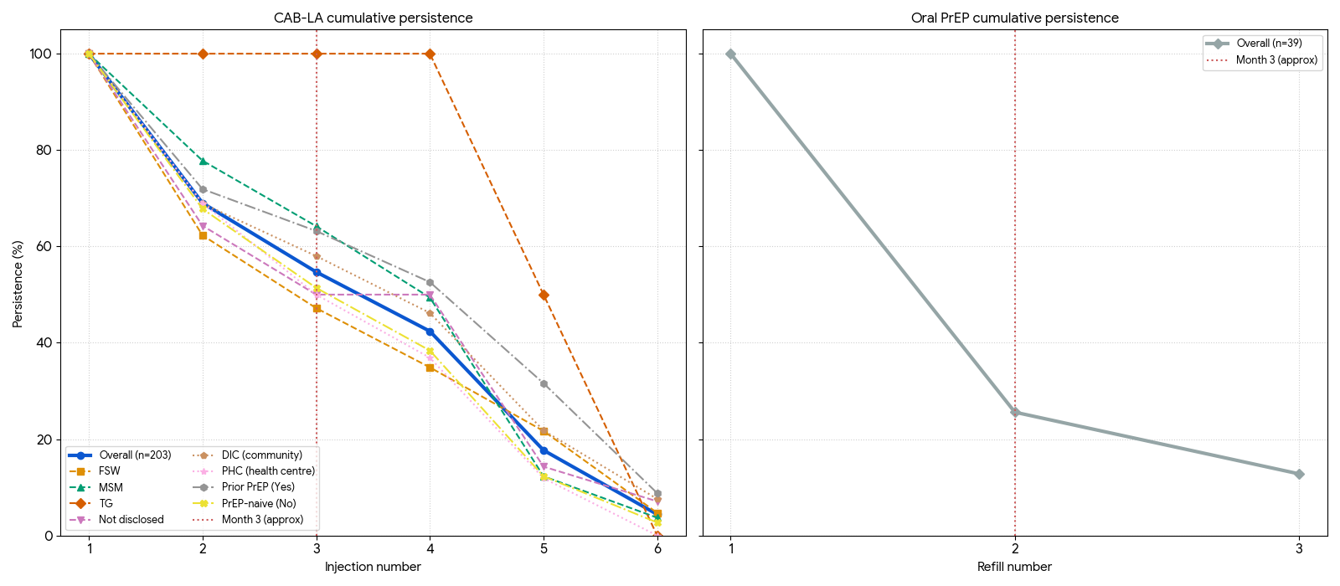
Results
PrEP coverage
MSF LA PrEP Technical Meeting
Notes:
Oral: historical fatigue
CAB-LA: opportunity to stay on PrEP longer

Slide 9
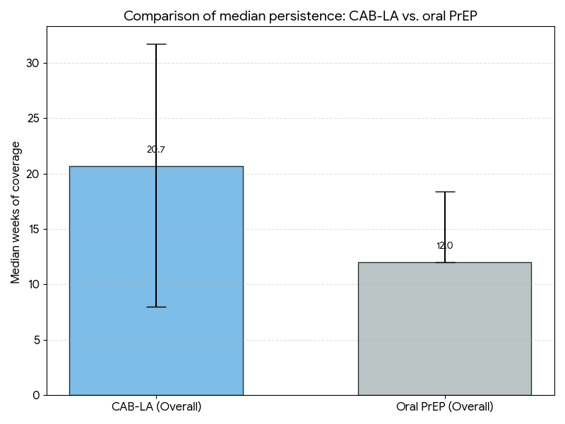
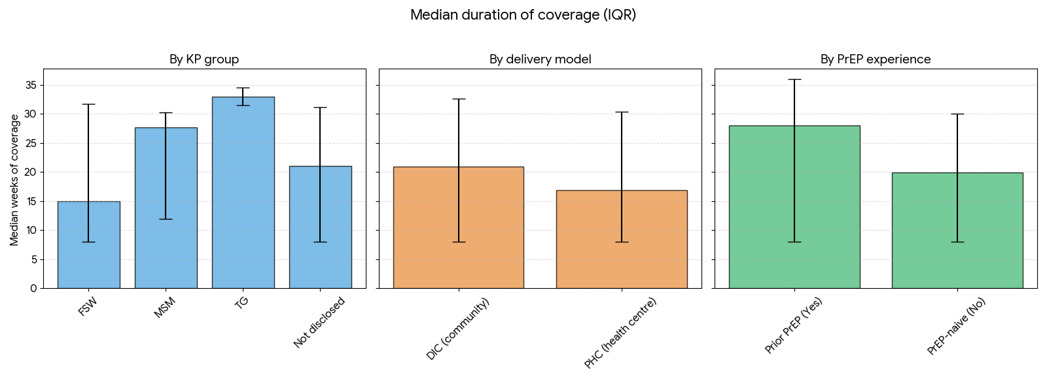
Results
PrEP coverage
MSF LA PrEP Technical Meeting
Notes:
(consider removing it)

Slide 10
Adverse Events — CAB-LA Injections (N = 203)
203
20.7%
74
0.36
Received CAB-LA injection
Participants with ≥1 AE
Total CAB-LA-attributed AEs
AEs per user (1.76 per affected)
AE Category Breakdown (% of 74 AEs)
DAIDS Severity Grade Distribution (74 AEs)
ISR (56.8%)
56.8%
50.0%
36.5%
13.5%
Fever (14.9%)
14.9%
Headache (12.2%)
12.2%
37
50.0%
Grade 1 – Mild
Dizziness (5.4%)
5.4%
27
36.5%
GI (4.1%)
4.1%
Grade 2 – Moderate
Fatigue (4.1%)
4.1%
10
13.5%
Hypersensitivity (2.7%)
2.7%
Grade 3 – Severe
Psychiatric (0%)
0%
0
0%
Grade 4 – Life-threatening
ISR sub-types (n=42 ISR events): Pain/discomfort 88.1% · Swelling 19.0% · Nodule 14.3% · Induration 7.1%
CAB-LA Choice Study · Beira, Mozambique · MSF Scientific Day 2026
Notes:
(does it meet any of the objectives?)
- offer as additional information

Slide 11
Community Voices on PrEP and CAB-LA
n=16 IDIs and FGDs | Beira, October 2025 | Translated from Portuguese
MESSAGING
ORAL PrEP
"
"
In the beginning, we said PrEP is an antiretroviral. That word created distrust. We had to say: PrEP is a medication that prevents HIV. Only then did people begin to accept it.
I used oral PrEP before. Honestly, I don't like it... it's not easy taking medication every day... and in my mind it says I'm not sick.
Community activist, FGD, Takaezana
FSW, IDI, Takaezana
CONVENIENCE
DISCRETION
CONTINUOUS PROTECTION
"
"
"
It's the kind of thing where you just get the injection and go home, only come back at the next appointment.
The injectable is better because nobody sees anything at home.
With the injection I'm protected the whole month.
FSW, IDI, Takaezana
Multiple IDIs
Multiple IDIs
CAB-LA Choice Study . Beira, Mozambique . MSF Scientific Day 2026
A. Flores et al.

Slide 12
Barriers to PrEP Access and Continuation
n=16 IDIs and FGDs | Beira, October 2025 | Translated from Portuguese
ACCESS
ADVERSE EFFECTS
PILL STIGMA
"
KEY FINDING
"
My friends there can't make it... there's no transport... there's no PrEP at the nearest health unit.
Reactions included headache, nausea, myalgia radiating to the leg, and generalised body pain. Severity was unpredictable: some tolerated the loading dose well, others experienced severe reactions at the second injection. At least two participants were bed-ridden for days; one required hospitalisation.
These tablets are the same as what HIV-positive people take. The first time I went to collect oral PrEP, I ran into my neighbour who is studying nursing — she was very upset, telling me I should not take those tablets because they were for seropositive people. She couldn't tell the difference.
MSM, IDI, Inhamizua, October 2025
Provider accounts and FGDs
MSM, FGD, Takaezana, October 2025
CAB-LA Choice Study . Beira, Mozambique . MSF Scientific Day 2026
A. Flores et al.

Slide 13

Results — Limitations
Limited impact assessment
No data on HIV incidence reduction, population impact, long-term protection, or behavioural/STI changes
Ongoing study
37.1% still in follow-up at analysis
Descriptive analysis; final analysis expected in August 2026
Generalisability
Findings based on MSF-supported community structures & choice-based design
Not directly transferable to rural or lower-resource settings without similar support
Notes:
The study could not quantitatively assess changes in sexual behaviour, condom use, or STI incidence following CAB‑LA initiation, despite qualitative signals of risk compensation. These outcomes were not systematically collected in the quantitative cohort, as follow‑up instruments focused on persistence and service engagement rather than behavioural outcomes, limiting the ability to estimate unintended prevention trade‑offs or combination‑prevention gaps. In addition, comparative effectiveness versus oral PrEP could not be rigorously estimated because there was no contemporaneous oral‑PrEP‑only comparator cohort at the same sites; oral PrEP outcomes are descriptive and rely on small numbers, requiring reliance on external trial evidence for efficacy comparisons rather than programme‑level inference.
Several data completeness issues constrain interpretation. First, 37.1% of participants were still in follow‑up at the time of analysis, resulting in right‑censoring and wide confidence intervals for later persistence estimates. Second, loss to follow‑up (LTFU) was substantial and represents the dominant attrition pathway, yet qualitative data disproportionately capture the perspectives of persistent users; Phase 1 qualitative sampling intentionally favoured continuers, introducing selection bias and limiting insight into discontinuation experiences. Third, key subgroups are under‑represented, most notably transgender participants (n=2), preventing meaningful disaggregation. Finally, enrolment form completeness issues (enrolment status recorded as 0% complete) raise concerns about upstream data quality that may affect covariate analyses if not resolved before final reporting.
Generalisability is constrained by both context and programme design. The study was conducted in Beira, a high‑burden urban setting with strong MSF community infrastructure (notably DICs and peer mobilisation), which may not reflect persistence outcomes in rural areas or settings without comparable community support. The choice‑based design, while programmatically realistic, limits causal inference because clients self‑select into CAB‑LA or oral PrEP, and structural drivers of choice (stigma, privacy, service accessibility) are inseparable from the observed outcomes. Moreover, findings are based on a pilot implementation phase with high support intensity and should therefore be extrapolated cautiously to national scale‑up contexts where staffing, follow‑up capacity, and outreach resources may differ substantially.

Slide 14


Key takeaways
PrEP choice is the new standard: it gives people autonomy and improves prevention effectiveness
People who need it most are generally marginalised and excluded from access
LA PrEP in a community model could improve access, uptake and continuation
Community networks are key to scaling up prevention and must be resourced adequately
Notes:
- PrEP choice is the new standard: it gives people autonomy and improves prevention effectiveness
- people who need it most are generally marginalized and exclced from access
- LA PrEP in a community model could improve access, uptake and continuation
- Community networks are key to scaling up prevention

Slide 15

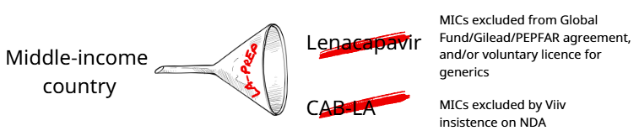
Thank you,
what’s next?
ViiV (only supplier of CAB-LA) currently refuses to quote prices or sell CAB-LA to MSF for middle-income countries (MICs) unless a non-disclosure agreement (NDA) is signed.
MSF is refusing Viiv’s confidentiality request, as pricing transparency helps ensure public scrutiny and accountability, which can lead to more affordable, accessible drugs.
“Viiv has demonstrated through its latest ad campaign that it understands very well that secrecy isn’t good for ending the HIV epidemic. Why is it insisting on silence in its procurement policies?”
- Antonio Flores, Senior HIV/TB Advisor

