Slide 1
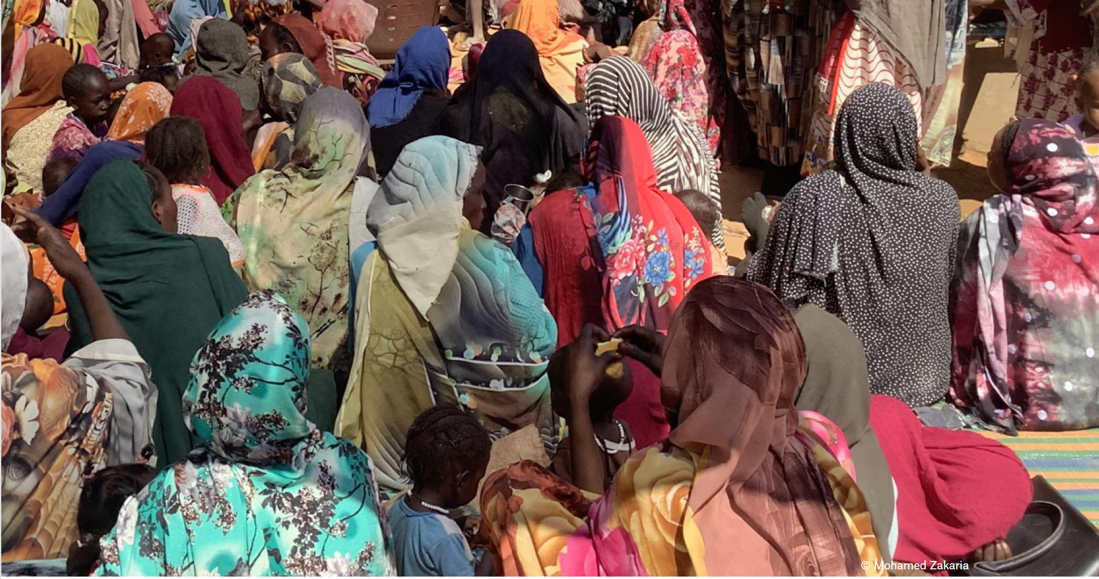


Rapid maternal death surveillance and response in humanitarian crisis settings: community-level insights from South Darfur, Sudan
Rijnberg N, Abdalla Osman R, Black B, Burkhardt G, Pereboom M, Almohammed A.
No Conflicts Of Interest
Notes:
Speaking on behalf of colleagues unable to join today.
Not fully representative of everyone who had worked on this topic.
Most maternal deaths are avoidable. Every death tells a story & provides an opportunity to learn and improve our care & humanitarian response.

Slide 2
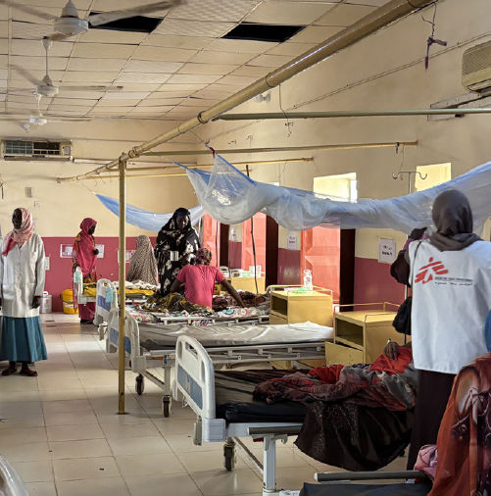
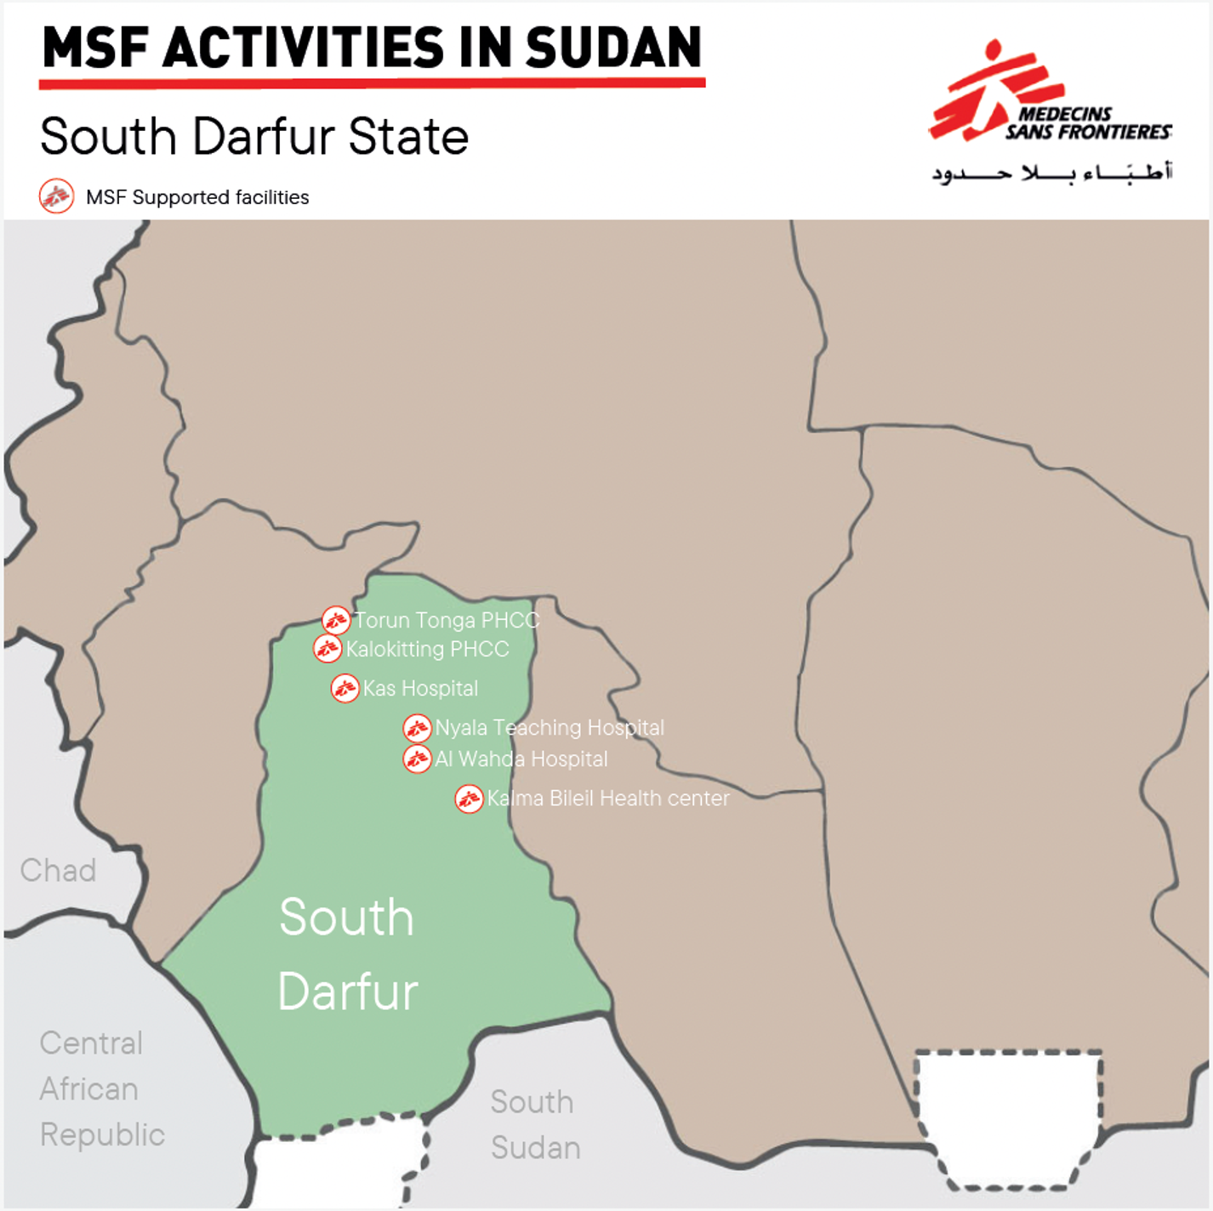
Context: Sudan April 2023 - Present
Notes:
Since April 2023, armed conflict has led to devastating consequences for maternal health in Sudan - Over 1 million pregnant women in urgent need of aid.
Maternal and perinatal death surveillance and response (MPDSR) is the global standard for monitoring, understanding and responding to maternal morbidity and mortality, but its use in acute humanitarian crises has been limited.
MSF OCA developed a specific tool for MPDSR in the crisis setting

Slide 3
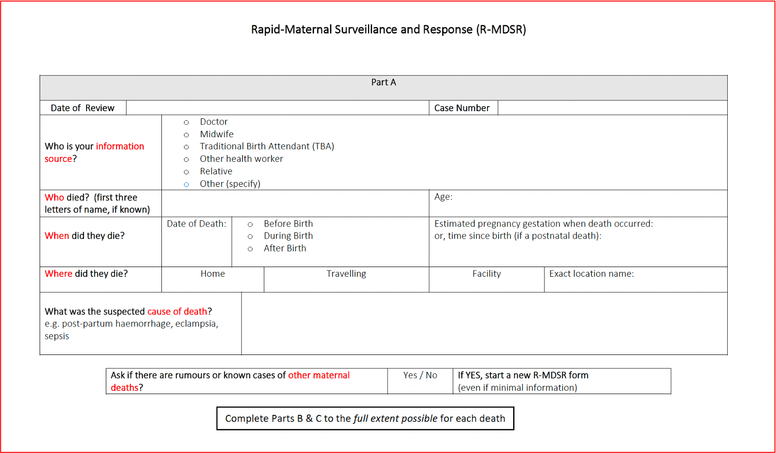
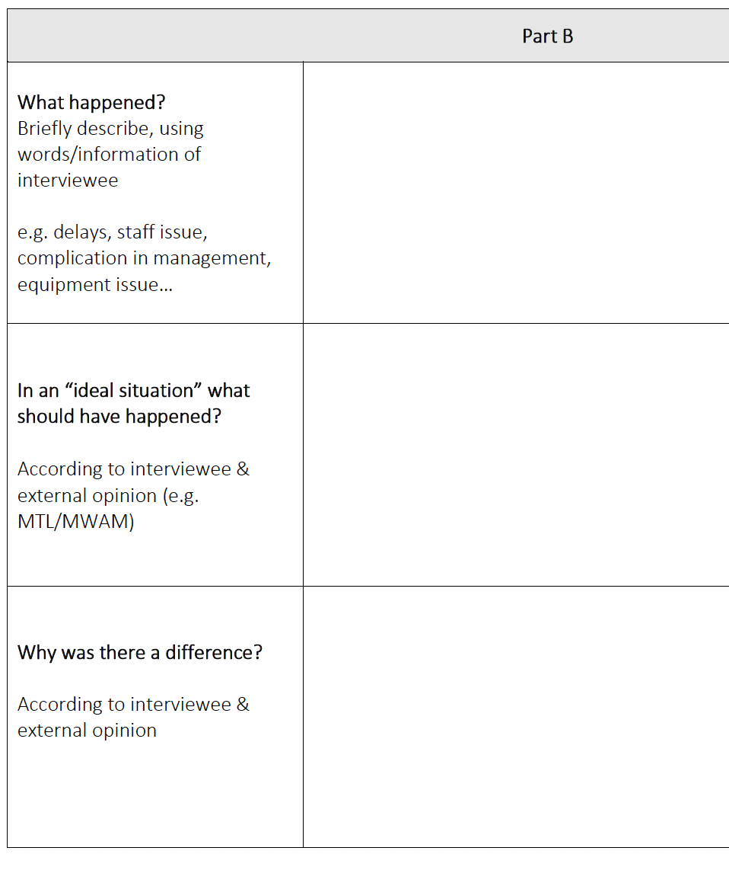
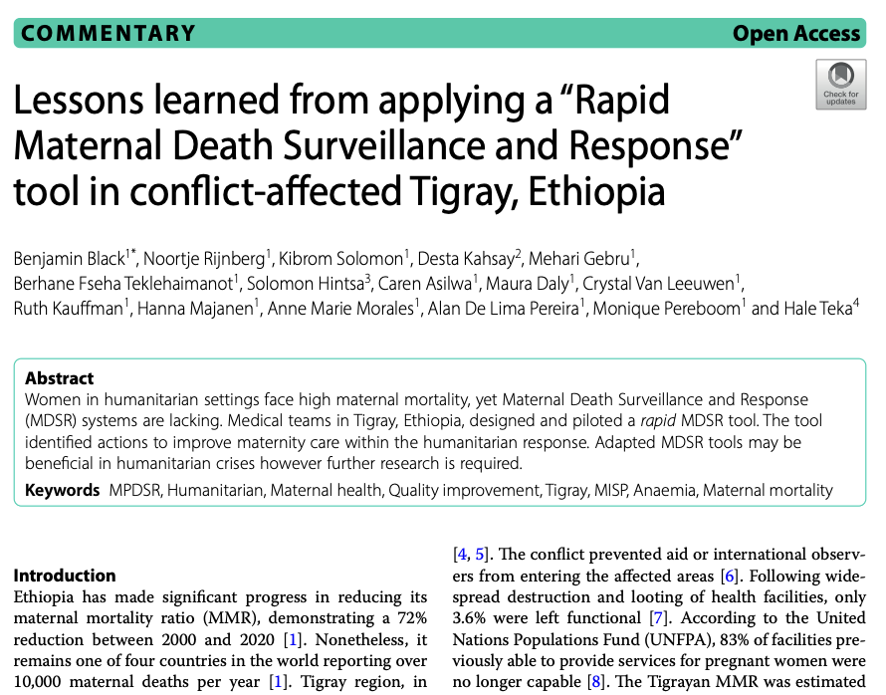

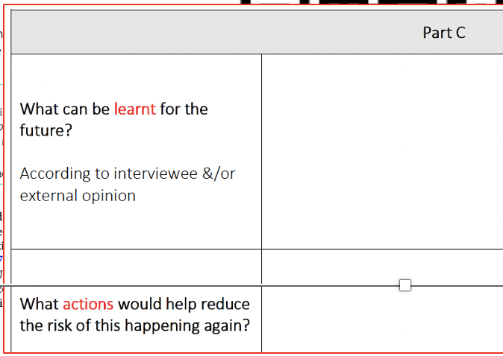
Notes:
MSF developed a rapid version of the MPDSR tool (R-MDSR), piloted successfully in an acute conflict setting (Tigray, Ethiopia, 2020–22).
In Tigray, Ethiopia, MSF were late to recognising & responding to high maternal mortality.
QR code links to paper published sharing lessons from the initial implementation of RMDSR
RMDSR was used early in MSF's Sudan response, initially in East Sudan in 2023.
Since January 2024, MSF has implemented R-MDSR in South Darfur, Sudan,
Building on lessons learned from its pilot in Ethiopia by integrating community engagement.

Slide 4
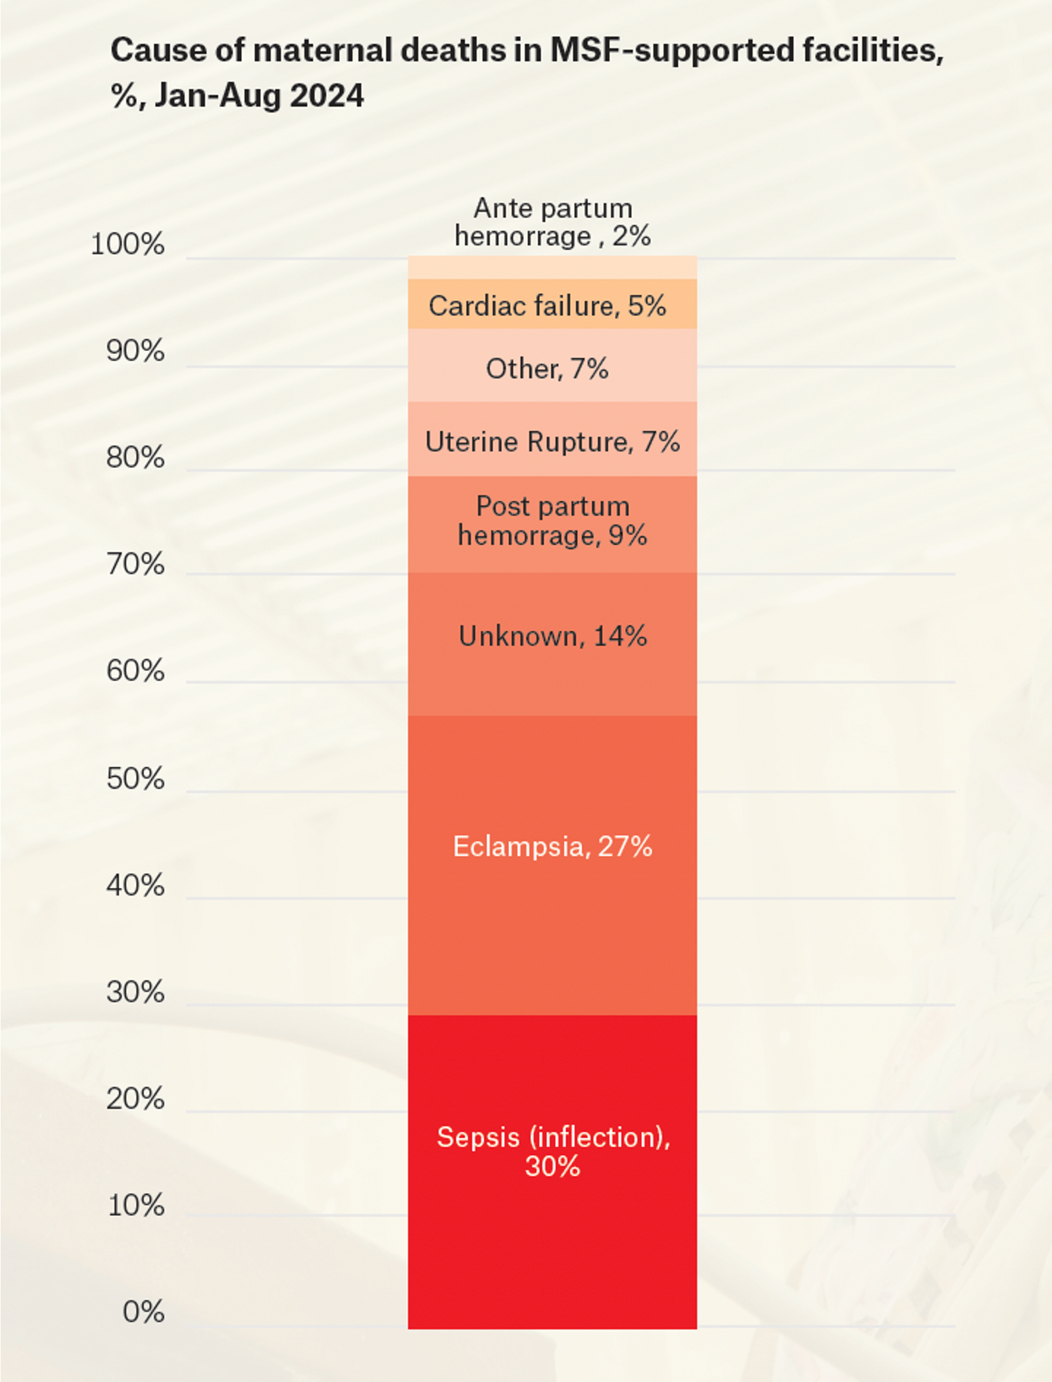
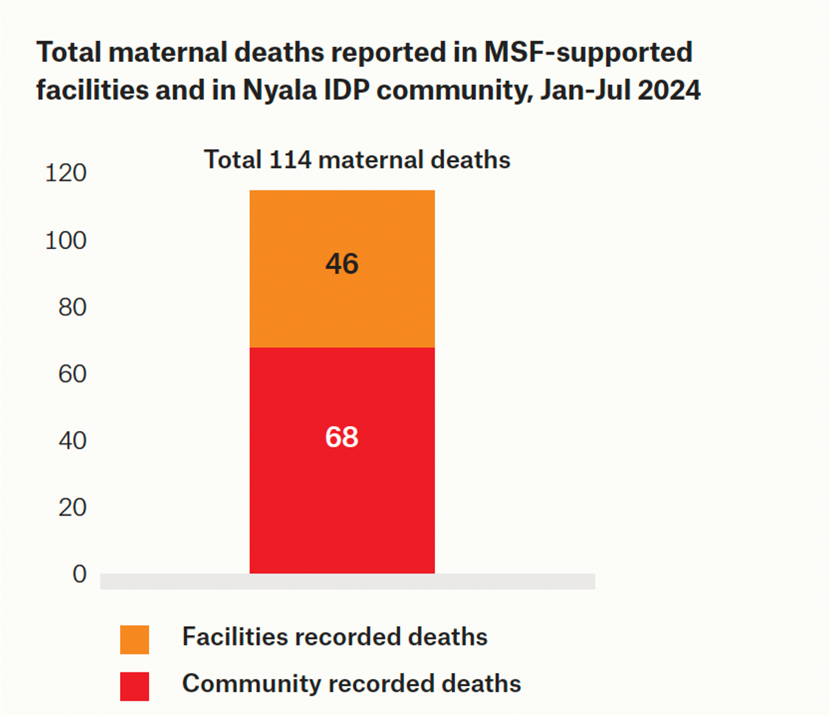
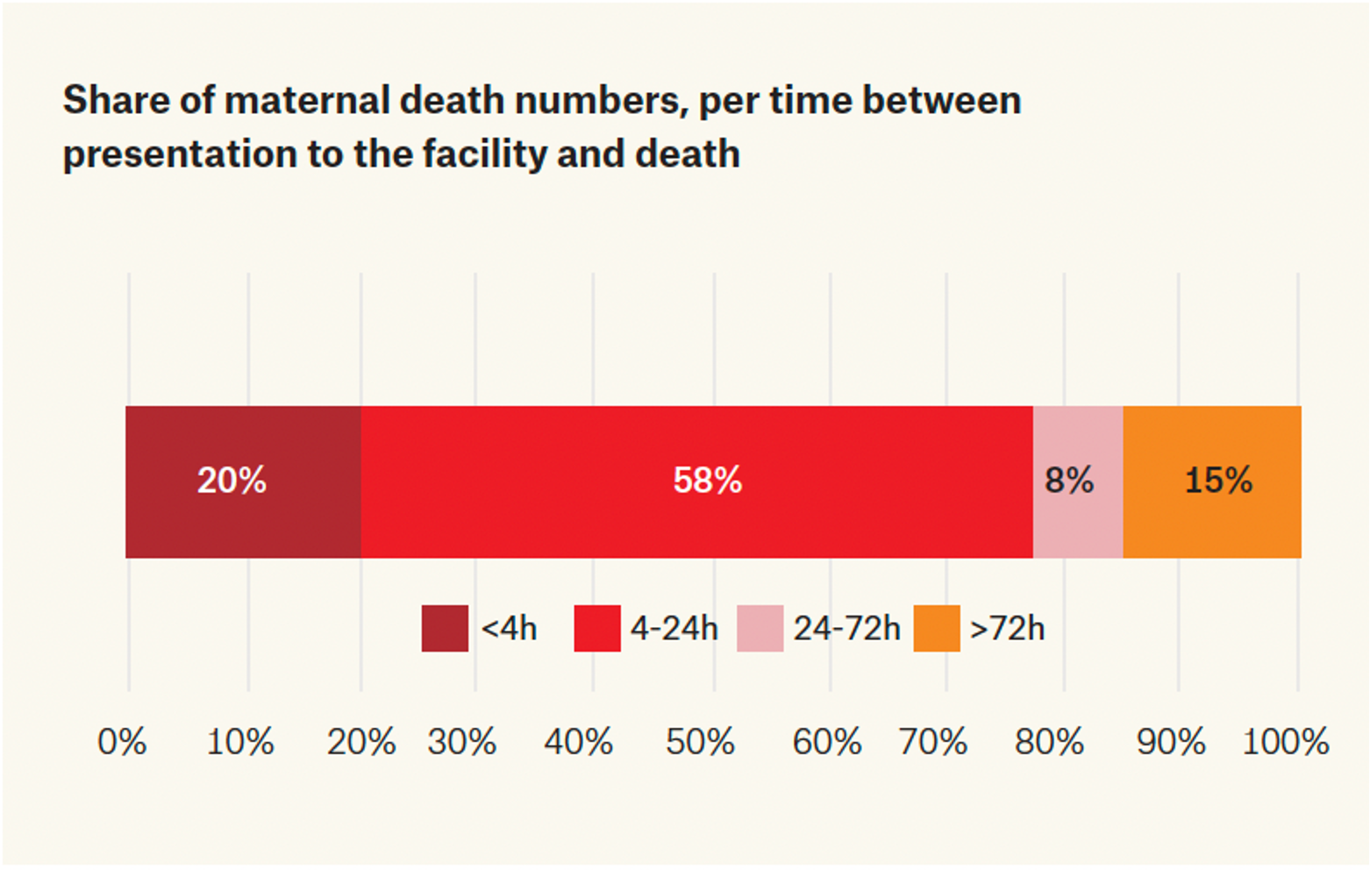
Findings
R-MDSR was implemented Jan–Jul 2024 in two MoH hospitals — Nyala Teaching and Kas Rural
Followed by snowball surveys in three nearby IDP camps, South Darfur
114 maternal deaths were reviewed: 40% facility & 60% community deaths
78% (32) facility deaths occurred within 24 hrs of arrival. Sepsis was the leading cause (not PPH).
Findings guided the creation of community-based women’s clinics from Aug 2024, offering ANC, PNC (including home visits), referral, contraception, and sexual violence care. Targeted hospital-based improvements included OT & other infrastructure repairs, IPC focus, lab support, triage improvements, post – op monitoring.
Notes:
Catastrophic level of maternal death, only a small sample of South Darfur.
More deaths than seen in one year across Western Europe
Timing of deaths & causes of deaths
Without using MDSR these deaths wouldn’t have been visible to MSF
Implications:
– Facility focus on sepsis, immediate care: Infrastructural repairs (OT/sterilization) would not have been prioritized.
Community: womens health clinics, ANC, low risk birth, referral. Expanded to broader SRHR
Advocacy internal and external (national, international & multi-agency levels)

Slide 5
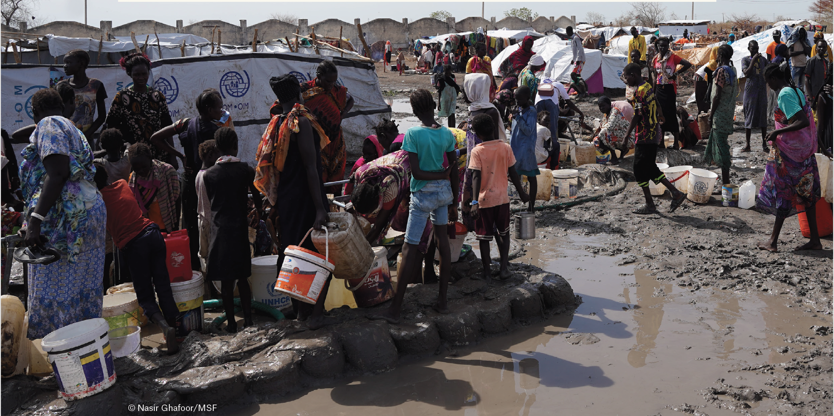

Feasibility: Facility & community R-MDSR is adaptable to volatile, resource-limited settings.
Impact: Enabled rapid data collection and analysis leading to evidence-based responses to improve outcomes
Value: Strengthened resource allocation, programme design, clinical priorities and advocacy initiatives.
Conclusion: R-MDSR supports teams to identify maternal deaths & respond to their causes within humanitarian crisis settings
Notes:
QR code links to MSF report on South Darfur "Diven Into Oblivion"

