Slide 1
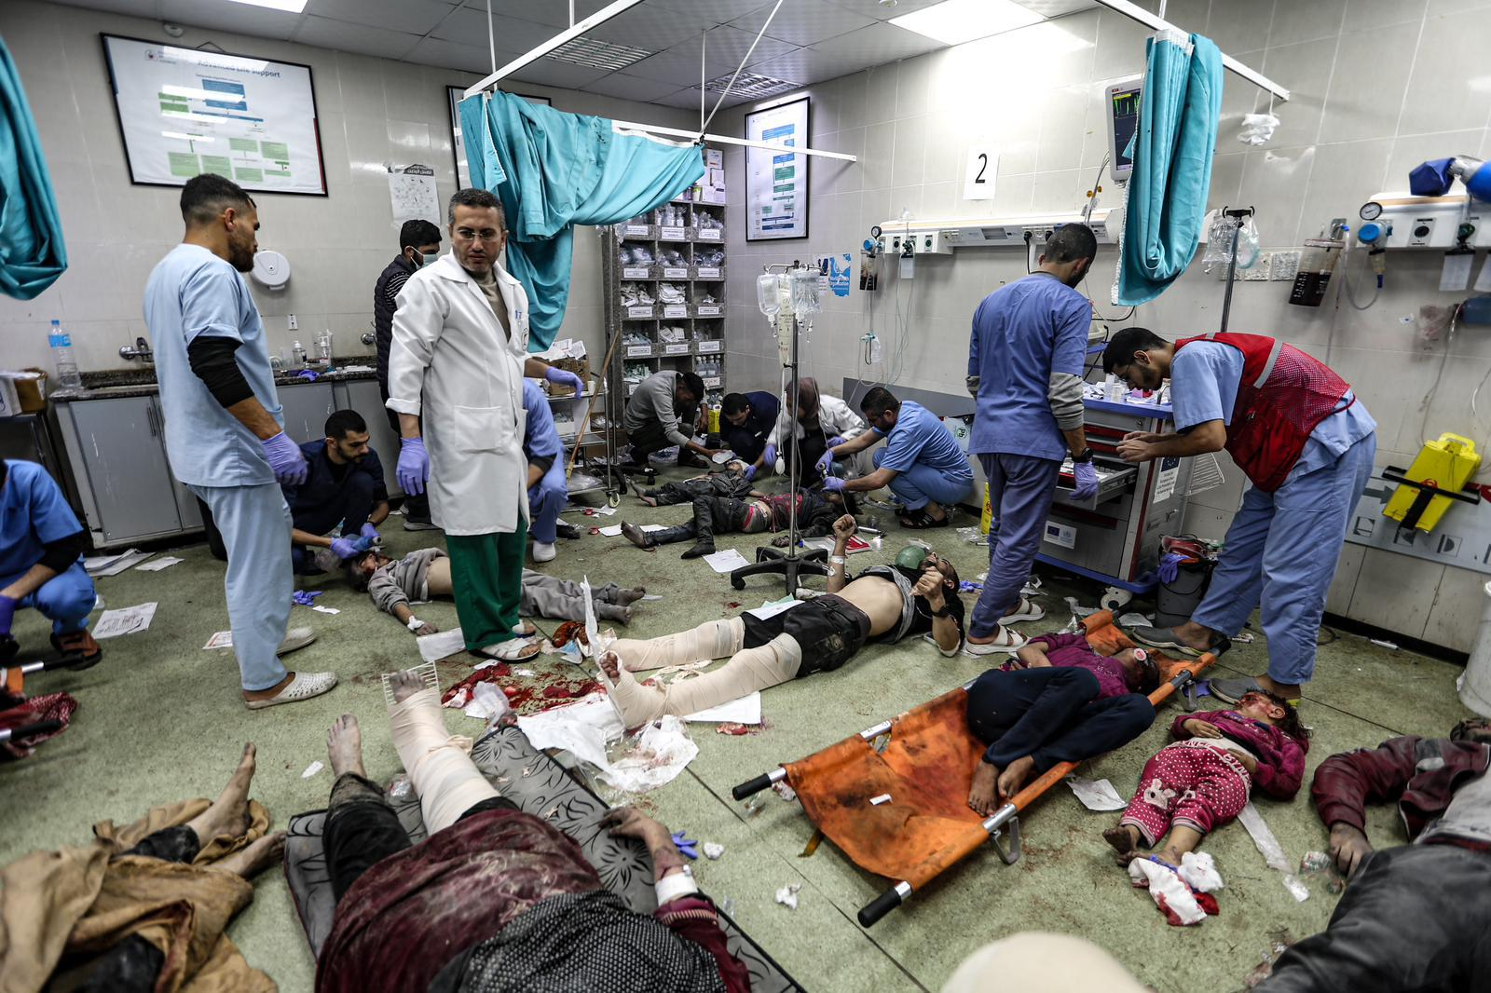


Traumatic injuries and surgical interventions at the Médecins Sans Frontières Surgical Field Hospital in Gaza, from August 2024 to August 2025: a retrospective analysis of medical records
Dr Sohaib Safi
Médecins Sans Frontières / Luxembourg Operational Research Unit / Operational Centre Brussels
Conflict of interest: the author has declared no conflict of interest.

Slide 2
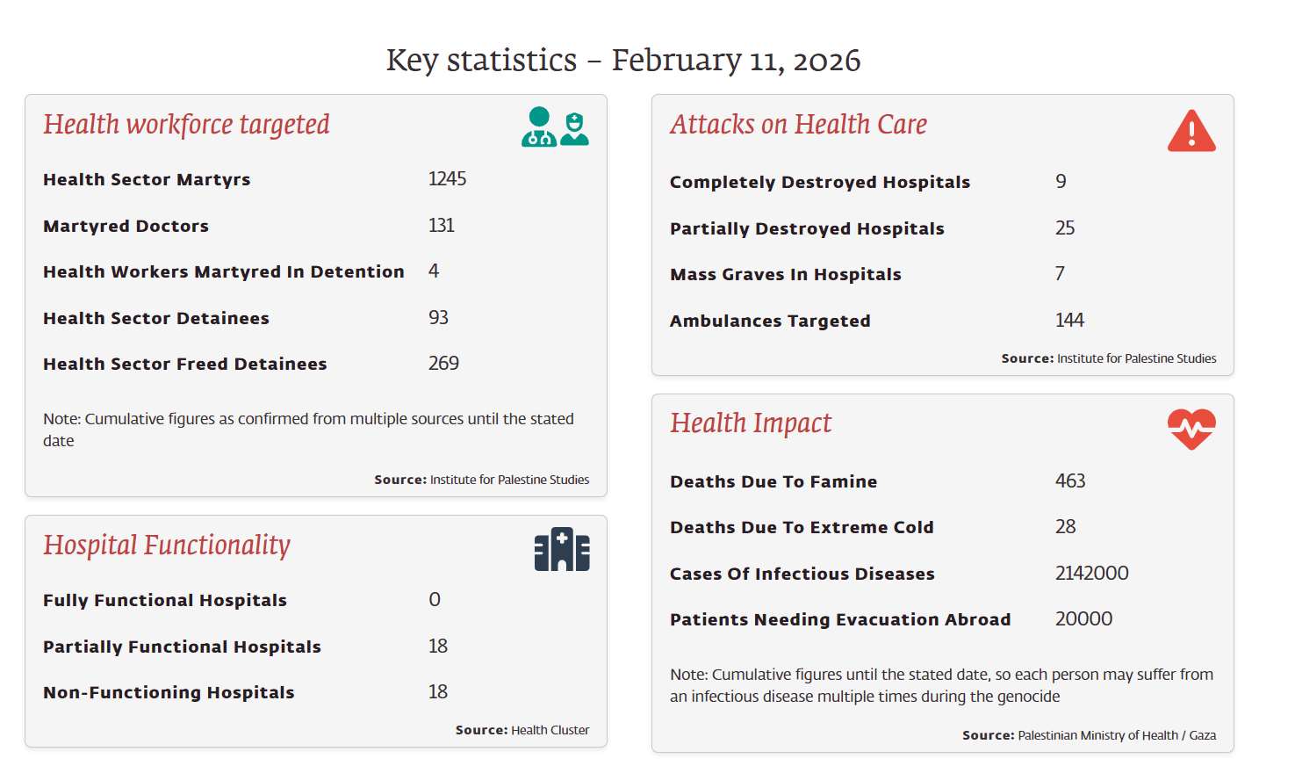
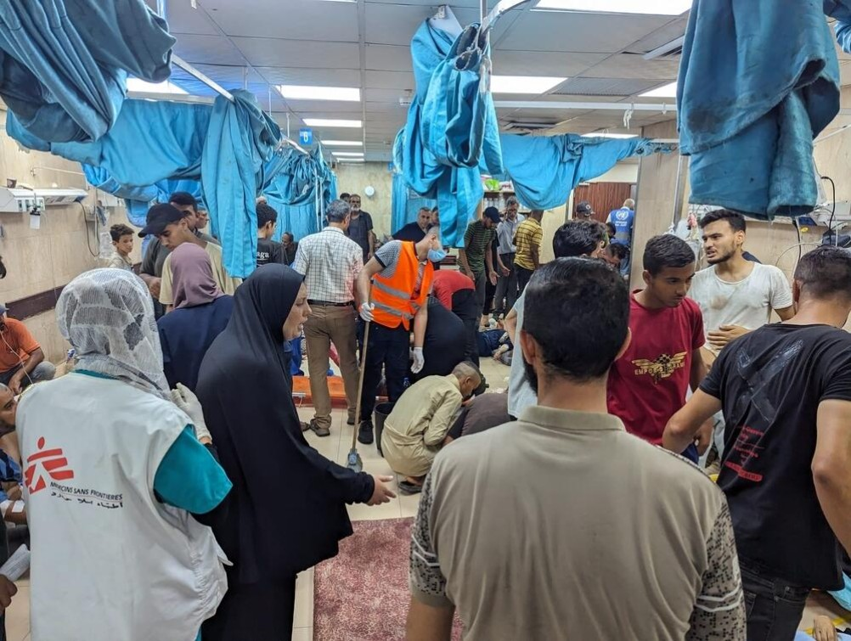
Context and Aim:
Conflict, attacks on healthcare, and why this hospital matters
Gaza, August 2024–August 2025
Repeated mass-casualty events and pressure on surgical capacity
MSF field hospital expanded trauma bed and operating theatre capacity
Aim: describe trauma patterns, surgical care, and early outcomes among patients reaching MSF care
Why it matters: systematic trauma and surgical evidence from Gaza remains limited

Slide 3
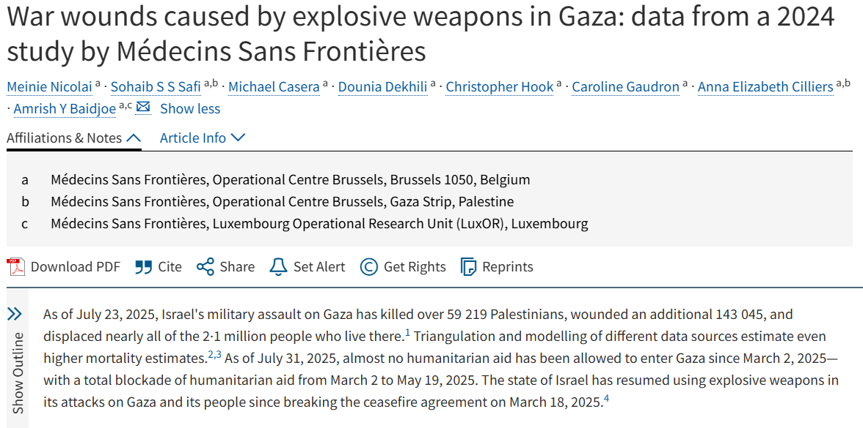

Wider trauma burden: published MSF analysis
Explosive-Weapons piece data:
Published MSF analysis, six MSF-OCB-supported facilities, Gaza, 2024
207,942 OPD consultations
Wound care represented 44.8% of all OPD consultations
Violent trauma represented 42.6% of wound-care consultations
Among violent-trauma wound-care consultations:
Bombs and shelling: 83.0%
Gunshots: 11.3%
Burns: 3.8%
Children among wound-care consultations:
<15 years: 29.7%
<5 years: 9.8%
Nicolai M, Safi S, Casera M et al.
War wounds caused by explosive weapons in Gaza: data from a 2024 study by Médecins Sans Frontières. The Lancet, 2025; 406, 687-688

Slide 4
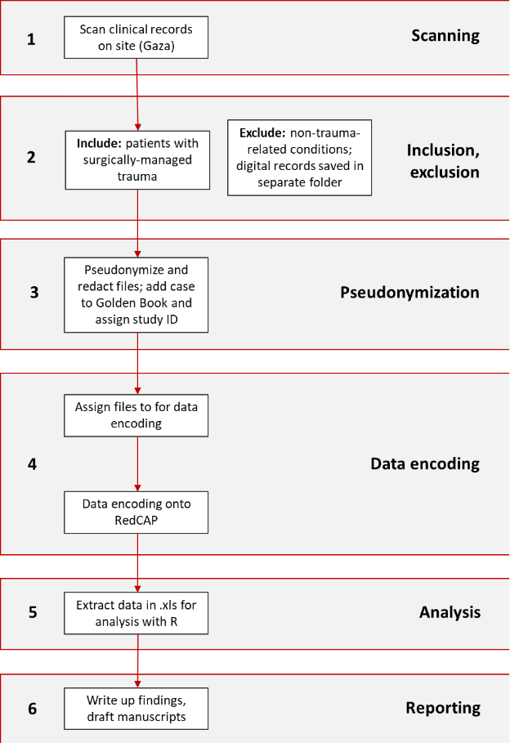
Study methods and data pathway
Approvals from:
- Gaza MoH
MSF-ERB
MSF – ILD
MSF – DPO
MSF – Patient safety
Methods:
Retrospective analysis of routinely collected inpatient records (Aug 2024–Aug 2025)
Data extracted into structured CRF (REDCap)
MSF ERB 2559 + Gaza MoH approval
Emergency Department → Operating Theatre → Intensive Care Unit → Surgical Inpatient Department → Outpatient Department
What we need to capture/analyse
Full clinical pathway
Injury mechanism and severity
Surgical procedures and re-interventions
Complications and outcomes
Why it matters
Surgical Planning
Preparedness in
conflict settings
Resource planning
Support from:
Universities and medical staff/students
Limitations
Routine records, incomplete documentation
Only patients who reached care
Ongoing data cleaning and analysis

Slide 5
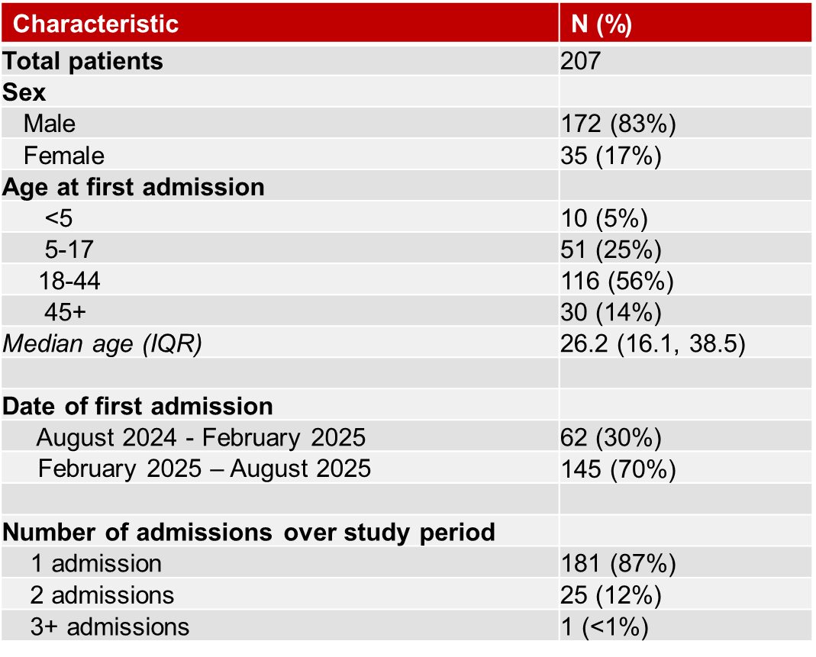
Preliminary analysis: major conflict-related surgical burden
Characteristics of patients admitted to MSF-OCB Field Hospital in Gaza, August 2024 – August 2025 (N=207)
Note: this is a preliminary analysis among a representative subgroup

Slide 6
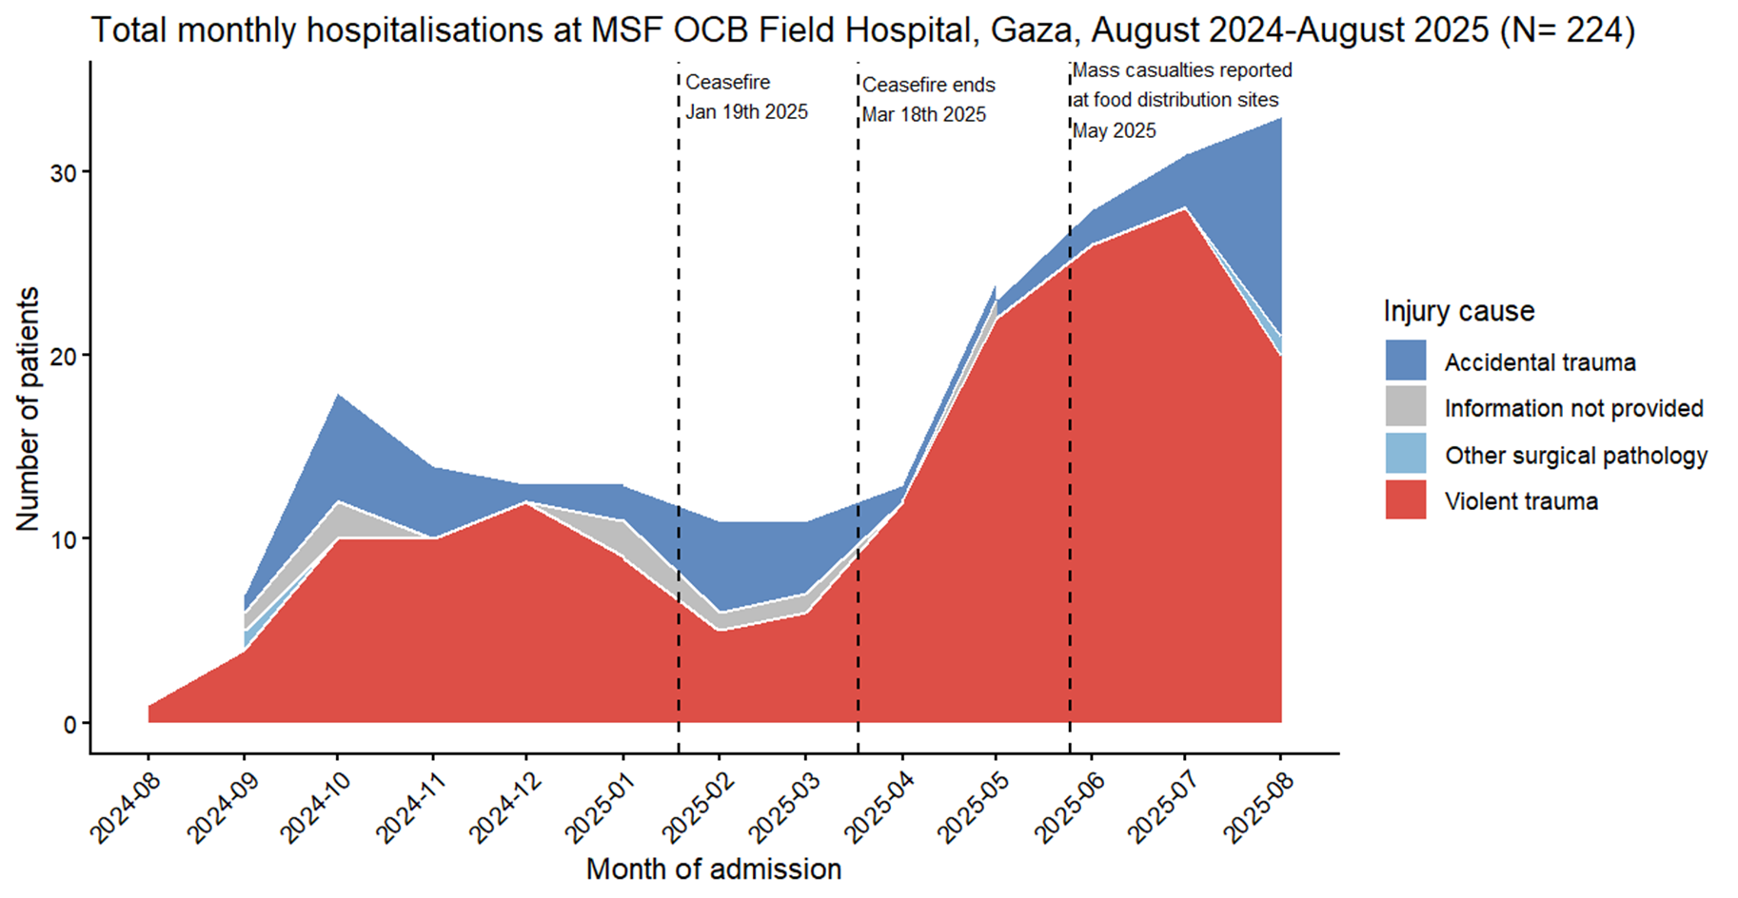
*Exclusions: re-admissions for complications or follow up of existing trauma

Slide 7
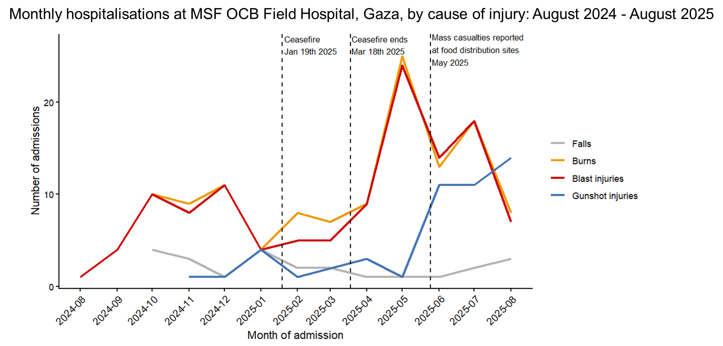

Slide 8
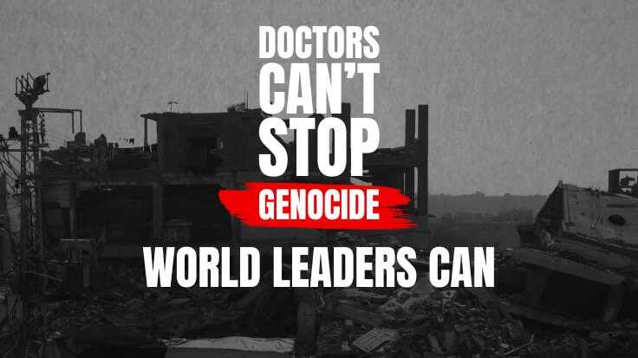
Testimony and Final Messages:
From medical data to medical advocacy
Clinical data can:
Document patterns of injury and care
Show patterns of weapon-related injury
Identify affected groups, including children
Demonstrate pressure on surgical services
Support planning, preparedness, and advocacy
Imperfect clinical data can still help MSF improve care, allocate resources, and bear witness; if used responsibly in collaboration with others
MSF should strengthen systematic trauma documentation in conflict settings
Alone

Slide 9
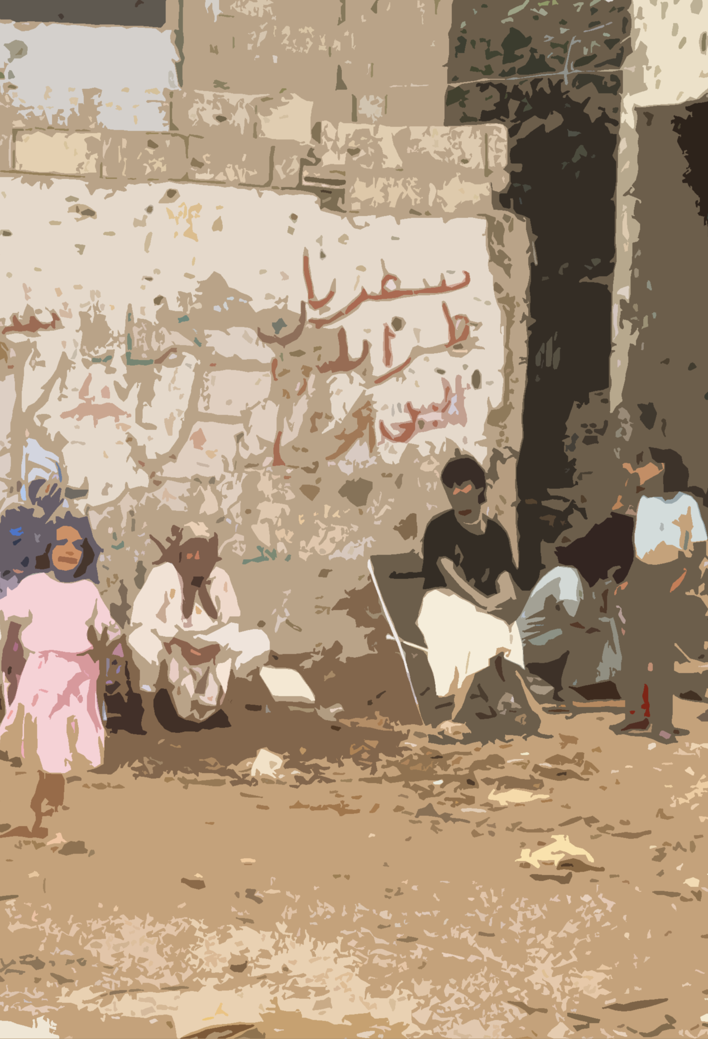
Primary Project team
Lead PIs:
Amrish Baidjoe (LuxOR Director): contact focal point
Shazeer Majeed (Surgical Referent, OCB)
Lead Support OR:
Sohaib S.S. Safi (LuxOR OR advisors, former Deputy Project Medical Referent, OCB-Gaza)
Laura Paris (LuxOR, consultant, former UNWRA)
Sylvia Lim (LuxOR OR Advisor, Epidemiology)
Temmy Sunyoto (LuxOR OR, clinical)
Innocent Nyaruhirira (Orthopedic Surgeon Referent, OCB)
Emergency Unit:
Christopher Hook (Medical Responsible)
Medical project level:
Mohammed Sommad and his team; Gaza data team – Scanning
Dr Ali, Dr Saber; Gaza Medical Doctors- Encoders
Support:
Intersectional Legal Department: Blandine Contamin, Alice Proby
Patients data safety: Marie Mescam
DPO officers, IT departments
External Partners: Utrecht Medical University, Karolinska Institut
Alone

