Slide 1
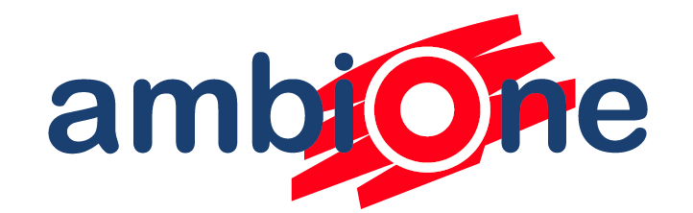
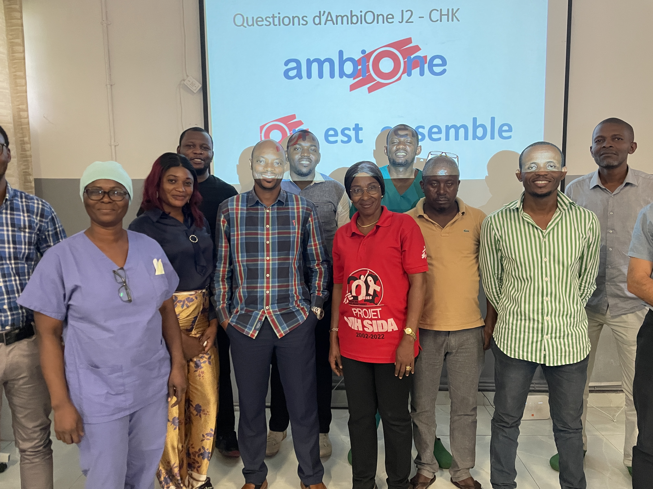
Is simple care, better care?
Moving to a simplified regimen for cryptococcal meningitis, the AmbiOne study
MSF scientific Days, May 2026
Notes:
Add this to next slide: Implementing single dose liposomal amphotericin B in low resource settings

Slide 2


Background: Advanced HIV disease still a problem
Advanced HIV disease responsible for 630,000 deaths annually
Cryptococcal meningitis: 2nd largest contributor to AIDS-related deaths after tuberculosis
Standard of care previously was a minimum of 7 days intravenous antifungal treatment
Notes:
Key point is to give context and highlight the above 50% mortality despite improving antifungal regimens. Highlight LP as a component of care.

Slide 3
Bridging the gap between research and reality
Routine care programmes in Africa using different CM treatments
Settings: routine care
2 week mortality: 25- 40%
10 week mortality: 44 – 74%
1: Molloy Sf et al ACTA Trial Study Team. Antifungal Combinations for Treatment of Cryptococcal Meningitis in Africa. N Engl J Med. 2018 Mar
2: Jarvis JN, et al Ambition Study Group. Single-Dose Liposomal Amphotericin B Treatment for Cryptococcal Meningitis. N Engl J Med. 2022 Mar
3: Patel RKK, et al. High Mortality in HIV-Associated Cryptococcal Meningitis Patients Treated With Amphotericin B-Based Therapy Under Routine Care Conditions in Africa. Open Forum Infect Dis. 2018 Oct
4: Meda J et al Cryptococcal meningitis management in Tanzania with strict schedule of serial lumbar punctures using intravenous tubing sets: an operational research study. J Acquir Immune Defic Syndr. 2014 Jun
Notes:
Narrative of routine care still showing worse outcomes than research. The most recent large research trial, the ambition trial, showed a single dose liposomal formulation was non inferior and had fewer side effects. AmbiOne was a trial to see how this worked in real world settings and what the implementation barriers are. Highlight that ambition was done in SSA.

Slide 4

Bridging the gap between research and reality
Routine care programmes in Africa using different CM treatments
Settings: routine care
2 week mortality: 25- 40%
10 week mortality: 44 – 74%
2- week mortality: 13% (CI: 10-17%)
10-week mortality: 25% (CI: 21-29%)
Single dose regimen
1: Molloy Sf et al ACTA Trial Study Team. Antifungal Combinations for Treatment of Cryptococcal Meningitis in Africa. N Engl J Med. 2018 Mar
2: Jarvis JN, et al Ambition Study Group. Single-Dose Liposomal Amphotericin B Treatment for Cryptococcal Meningitis. N Engl J Med. 2022 Mar
3: Patel RKK, et al. High Mortality in HIV-Associated Cryptococcal Meningitis Patients Treated With Amphotericin B-Based Therapy Under Routine Care Conditions in Africa. Open Forum Infect Dis. 2018 Oct
4: Meda J et al Cryptococcal meningitis management in Tanzania with strict schedule of serial lumbar punctures using intravenous tubing sets: an operational research study. J Acquir Immune Defic Syndr. 2014 Jun
Notes:
Narrative of routine care still showing worse outcomes than research. The most recent large research trial, the ambition trial, showed a single dose liposomal formulation was non inferior and had fewer side effects. AmbiOne was a trial to see how this worked in real world settings and what the implementation barriers are. Highlight that ambition was done in SSA.

Slide 5
Bridging the gap between research and reality
Routine care programmes in Africa using different CM treatments
Settings: routine care
2 week mortality: 25- 40%
10 week mortality: 44 – 74%
2- week mortality: 13% (CI: 10-17%)
10-week mortality: 25% (CI: 21-29%)
Single dose regimen
1: Molloy Sf et al ACTA Trial Study Team. Antifungal Combinations for Treatment of Cryptococcal Meningitis in Africa. N Engl J Med. 2018 Mar
2: Jarvis JN, et al Ambition Study Group. Single-Dose Liposomal Amphotericin B Treatment for Cryptococcal Meningitis. N Engl J Med. 2022 Mar
3: Patel RKK, et al. High Mortality in HIV-Associated Cryptococcal Meningitis Patients Treated With Amphotericin B-Based Therapy Under Routine Care Conditions in Africa. Open Forum Infect Dis. 2018 Oct
4: Meda J et al Cryptococcal meningitis management in Tanzania with strict schedule of serial lumbar punctures using intravenous tubing sets: an operational research study. J Acquir Immune Defic Syndr. 2014 Jun
Notes:
Narrative of routine care still showing worse outcomes than research. The most recent large research trial, the ambition trial, showed a single dose liposomal formulation was non inferior and had fewer side effects. AmbiOne was a trial to see how this worked in real world settings and what the implementation barriers are. Highlight that ambition was done in SSA.

Slide 6
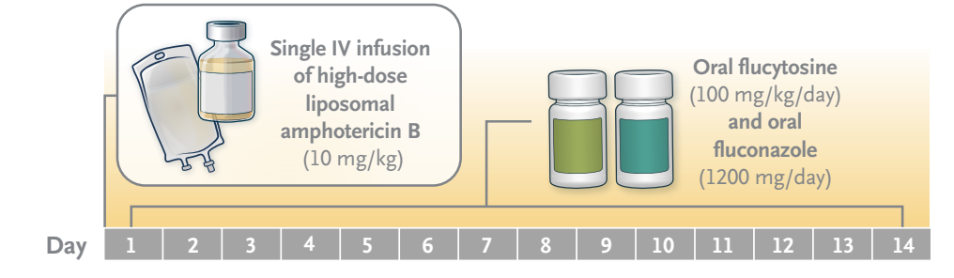
Study rationale and design
Evidence gap: Real world evidence about implementation barriers of single dose regimen in low resource settings.
Design: Mixed methods implementation study of single dose regimen as per 2022 WHO guidelines
Eligibility: Adults (≥ 18yo) in inpatient care living with HIV and microbiologically confirmed cryptococcal meningitis that consented for inclusion.

Slide 7
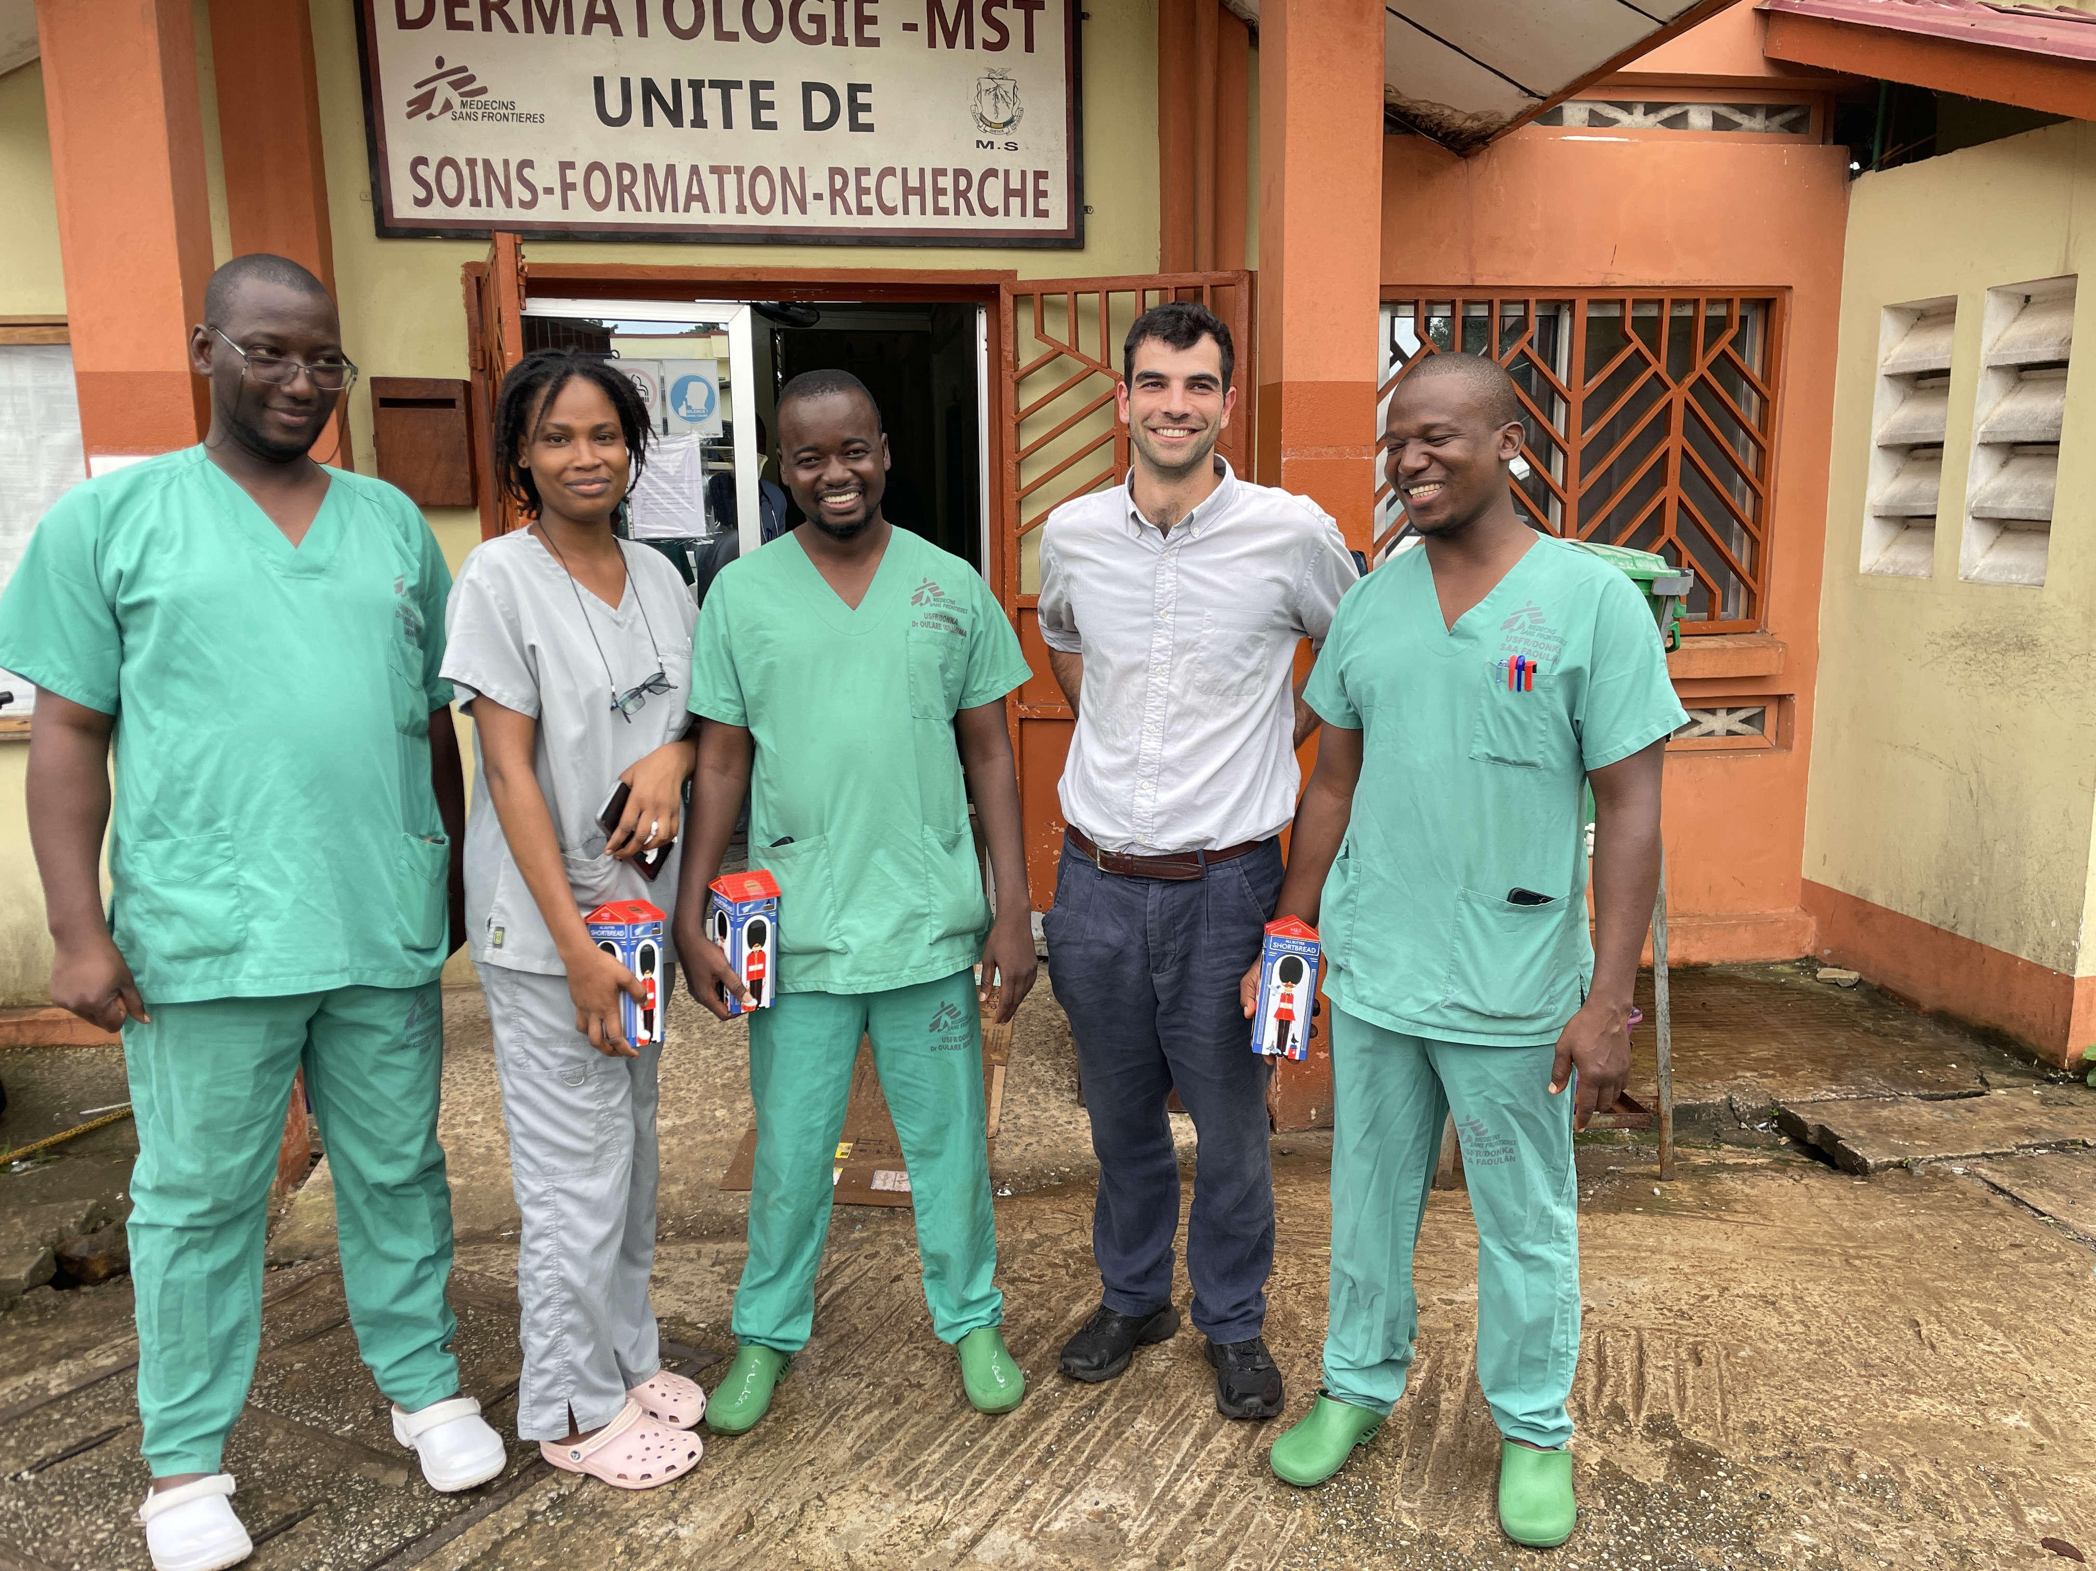

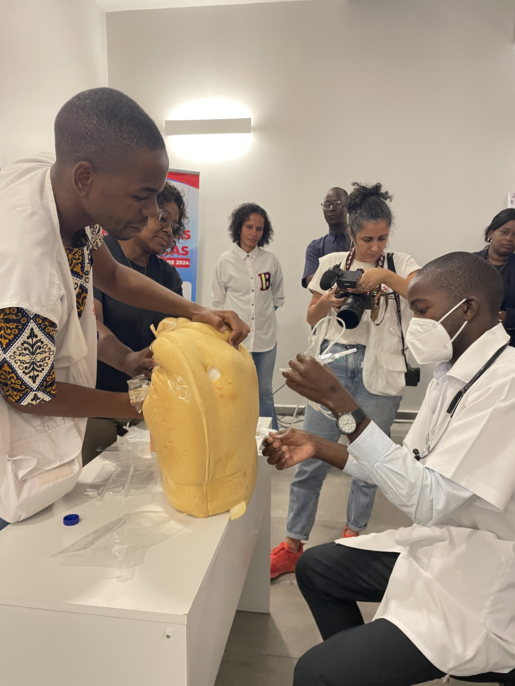
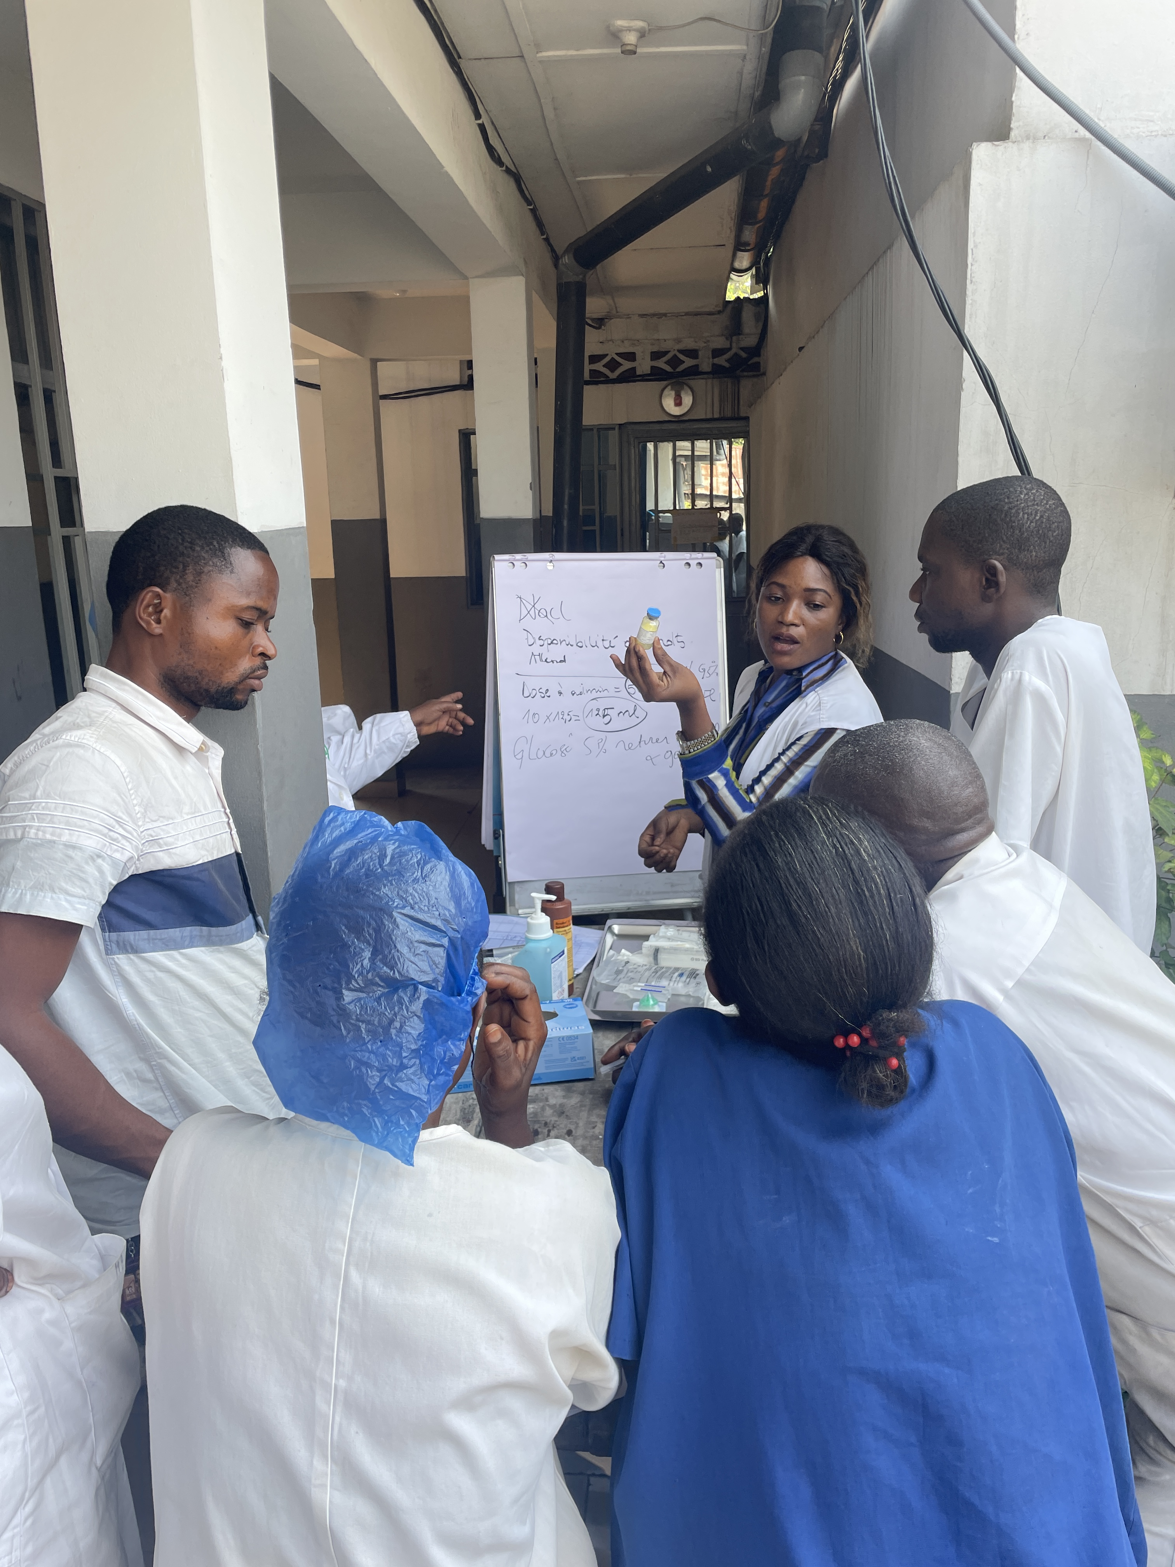
Study sites: MSF supported HIV units
2023-2026
USFR, Conakry, Guinea
CHK, Kinshasa, DRC
BCH, Beira, Mozambique
This study was approved by the Médecins Sans Frontières Ethics Review Board under the AmbiOne protocol, on 17 October 2023 along with local ethical review boards in the respective countries.

Slide 8
Endpoints
Primary Outcomes (aligned with previous RCT outcomes)
Mortality at 2- & 10-weeks from start of induction therapy for Cryptococcal Meningitis
Secondary outcomes
Adherence to optimised care package (Intracranial pressure management, toxicity surveillance, time to diagnosis and treatment)
Proportion of deaths after hospital discharge
Length of hospital stay among patients that survived to discharge
Frequency of adverse events (Serious Adverse Events grade III vs IV)
Notes:
WHO care guidelines include antinfungal regimen and other adjunct care (including ICP management, often challenging due to need to do LPs).

Slide 9
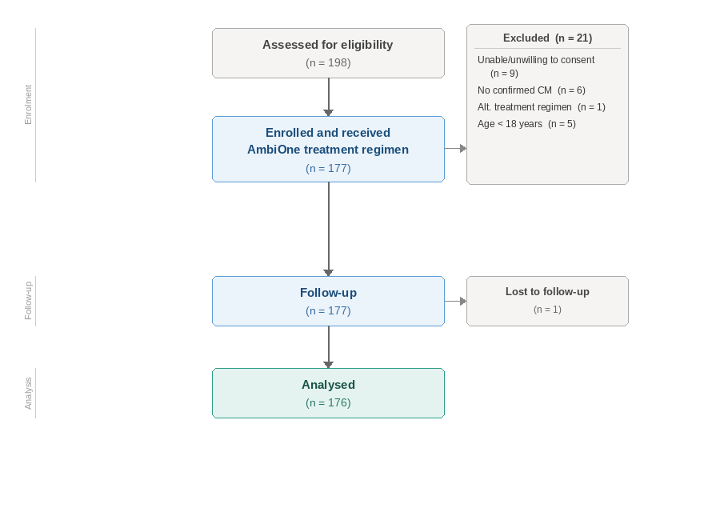
CONSORT Flow Diagram
AmbiOne study

Slide 10
Baseline characteristics of AmbiOne
Baseline characteristics
Table 1. Baseline characteristics of participants enrolled in the AmbiOne implementation study
Notes:
Discussions from 24-07-2025: TE – can you get % that are linked to existing MSF care, in general is there a ‘missed opportunities path analysis you can do from pre-hosp, IPD, post hosp.

Slide 11
Baseline characteristics of AmbiOne
Baseline characteristics
Table 1. Baseline characteristics of participants enrolled in the AmbiOne implementation study
Notes:
Discussions from 24-07-2025: TE – can you get % that are linked to existing MSF care, in general is there a ‘missed opportunities path analysis you can do from pre-hosp, IPD, post hosp.

Slide 12
Baseline characteristics of AmbiOne
Baseline characteristics
Table 1. Baseline characteristics of participants enrolled in the AmbiOne implementation study
Notes:
Discussions from 24-07-2025: TE – can you get % that are linked to existing MSF care, in general is there a ‘missed opportunities path analysis you can do from pre-hosp, IPD, post hosp.

Slide 13
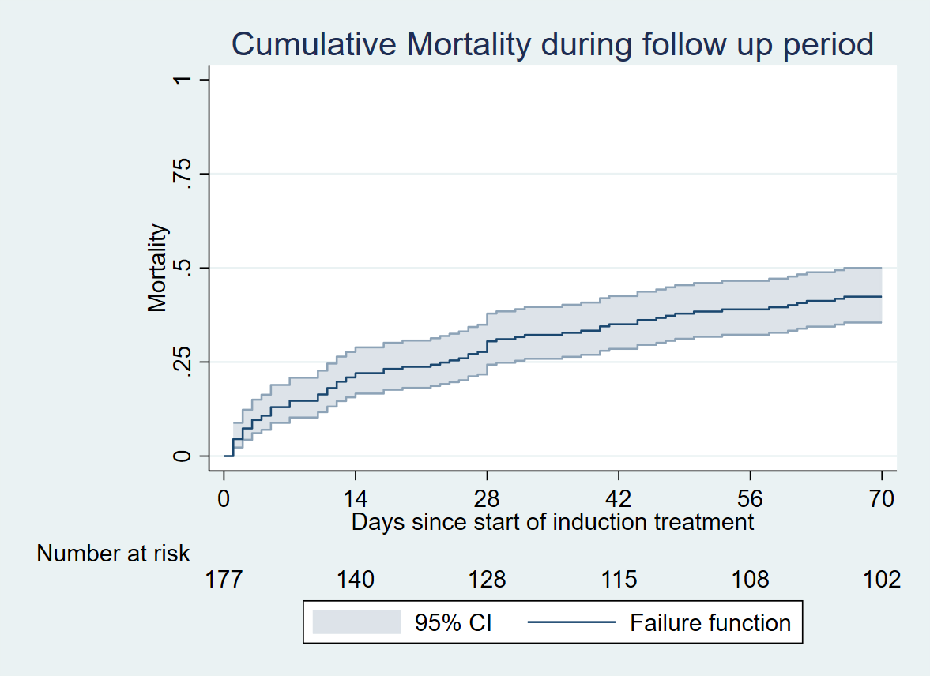
Primary outcomes: 2- & 10-week mortality
2-week mortality: 22.0%
(95% CI, 16.6-28.9)
10-week mortality 42.4%
(95% CI, 35.5-50.0)
Lost to follow up <1% (1/177) – censored at last contact.

Slide 14
Primary outcomes: 2- & 10-week mortality
2-week mortality: 22.0%
(95% CI, 16.6-28.9)
10-week mortality 42.4%
(95% CI, 35.5-50.0)
Lost to follow up <1% (1/177) – censored at last contact.
23%
25%
Inpatient mortality
Post-discharge mortality
41 of 177 patients
34 of 136 that survived to discharge

Slide 15
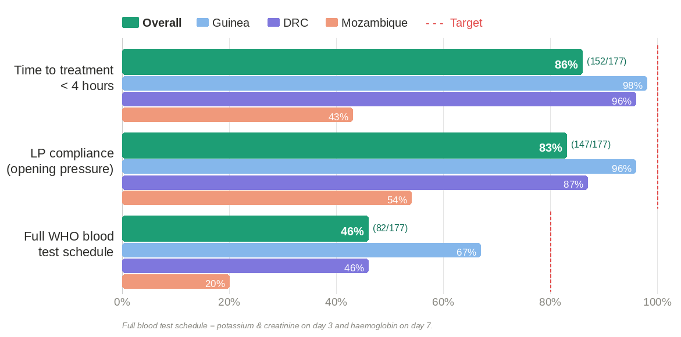
Implementation efficacy
Secondary outcomes: Implementation fidelity
Key implementation lessons
⚡ Co-location of LP kits, CrAg tests, and L-AmB in the emergency room reduced time to treatment.
⚡ Laboratory monitoring challenging to achieve despite implementation focus.
Notes:
Alongside strengthening of the CrAg screening program and lumbar puncture compliance etc: highlight this – implementation can achieve adequate time and LP uptake. It can not achieve lab benefits.
Discussion 24-07: unpack the delay to diagnosis in BCH in terms of time to LP and time to CrAg result: the majority were between crag and amb administration.
The majority of non-compliant LPs were because they didn’t have baseline pressure measured or documented but the majority got two. Should we take 2 as compliant or baseline + 1 more as compliant?
TE: Is there any way you can see if the stay is appropriate or unnecessarily long?

Slide 16
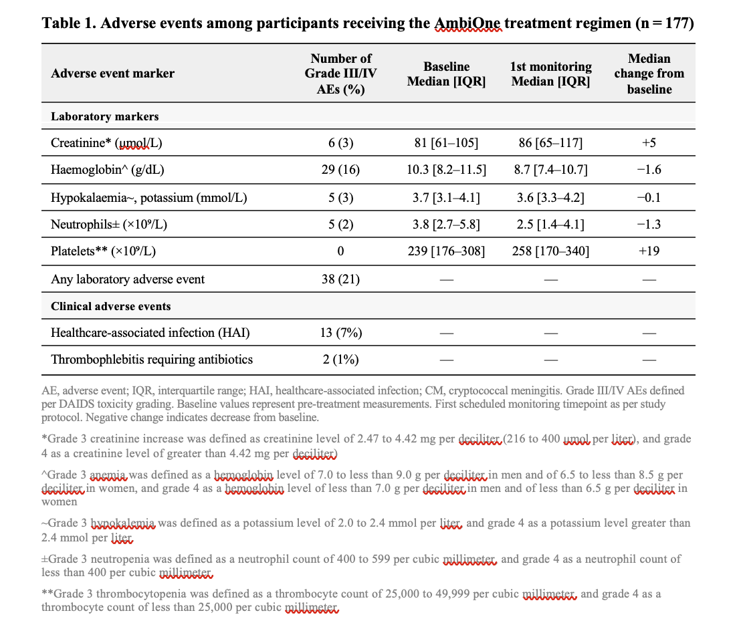
Secondary outcomes: adverse events

Slide 17
Secondary outcomes:
Length of stay
37%
Key observation
Raised Intracranial pressure post-discharge
Discharged within 7 days
More than a third of survivors were discharged within 7 days, a benefit of the single dose regimen. Earlier discharge was associated with better outcomes (HR 0.25, p = 0.005, mitigated by clinical state )
50 of 136 patients
14%
Raised ICP post-discharge
19 of 136 patients
Notes:
Flag post discharge mortality, flag that median time to death post discharge is 19 days so majority happening prior to 3 weeks so this is a key time period.

Slide 18
Qualitative work: high acceptability for a simpler regimen
High acceptability - a regimen more compatible with resource limited healthcare systems
  Nurses: Marked reduction in burden of IV administration work
  Doctors: Perceived reductions in length of stay and laboratory monitoring requirements.
  Initial adoption hesitancy: simplified seen as inferior by some HCWs.
Old 7 day regimen
Single dose regimen
Notes:
Referral drag: formal and informal fees leading to dealys reaching referral centres was echoed across multiple different contributors. Participants did not describe this as corruption but the usual system. MSF’s opposition to this was perceived as a reason for poor integration between MoG and MSF services.

Slide 19
Qualitative work: challenges
System level challenges in cryptococcal care: “the system is full of trap doors”
  Late referral from other services.
  Performance of lumbar puncture a significant barrier in non-specialist centres.
  Cost to participants is a significant barrier to post discharge care.
“Sometimes the family has to decide if they want to pay for a readmission or for a funeral”

Slide 20

Qualitative work: challenges
System level challenges in cryptococcal care: “the system is full of trap doors”
  Late referral from other services.
  Performance of lumbar puncture a significant barrier in non-specialist centres.
  Cost to participants is a significant barrier to post discharge care.
“Sometimes the family has to decide if they want to pay for a readmission or for a funeral”

Slide 21
Qualitative work: challenges
Total pill burden for 50kg patient in first 10 weeks of CM treatment
Pill | Total
Flucytosine | 140
Fluconazole | 308
Rifafour (RHZE) | 280
Pyridoxine | 70
Cotrimoxazole | 308
Folic Acid | 42
TLD (1 tablet) | 42
DTG boost | 42
 | 1190
System level challenges in cryptococcal care: “the system is full of trap doors”
  Late referral from other services.
  Performance of lumbar puncture a significant barrier in non-specialist centres.
  Cost to participants is a significant barrier to post discharge care.
“Sometimes the family has to decide if they want to pay for a readmission or for a funeral”

Slide 22
Conclusions and discussion
Single-dose L-AmB was feasible to implement outside of controlled research settings with acceptable early outcomes.
Substantial mortality between weeks 2 and 10, largely post-discharge, indicates that regimen simplification must be paired with strengthened follow-up.
Limited capacity for laboratory monitoring and shorter length of stay underscored the operational advantage of simplified regimens

Slide 23
Summary
What is your main question?
  What were the outcomes and implementation barriers of single L-AmB for CM.
What did you find?
  Gap remains in survival between research outcomes and real-world routine settings.
  The early post discharge period is a key focus for interventions.
Why is it important?
  Need for implementation focus on care quality to close the gap between outcomes in research settings and routine care.
  Lower toxicity and shorter length of stay bring health system and individual benefits
Notes:
Closing line – if you’re working in an HIV program and youre not using this regimen in your settings, ask yourself why?

Slide 24







Acknowledgements
Merci beaucoup, obrigado, matondi
Participants
Study teams and collaborators
Ministry of Health partners
Regulatory authorities
Academic partners
Jonathan Falconer*^{1,2} , Cedric Mafu³, Romao Sabuni⁴, Oulare Ibrahima⁵, Barry Ibrahima⁵, Montserrat Barrios⁴, Naftal Joao⁴, Gisele Mucinya³, Alain Tshimungu³, Freddy Mangana¹, Sako Fode Bangaly⁵, Destin Nyalenge³, Adelard Shyaka⁵, Petros Isaakidis,¹ Antonio Flores¹, Rosie Burton¹, Tom Ellman¹,, David Lawrence⁶, Nelesh P. Govender², Joseph Jarvis⁶, Esther Casas¹
johnny.falconer@joburg.msf.org

