Slide 1
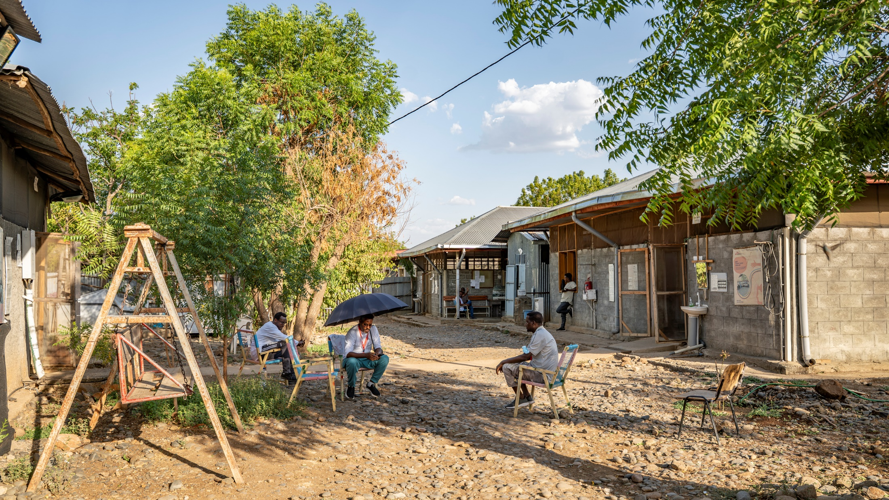




Polyvalent antivenom for snakebite envenoming in Ethiopia: a prospective cohort study
Paula Casado Aguirregabiria / MSF / 2026
Alan de Lima Pereira
Médecins Sans Frontières
20th May 2026, London
The study group have declared no conflict of interest.

Slide 2
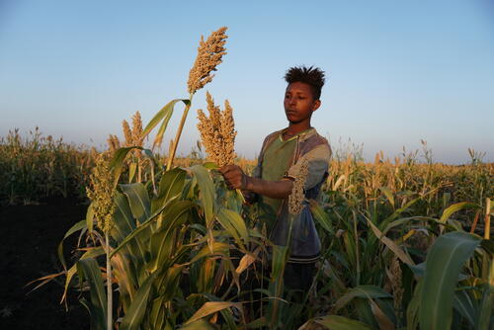
A Neglected Tropical Disease
Snake bite: every ten seconds globally
100,000 deaths annually
Agricultural workers and children
WHO Neglected Tropical Disease (NTD) since 2017
Lack of safe, effective, affordable treatment options
Susanne Doettling, / MSF /2018
*World Health Organisation (WHO), Factsheet on Snakebite Envenoming, 2023
Notes:
Better snakebite data needed to save lives and limbs
-
1.8 - 2.7 million envenomations annually
- Around 81,410 to 137,880 deaths annually
- Three times as many permanent disabilities.
- Significant underreporting remains

Slide 3
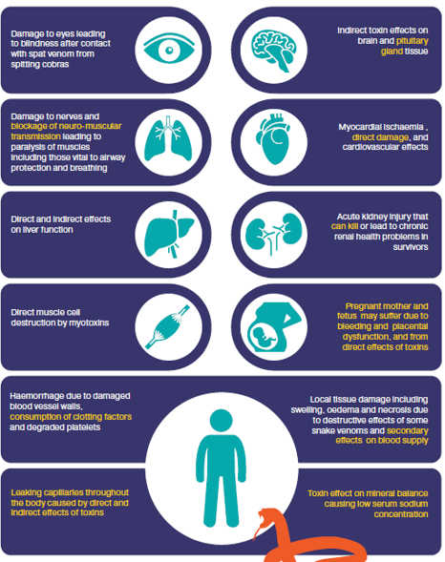
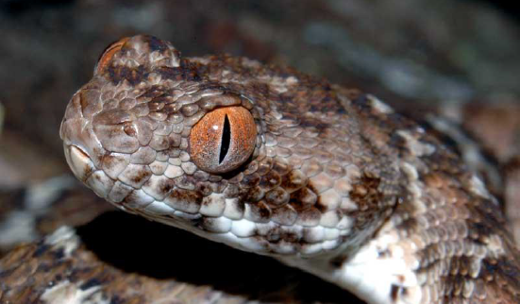
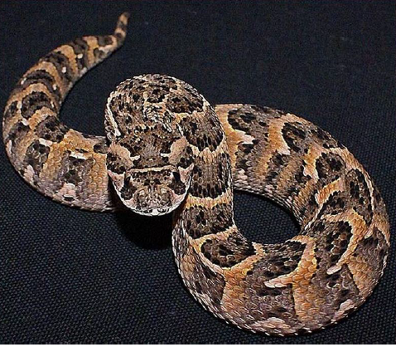
Snakes of North West Ethiopia
East African Carpet Viper – Hemotoxic, Cytotoxic
Puff Adder – Cytotoxic, Hemototoxic
Gebrewold et al, Distribution of snake species and snakebites in hotspots of Ethiopia, The Journal of Infection in Developing Countries, 2022

Slide 4
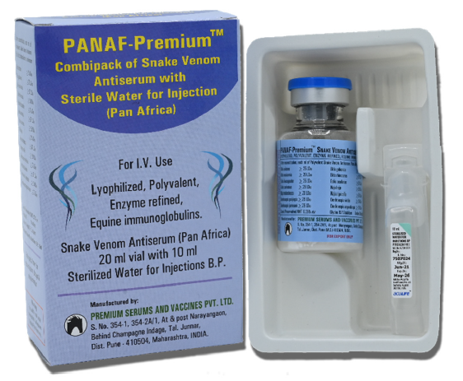
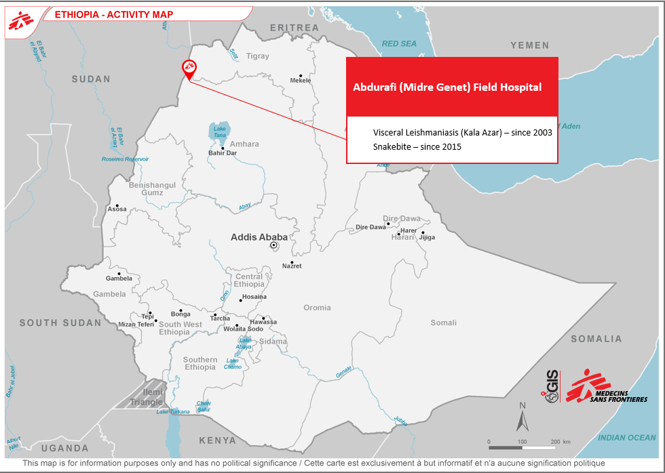
Premium PANAF Antivenom
Polyvalent – effective against 24 species of African snakes
Lyophilised – Store below 30°C
WHO recommended 2023 – no clinical data from humans
Approval process ongoing in several sub-Saharan countries
Post-marketing safety data lacking
Cost: US$84-280 per treatment (3-10 vials)
* WHO, Recommendation Notice, 2023
Notes:
Premium Serums and Vaccines Pvt. Ltd, India

Slide 5
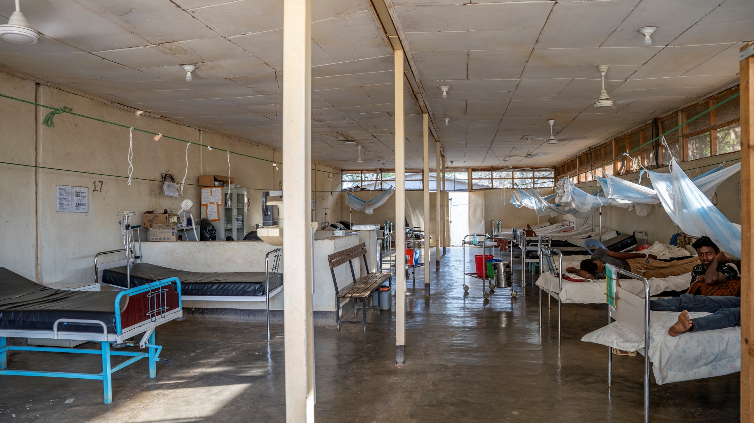
Study Objectives
.
Determine the safety and effectiveness of the new polyvalent antivenom (Premium-PANAF) for the treatment of haemotoxic, cytotoxic and neurotoxic envenoming.
Paula Casado Aguirregabiria / MSF / 2026

Slide 6
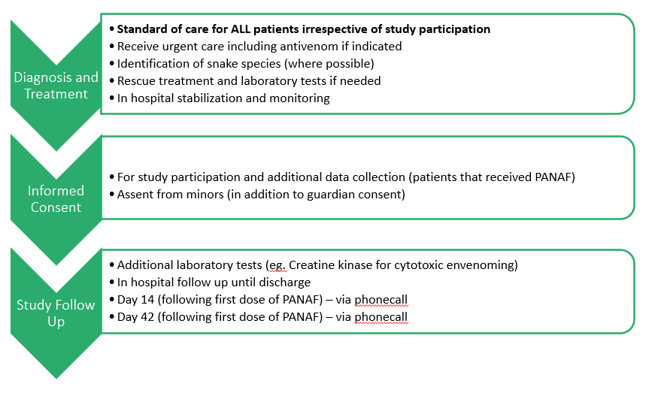
Primary Endpoints and Patient Flow
Safety
Proportion of patients with severe allergic reactions within 6 hours of antivenom administration
Effectiveness
Correction of coagulopathy as measured by the 20-minute whole blood clotting test at 6 hours after antivenom administration

Slide 7
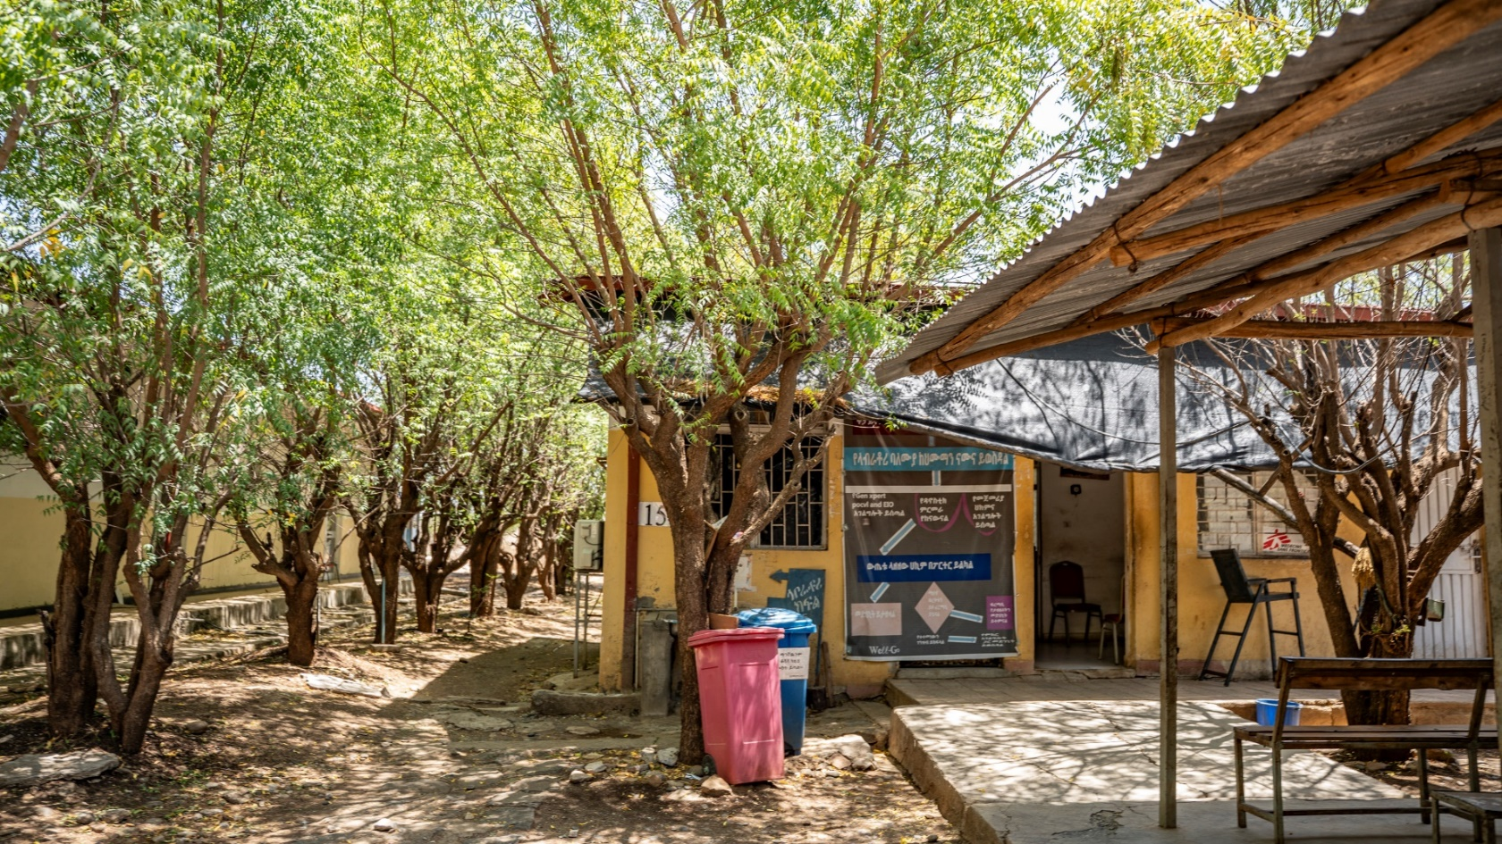
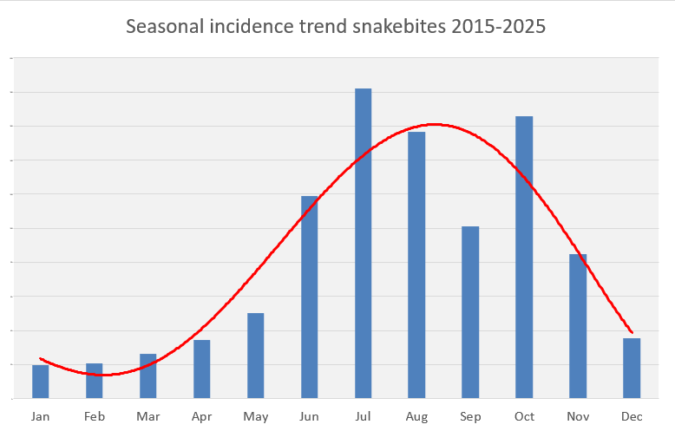
Inclusion criteria
History of snakebite envenoming and have received Premium PANAF in facility
AND
Informed consent
Exclusion criteria
Already received antivenom outside of facility
OR
Children without guardian or unwilling to give informed consent
Sample Size
400 hemotoxic syndromes, would detect a 5% relative increase (above 83% baseline) in the occurrence of corrected coagulopathy at 6 hours *
Hence 600 patients recruitment planned over 12 months
* compared to a 2010 trial that showed 83% effectiveness in coagulopathy correction in Nigeria – Abubaker et al, PLoS NTD
Notes:
Abubakar IS, Abubakar SB, Habib AG, Nasidi A, Durfa N, Yusuf PO, Larnyang S, Garnvwa J, Sokomba E, Salako L, Theakston RD, Juszczak E, Alder N, Warrell DA; Nigeria-UK EchiTab Study Group. Randomised controlled double-blind non-inferiority trial of two antivenoms for saw-scaled or carpet viper (Echis ocellatus) envenoming in Nigeria. PLoS Negl Trop Dis. 2010 Jul 27;4(7):e767. doi: 10.1371/journal.pntd.0000767. PMID: 20668549; PMCID: PMC2910709.

Slide 8
Interim Results: Demographics
Recruitment Period | 2nd June 2025 to 22nd March2026
Total snakebite patients | 1752
Total receiving PANAF | 643 (37%)
Total recruited | 600 (93%)
Mean age | 27 years [Range: 2 to 70 years]
Sex distribution | Male: 547 [91%]
Primary reason for exclusion | Child with no legal guardian present

Slide 9
Interim Results (n=600)
Visited traditional practitioner before presentation | 207 (35%)
Time since snakebite to presentation | < 6 hrs (203, 34%) 6 - 24hrs (320, 53%) > 24 hours (77, 13%)
Body site bitten | Foot (391, 65%), Hand (156, 26%)
Environment where snakebite happened | Agricultural Fields (509, 85%)
Snake Species | Puff Adder (157, 26%) Carpet viper (134, 22%) Unknown (207, 35%) Others (102, 17%)
Syndromic Classification | Haemotoxic with cytotoxicity (395, 67%) Haemotoxic only (98, 16%) Severe cytotoxic only (69, 12%) Other/Undetermined (36, 6%] Neurotoxic (2, 0.3%)

Slide 10
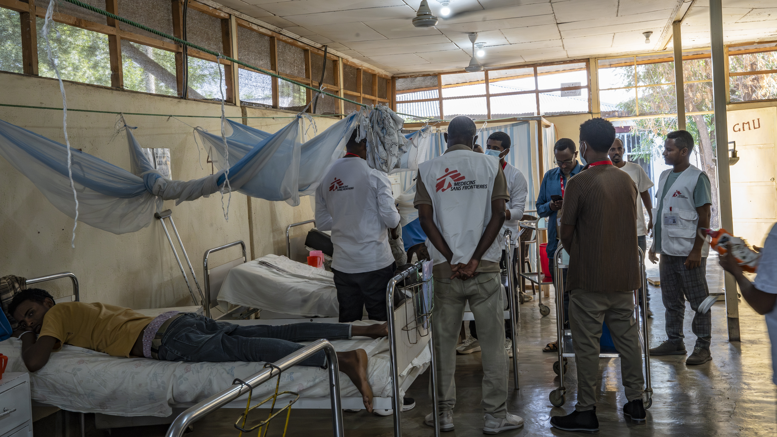
Paula Casado Aguirregabiria / MSF / 2026

Slide 11
Interim Results: Outcomes
Discharge outcome | Discharged home (598, 99.7%) Deceased (0, 0%), Referral to external facility (2, 0.3%) – both improved
Allergic Reactions (Safety) (n=600) | Total – 160 [27%] (Mild /Moderate – 149 [25%], Severe - 11 [1.8%] )
Correction of coagulopathy (Effectiveness) (n=500) | < 6 hours: 261 (52%) < 24 hours: 421 (84%) < 48 hours: 471 (94%)
Number of vials needed | Mean – 5.66 vials (2 doses) Median – 3 vials (1 dose) 127 (21%) patients needed > 2 doses (six vials)
Patients needing rescue treatment with EchiTAB-Plus-ICP (non-response) | 6 (1.0%)

Slide 12
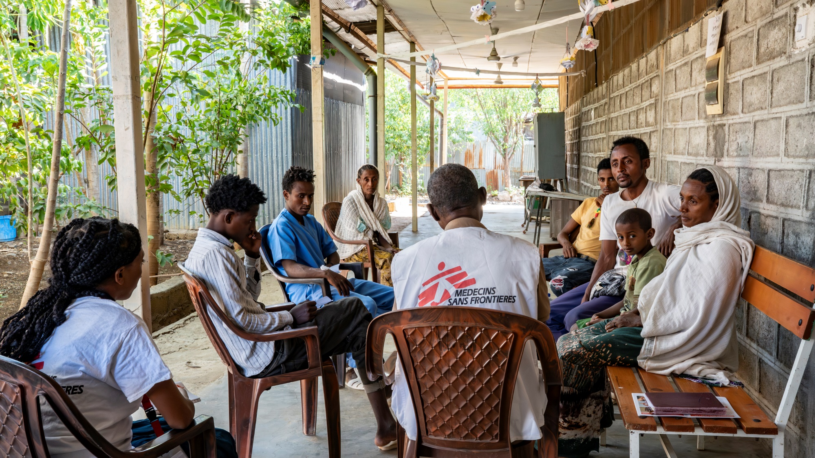
Study Limitations & Challenges
Study Design – Prospective Observational Cohort
Single Site Study
Selection Bias
Inadequate data on neurotoxic syndrome
Time to presentation – majority early presenters
Validity across all snake species
Population demographic – Older age and female
Implementation challenges – security and conflict, safety monitoring, supplies
Paula Casado Aguirregabiria / MSF / 2026
Notes:
Selection bias in patients coming to the centre

Slide 13
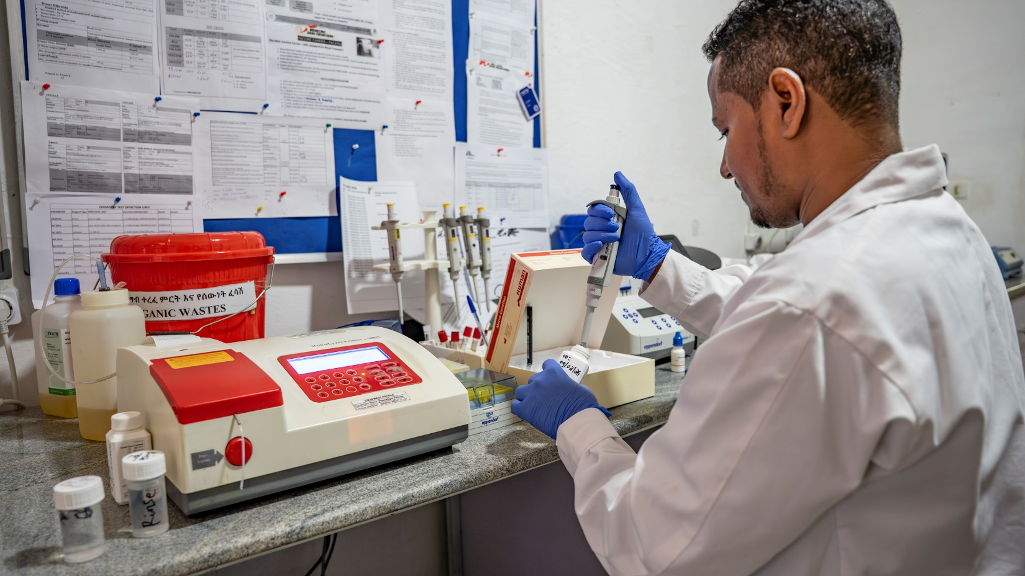
Conclusions
Results are encouraging and suggest Premium PANAF is safe for all snakebites, and effective for haemotoxic and cytotoxic syndromes.
Further research needed in:
Other regions of Africa with different snake species
Females and older age groups
Neurotoxic syndromes
Late or severe presenters
Paula Casado Aguirregabiria / MSF / 2026

Slide 14
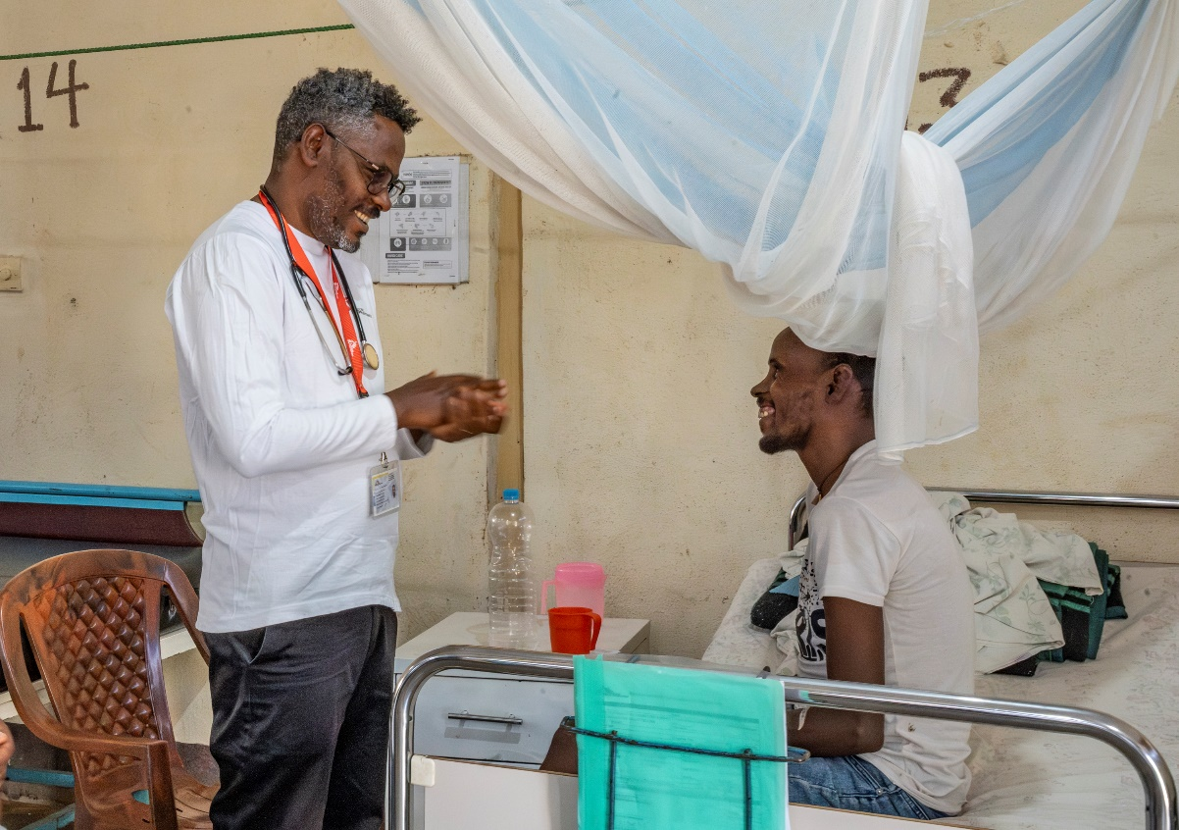
Acknowledgements
Our patients in Northwest Ethiopia – the driving force for us to do better.
MSF teams in Abdurafi and the Ethiopia Country Program
Collaborating Institutions:
Médecins Sans Frontières (MSF), University of Gondar, Amhara public Health Institute (APHI), Ethiopian Public Health Institute (EPHI), Ethiopian Federal Ministry of Health (EFMoH), London School of Hygiene and Tropical Medicine (LSHTM)
Study group:
Koert Ritmeijer, Study Coordinator, MSF
Workineh Necho, Site-principal investigator, Abdurafi, MSF
Kassaye Demeke, Co-investigator, University of Gondar, Ethiopia
Molla Dessie, Amlaku Terefe, Taye Zeru, Fikre Seife, Gashaw Gebrewold, Kasaye Sisaye, Molla Dessie, Kassaw Tigabu, Annie Morales, Birhanu Sahelie, Noni Winkler, Yigremachew Girma, Anthony Pedzisayi, Camilla Midtgaard, Winston Mulanda, Patrick Keating, Gabriel Alcoba, Agatha Bestman, Kalyan Velivela, Abdul Mullahzada
Academic Advisors:
Bhargavi Rao, Sakib Burza, Chris Drakeley, Matthew Coldiron
Paula Casado Aguirregabiria / MSF / 2026

Slide 15
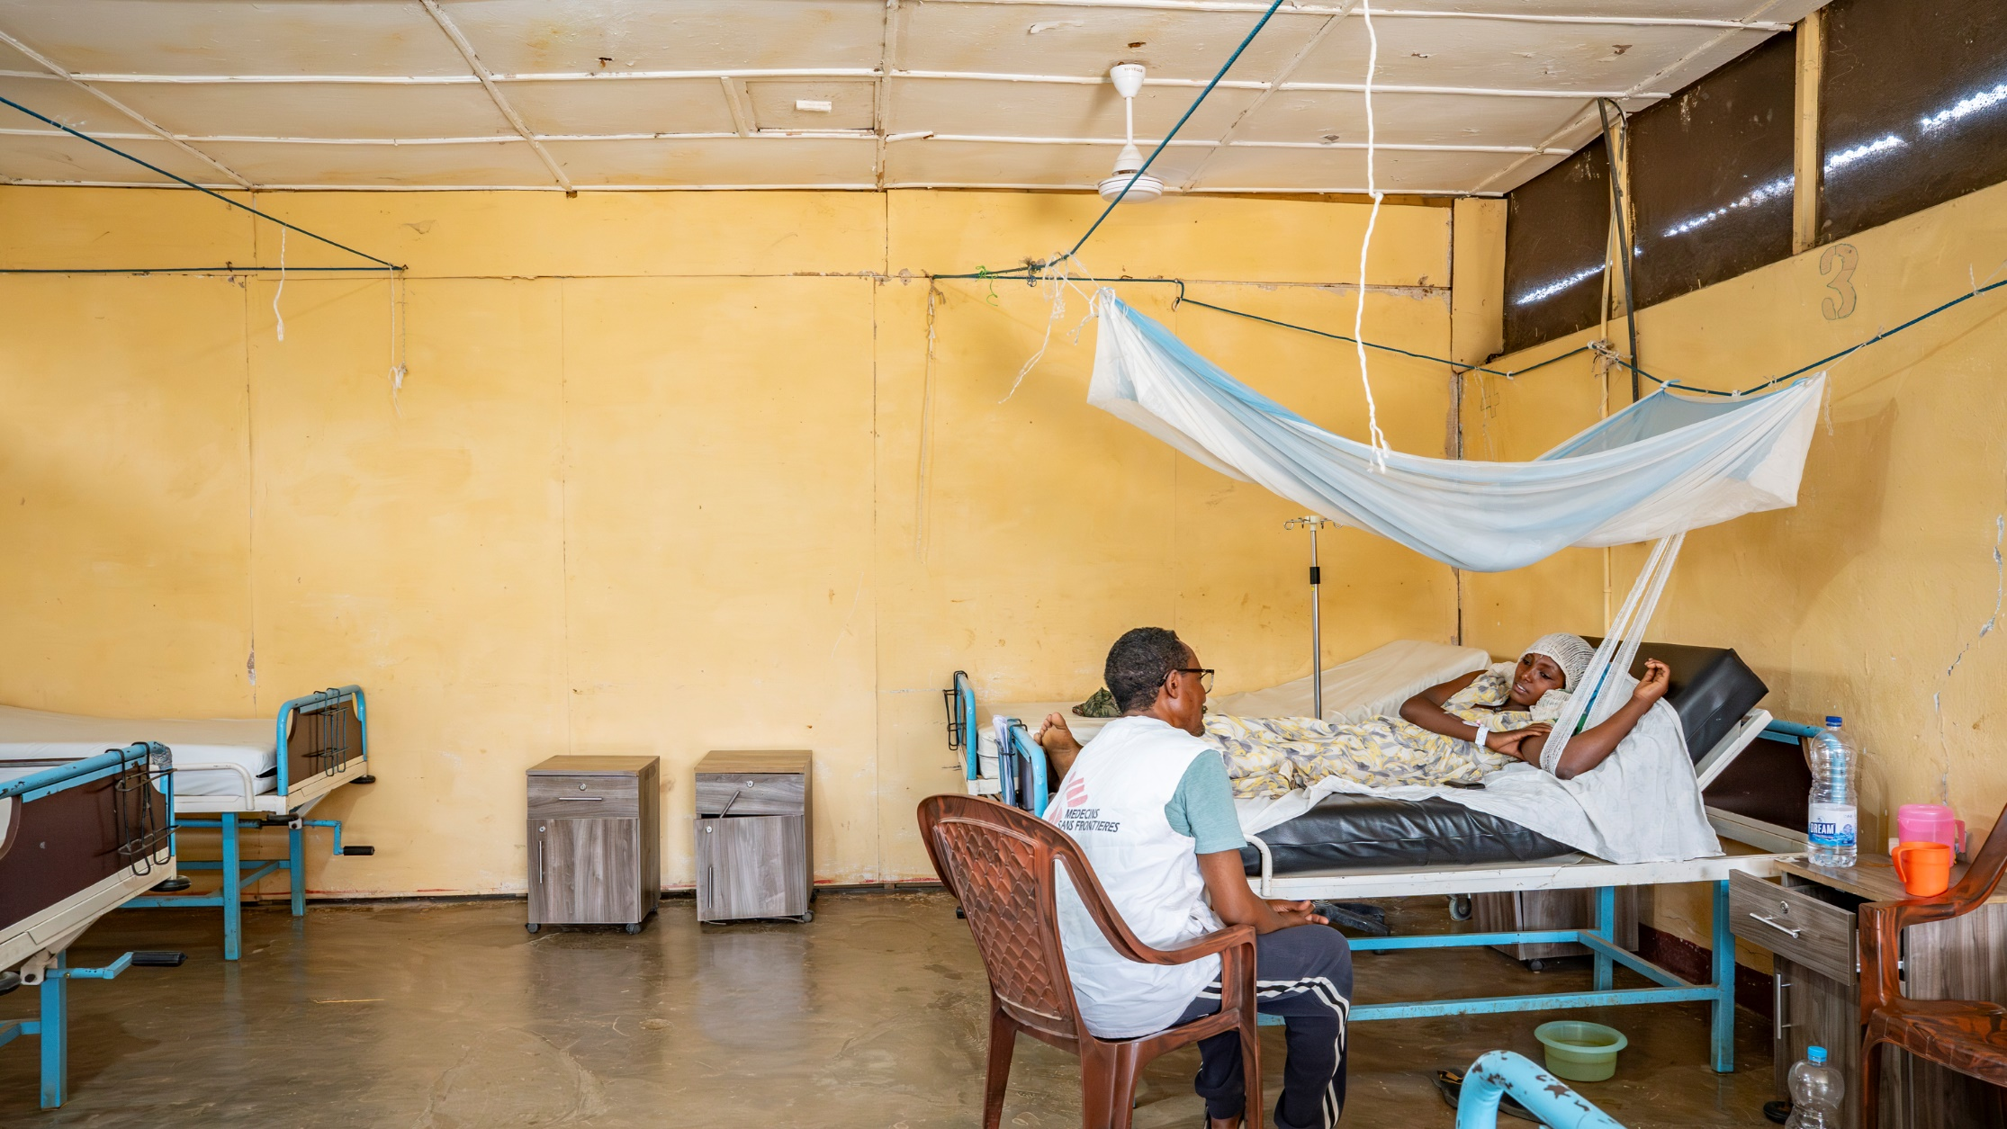
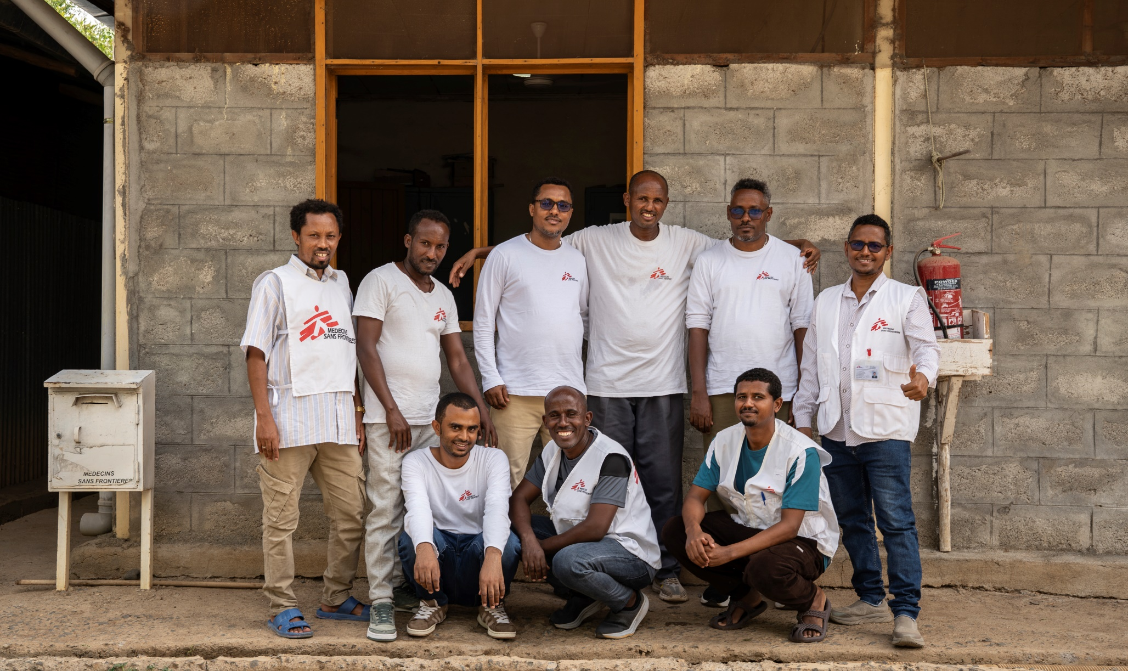
Let's Connect
EMAIL
Alan.Pereira@amsterdam.msf.org
Koert.Ritmeijer@amsterdam.msf.org
SOCIAL MEDIA
@msf
Paula Casado Aguirregabiria / MSF / 2026

