Slide 1







Evaluating the effect of implementing the Responses to Illness Severity Quantification (RISQ) System on mortality in acutely malnourished children treated in Chad:
the CRIMSON cluster randomised trial
Nancy M. Dale
Tampere University, Finland
Conflict of interest: the author has declared no conflict of interest
Principal Investigators: Dr. Christopher Parshuram and Dr Youssouf Djidita Hagre
Notes:
Thank you very much for inviting us to present our CRIMSON trial.
This is a cluster randomized evaluated the Responses to Illness Severity Quantification (or RISQ) System on mortality in acutely malnourished children treated in Chad.
I present on behalf of the principal investigators Dr Chris Parshuram from the Hospital for Sick Children in Toronto Canada, and Dr Djidita Hargre from the Mother and Child Hospital in N’Djamena, Chad.
The study partnership included the Alliance for International Medical Action, otherwise known as ALIMA,, and our Chadian partners, from the Ministry of Health and Alert Sante
The study was funded by Elrha.
I have not conflict of interest to declare
In my presentation today I will describe the RISQ System, provide background and methodology of our trial and present findings from our primary outcome. I will conclude with some take-home messages that relate our findings to program operations in low-resource humanitarian settings.

Slide 2
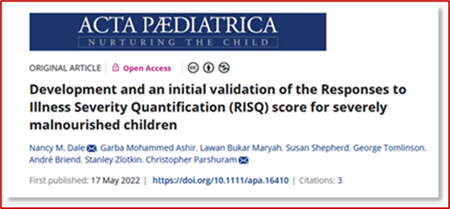
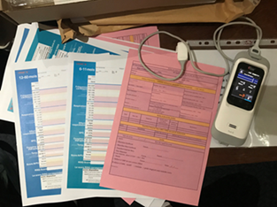
RISQ
Responses to Illness Severity Quantification System
System of care to improve clinical practice and child survival in resource-limited settings
1) Validated 7-item RISQ Score:
Heart rate; respiratory rate; respiratory effort; oxygen saturation; oxygen use; temperature; level of consciousness
2) Score-matched care recommendations
Frequency of observation, consideration of secondary review, guidance on level of care required
3) Age-specific documentation record
6-11 months; 12-59 months
4 ) Implementation training program
Theoretical, practical, score-calculation, case studies
* To be used as an adjunct to usual care
Notes:
So what is RISQ?
It is a clinical decision support system to help clinicians rapidly identify children with signs of severe illnesses and prioritize their care.
It has 4 parts:
The 7 –item RISQ Score. Each of these items -heart rate, respiratory rate, respiratory effort, oxygen saturation, oxygen use, temperature, and level of consciousness – have a subscore that, when summed, provides the total ‘RISQ score’.
The score was developed collaboratively with our colleagues from the University of Maiduguri Teaching Hospital on a cohort of children admitted to the Inpatient Therapeutic Feeding Centre .
Our published validation work showed that the RISQ score was predictive of death and reflected both clinical deterioration and improvement in acutely malnourished hospitalized children.
2) Score-matched care recommendations focus on frequency of assessment and consideration for advanced levels of care
They were developed by convening an expert panel of doctors and nurses with extensive experience caring for children with acute malnutrition and currently practicing in resource limited settings.
3) Age specific documentation records account for age-related changes in vital signs with a box at the bottom providing the recommendations for care
4 ) The training program intended for nurses and doctors and includes a train-the-trainer module so a small team can provide refresher training and support on-site as needed.

Slide 3
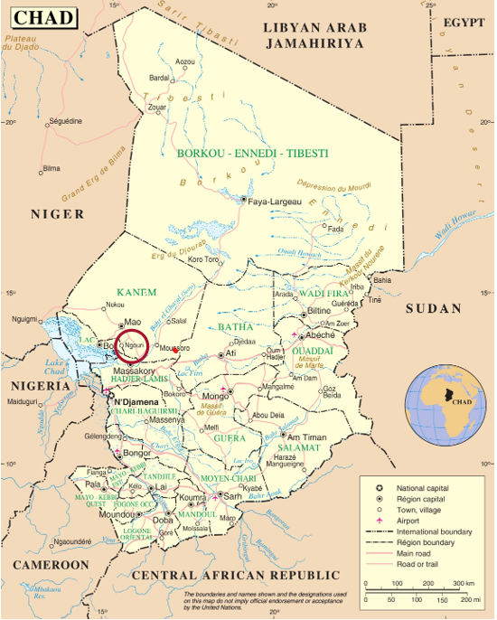
Background
Aim: To evaluate the effect of implementation of the RISQ System on mortality and processes of care in a nutritional program
The study addresses child mortality associated with acute malnutrition
Hospital mortality remains high
Strategies needed to identify/manage care of high-risk children
Ngouri, Chad
Population of study area is 210,000
Children aged 6-59 months is 40,000 (~ 25% admitted to OptiMA)
Optimizing Acute Malnutrition Treatment (OptiMA)
Mid-upper arm circumference (MUAC) based inclusion
Dose-adjusted therapeutic food for treatment
Management of acute illness with current guidelines
USE IMAGEHERE
Notes:
The Aim of the study was to evaluate the effect of implementing the RISQ System on mortality and processes of care within the OptiMA nutrition program in Chad
Our study directly addresses mortality in children with acute malnutrition.
Our study took placed in rural Chad and was nested within an OptiMA nutrition program run by ALIMA.
OptiMA is an operational research nutrition program with admission and discharge criteria based on mid-upper arm circumference, or MUAC, and/or the presence of oedema
Clinical assessments follow the standard World Health Organization guidelines for nutrition programs with the addition of pulse oximeters

Slide 4
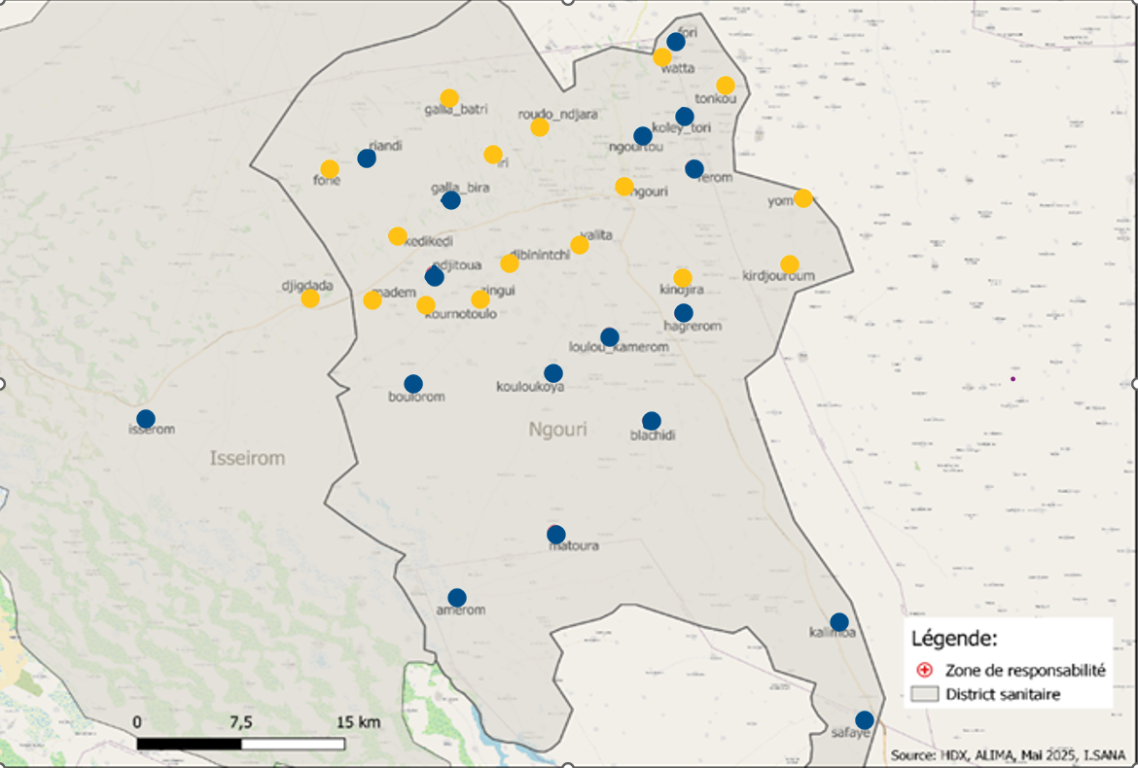

Methods
Health Centres Randomized, Ngouri, Chad
Design: Cluster randomized trial
Setting: Ngouri Health District, Chad
Clusters: Health centers (HC) n=34
Participants: Aged 6-59 months enrolled in OptiMA; health centre staff
Intervention: RISQ System
Comparator: ‘Usual care’
Randomization: 1:1 (Usual care: Usual care + RISQ System)
Sample size = number of children treated in the program (~20,000 )
Primary Outcome: mortality occurring during the period of treatment for up to 60-days after programme admission (if child is not yet discharged).
Secondary Outcomes: Processes of care, Implementation fidelity, Acceptability
USE IMAGE HERE
Protocol Registered: Clinical Trials: CT 1000080735; Published: Trials, 2025
Research Ethics Board Approval: SickKids # 1000080735/Comité National de Bioéthique du Tchad
Notes:
This cluster randomized trial involved 34 clusters which were defined as individual outpatient health centres in the OptiMA program.
Health centre staff enrolled children 6-59 months that matched OptiMA admission criteria of having a MUAC of less than 125 mm. There was one referral hospital for all 34 health centres
The health centres were randomized 1:1 to either usual care, or usual care with the addition of the RISQ System.
There was no other differences in care between the arms of the study except for the addition of RISQ.
RISQ was operationalized at the point of nurse consultation for every routine outpatient program visit.
‘Usual care’ for all centres included support for staffing, medical supplies and transportation to district hospital from ALIMA.
We estimate approximetly 20,000 children for enrollment
The Primary Outcome of the study was mortality up to program discharge but no longer than 60 days (if child is not yet discharged).
Discharge was defined as either nutritional recovery (ie. achieving a MUAC greater than 125mm for 2 consecutive visits, or defaulting from program
Defaulting was nonattendance at a weekly visit for three consecutive weeks in children who identified as alive community follow-up
Secondary outcomes we evaluated the ability of staff to use the RISQ System>

Slide 5
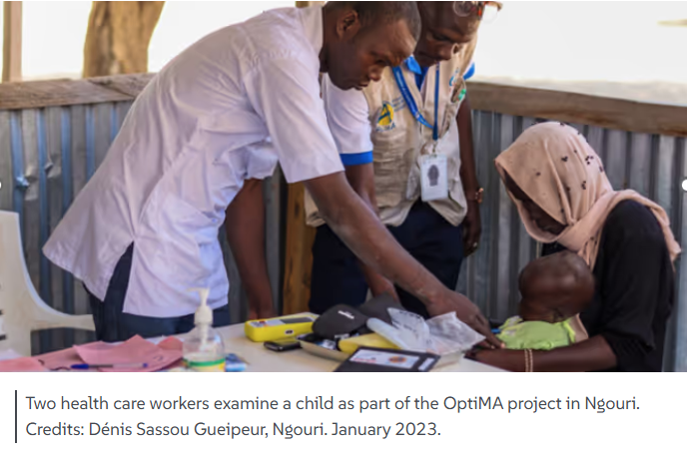
Methods
Period 1: Baseline (June 30, 2022- July 1, 2023)
12-month enrollment
pulse oximeters introduced /7 items measured as usual care
Period 2: Intervention (September 11, 2023 – September 10, 2024)
12-month enrollment
data collection /refreshers/ questionnaires
Analysis
Bayesian model (blinded interim analysis with DSMB)
posterior probability of mortality reduction, relative risk, 95% credible interval
main unit of analysis was program admission
primary analysis adjusted for cluster-specific mortality baseline period
95% probability of reduction in mortality judged sufficient to conclude benefit
USE IMAGE HERE
Notes:
This study consisted of 2 periods
A baseline period and an intervention period
For the analysis, the aim was to estimate the treatment effect - so the change in risk of death with use of the RISQ System
There was expected to have small number of deaths at some cluster sites which could pose challenges for some methods of analysis, The Bayesian approach was used as it was well suited to this scenario.
For our study we present the posterior probability of mortality reduction with the main unit of analysis being program admissions.
The primary analysis was adjusted for cluster-specific mortality from the baseline period,
A 95% probability of reduction in mortality was judged sufficient to conclude benefit of the use of RISQ.
Our manuscript is currently under review and the results we present are not yet published.

Slide 6
Results: Enrollment
Overall
34 clusters
10,846 individual patients
68 eligible staff
14677 program-admissions
6 primary outcome unknown
Participant characteristics
Age: 17.1 (9.2) months Mean (SD)
Males: 6363 (43·4%) Number (%)
MUAC: 118 (6) mm Mean (SD)
Oedema: 275 (1·9 %) Number of children (%)
Length of stay in the program: 29 (29-43) days Median (IQR)
In program more than 60 days: 1672 (11·4%) Number (%)
*Manuscript currently under peer review
Notes:
Results for enrollment showed 68 healthcare eligible staff were trained, enrolled children and participated in qualitative assessment of the system. and jJust over 10,000 children were enrolled.
Almost 20% of children had repeated admissions during the 12 months giving us a total of 14677 program admissions.
Overall, there were similar number of males and as females, Fewer than 2% had oedema and the large majority were admitted with low MUAC.
There were 6 children that had unknown primary outcome at the end of the study and sensitivity analysis was conducted for them.
Baseline mortality was 0·60% in RISQ clusters and 0·72% in usual care clusters

Slide 7
Results: Primary outcome
 | RISQ | Usual Care
Program Admissions N | 7497 | 7174
60-day in-program Mortality N(%) | 35 (0.47) | 59 (0.82)
Odds Ratio (95% CrI) 0.58 (0.30,1.07)
Posterior Probability of Benefit 96.1%
Notes:
Enrollment was similar in both arms of the trial and these numbers also were reflective in individual patient admissions.
Children from RISQ clusters had a greater decrease in mortality from baseline than usual care clusters
Our results showed there was a 96·1% probability that mortality was reduced with RISQ System compared with usual care
To help explain results, An OR < 1 means there is a lower risk of death in the RISQ arm ( so a benefit from use of RISQ). If there is a high probability that OR < 1, there is a high probability that the use of RISQ is beneficial.
So for us, there is a 96.1% probability that the OR is < 1, a 1.4% probability it is between 1 and 1.07, and a 2.5% probability it is > 1.07

Slide 8
Results: Secondary Outcome
Hospitalization
 | RISQ | Usual Care
Program Admission N | 7497 | 7174
Any Hospitalization N (%) | 293 (3.9) | 430 (6.0)
Odds Ratio (95% CrI) 0·66 (95% CrI 0·39–1.07)
Posterior Probability of Benefit 95.7%
Fidelity Assessments
RISQ scores were documented on 99·9% of the forms
Errors in 171 (2·8%) of the 6606 visits where RISQ score calculations were checked.
Notes:
Hospitalisations were less frequent in patients from RISQ clusters than from usual care clusters.
There was a 95·7% probability of lower admission rates in patients from RISQ clusters.
Looking at adherence to the RISQ System we found, 99.9% of nurses completed and recorded a RISQ Score with just under 3% having made errors in the score calculation. Keep in mind, that these results were from a trial that involved study nurses available for on-site refresher training as needed.

Slide 9
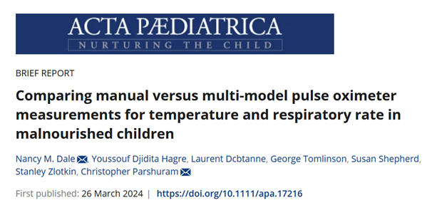

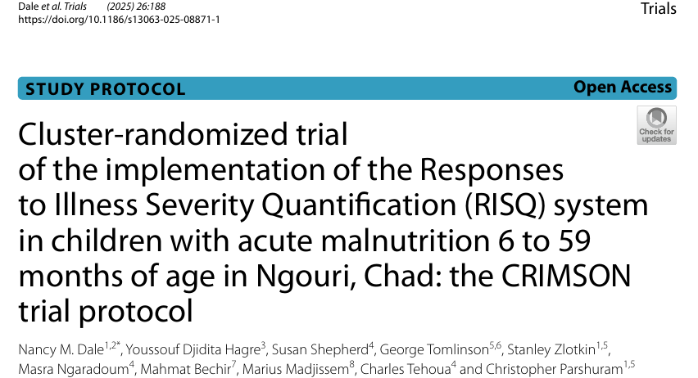

Implications and Impact
Mechanisms of effect:
Rapid identification and prioritization in outpatient settings
Integrated simplified approaches to severity of illness assessment and management
Potential for longitudinal monitoring of clinical trajectory
Impact:
Evidence- based
Applicability across the healthcare team
Operationally feasible
Potential for more efficient care (reduction of cost for hospital care)
May reduce preventable deaths and hospitalisation (lives saved per 1000 children admitted)
Notes:
We would like to highlight a few take-home messages that apply to operations.
First: There is a high probability that implementing RISQ in nutrition programs may reduce preventable deaths.
Second: Using RISQ may improve efficiency of care by identifying children who need hospital referral the most.
Third: Operationally, implementing RISQ requires pulse oximeters, training and as seen in our trial having a small team of trainers on the ground for support helps with adherence.
Forth: RISQ It is applicable across the healthcare team and directly helps improve clinical assessments of nurses and empowers them with providing support for clinical decision making.
Last, The RISQ System was scientifically developed by clinicians and researchers with direct experience in medical humanitarian action.

Slide 10
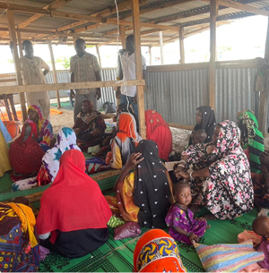
What’s next?
Expanding implementation
Exploring automated versions
Further evaluation in inpatient care/other contexts/populations
USE IMAGE HERE
Notes:
So, our call to action:
We encourage you to read our publications and especially this one when it comes out, network with us, and think about how the RISQ System might fit into your programs.
Currently ALIMA is planning to expand implementation in OptiMA
We are exploring development and use of automated versions of the RISQ system
Plans for further evaluation of RISQ in inpatient care with developed documentation forms ready to go.

Slide 11

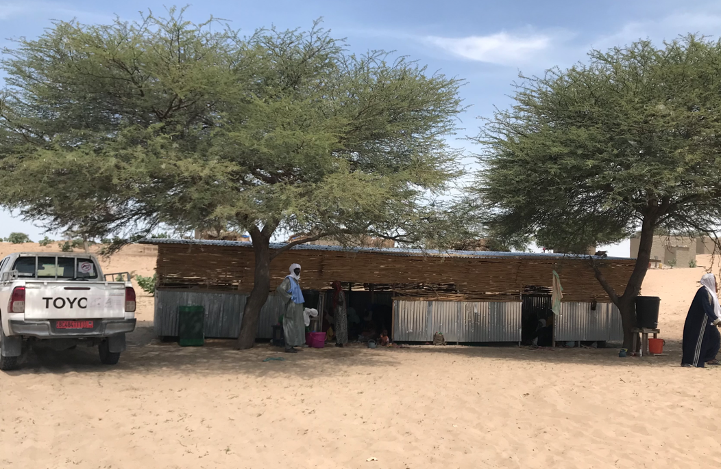
Acknowledgements
CRIMSON
Children and caregivers
Health Centre Nurses
CRIMSON Study Team
ELRHA (R2HC Team)
Ministry of Health: Lake District and N’Djamena
ALIMA Chad Team
Alert Sante
OptiMA and CRIMSON Data Team
CRIMSON Statistician
Data Safety Monitoring Board
University of N’Djamena/Mother and Child Teaching Hospital
SickKids Research Institute
RISQ
ALIMA
University of Maiduguri Teaching Hospital
RISQ Study Nurses
SickKids Centre for Global Child Health and Centre for Safety Research
Tampere University
E
Notes:
Slide 11
I would like to take this moment to thank the children, their caregivers and the health care staff that were enrolled in this study.
This list involves many people, most whom have been acknowledged by name in our publications.
They have all been involved in RISQ and all have dedicated their time with the aim of improving the lives of children.
I thank them all for their hard work and thank you MSF for this incredible platform to present our work.

Slide 12
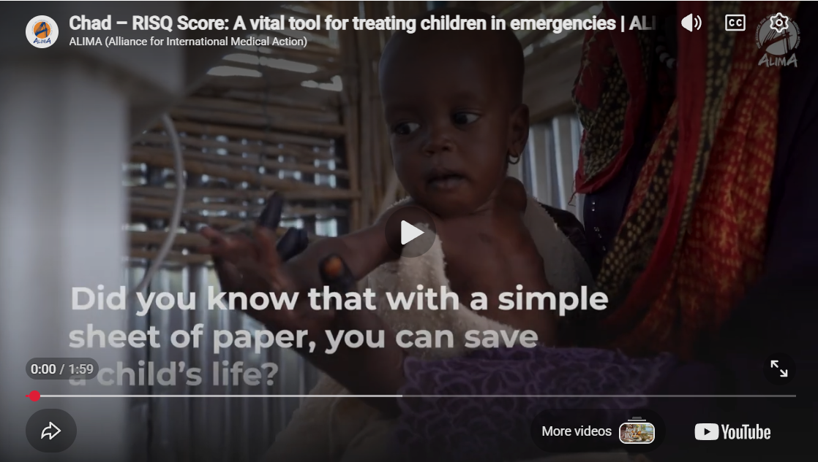
Let's Connect
EMAIL
dalenm2025@gmail.com
USE IMAGE HERE
SOCIAL MEDIA
@ALIMA
RISQ Score: A vital tool for treating children in emergencies - ALIMA

