Slide 1
Lived experiences and perceptions of palliative care among advanced HIV patients: qualitative study, Bihar, India
Conflict of Interest
The author has declared no conflict of interest.
Mohit Nair, Pragya Kumar, Raman Mahajan, Amit Harshana, Kathryn Richardson, Laura Moreto-Planas, Sakib Burza
Notes:
Thank you very much for the kind introduction. My name is Mohit Nair, and I have worked with MSF OCBA in India for several years in qualitative and mixed-methods research. Today, I’ll be speaking to you about the lived experiences and perceptions of palliative care among advanced HIV patients in Bihar, which is a timely and key area for OCBA in India.

Slide 2
Introduction
Adult prevalence of HIV in India is estimated at ~0.22% (95% CI 0.16-0.30)
In Bihar, MSF provides in-patient care to acutely unwell people living with HIV/AIDS (PLHA)
Defined by World Health Organization (WHO) as CD4 cell count <200 cells/mm3 or a clinical stage 3 or 4 event
High mortality rate of up to 40%
Very few research studies of palliative care in the Indian literature
Notes:
According to the National AIDS Control Organization (NACO), the 2017 adult prevalence of HIV in India is estimated at 0.22% (0.16%-0.30%).[1-2] Bihar, with a population of 110 million people, is one of the largest and least economically developed states and is one of 6 states where AIDS-related deaths continue to rise.[1]
In Bihar, Medecins Sans Frontieres (MSF) provides dedicated and holistic in-patient care to acutely unwell people living with HIV/AIDS (PLHA), a particularly vulnerable cohort of patients who are severely stigmatized and routinely denied access to health care.[3-4] Defined by World Health Organization (WHO) as ‘advanced HIV’ (CD4 cell count <200 cells/mm3 or a clinical stage 3 or 4 event), their mortality rate remains high (up to 40%).[5-6]
There are very few studies in LMICs looking at this vulnerable cohort of patients. None that we could find in India- most palliative care studies in India focus on cancer care in Southern India. Given this context, our study served a unique niche and aimed to:
To understand how PLHA and caregivers of hospitalized patients view palliative care and end-of-life care, and uncover their expectations of healthcare providers;
To uncover how the dying process is experienced by other patients and relatives of deceased patients.

Slide 3
Study objectives
The objectives of this study:
To understand how PLHA and caregivers of hospitalized patients view palliative care and end-of-life care, and uncover their expectations of healthcare providers
To uncover how the dying process is experienced by other patients and relatives of deceased patients
This study was approved by the MSF Ethical Review Board and the Ethics Committee of the All India Institute of Medical Sciences, Bihar, India.
Notes:
According to the National AIDS Control Organization (NACO), the 2017 adult prevalence of HIV in India is estimated at 0.22% (0.16%-0.30%).[1-2] Bihar, with a population of 110 million people, is one of the largest and least economically developed states and is one of 6 states where AIDS-related deaths continue to rise.[1]
In Bihar, Medecins Sans Frontieres (MSF) provides dedicated and holistic in-patient care to acutely unwell people living with HIV/AIDS (PLHA), a particularly vulnerable cohort of patients who are severely stigmatized and routinely denied access to health care.[3-4] Defined by World Health Organization (WHO) as ‘advanced HIV’ (CD4 cell count <200 cells/mm3 or a clinical stage 3 or 4 event), their mortality rate remains high (up to 40%).[5-6]
There are very few studies in LMICs looking at this vulnerable cohort of patients. None that we could find in India- most palliative care studies in India focus on cancer care in Southern India. Given this context, our study served a unique niche and aimed to:
To understand how PLHA and caregivers of hospitalized patients view palliative care and end-of-life care, and uncover their expectations of healthcare providers;
To uncover how the dying process is experienced by other patients and relatives of deceased patients.

Slide 4
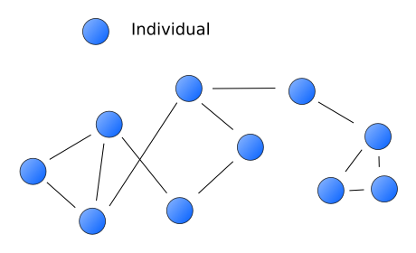
Methods
Exploratory, qualitative study design with semi-structured in-depth interviews and one focus group discussion (FGD)
Purposively selected 29 participants
Ten critically unwell PLHA, five caregivers, seven relatives of deceased patients, seven key informants from community-based organizations (CBOs)
Face-to-face interviews with audio recording
Verbatim transcription and translation from local languages
Thematic analysis of data using NVIVO 11
All participants provided written informed consent
12 men
17 women
Notes:
We utilized an exploratory, qualitative study design utilizing semi-structured in-depth interviews (IDIs), and a focus group discussion (FGD). The study population comprised recently discharged PLHA, relatives of deceased patients who had received treatment, and caregivers of hospitalized patients being treated at the time of the study in the MSF supported advanced HIV in-patient ward at a governmental secondary care hospital in Patna. Key informants from community-based organizations that worked on HIV or palliative care were also included in the sampling frame.
Data collection took place over a one-month period in April-May 2019. All interviews happened face-to-face using a semi-structured topic guide after obtaining written-informed consent. Interviews were audio recorded with written informed consent.
We interviewed 10 critically unwell PLHA, along with 5 caregivers, as well as 7 relatives of deceased patients, and 7 key informants from CBOs in Patna who work in HIV and/or palliative care.

Slide 5
Results (1):
Fear of dying and the need for a separate ward for dying patients
“With this disease, some are coming for the first time…and some of them are coming for the last time [stage of disease]. So if you keep all the people [together], they will become really worried and anxious and think I will also become [dead] like that one day” [male, aged 36, relative of deceased patient].
Notes:
PLHA who were critically ill and several relatives of deceased PLHA preferred to have a separate room for dying PLHA as many had witnessed other deaths and expressed discomfort. Many PLHA claimed that dying patients made them even more nervous: “it causes a lot of fear and concern when you look at those patients. The ones who are healthy will also become anxious” [PT 12, male, age 44, patient]. This particular patient’s wife similarly reported that she usually shielded her husband from news about deaths to keep him motivated: “I did not tell him about the deaths of any other patients who have passed away here…because he used to think that all the time in his head and cry- and he asks: will I also die one day like this? He gets very tense thinking about this. This is why I do not tell him” [PT 13, female, age 32, caregiver].
However, the prospect of separation also brought about concerns of social isolation and the potential for ignorance and lack of attention among patients who had known others admitted to separate rooms: “if they are separated, it would be difficult for us to meet and give them companionship. Only doctors and nurses will visit them…it is nice the way things are. Because they talk to me, and I talk to them. If someone has to stay alone [in a separate ward], then you feel isolated and the heart…feels uneasy” [PT 5, female, age 21, patient]. A separate space was perceived as being a place for very helpless patients: “some patients are kept in this room who are very helpless. So, they are kept there” [PT 1, male, age 46, patient].

Slide 6
Results (2):
Transparency regarding a poor prognosis
“The only thing that makes me sad is that I was not informed beforehand of my mother’s condition. If I knew ahead of time that she was going to die, I could have let my sister talk to my mother on her deathbed” [male, aged 17, relative of deceased patient].
Notes:
We noted a very interesting discrepancy between PLHA and relatives of deceased patients when it came to disclosing a terminal prognosis to dying patients and their caregivers. Many PLHA who had been critically ill themselves reported that transparent disclosure of prognosis to dying patients would make them anxious or even kill them, and that this should never be done. Instead, respondents claimed that the prognosis should be disclosed only to family members: “it would be better if only the family members are informed, and not the patient actually. The patient will pass away just hearing the news” [PT 3, male, age 40, patient].
Relatives of deceased patients deeply regretted not having had meaningful last moments with their loved ones before their death. Many perceived that the prognosis should be disclosed, so the patient has a chance to meet loved ones: “The only thing that makes me sad is that I was not informed beforehand of my mother’s condition. If I knew ahead of time that she was going to die, I could have let my sister talk to my mother on her deathbed” [RD 2, male, age 17, relative of deceased patient].

Slide 7
Results (3):
Critically ill PLHA lacked awareness of palliative care
“I am illiterate and haven’t studied anything…so what will I understand?” [female, aged 35, caregiver].
“Most important of all, the patient should get the medicines timely, the treatment should be done well, the lodging and food…all these facilities should be good” [male, aged 25, patient].
Notes:
Among patients, it is also important to note that there was very little awareness of palliative care- even more educated patients had never heard of the term before. When probed about the course of treatment, patients reported being illiterate and ill-informed: “I am illiterate and haven’t studied anything…so what will I understand, Sir?” [PT 4, female, age 35, caregiver]. When asked which factors were important in palliative care however, patients prioritized getting medicines on time, followed by food and accommodation: “most important of all, the patient should get the medicines timely, the treatment should be done well, the lodging and food…all these facilities should be good” [PT 7, male, age 25, patient]. A full recovery was deemed most important regardless of the prospects: “The patient wants to have a full recovery after treatment is started- whatever the illness, any person wishes that their patient will get better” [RD 2, male, age 17, relative of deceased patient].

Slide 8
Results (4):
Experiences of patient deaths and discharge procedures
“Like when he died, then and there within a few seconds, they called an ambulance and sent him onward to his home…they were only concerned with whatever paperwork was required to be done, they only hired and paid the ambulance and turned them [deceased patient and relatives] away from there” [male, aged 18, relative of deceased patient].
Notes:
In general, patient deaths were quite traumatic for other PLHA, which supported the thematic detailing the need for a dedicated palliative care area. There was limited space for grieving relatives and some patients felt like they had been rushed when their relative passed away: “like when he died, then and there within a few seconds, they called an ambulance and sent him onward to his home…they were only concerned with whatever paperwork was required to be done, they only hired and paid the ambulance and turned them [deceased patient and relatives] away from there” [RD 5, male, age 18, relative of deceased patient]. Relatives reported that they were screaming in grief in the hospital and were usually taken to another room away from the patient with limited time to grieve and limited counseling support.
Meanwhile, other PLHA admitted in the facility would occasionally become anxious upon hearing these cries and attempt to console the patient to stop crying.
At other government facilities in Bihar (non-MSF), the situation was even worse: “like in the [government] hospital…they said that they would only treat this patient when they give some money. Then only they will touch or treat the patient- they did not want to do anything for him…[after he died], some fat and big people started trying to move my husband’s body. Right away, I threatened them and said: beware! I have people with me. So don’t dare touch my patient” [RD 3, female, age 35, relative of deceased patient].

Slide 9
Results (5):
Hospital-based palliative care patients require social support
“We do nothing all day. When my husband comes and visits, I smile and laugh with him, but when he returns home, I feel all alone…my father is there, and I can’t speak that much with him. I don’t know. Everything is good, but I get a little bored here” [female, aged 21, patient].
Notes:
“The options are limited…I am confined to my bed all day long…if there are loved ones nearby, then sometimes I chat with them. Sometimes, I take a walk along the corridors with the help of my companions” [PT 3, male, age 40, patient]. Some patients reported feeling socially isolated and bored after several days of admission: “we do nothing all day. When my husband comes and visits, I smile and laugh with him, but when he returns home, I feel all alone…my father is there, and I can’t speak that much with him. I don’t know. Everything is good, but I get a little bored here” [PT 5, female, age 21, patient]. When asked what could be provided to help pass the time, many patients hesitated to answer, stating that this was a hospital not a place for entertainment and they had no such expectations. After some probing however, several patients suggested that a television, space to walk around, or board games could be provided in the spaces to make them more patient-friendly.

Slide 10
Results (6):
Preference for home-based palliative care and other services
“If the doctor knows they will no longer be able to save the patient, they should send him home. So, the patient can meet the rest of his family, talk to everyone, and die peacefully at home” [female, aged 40, caregiver].
Notes:
According to some PLHA, dying patients should be sent home with medicines and proper guidance to be able to see their relatives: “such a patient should be sent home- shouldn't be hospitalized…It would be good if the patient is kept on regular follow-up. They should tell me that I should come in X number of days and give me advice regarding my lifestyle at discharge. What should be done to stay healthy” [PT 3, male, age 40, patient]. They should be given financial assistance and a vehicle to return home and be with family members: “if she tries to get a vehicle on her own, she will face a lot of difficulty. Ambulance should be provided from here. If the doctor knows they will no longer be able to save the patient, they should send him home. So, the patient can meet the rest of his family, talk to everyone. All people cannot come to the hospital” [PT 8, female, age 40, caregiver].
Similarly, in accordance with most local and religious customs, relatives and patients alike noted a preference for home death over hospital-based deaths as certain rituals needed to be followed. For instance, in Hindu tradition, the body is typically cremated followed by a mourning period: “what happens here is that we go and we collect sticks and we burn [cremate] the body. And…this is what we do for final rites. And after 13 days, there is another ritual for death where we feed the priests. We also call the villagers and we feed them. This is the final rites which are followed usually” [PT 8, female, age 40, caregiver].

Slide 11
Discussion
PLHA have complex care needs beyond pain management
Advanced care planning and psychosocial support are critical components
Western bioethics values full disclosure between doctor and patient, but our findings indicate some cultures may not be as welcome to this kind of transparency
Palliative care should be introduced and discussed early in the care process
The grieving process should allow patients to spend time with the deceased in a private room
Home-based palliative care services should be expanded in Bihar, especially for this vulnerable cohort of PLHA
Notes:
Palliative care programs in India have mostly been limited to cancer care and treatment, and service provision is often done by CBOs or NGOs. Advanced HIV patients have complex care needs and require supportive palliative care services, which go beyond pain management and include exploring the patient’s understanding of illness and prognosis, psychosocial support for patients and caregivers, and advance care planning.
There are notable differences in cultural norms and practices with respect to death and dying, especially in terms of patient-centered vs. family-centered decision making.[27-29] While Western bioethics values full disclosure between the doctor and patient, our findings indicate that other cultures may not be as welcome to this kind of transparency. Having said this, one should not make assumptions on the information a patient wishes to receive about their condition or prognosis based on their cultural background. As it is difficult to predict an individual’s preferences, it is important to explore with each patient how much and what type of information they wish to receive. The doctor should also explore how much information the patient wishes to be disclosed to family members. Our results also found that patients perceived the providers’ desire to continue treating the patient at all costs as a positive phenomenon, even though this may be a function of therapeutic obstinacy.
In order to improve care and treatment for critically ill PLHA, palliative care should be introduced and discussed early in the care process by a team of providers that is aware of the patient history and care plan. A separate tailor-made area addressing the specific needs should be provided to PLHA receiving palliative care, but extra care should be taken to ensure that patients and caregivers are regularly visited and recreational activities are provided to prevent isolation. The grieving process should allow patients to spend time with the deceased in a separate room without rushing them toward an ambulance or ushering them to a corner of the hospital. Healthcare providers should take precautions to ensure that a private space can be provided for grieving relatives. Providers must also exercise greater caution in counseling relatives of critically ill PLHA regarding the disclosure of a poor prognosis, as they often have strong opinions which may conflict with the needs of the patient. Finally, home-based palliative care programs should be greatly expanded in Bihar, especially for this vulnerable cohort of advanced HIV patients, in order to respect the needs of terminal patients and relatives, many of whom prefer home deaths and proper rituals over hospital-based deaths.

Slide 12
Limitations
Recall bias for relatives of deceased patients
We achieved saturation in the study, but not in each analytical sub-group of participants
Geographic coverage and sample size was limited in the study
Notes:
Despite the broad variation of participants in the study, there were a few limitations in the current study. Firstly, recall bias may have played a role in accurately describing encounters with hospital staff in the case of relatives of deceased patients. Secondly, while we achieved saturation in the qualitative study as a whole, we did not attain saturation in each individual sub-group of participants.

Slide 13
Conclusion
A pressing need to improve palliative care provision in Bihar, particularly for PLHA
Patients in end-of-life care may benefit from a separate dedicated ward with adequate psychosocial counseling and recreational activities to prevent social isolation
Crucial to understand how patients want information to be delivered and whether they want to delegate decision-making to family members
Notes:
There is a need to improve palliative care provision in Bihar, particularly for advanced HIV patients. Patients on end-of-life care may benefit from a separate dedicated space, with adequate psychosocial counseling and recreational activities to prevent social isolation. It is also crucial to understand how patients want information to be delivered and whether they wish to delegate decision making to family members, in order for care teams to gauge how to involve the family in the treatment plan.
As a final note, we are currently in the middle of a pandemic that, fortunately or unfortunately, will make us rethink how we approach palliative care. Basic palliative care training to all medical and nursing students has been the recommendation of the palliative care community for many years, and had it been heeded, the health-care workforce would be more prepared for this pandemic.

Slide 14
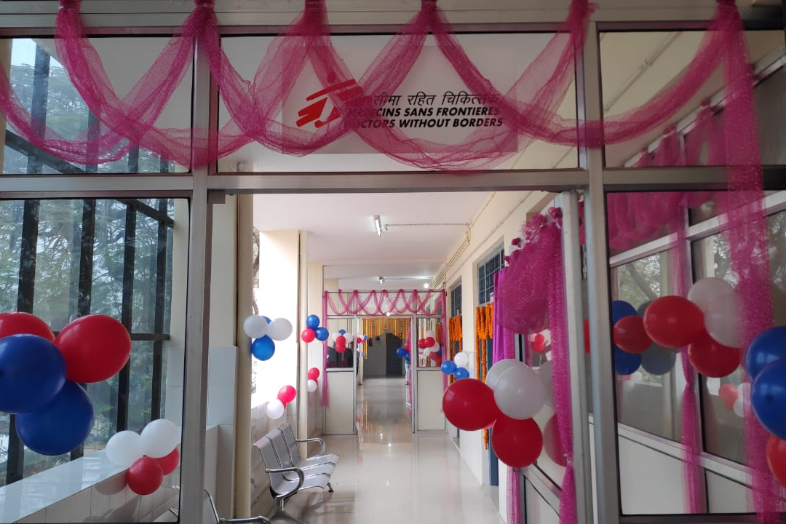
Acknowledgements
Chhavi Kumar, Rohit Kumar, Shweta Singh, and the Medecins Sans Frontieres field and capital coordination teams. We are grateful to Ria Roy, Pallavi Lohani, Anuradha Ratan, Apurv Agrawal, and all medical interns and residents at the All India Institute of Medical Sciences (Patna) for their support in the study.

