Slide 1
Waterborne illnesses are one of leading threats in displacement crises.
Safe water is essential for protecting public health. We have guidelines to do this.
…But do they work?
Notes:
Waterborne illnesses are among the leading causes of preventable mortality and morbidity among displaced people.
Safe water is essential for protecting public health, and we as humanitarian responders have a number of guidelines to help us deliver safe water…
…But do they work?

Slide 2
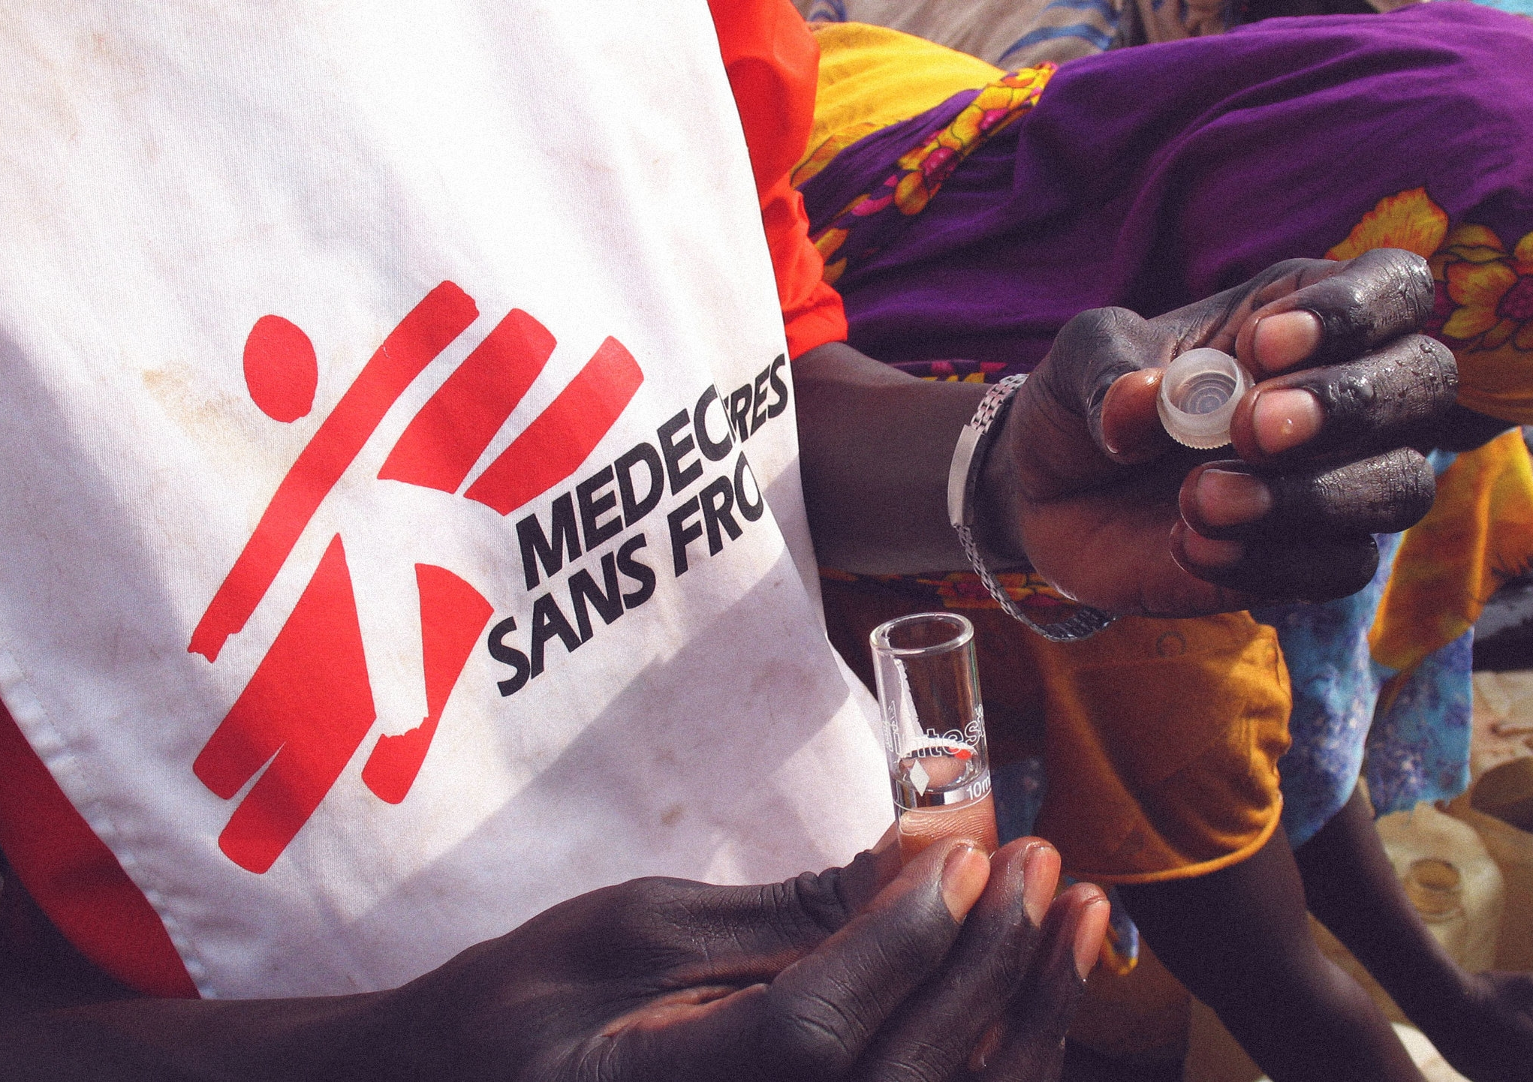

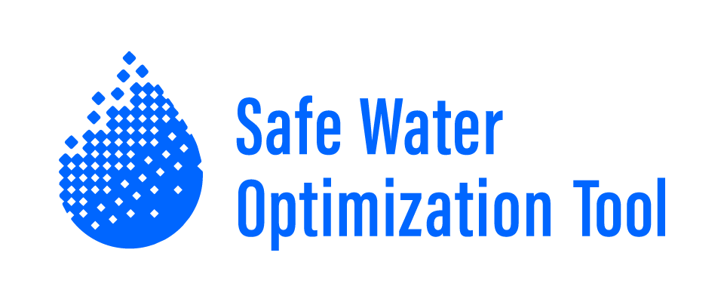

Conflict of Interest
The author has declared no conflict of interest.
Development of a
machine-learning enabled Safe Water Optimization Tool for humanitarian response
Syed Imran Ali, PhD
J. Fesselet, M. Arnold, U. Khan, S. S. Ali,
M. Spendlove, A. Vasileiou, M. De Santi,
R. Shakir, D. Adler, and J. Orbinski
Dahdaleh Institute for Global Health Research, York University, Toronto ,Canada
Médecins Sans Frontières, Amsterdam, The Netherlands
Notes:
Hi. My name is Imran Ali. I want to answer this question today and tell you about the work we’re doing to ensure water is safe and public health is protected in emergencies.
I’m giving this presentation on behalf of an amazing group of collaborators at MSF OCA and the Dahdaleh Institute for Global Health Research at York University.

Slide 3
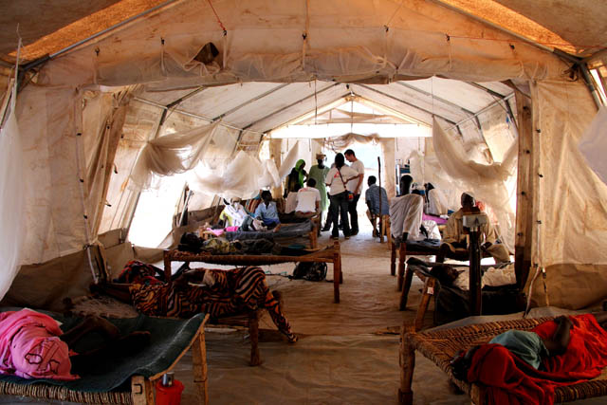
Notes:
Let me tell you where this story begins…
In Maban County, South Sudan, in 2012-13, MSF responded to major refugee crisis. The Maban County refugee camps were overwhelmed, under-serviced, and faced multiple outbreaks of waterborne illness.
This is an image of a Hepatitis E isolation ward in the Batil camp. Hepatitis E is a vicious waterborne illness for which there is no cure. All we can do medically is offer supportive care.
In the general population in these camps, the crude fatality rate associated with Hep E was around 2%.
But for pregnant women in their 2nd or 3rd trimester, it jumped to 20%.
And when we had one case come in, it often meant two deaths as the child would either die in utero or be delivered so prematurely they had very little chance of survival.
This was incredibly difficult for all of the MSF team to witness.
It firmed our resolve to beat back the outbreak by stopping its transmission through the environment. To do this, we had to improve water, sanitation, and hygiene (WASH) services in the camps.
With UNHCR, Oxfam, and other agencies, we worked to improve WASH services in the camps and eventually beat back the outbreak.

Slide 4
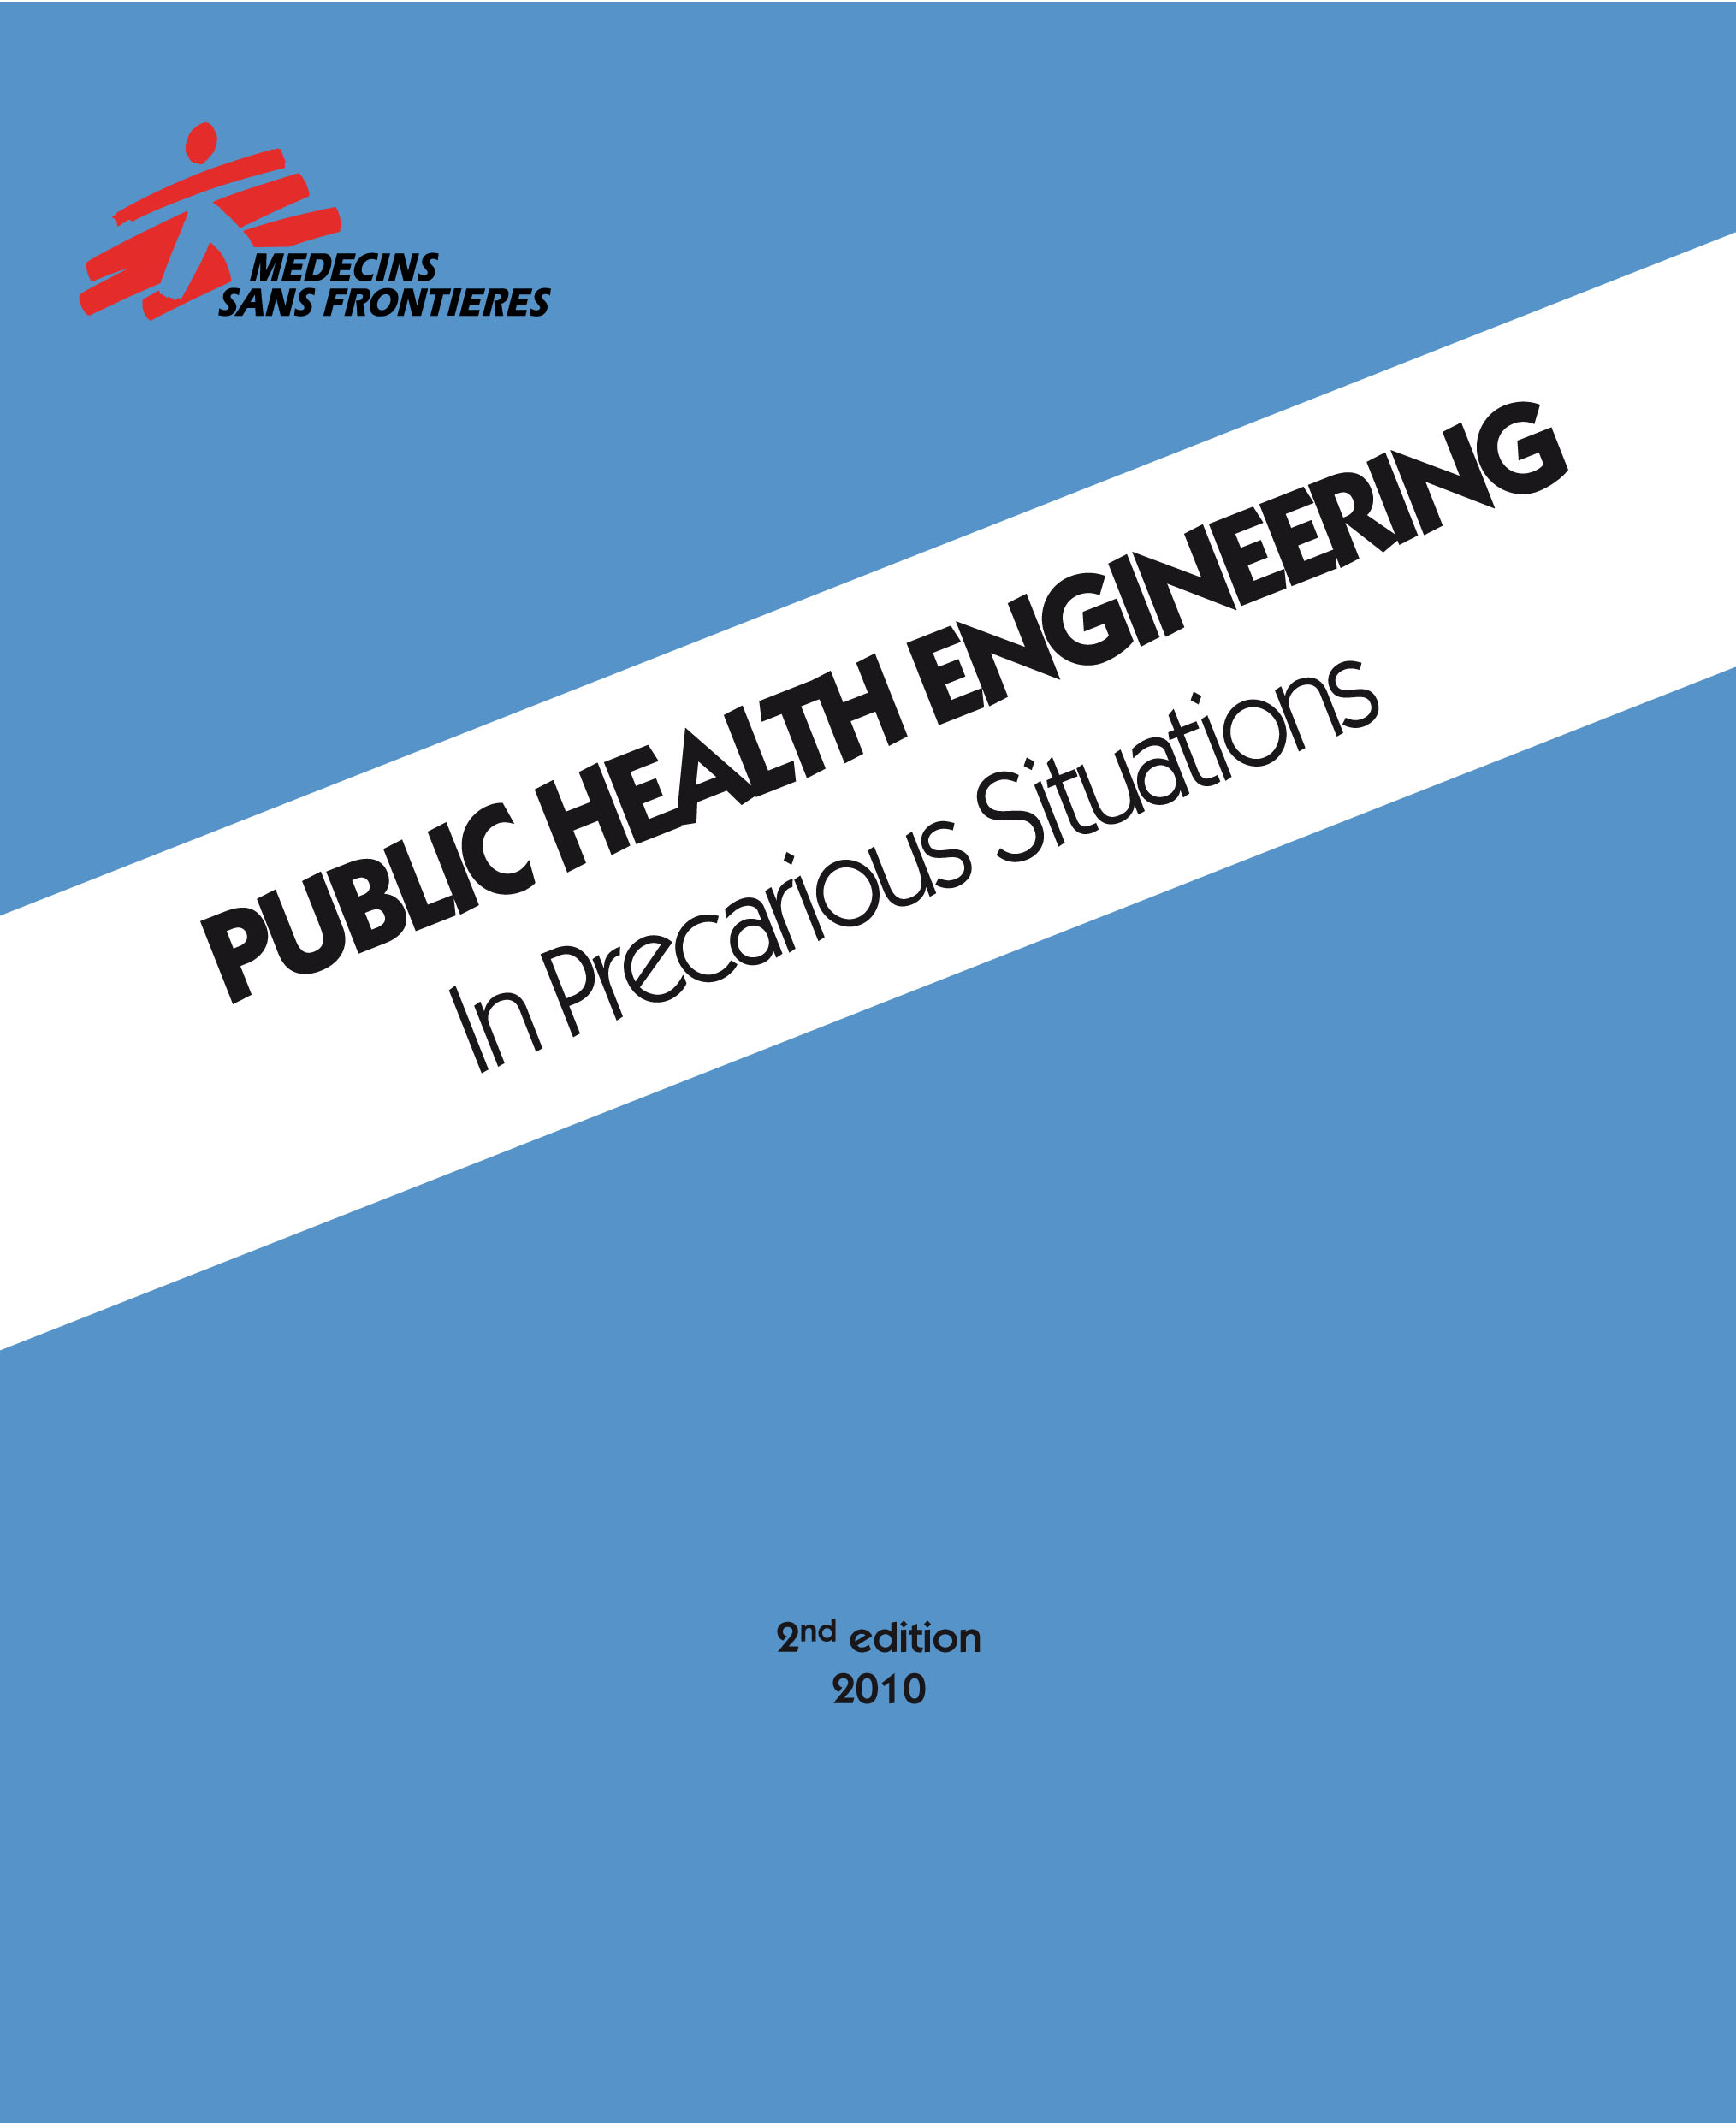
Chlorination Guidelines
Free residual chlorine (FRC) at camp tapstands:
→ 0.2 - 0.5 mg/L under normal conditions
→ 0.5 - 1.0 mg/L during outbreaks or when pH or turbidity are elevated
Notes:
One of the big things we worked on was improving water treatment and water safety in the camps.
To do this, we were guided by core humanitarian standards on how to chlorinate water to make sure it’s disinfected and then has some residual protection to keep it safe.
The MSF, Sphere, and other guidelines all say the same thing: that free residual chlorine (or FRC for short) at water distribution points should be between:
0.2 - 0.5 mg/L, under normal conditions;
or increased to 0.5 - 1.0 mg/L, during outbreaks or when pH or turbidity are elevated.
But even when we achieved these targets at water distribution points, when we went to people’s tents, and tested the water they were actually drinking we often found that it had no chlorine protection.
In fact, there was also evidence that water in people’s tents was being fecally contaminated, all in the midst of major waterborne outbreaks!

Slide 5
Chlorination Guidelines
Free residual chlorine (FRC) at camp tapstands:
→ 0.2 - 0.5 mg/L under normal conditions
→ 0.5 - 1.0 mg/L during outbreaks or when pH or turbidity are elevated
FRC guidelines not based on any field evidence!
Notes:
We started to do some digging on these guidelines, and discovered that the FRC standards are not actually based on any field evidence from humanitarian settings!
Instead, they come from conventions meant for municipal piped water systems in cities!
So no wonder they didn’t work in refugee camps.

Slide 6

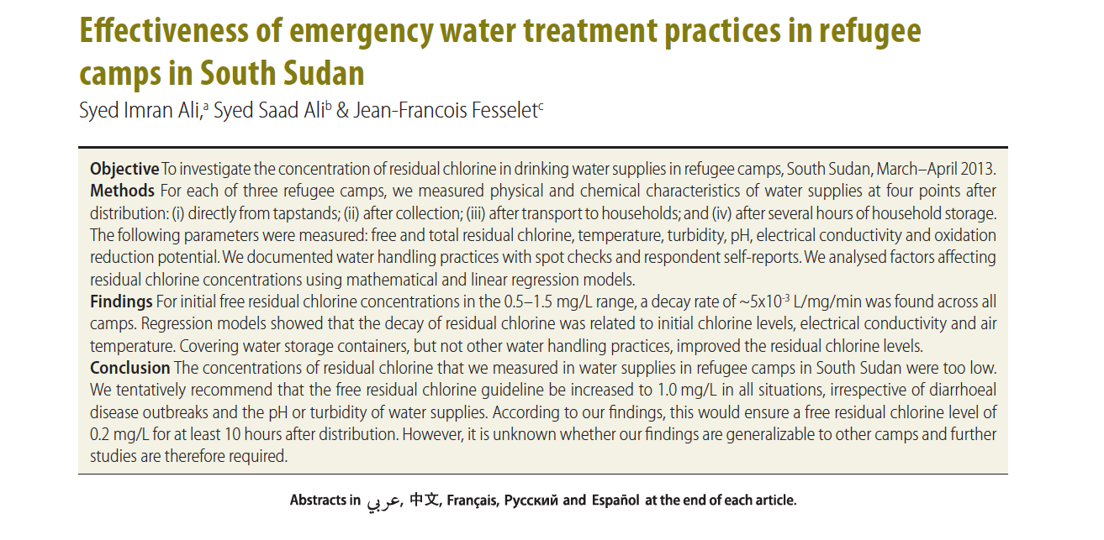
Chlorination Guidelines
Free residual chlorine (FRC) at camp tapstands:
→ 0.2 - 0.5 mg/L under normal conditions
→ 0.5 - 1.0 mg/L during outbreaks or when pH or turbidity are elevated
FRC guidelines not based on any field evidence!
Water recontamination linked to spread of waterborne diseases in Uganda, Malawi, Kenya, Sudan²⁻⁷
Notes:
We shared our concerns about the humanitarian FRC guidelines in an article in the Bulletin of the World Health Organization…
And as we looked into it more, we found many reports of water being recontaminated and leading to the spread of waterborne illnesses among displaced populations.

Slide 7
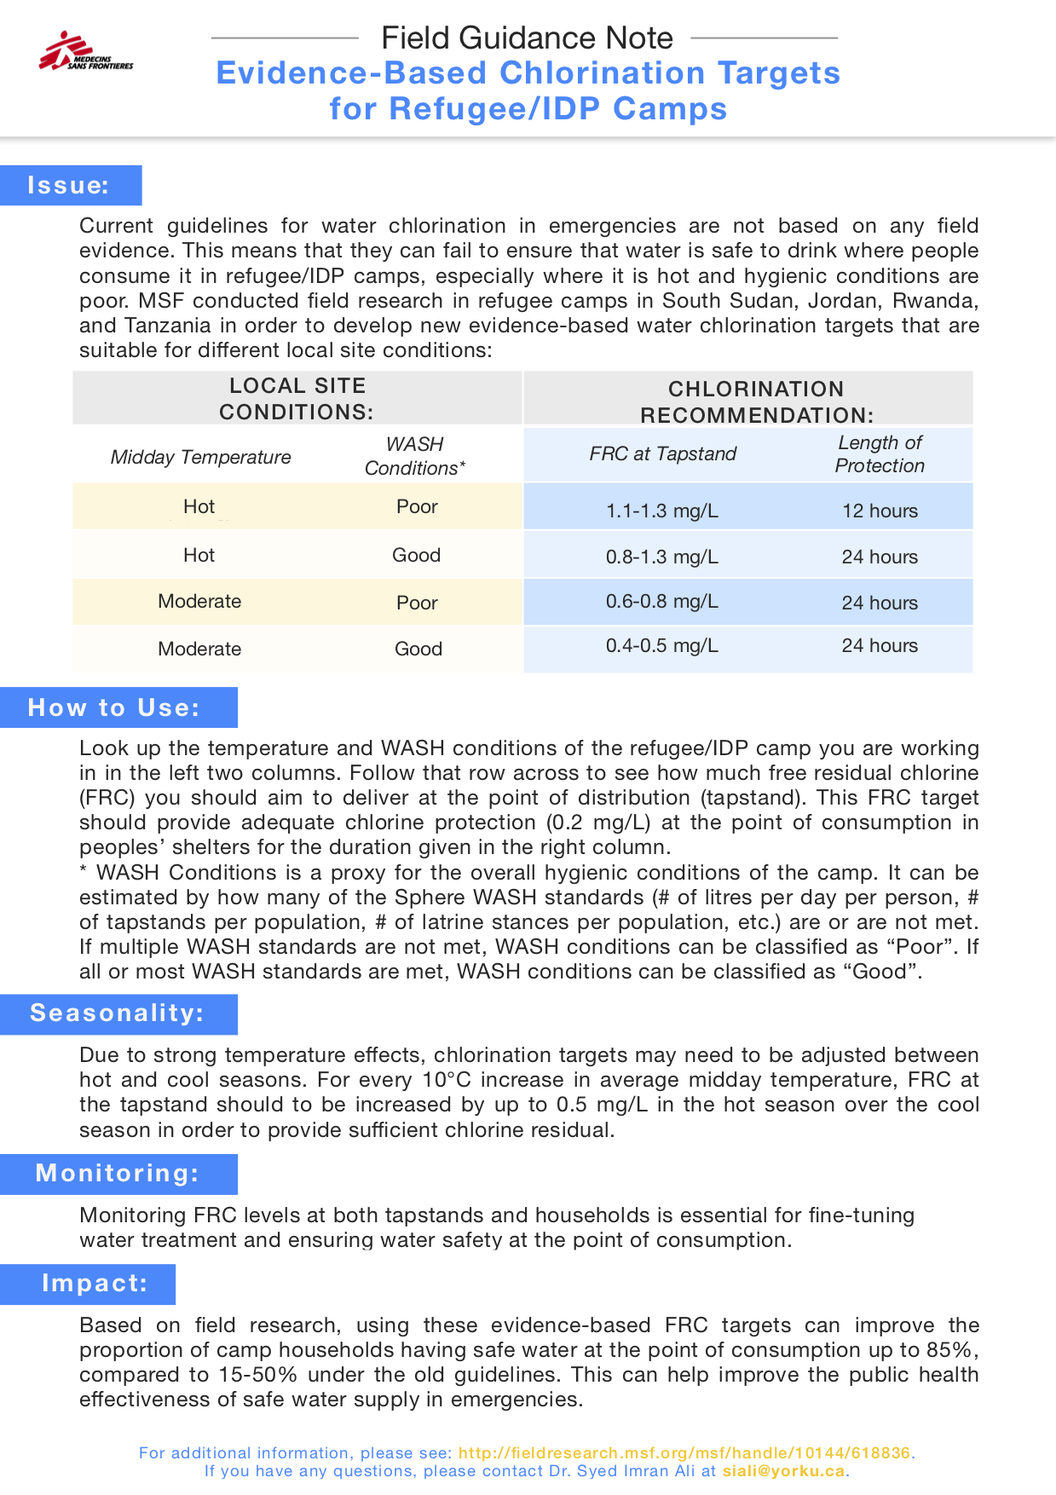
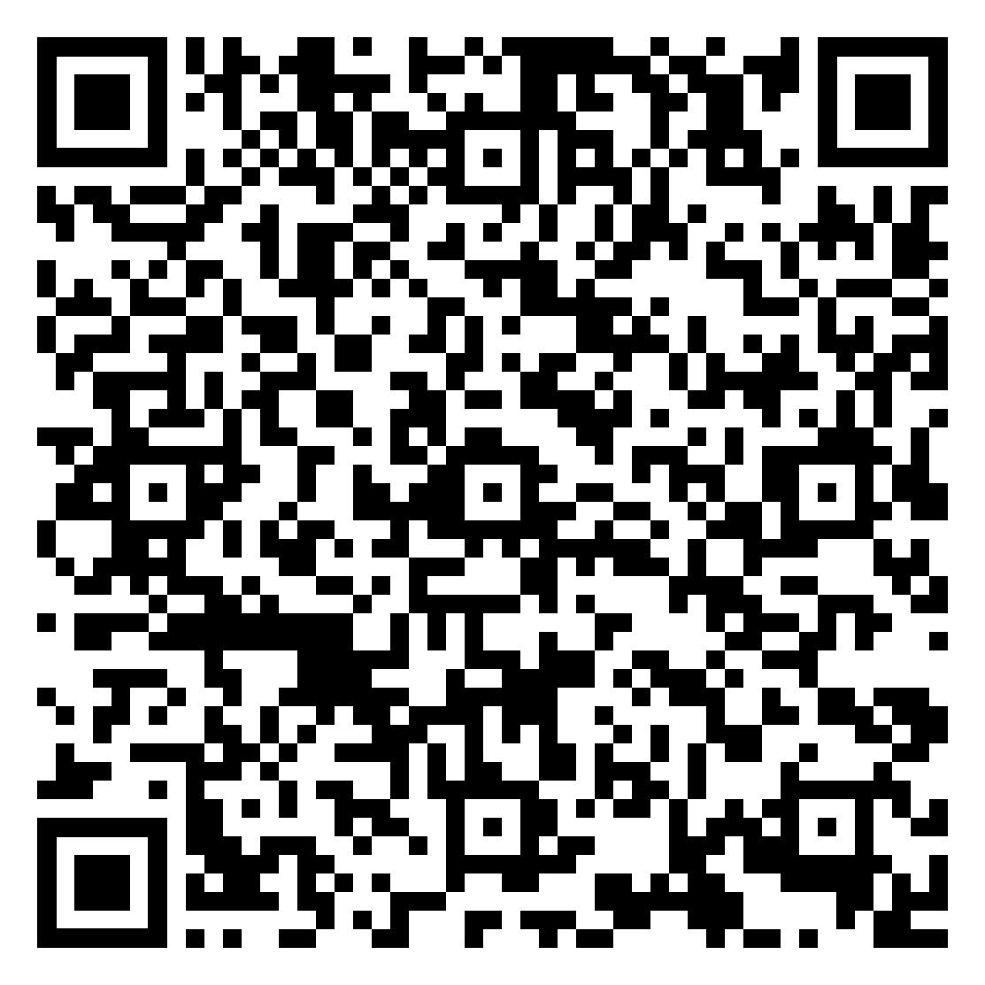
Evidence-based Guidelines!
Notes:
In response to this, we launched work to develop the first evidence-based guidance for water chlorination in emergencies.
We carried out a large multi-site study in refugee camps in South Sudan, Jordan, Rwanda, and Tanzania.
We generated a new set of evidence-based FRC targets suitable for different temperature and environmental conditions.
This is work that we previously presented at Sci Days. You can check out this guidance document by scanning this QR code with your phone.

Slide 8
Evidence-based Guidelines!
External validity?
Notes:
But there was a lingering problem of external validity.
If the new guidance was based on evidence from 4 specific sites, how did we know for sure it would work elsewhere? In Bangladesh? In Nigeria? In Yemen?

Slide 9
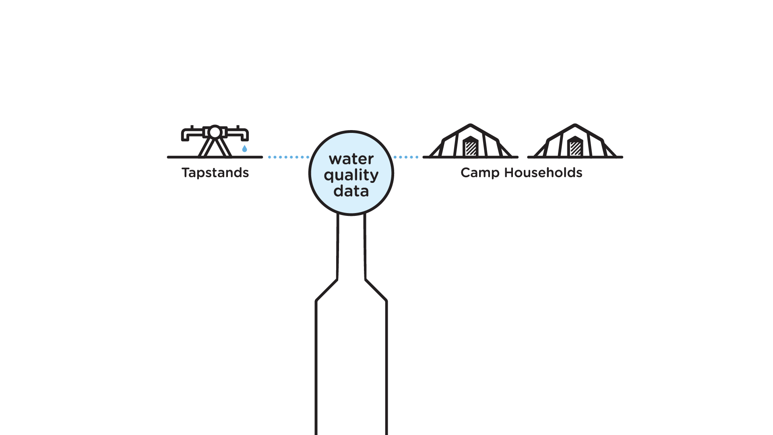
An opportunity!
Notes:
This got us thinking…
Humanitarian agencies are regularly collecting water quality monitoring data in refugee and IDP camps all the time.
Mostly it just gets used for reporting purposes… but there’s potentially life-preserving information inside that data.

Slide 10

An opportunity!
Site-specific
Evidence-based
FRC Target
Notes:
We had developed some pretty advanced data analytics as part of our earlier research.
We realized that if we could put those analytics up on the cloud, any fieldworker anywhere in the world could simply upload their monitoring data and use it to generate a custom, site-specific, and evidence-based FRC target that ensures water remains safe to drink for the entire time its stored and used in people’s homes.

Slide 11
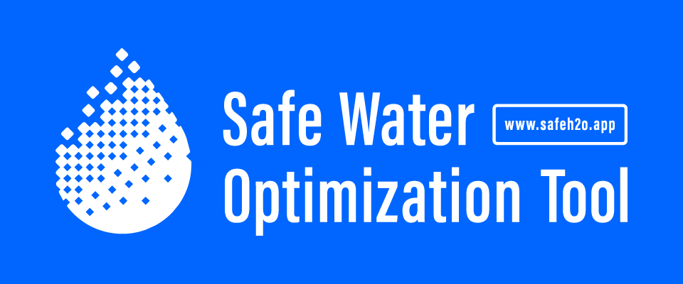
An opportunity!
Site-specific
Evidence-based
FRC Target
Notes:
The Safe Water Optimization Tool was born!!

Slide 12
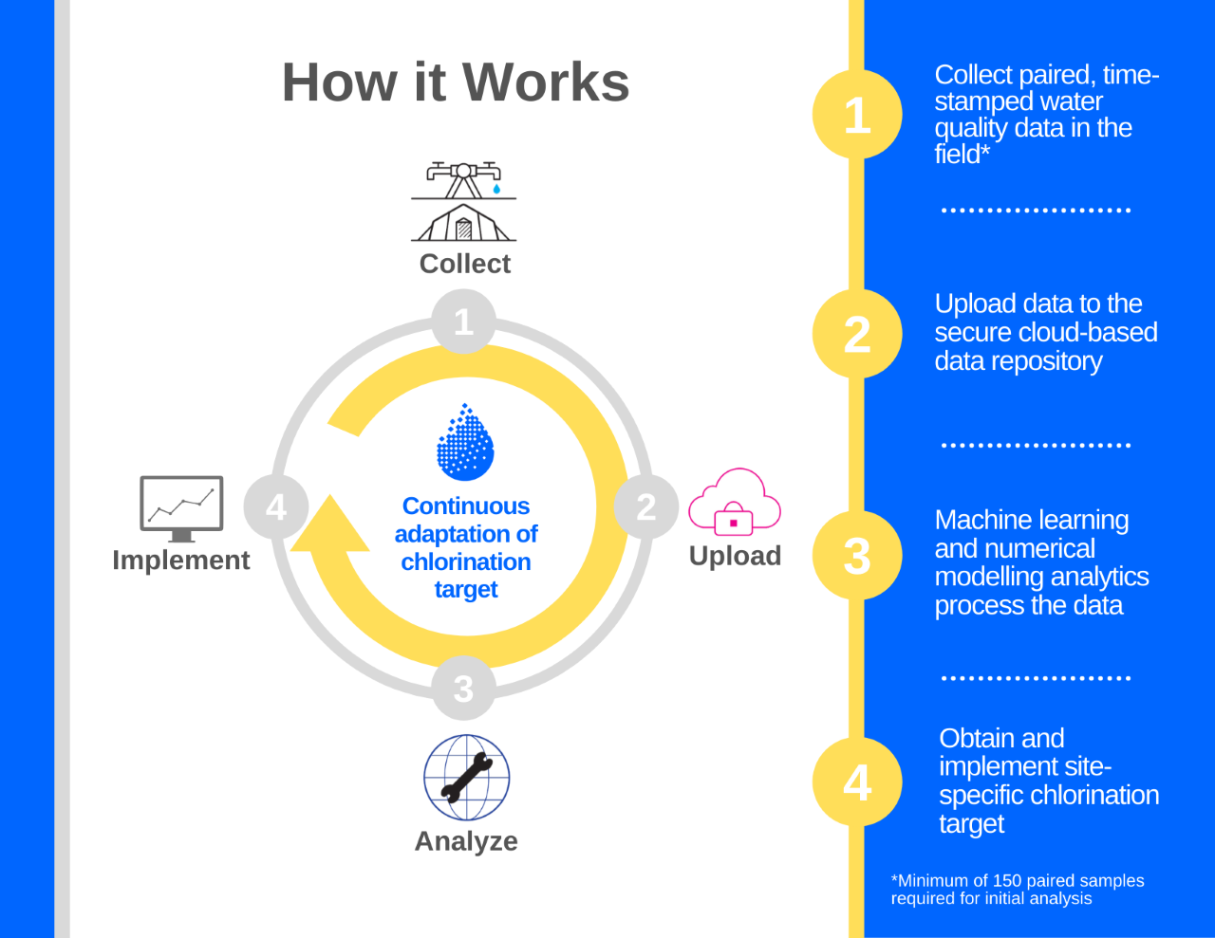
Notes:
Here’s how the SWOT as we call it for short works:
First, field workers collect paired water quality data, first from the water distribution points, and then from households after the usual duration that water is stored and used in people’s homes.
Step two, they upload that data to the SWOT web tool.
Step three, that data is used to train the SWOT analytics, which generate a recommendation on how much FRC there must be at water distribution points in order to ensure there’s enough residual protection for the entire duration of household storage and use.

Slide 13
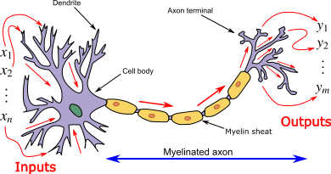
Artificial Neural Networks (ANN)
Notes:
The SWOT is built on two analytical engines that help unlock the life-preserving information inside monitoring data.
One of these is a Machine Learning engine, which utilizes artificial neural networks, a type of ‘supervised learning’ AI that mimics the structure of a neuron in which a set of inputs are mapped to a set of outputs and builds a predictive model.

Slide 14
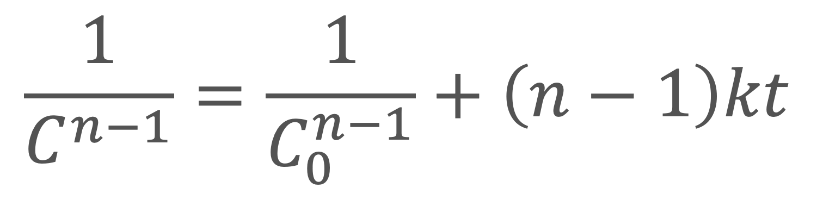
Artificial Neural Networks
Numerical Modelling
$$\frac{1}{C^{n−1}}=\frac{1}{C_{0}^{n−1}}+\left(n−1\right)kt$$
Notes:
The second is a Numerical Modelling engine based on engineering optimization principles.
Here, we use field data to analytical solve the general integrated rate law – a fundamental law from chemistry that tells us us how fast the concentration of a chemical species is changing over time as it reacts.
This allows us to predict FRC at different times under the prevailing decay conditions represented in the site data.
All analytics and software development we’ve done is open source and can be accessed via Github.

Slide 15

The FRC target at the tapstand should be 0.8 – 1.0 mg/L to ensure safe water at the household up to 15 hours post collection.
Notes:
Step four, based on outputs from the two analytical engines, the SWOT issues a recommendation -- sent via email to field workers -- on how much FRC they need to have at water distribution points.
Fieldworkers implement the SWOT’s FRC recommendation, and continue to monitor water quality and upload data.
The SWOT learns from new data coming in and adjusts the FRC target as conditions change in the field.

Slide 16
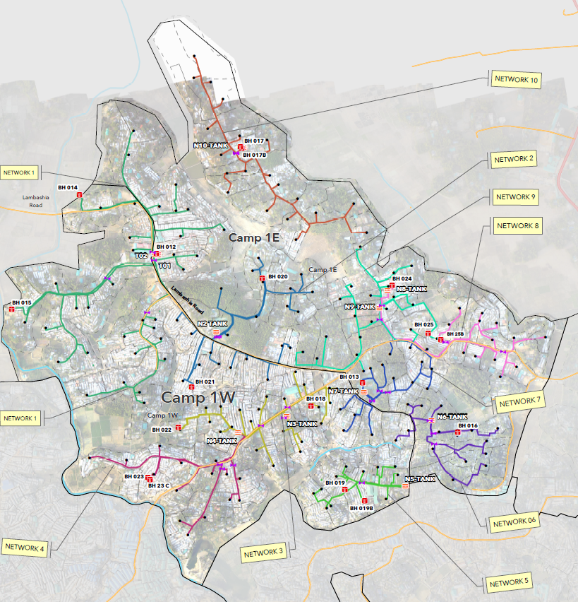
Proof of Concept Study: Bangladesh
SWOT PoC at Kutupalong-Balukhali Extension Site, Cox’s Bazaar
Context | Rohingya refugees from Myanmar Up to 1M people in entire K-B Extension Site
Implementation Site | Camp 1 in NW sector of K-B
Population | 83,000 people
Water System Operators | MSF and BRAC
# of Networks | 10
# of Boreholes | 14 Solar/hybrid power with inline chlorination
# of Tapstands | 190
SWOT Study Period | July – December 2019
Notes:
Once we built the SWOT, we set out to evaluate its effectiveness for optimizing household water safety through a proof-of-concept study at Kutupalong-Balukhali in Bangladesh, a massive refugee settlement that hosts around ~1m Rohingya people who have fled neighbouring Myanmar.
At Kutapolong, MSF was carrying out medical and water and sanitation activities including operating water supply systems in multiple parts of the camp.
We selected Camp 1 in the NW sector of Kutapolong, where MSF operated a water supply system serving 83,000 people.

Slide 17
Methods
Measure water quality at tapstand:
- FRC
- Temp
- EC
Accompany water-user to shelter, mark container
Return after 4 to 18 hours of household storage/use and measure FRC again from same container.
Total dataset: July-Dec 2019 (6 mo.): n= 2095
Training data: July-Sept, n=899
Evaluation data: Oct-Dec, n=1196
Rapid KAP survey: Contextual data incl. HH storage time
Ethics approval: MSF ERB, York University ERB, and National ERB in Bangladesh
Notes:
1. Across the 10 networks in Camp 1, we measured 3 water quality parameters directly from water leaving the tap: FRC; water temperature; and electrical conductivity (or EC). [NEXT]
2. Once users had collected their water from the tapstand, we accompanied them back to their shelters where we marked each container of water. [NEXT]
3. We then returned to that same household 4 to 18 hours later and measured FRC again from the same container. [NEXT]
Between July and December, we collected 2095 paired observations following this protocol.
We used data from July to September to train the SWOT's analytical models and generate a site-specific water chlorination target.
We used data from Oct-Dec to assess evaluate the household water safety effectiveness of the SWOT FRC recommendation versus the current Sphere FRC guideline.
We also conducted a rapid KAP survey to gather contextual data, including the typical maximum length of time that water is stored and used in households.
We obtained ethics approval from the MSF ERB, York University Ethics Review Board, and the Ethical Review Committee of the Centre for Injury Prevention and Research Bangladesh.

Slide 18
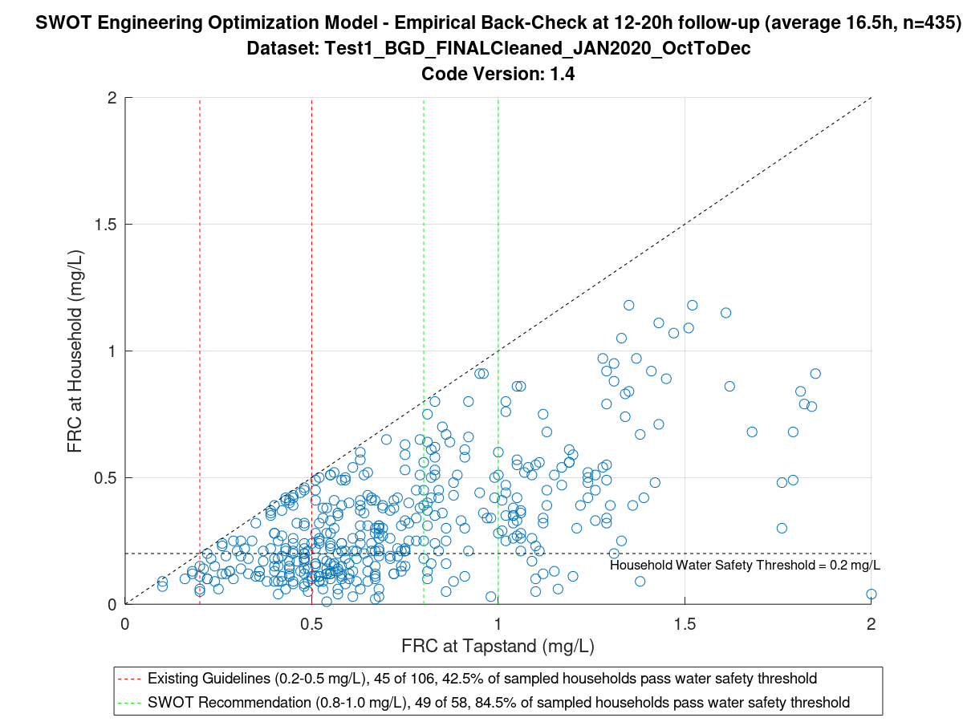
Results
Household Water Safety Evaluation:
Evaluation period: Oct-Dec 2019
Targeted protection time: 15 hours
SWOT FRC Target: 0.8 – 1.0 mg/L
Data subset: Samples with HH follow-up at 12-18h
Average time in subset: 16.5 hours
# of observations: 435
The FRC target at the water distribution points should be 0.8 – 1.0 mg/L to ensure safe water at the household (≥0.2 mg/L FRC) up to 15 hours post collection.
Notes:
From the KAP survey, we learned that the maximum length of time water is typically stored in households was around 15 hours.
The SWOT recommended that FRC at water distribution points be set to 0.8 mg/L to 1.0 mg/L in order to have 0.2 mg/L FRC at the household up to 15 hours later. [NEXT]
We evaluated the household water safety effectiveness of the SWOT FRC recommendation versus the Sphere FRC guideline by assessing the proportion of household samples that exceeded the household water safety threshold of 0.2 mg/L at follow-up when upstream FRC was in line with either range.

Slide 19
Implementing the SWOT FRC recommendation at the tapstand would double the proportion of households with safe water at the Bangladesh site.
Results
Household Water Safety Evaluation:
Notes:
In the Bangladesh PoC, we observed that the existing Sphere FRC guideline yielded safe water in 43% of sampled households 15h later.
In comparison, the SWOT recommendation of 0.8 – 1.0 mg/L yielded safe water in 85% of sampled households 15h later. [NEXT]
Overall, the Bangladesh PoC demonstrated that implementing the SWOT recommendation at tapstands would nearly double the proportion of households with safe water compared to the existing Sphere guideline. [NEXT]
One of the major concerns that comes up about chlorinated water is taste and odour driven rejection – so we did some digging on this through the KAP survey as well.
We found that about 80% of respondents had no complaints about the taste/odour of chlorinated water. Only a small minority of around 10% had such complaints, indicating a generally high level of acceptance of water chlorination in this population.

Slide 20
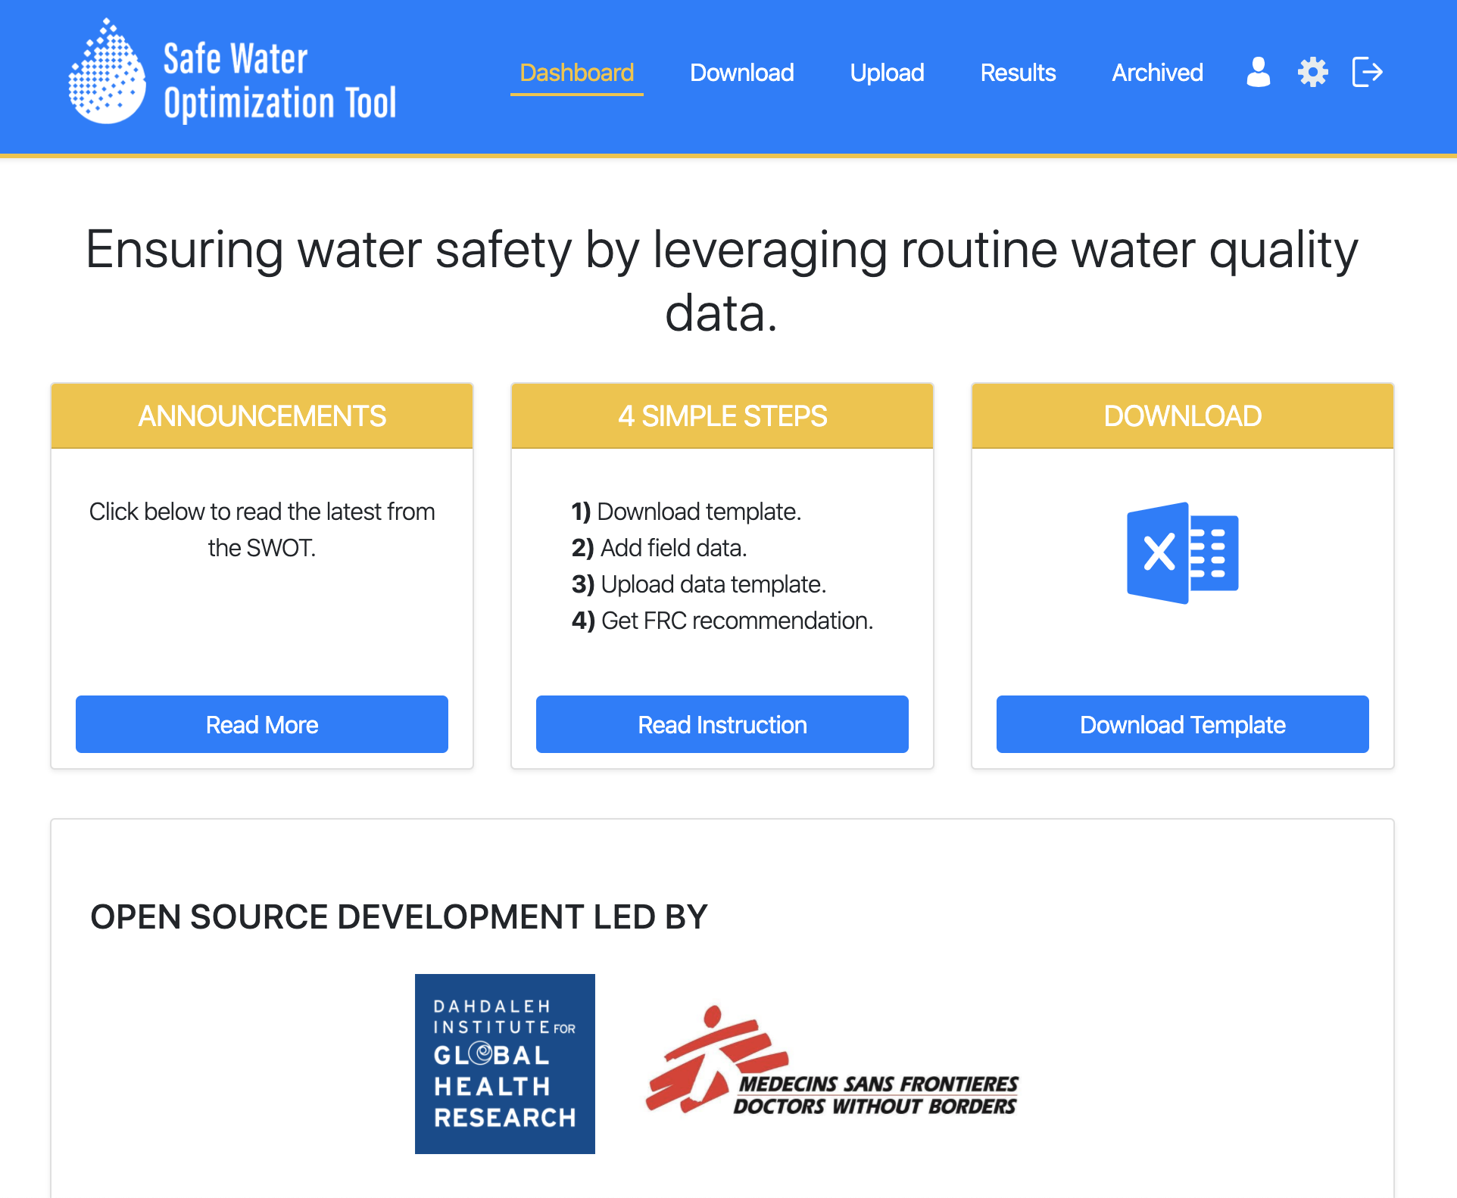
Conclusions
SWOT outperforms Sphere FRC guidelines for ensuring household water safety
Implement and evaluate the SWOT in future water supply projects → request a field trial!
Next steps:
    → Diversify applications to surface water treatment, water trucking, medical facilities, and intermittent water systems
    → Develop rapid protocols to evaluate chlorine taste/odour rejection thresholds and DBPs
www.safeh2o.app
Notes:
The Bangladesh PoC study showed that the SWOT outperforms Sphere FRC guidelines for ensuring household water safety.
By improving household water safety, the SWOT has the potential to yield public health benefits and improve monitoring, reporting, and accountability for water safety to populations & donors.
The SWOT is ready! So go use it! You can check it out at the URL there and request an implementation for your project.
Right now, we have new field trials under way in Nigeria (with MSF) and in Tanzania (with UNHCR & NRC), and shortly with Medair and other agencies too.
Our next steps in growing the SWOT are to:
Diversify applications to surface water treatment, water trucking, medical facilities, and intermittent water systems in non-emergency settings.
And to develop rapid protocols for evaluating chlorine taste/odour rejection thresholds and disinfection by-products – both of which constitute important upper limits to chlorination practice.
Put together, all of these tools will form part of the overall SWOT toolkit for advancing effective and acceptable safe water practice in humanitarian response.

Slide 21
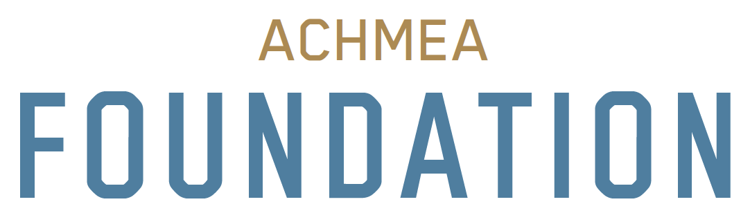
Acknowledgments
www.safeh2o.app
Want to use the SWOT?
Contact us at hello@safeh2o.app
MSF Amsterdam HQ:
SWOT Steering Committee: Melissa McRae, Kathy Rombouts, Stephane Chambet-Weil, Biserka Pop-Stefanijia, Juan Nocua, Jeff Fesselet
WatSan Unit Advisors: Dawn Taylor, Nick Schreiner, Biserka Pop-Stefanijia
IT Dept: Remon van Roeden, Tijs Berends
MSF field team in Mbawa, Nigeria
UNHCR & NRC field teams in Nyaragusu, Tanzania
Anne Hyvaerinen, UNHCR
Nosakhare Boadi, UNHCR
MSF & BRAC field teams in Cox’s Bazar, Bangladesh
Thanks to Rizwan Ali for the dope logo design!
Notes:
Thank you. Please check it out at the link above.
We would like to thank the Achmea Foundation for supporting this work.
We have a great number of people to thank without whom this work would not be possible, including at MSF OCA and the field teams in Nigeria, Tanzania, and Bangladesh.
Also, we want to give a shoutout to Rizwan Ali, our volunteer graphic designer, for designing our dope SWOT logo!
Thank you!

Slide 22
References
www.safeh2o.app
Want to use the SWOT?
Contact us at hello@safeh2o.app
Ali, S. I., S. S. Ali, and J. Fesselet, ‘Effectiveness of emergency water treatment practices in refugee camps in South Sudan,’ Bulletin of the World Health Organization 93(2015): 550–558.
Steele, A.; Clarke, B.; Watkins, O. Impact of jerry can disinfection in a camp environment - experiences in an IDP camp in Northern Uganda. Journal of Water and Health 2008, 6 (4), 559–564.
Swerdlow, D. L.; Malenga, G.; Begkoyian, G.; Nyangulu, D.; Toole, M.; Waldman, R. J.; Puhr, D. N. D.; Tauxe, R. V. Epidemic cholera among refugees in Malawi, Africa: treatment and transmission. Epidemiology and Infection 1997, 118 (3), 207–214.
Roberts, L.; Chartier, Y.; Chartier, O.; Malenga, G.; Toole, M.; Rodka, H. Keeping clean water clean in a Malawi refugee camp: a randomized intervention trial. Bulletin of the World Health Organization 2001, 79 (4), 280–287.
Mahamud, A. S.; Ahmed, J. A.; Nyoka, R.; Auko, E.; Kahi, V.; Nguhi, M.; Burton, J. W.; Muhindo, B. Z.; Breiman, R. F.; Eidex, R. B. Epidemic cholera in Kakuma Refugee Camp, Kenya, 2009 : the importance of sanitation and soap. Journal of Infection in Developing Countries 2012, 6 (3), 234–241.
Shultz, A.; Omollo, J. O.; Burke, H.; Qassim, M.; Ochieng, J. B.; Weinberg, M.; Feikin, D. R.; Breiman, R. F. Cholera Outbreak in Kenyan Refugee Camp: Risk Factors for Illness and Importance of Sanitation. American Journal of Tropical Medicine and Hygiene 2009, 80 (4), 640–645.
Walden, V. M.; Lamond, E.; Field, S. A. Container contamination as a possible source of a diarrhoea outbreak in Abou Shouk camp, Darfur province, Sudan. Disasters 2005, 29 (3), 213–221.

