Slide 1
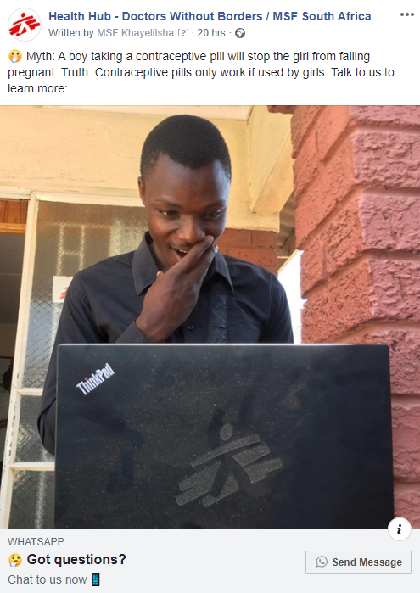
A Facebook-to-WhatsApp hotline for contraception information for adolescents and parents in Mbare, Zimbabwe
Conflict of Interest
The author has declared no conflict of interest.
Brian Hove

Slide 2
Introduction
MSF has been working in Mbare, Harare, since 2015 providing Adolescent Sexual and Reproductive Health services

Slide 3
MSF in Mbare
A high-density suburb in the southern district of Harare
Estimated population: 800,000
66.7% adolescents

Slide 4
Why use social media for sexual health education?
Zimbabwe has a high usage of social media:
(Tech Zim, 2019)
The innovation aimed to use social media to overcoming the social barriers that make sexual education and contraception a taboo subject
Social Network | Total Addressable Ad Audience In Zim | % of males | % of females
Facebook | 1 100 000 | 59% | 41%
LinkedIn | 510 000 | 59% | 41%
Instagram | 290 000 | 60% | 40%
Twitter | 193 500 | 78% | 22%
Snapchat | N/A | N/A | N/A

Slide 5
Methods
An innovative combination of technological tools (DHP approach) and peer-to-peer education skills
Patients recruited through geo-targeted Facebook adverts, featuring 104 different messages and images
Targeted both male and female users within the adolescent and parents groups
The messages and images covered common questions and misconceptions around contraceptive use
Data was protected by end-to-end encryption
Client confidentiality was maintained, and an escalation protocol was implemented to refer callers in need of urgent support with their consent

Slide 6
Results
The adverts reached 115,008 people in Mbare over 44 days
836 conversations were started (19 people/day)
644 (77%) with adolescents
192 (23%) with parents and caregivers averaging
Innovation increased the overall reach and acceptance of contraceptives with 96 (11%) clinic referrals out of 904 clinic visits during the period
The hotline number was kept by clients for further questions and was passed among friends

Slide 7
Conclusion
The DHP campaign has potential as a means for clients to discuss sensitive topics
The campaign was extended from 1 month to 2 months, due to positive results with the volume of conversations suggesting a high interest in the target population
The campaign was low cost with high positive impact: $867 USD
DHP can be recommended to navigate societal norms and culture when addressing taboo medical topics

Slide 8
Acknowledgments
Dr Abraham Mapfumo (MSF), Omer Abdala (MSF), Cynthia Banda (MSF), Dr Collins Nyatsambo (City of Harare), Dr Reinaldo Ortuno (MSF), Jakub Hein (MSF)
Mbare Community

