Slide 1
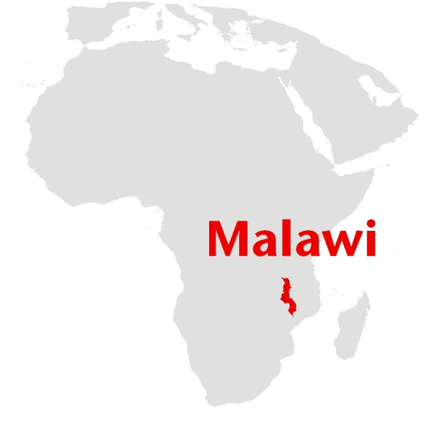
Social mapping in Malawi:
involving humanitarian aid beneficiaries in decision-making during the response to an emergency
MSF Scientific Days | May, 25th 2018 | London (UK
*Labana Steven, Ronan Guede, Quentin Pullinckx, Blessings Chiepa
Médecins Sans Frontières (MSF), Blantyre, Malawi
*msfocb-blantyre-logprojectdev@brussels.msf.org

Slide 2
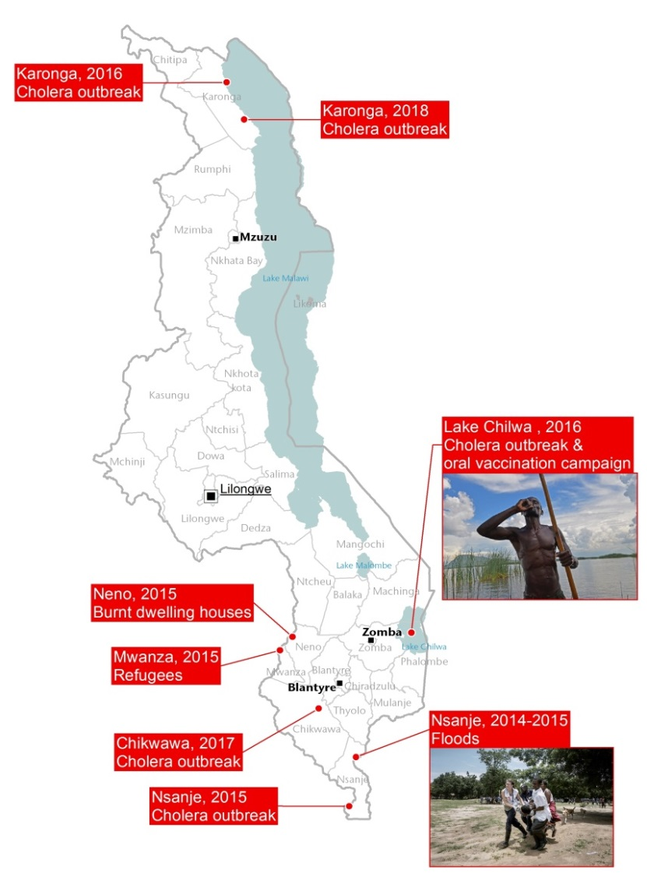
Introduction
“We work FOR the beneficiaries”. But do we work WITH the beneficiaries in emergencies?
Captured from HIV /AIDS Experience
Started in Nsanje flood 2014) extended to 7 other emergency projects.
The latest projects introduced the use of GIS.
Notes:
Karonga :

Slide 3
Social mapping ?
Visual method of showing location of households and the distribution of
different people together with the social structure, groups and organisations of an area.

Slide 4
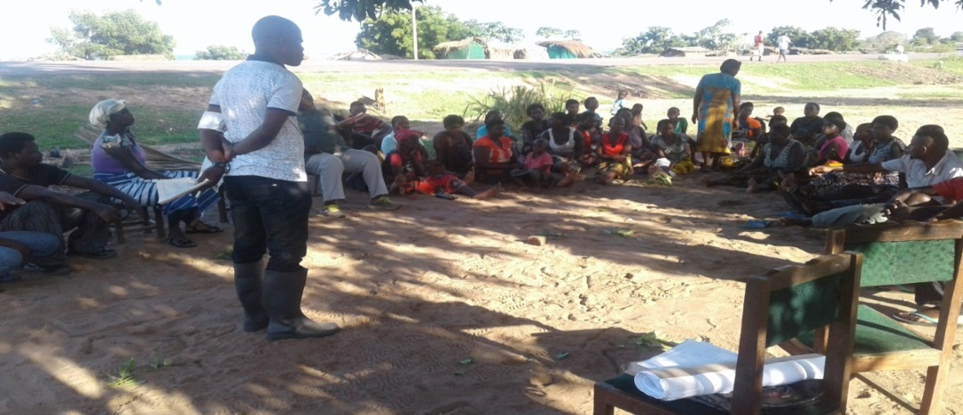
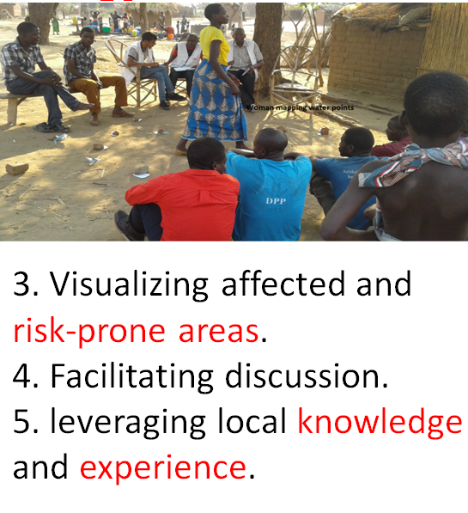
Methodology
Preparatory steps :
1. Preparation of open questions relating to : risks , role and deliverables.
2. Electing representatives from affected/

Slide 5
Results
Before response
Located critical, isolated, affected communities.
Identified high-risk communities.
Prioritization of needs.
Identified strategic positions.
Information before social mapping

Slide 6
Results … continued
Increased community ownership and participation.
Covered critical hard to reach beneficiaries 70,000.
Reinforced transparency and accountability
Mosquito nets | Water treatment kits | Shelters | Cloths in Kgs
25898 | 7205 | 4963 | 1560

Slide 7
Conclusion
a simple, low cost approach Increased understanding of local context and needs, confidence & gained support from beneficiaries
GIS maps of social mapping outcomes : precise localisation presentable and analytical

Slide 8
Recommendation: MSF responsive actions should avoid killing existing initiatives from affected communities by considering scaling up innovations of listening and soliciting support from beneficiaries

Slide 9
“Voices from the projects must be prioritized over voices from headquarters, and we must increase the space given to the perspective of patients and their communities. We should let patients and communities speak for themselves whenever they are able, and amplify their voices so they can be heard.”
Manifesto « A call for change : Challenging MFS’s status quo on evolution and growth”, MSF, International Board, March 2018

Slide 10
Acknowledgements
Affected Communities and Beneficiaries
Ministry of health
MSF Emergency team
photographs ownership is MSF Malawi
“We confirm that we have obtained permission to use images from the participants/patients/individuals included in this presentation”
@ Aurelie Baumel

