Slide 1

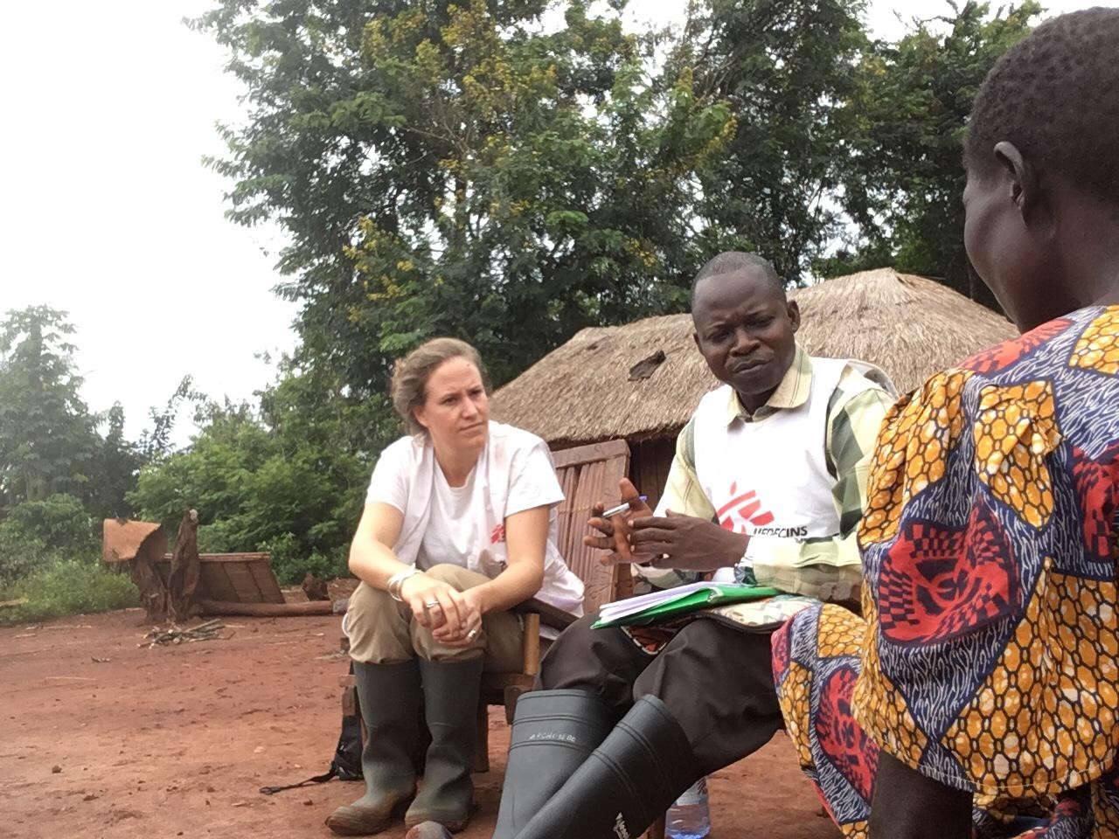
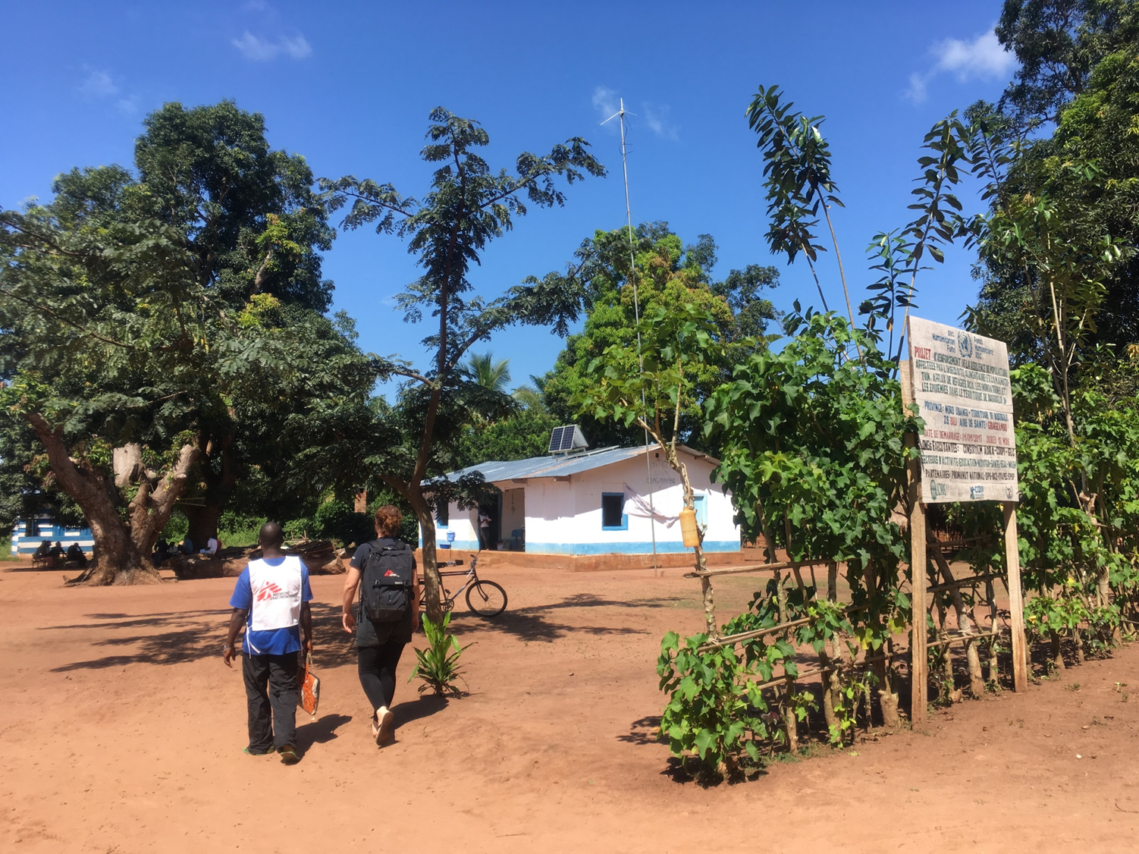
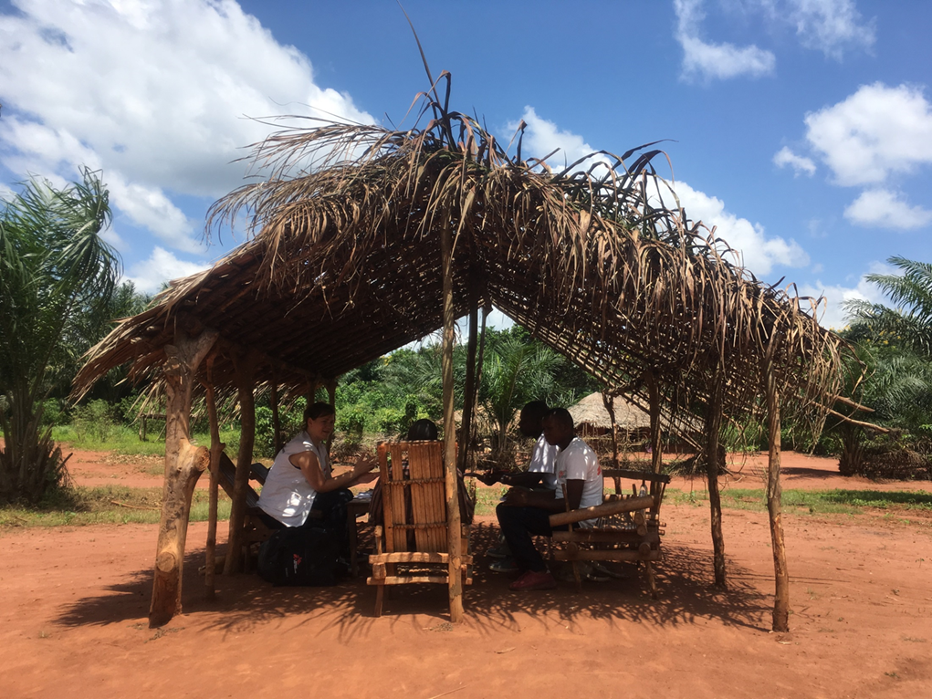
Exploring perceptions of malaria prevention and treatment in rural Democratic Republic of Congo: results from two qualitative studies
Venables E^{1, 2}, Whitehouse K ¹, Penson F ³, Robays J ⁴, Pangozo J³, Magbodo NE³, Tresor Longina D⁵, Mashako M⁶
¹Luxembourg Operational Research Unit, Médecins Sans Frontières, Luxembourg, Luxembourg, ²University of Cape Town, Division of Social and Behavioural Sciences, Cape Town, South Africa, ³Médecins Sans Frontières, Bili, Congo, DRC ⁴Médecins Sans Frontières, Medical Department, Brussels, Belgium ⁵Ministry of Health, Bili, DRC
⁶Médecins Sans Frontières, Kinshasa, DRC
Corresponding author: emilie.venables@brussels.msf.org
Background
Results
In 2016, more than 15 million cases of malaria were reported in the Democratic Republic of Congo (DRC), and malaria was the leading cause of death.
MSF has been providing treatment for malaria to children under five in Bili, a rural area of DRC, since 2017.
Sub-optimal household bednet usage and poor adherence to Artesunate-Amodiaquine Fixed-Dose Combination (ASAQ-FDC) have been observed in children.
In October 2018, two qualitative studies were carried out in parallel to explore these issues and to improve project understanding of community perceptions around malaria prevention and treatment.
Themes focussed on understanding malaria prevention and treatment; reasons for non-adherence to treatment; sub-optimal bednet usage and recommendations for improving services:
Malaria and ASAQ-FDC were well-known amongst all participants but there was limited care-giver understanding of the modes of malaria transmission.
Treatment was not always well-explained to care-givers by health providers and information sharing during consultations was often one-directional.
Bednet use was widely reported as important by care-givers, however household observations identified insufficient bednets for family members and visitors.
Many bednets were in poor condition, and maintenance was inconsistent across households.
Most care-givers were female, yet care for sick children is often a shared responsibility, thus involving other family members is essential.
Heath-care workers included clinical staff, community outreach and referral agents, triage and female community liaisons.
Items and images can span one column or they can span two columns
Methods
During education sessions, you need to bring all the women to one side and talk to them about malaria prevention, not at the same time as the men. Some women are embarrassed to share their ideas in front of men, so that could help women learn how to protect themselves.
Mother of 4, aged 45, Gbagayambo
Community members, including village chiefs and outreach teams, can play an active role in the organisation of bednet distributions.
2 studies conducted in 4 rural sites in Bili, Northern Ubangi, DRC
Purposive sampling was used
Interviews were conducted in Lingala, and transcribed and translated into French
Transcripts were coded using NVivo and thematically analysed
Rural health care workers are uniquely placed to reinforce malaria prevention messaging during and between bednet distributions.
93 in-depth interviews were carried out across the two studies with:
Care-givers (n=68)
Health-care workers (n=18)
Community leaders (n=7)
Two focus groups were conducted with 12 community health promotion staff.
Participant observations of ACT consultations (n=39) and household observations of bednet usage (n=33) were also conducted.
Images 2 and 3: Data collection in Bili
Studies on reasons for sub-optimal treatment adherence and bednet usage are commonly found within malaria literature, but our findings show the importance of using qualitative research to explore and document what may seem ‘obvious’.
Conclusions
Providing information about malaria treatment and prevention should be considered a process, not a ‘one-off’ intervention. More emphasis on supporting care-givers with adherence at household level is needed. Supporting future bednet distributions with ongoing health promotion activities is essential.
Acknowledgements
Do not forget to add these
Acknowledgements
The MSF team in Bili who supported the study, the care-givers, community leaders and health-care workers who participated.
Image 1: In-depth interview being conducted

