Slide 1

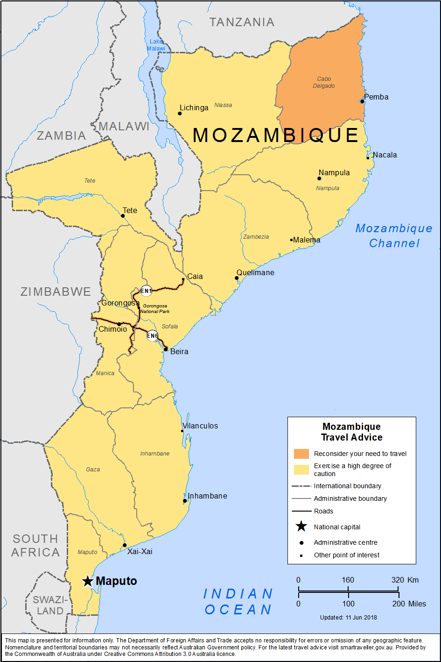
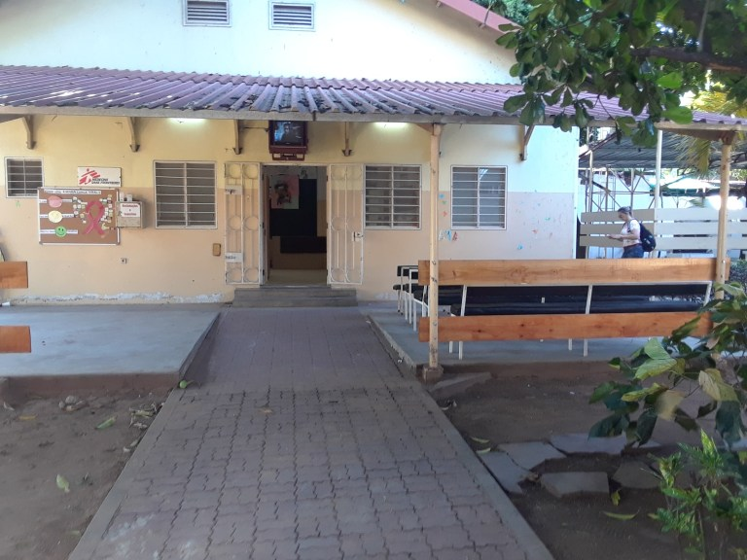
Cryptococcal antigen screening and meningitis diagnosis for advanced HIV patients in an ambulatory model of care in Maputo, Mozambique
Ana Gutierrez¹, Robert Deiss¹, Natalia Tamayo Antabak¹, Lucas Molfino¹, Iza Ciglenecki², Sheila Issufo³
¹Médecins Sans Frontières (MSF), Maputo, Mozambique; ²MSF, Geneva, Switzerland; ³Ministry of Health, Maputo, Mozambique
Cryptococcal meningitis can be diagnosed and successfully treated in an ambulatory setting.
Introduction
Conclusions
Cryptococcus neoformans is the most common cause of meningitis in adults living with HIV in sub-Saharan Africa.
Annually 278,000 are diagnosed with cryptococcal antigenaemia worldwide.
Increasingly, CM is occurring in patients who are presenting very late to care, or failing their current
ART regimen.
Nonetheless, routine screening for serum cryptococcal antigen (CrAg) has not been widely implemented for patients with advanced HIV infection, despite World Health Organization (WHO) recommendations.
We report results following implementation of systematic cryptococcal antigen screening and meningitis diagnosis for advanced HIV patients in the ambulatory setting of a Ministry of Health and MSF-supported health care facility in Maputo, Mozambique.
Methods
We analysed retrospective laboratory and clinical data between January 2016-December 2018 for HIV+ patients admitted with CD4 count < 200 cells/ul, who received routine and systematic point-of-care serum CrAg testing (IMMY; Norman, OK, USA).
Cerebrospinal fluid (CSF) was obtained on patients who were serum CrAg-positive: patients with positive results received treatment for CM according to WHO recommendations. For CrAg-negative patients, pre-emptive therapy was prescribed.
This is the first report describing implementation and results of an ambulatory-centred screening and treatment intervention for cryptococcal infection in Maputo, Mozambique.
Introduction of point-of-care serum CrAg screening and CM diagnosis for advanced HIV disease within an ambulatory model of care was feasible and led to lower than previously reported 12-week mortality in a real world setting.
To reduce AIDS-related deaths, it is critical to ensure that patients with CD4 counts < 200 cells/μL are screened for cryptococcal antigenaemia and receive pre-emptive therapy and prompt and optimal treatment for CM.
Further research and new management strategies, including shortened courses of Liposomal Amphotericin B, will further facilitate the care and treatment of patients in ambulatory settings.
“Hospitalization” area. Here, patients receive lumbar punctures, Amphotericin B, and routine venipuncture.
Results
Among 1,638 patients screened, the prevalence of cryptococcal antigenemia was 5.3% (N=86).
Of these, 34% (N=29) were diagnosed with CM, yielding a total sample prevalence of 1.8%.
CM patients were primarily female (59%), with a median age of 37 years (IQR: 29, 43), and median CD4: 43 cells/ul (IQR: 13, 91).
For patients who underwent CM treatment, 2 (7%) died within the first week of treatment.
At 12 weeks, 62% (18/29) patients remained in ambulatory care, 24% (7/29) had died, and 14% (4/29) were lost-to-follow-up.
Flow Diagram (Ambulatory CrAg
Screening)
1,638 patients screened
Source: Department of Foreign Affairs and Trade, Australian Government.
For questions or comments contact:
msfch-chamanculo-CRAM@ geneva.msf.org
86 (5.3%) serum CrAg+
29 (1.8%) with CM
Acknowledgements
CRAM Medical, Laboratory, Administration and M&E Teams
MoH- Mozambique
12 Week Outcomes
7 (24%) deaths
18 (62%) remain in care
4 (14%) LTFU
Centro de Referencia, Alto Mae (CRAM). Each day, CRAM services an average of 120 patients daily.

