Slide 1
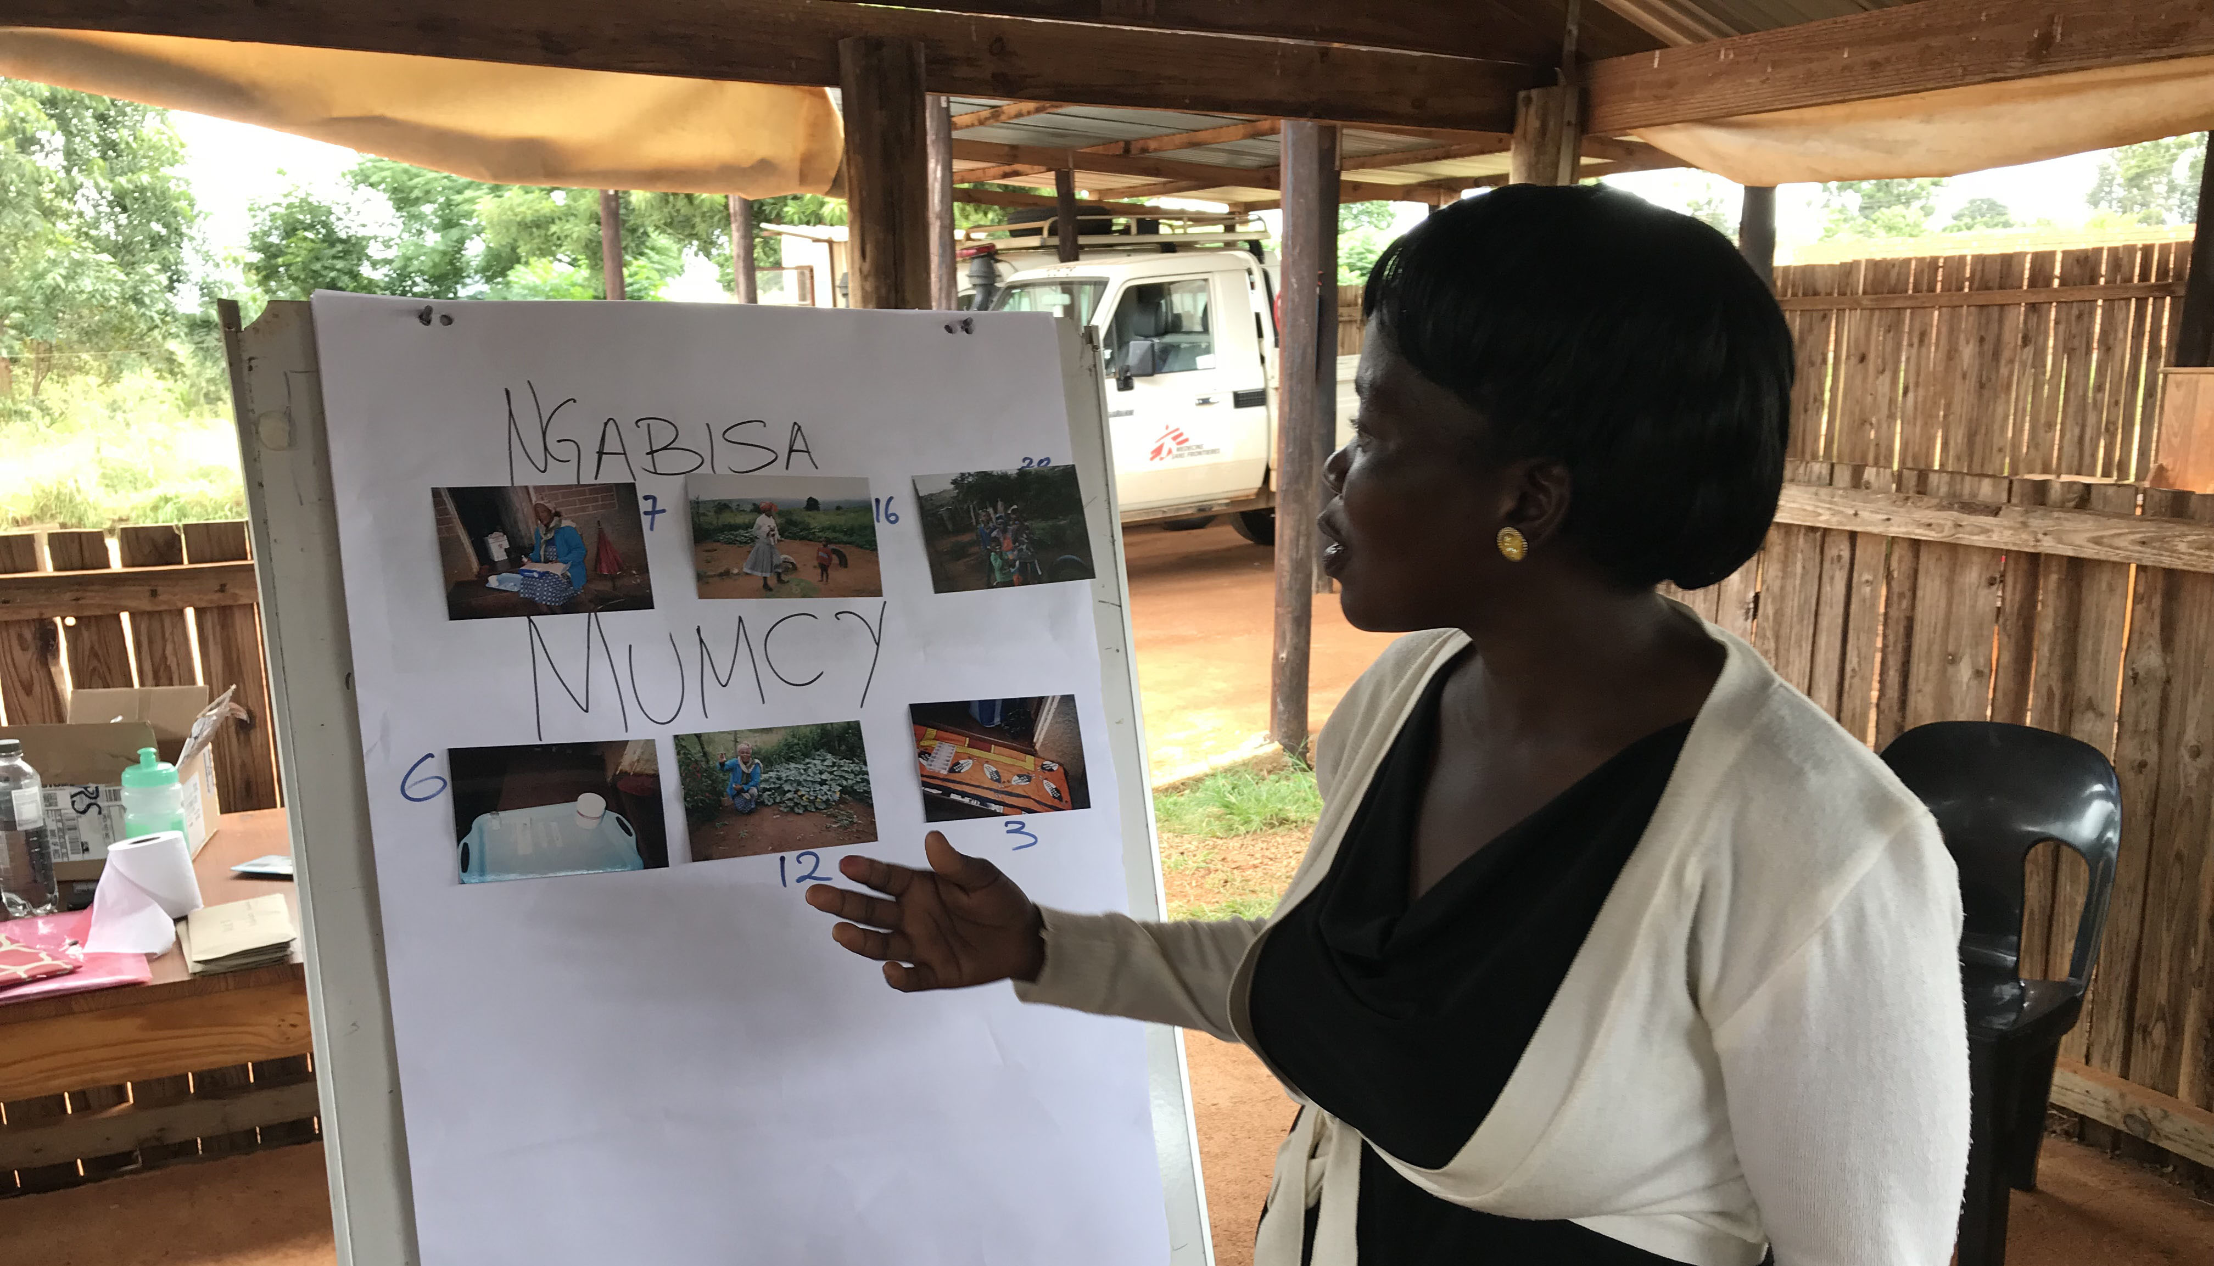
“She is like my mother”
The role of community treatment supporters in treatment for drug-resistant tuberculosis, rural Eswatini
Doris Burtscher¹, Debrah Vambe², Pia Juul Bjertrup³, Velibanti Dlamini³, Nqobile Mmema³, Siphiwe Ngwenya², Barbara Rusch⁴, Bernhard Kerschberger³
¹MSF/Vienna Evaluation Unit, Vienna, Austria, ²National Tuberculosis Control Program (NTCP), Manzini, Eswatini,
³MSF, Mbabane, Eswatini, ⁴MSF, Geneva
Introduction
The WHO recommends clinic- and community-based care models for DR-TB care provision. In community-based care, treatment is provided in the community by nurses or trained lay cadres. In southern Eswatini, DR-TB patients with access constraints to health facilities receive community-based DR-TB care since 2009. Lay people living nearby patients' homes, called community treatment supporters (CTS), were trained and compensated for DR-TB treatment provision, including daily intra-muscular injections, daily DOT (directed observed treatment) and psychological support. This study examined whether or not this model of care is supportive to patients and poses any risks or harm.
Methods
The exploratory qualitative research study was conducted in rural Shiselweni (Eswatini) in February 2018. For in-depth interviews (26), focus group discussions (5) and PhotoVoice, as a culturally sensitive participatory method, we identified nine adult DR-TB patients (≥ 18 years) and their CTS enrolled in community-based DR-TB care. One or two family members of each DR-TB patient were interviewed; additionally 16 community leaders took part in group discussions. Data was thematically analysed and manually coded. Codes were generated and main themes extracted. Methodological triangulation of findings enhanced the interpretation.
DR-TB patient explaining her pictures to the other patients and treatment supporters in the Photo-release workshop. Doris Burtscher/MSF.
Positive aspects included emotional support, trust and dedicated, individual care provided by CTS, and many more enabling practical, financial and social factors. An increase of knowledge inside the community and a reduction of stigma were further observed.
The PhotoVoice approach highlighted one theme that was especially important for the patients and the CTS – their relationship. This relationship is profoundly supportive and compassionate and crucial for patients’ motivation to continue and finish treatment and strongly professional for the CTS to do a good job.
Conclusion
This study demonstrates that community-based DR-TB treatment is a supportive model of care for patients with access constraints to health facilities leading to an increase of awareness and knowledge within the communities. This model of care simultaneously illustrates a reduction in stigma because not only do patients get cured but community leaders do witness it.
However, it is essential not to overlook concerns related to social and economic problems within the families and to seriously take into consideration family members’ fears and worries about potential infection risks. To mitigate these anxieties, information and sensitization within the families and constant follow-up of patients is crucial.
The study as a whole was an extremely positive experience for everyone involved. Through the PhotoVoice approach participants became actors and were enabled to view their DR-TB treatment from an external perspective.
“She is like my mother.”
Patients showed their thankfulness and appreciation to their CTS with one seeing her like his mother. The CTS, in turn, thought of themselves as nurses. They were keen to show that they do their job well, are conscientious about what and how they do it and in which way they feel empowered by being a CTS.
Results
DR-TB treatment represents multiple challenges for patients to continue and successfully complete it. All interviewed patients, CTS and a great majority of family members considered the community-based DR-TB treatment model the most supportive and appropriate one. Concerns were mainly related to social and economic problems within the family and infection risks inside the homestead.
Acknowledgements
I would like to thank all the people in Shiselweni region that talked to me and worked with me to make this study possible. Also, I would like to thank the MSF teams in Eswatini as well as at Geneva headquarters and Vienna for their valuable support.
Ethics
Authorisation was obtained from the Scientific and Ethics Committee of the Ministry of Health in Mbabane, Eswatini and the MSF Ethics Review Board. No conflict of interest.

