Slide 1
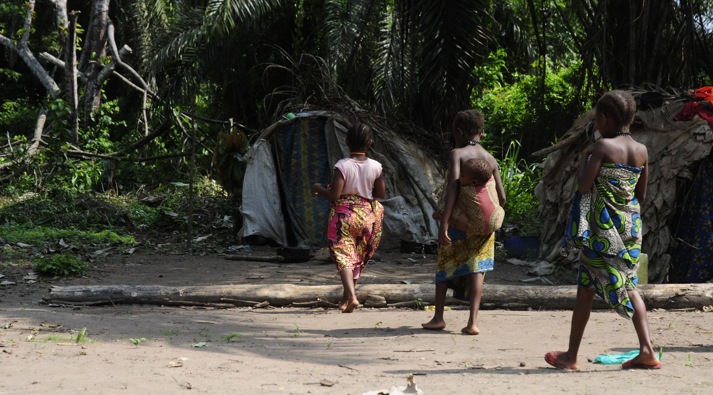
“Better dead than being mocked”
Perceptions and attitudes towards unwanted pregnancy and abortion in the Democratic Republic of Congo, a qualitative study
Doris Burtscher¹, Catrin Schulte-Hillen², Manisha Kumar³, Jean-François Saint-Sauveur⁴, Eva Deplecker⁵, Brice de le Vingne⁵, Emilie Fourrey⁶
¹MSF, Vienna Evaluation Unit/Anthropology, Austria; ²MSF, International Office, Geneva; ³MSF, Kinshasa/BALI, DRC;
⁴MSF, OCBA, Spain; ⁵ MSF, OCB, Belgium; ⁶ MSF, OCP, France.
Introduction
Unwanted pregnancy and unsafe abortion contribute significantly to the burden of ill health, maternal suffering and death in the Democratic Republic of Congo (DRC). A qualitative study was conducted to improve understanding of vulnerabilities of women and girls with health care needs related to unwanted pregnancy and abortions, to better understand their health-seeking behaviour and to identify barriers that hinder women and girls from accessing health care.
Methods
Data was collected in three different areas in DRC: Mweso/North-Kivu, Mambasa/Ituri and Lulingu/South-Kivu, using in-depth individual interviews (124), group discussions (36) and observations. Respondents were purposively selected with the help of MSF team members. The study population was composed of different groups of respondents in and around the three study areas. All interviews were recorded. Transcriptions were screened for relevant information, manually coded and analysed, inspired by qualitative content analysis. Methodological triangulation of findings enhanced the interpretation of data.
Women in a Bambuti camp in Ituri. Doris Burtscher/MSF.
The main reasons for women to abort are related to
culture and community: shame, stigma, especially concerning victims of sexual violence, pregnancy outside of marriage, pregnancy while breastfeeding (in which case termination of pregnancy is socially accepted);
socio-demographics and finances: lack of financial means, marital status, young age, wish to continue studies, high number of children to care for;
unwanted pregnancy resulting from transactional sex or rape by armed groups or within the community;
Contrary to the prevailing critical narrative on abortion, the study highlights a significant demand in all three study sites.
Conclusion
Interviews shed light on the lack of decision-making power women have or are perceived to have regarding their sexuality, in marriage and outside. In marriage the pre-dominant notion is related to the
duty to satisfy the husband’s demands and expectations (sex, children, faithfulness and the acceptance of his lack thereof). Outside of marriage the pre-dominant notions are sexual violence (rape) and social violence (stigma, poverty, isolation from the family), which pushes women and girls into transactional sex as a means for (family) survival and child support.
The Lega proverb “Better dead than being mocked” shows once more how difficult the situation is; women and girls rather risk dying by performing an unsafe abortion than keeping the pregnancy and being mocked for their unwanted or unplanned pregnancy.
“She can have fear of death but she sees: If I stay like that [pregnant], (…) without husband, I can be mocked, it’s better to do like that [abortion]; she does it out of constraint. But she knows well that it is death, (…) but she does it to avoid being ridiculed, being seen badly.” (group discussion men, South-Kivu)
Results
Perceptions and attitudes towards abortion vary across the three study areas.
In North-Kivu abortions are seen as morally reprehensible, contrary to the observations of a widespread practice of abortion.
In Ituri, many see abortions as an appropriate solution for reducing maternal mortality. Despite legal considerations prevailing, women continue seeking abortions, whereas health professionals are hindered providing adequate medical care.
In South-Kivu, people are primarily opposed to abortion due to traditional Lega values combined with legal and religious influences, whereas some tolerance exists towards breastfeeding women.
Acknowledgements
I would like to thank all the people in Ituri, North- and South-Kivu that worked with me and talked to me to make this study possible. Also, I would like to thank the MSF teams in DRC as well as at the different headquarters and Vienna for their valuable support.
Ethics
Authorisation was obtained from the Ethical Committee, University of Kinshasa, Ecole de Santé Publique and MSF Ethics Review Board. No conflict of interest.

