Slide 1
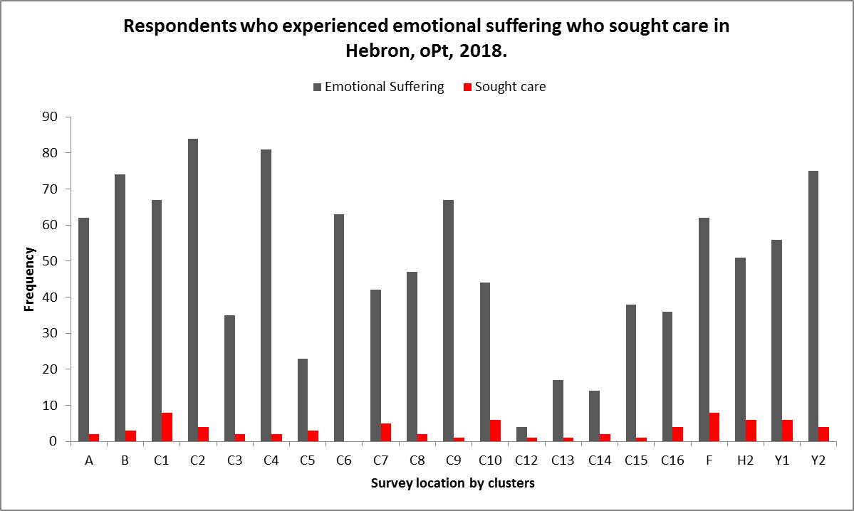
Mental health needs and care seeking behaviour in Hebron, Occupied Palestinian Territory: cross-sectional survey
Sylvia Lim*, Ghassan Aziz*, Maria Cristobal**, Cristina Carreno**
*Center for the Advancement of Humanitarian Medicine (CAHM), MSF-OCBA, Amman, Jordan
**Mental Health Advisor, Medical Department, MSF-OCBA, Barcelona, Spain
Introduction
Results
Five decades of occupation of the Palestinian territory (oPt) have extolled a heavy burden on Palestinians; they continue to suffer the effects of human rights violations, face daily movement restrictions and increased settler-related violence. The protracted conflict has deeply impacted Palestinians and MSF has responded to their resulting health needs since 1988. In addressing mental health needs in the West Bank, MSF-OCBA has been running a Mental Health and Psychosocial programme in Hebron since 2000. Though there were capitalization and other analysis about MSF’s mental health programming in Hebron, little was known about the health status and care seeking behavior of the community the project serves. To fill this gap, MSF-OCBA’s Center for the Advancement of Humanitarian Medicine conducted a Community-based Assessment
in March 2018.
943 Households and 4,868 individuals
surveyed
3,137 respondents aged >15 years
answered mental health questions
33.3%
reported emotional suffering
at least 30 days before the assessment
6.8%
with emotional suffering
sought mental health care
Top reasons
for not seeking
mental health care
Did not know they needed care
73.2%
Did not want others to know about it
13.9%
Did not know of existing services
7.8%
Additional findings
Conclusion
The findings show significant and continuous mental health needs in Hebron at the time of the assessment. In contrast to the needs, mental health care seeking behavior remains low. Reasons provided by respondents for not seeking mental health care point to a low level of mental health wellbeing awareness within the community, and knowledge of where to obtain services. The results also illustrate the strong presence of stigma of mental needs and issues in this context. Findings from this survey can be used to define and develop more integrated and targeted approaches to mental health care in Hebron.
Recommendations
Implement systematic screenings of populations exposed to potentially traumatic events in MSF project.
Increase communication activities and advocacy to raise awareness and sensitization on mental health issues and available services.
Develop more integrated and targeted approaches in awareness raising activities, screenings and counseling for vulnerable populations such as those with disabilities.
Of those reporting emotional suffering, 40% had trouble performing daily activities, sleeping, and/or felt sad, irritable or nervous.
Out of the 21 clusters surveyed, less than one third of those reported emotional suffering sought care. This is particularly evident in Area C6, where none of the respondents who experienced emotional suffering sought help. (See Figure 1.)
Of the group that sought mental health assistance, only 12.2% used MSF services. More than one-third utilized other NGO services while nearly 20% used MoH services.
One third of those who sought help paid for the services.
Thirty-five percent of those who received mental health care reported that they rarely or never felt better after the sessions.
The modular Community-based Assessment, developed by CAHM in 2016, surveys respondents at both the household and individual level. Deployed through mobile devices, the assessment consists of 21 thematic modules such as mortality, food security, reproductive and mental health, and exposure to violence. The modules can be customized according to context and needs.
Methods
A cross-sectional assessment was conducted in the city of Hebron and four refugee camps in the north and south of the city. Participants were randomly sampled using a multi-stage cluster sampling methodology. A standardized questionnaire, which included modules on demographic, non communicable disease, mental health, and access to care, was administered using mobile devices and Dharma, a data collection tool. The questions appeared on the tool in both English and Arabic and the assessment was conducted in Arabic. Data was then analyzed using Excel in order to produce descriptive statistics.
Figure 1. Comparison of respondents who reported emotional suffering versus those who sought mental health care according to the surveyed clusters.
In comparison:
Special group:
Approximately 38% of all individual respondents reported needing health care in the 30 days prior to the survey.
Out of this group, 94% sought medical care, and obtained it through private clinics or
MoH facilities.
Top reasons for seeking care were respiratory conditions, joint diseases, and dental care.
Nearly 38% of the respondents who reported having a disability also reported emotional suffering.
Only one in five persons out of this group reported seeking mental health care.
Top reasons for not seeking care: they did not know where to seek care and did not want others to know about it.

