Slide 1
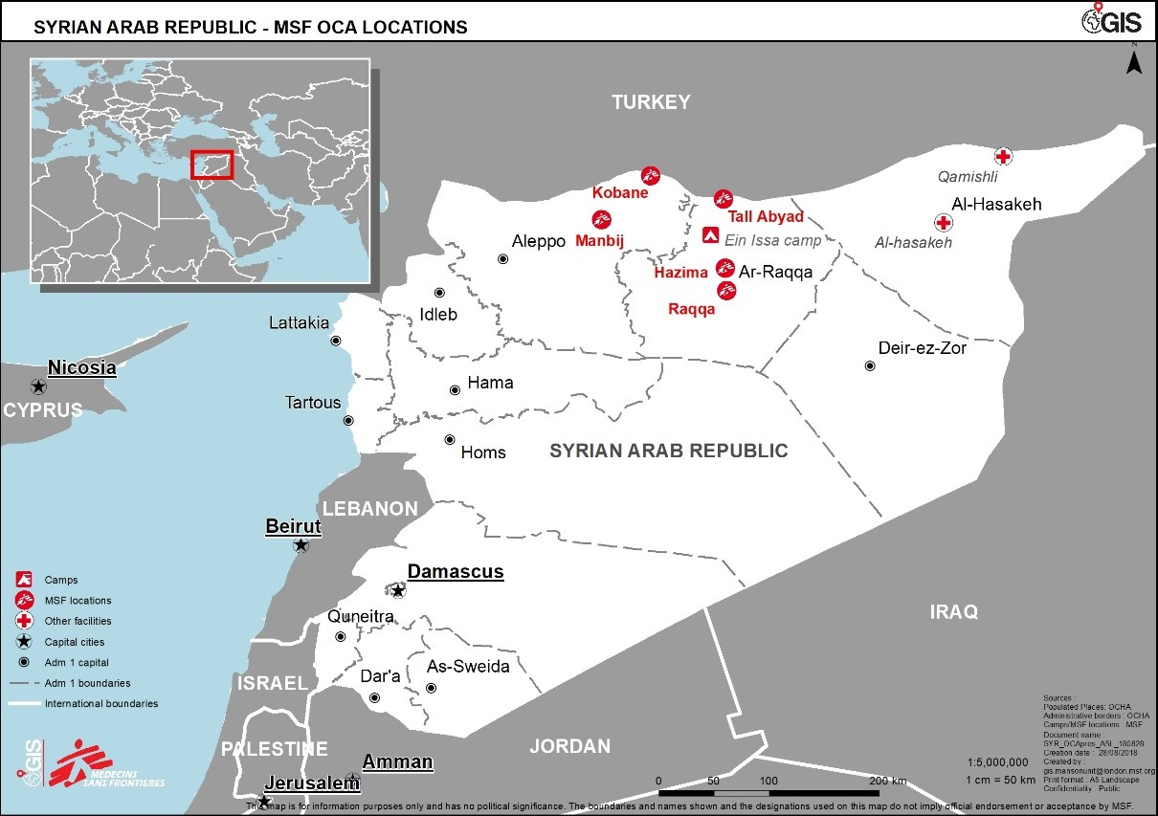
Blast-related injuries from explosive remnants of war in a post-conflict setting, Raqqa, Syria
A retrospective analysis
Jennifer OKeeffe¹, Larissa Vernier¹, Vanessa Cramond¹, Shazeer Majeed¹, Antonio Isidro Carrion Martin^{3,^} , Maartje Hoetjes², Mohana Amirtharajah²
¹ Médecins Sans Frontières, Tal-Abyad, Syria, ² Médecins sans Frontières,, Amsterdam, the Netherlands: ³ Médecins sans Frontières, London, United Kingdom
Background
In June 2017, the U.S-backed Syrian Democratic Forces (SDF) launched a military operation to retake the city of Raqqa, Syria, from the so-called Islamic State. The city population incurred mass numbers of wounded. In the post-offensive period, the population returned to a city (Raqqa) contaminated with improvised explosive devices (IEDs) and explosive remnants of war (ERWs), resulting in a second wave of wounded patients. Médecins Sans Frontières (MSF) supported a hospital in Tal-Abyad (north of Raqqa) and scaled up operations in response to this crisis.
Objectives
To describe the cohort of blast wounded cases admitted to this hospital, in order to understand better their medical needs.
Methods
Table 1. Comparison of blast admissions to Tal Abyad Hospital
Variable (n; %) | Offensive | Post-offensive | p value
Total Cases | 97 (100.0) | 225 (100.0) | <0.001
Female | 31 (32.0) | 25 (11.1) | <0.001
Age <18 | 41 (42.3) | 56 (24.9) | 0.002
Exit Status
Discharged | 79 (81.4) | 164 (72.9) | 0.047
Defaulted | 8 (8.3) | 40 (17.8)
Transferred | 6 (6.2) | 18 (8.0)
Died | 4 (4.1) | 3 (1.3)
Patient Infections | 8 (8.3) | 26 (11.6) | 0.375
Surgical Complications | 17 (7.5) | 40 (4.7) | 0.091
Anaesthetic Complications | 3 (1.3) | 6 (0.7) | 0.287
Variable (Median; IQR) | Offensive | Post-offensive | p value
Injuries/ patient | 1 (1) | 2 (1) | <0.001
Interventions/ patient | 1 (3) | 2 (4) | <0.001
Length of Stay/ patient | 4 (7) | 7 (11) | <0.001
Retrospective data extraction from clinical charts in the MSF-supported hospital.
Included all new admissions for blast-wounded patients with key data elements documented.
Performed comparative analyses from the offensive period (June 6, 2017 to October 17, 2017) and the post-offensive period (October 18, 2017 to March 17, 2018).
Findings
Post-offensive period saw more than twice the number of patients in similar time period (See Figure 1 and Table 1).
Offensive period had a significantly higher proportion of female and paediatric patients.
No significant differences in patient outcomes between periods.
No significant differences in patient infections, surgical or anaesthetic complications between periods.
Post –offensive period included more cases with multiple traumatic injuries.
Post- offensive period cases were more labor intensive with higher median number of interventions and number of days in hospital.
Conclusion
In the wake of the Raqqa offensive, the MSF-supported district hospital received a second, larger and more complex wave of blast-wounded cases as the population returned to a city strewn with IEDs and ERWs.
These findings indicate the high risk of traumatic injury to the population even after warring factions have vacated conflict zones.
Medical humanitarian actors should be prepared for a continued and scaled up response in areas known to be highly contaminated with explosive ordnance.
Acknowledgements
The study team would like to acknowledge the skill, commitment and dedication of the health care
teams at the MSF supported hospital as well as all staff who assisted in the implementation of this research.
Figure 1. Distrubution of new blast case admissions, in the offensive and postoffensive period, by week, Tal Abyad hospital, 2016 -2017.

