Slide 1

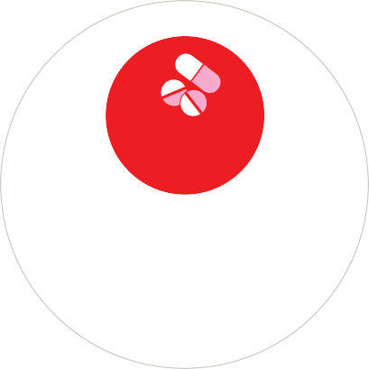
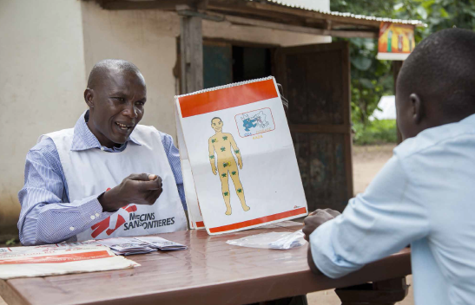
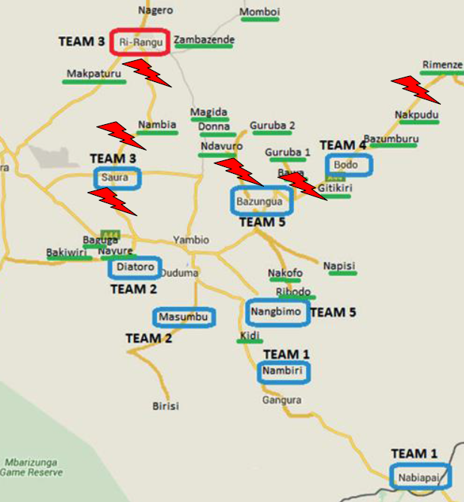
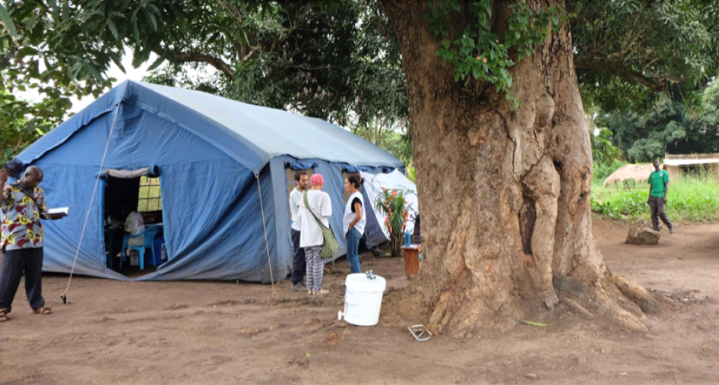
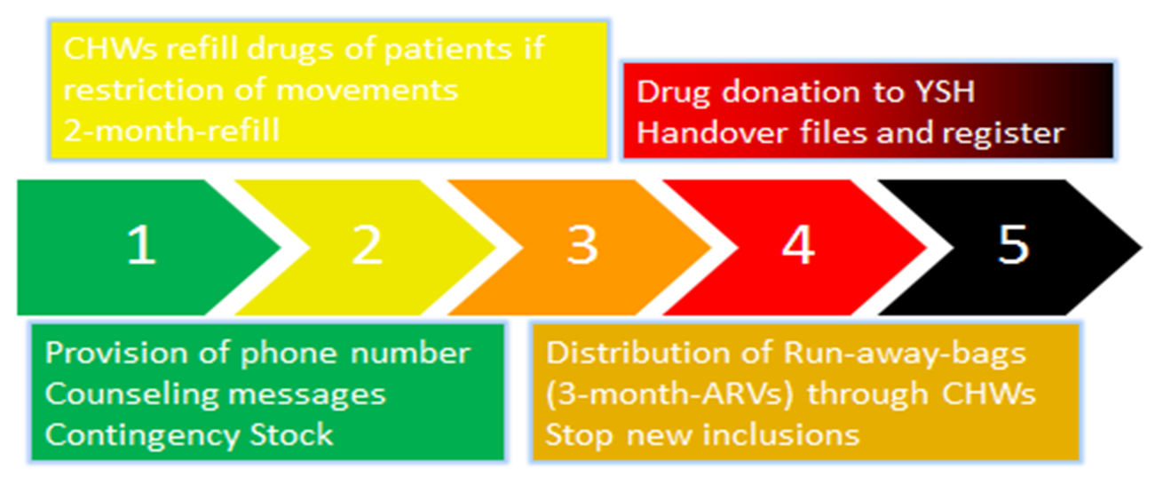
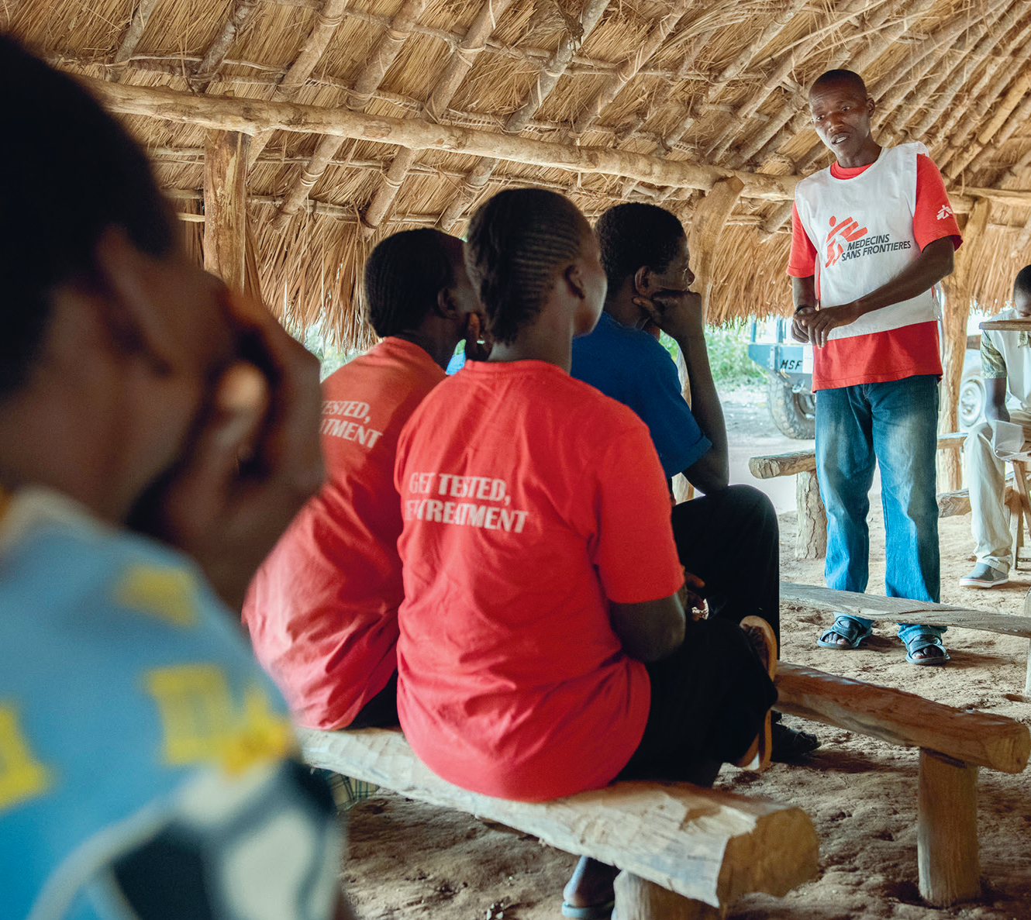
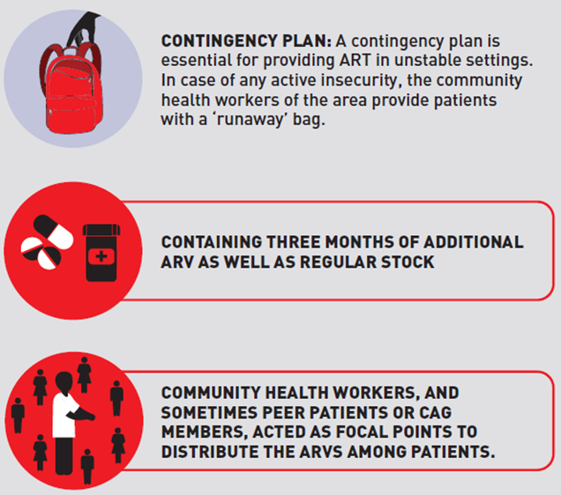
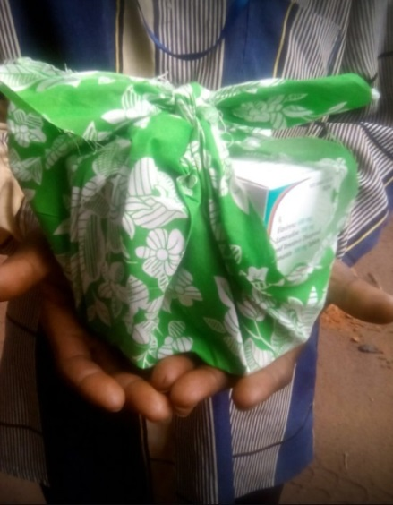
ART in times of war: the MSF Experience in Yambio, South Sudan
Laura Moretó-Planas¹, Beatriz Alonso², Vicente Descalzo-Jorro², Buai Tut², Fara Temessadouno³, Alex Joseph Nyniyal⁴, Mohamed Eltom⁵, Endashaw M Aderie², Cecilia Ferreyra¹
¹Médecins sans Frontières (MSF), Medical Department, Barcelona, Spain, ²MSF, Juba, South Sudan, ³Épicentre, Dakar Unit, ⁴Ministry of Health, Republic of South Sudan, HIV/AIDS/STI, Juba, South Sudan, ⁵MSF, Operational Centre Barcelona, Nairobi Unit
BACKGROUND
METHODS
Programme data from July 2015 to June 2018 was analysed; data on viral load suppression was routinely recorded and patients affected by conflict situations were flagged.
Kaplan-Meier was performed to estimate retention in care (RIC).
2.7%
10%
According to UNAIDS, HIV prevalence in South Sudan was 2.7% in 2017
Only 10% of South Sudanese people and 5% of children living with HIV had access to ART in 2017
Counselling session in Yambio
HIV contingency plan was feasible and had comparable results to HIV programs in stable setting
Innovative strategies are needed in conflict settings to increase access to HIV services while ensuring continuation of ART in case of security deterioration.
OUTCOMES
In 2015, a pilot project of community-based Test & Treat (T&T) was implemented in Yambio with the aim to determine feasibility of the strategy. The project was handed over by July 2018.
Five mobile teams provided HIV counselling and testing and same day ART initiation.
From September 2015 to June 2018, 395 patients started ART. Contingency plan was activated 9 times and provided to 101 patients in 6 different locations with drug refill.
Kaplan-Meier estimated that retention in care (RIC) of patients who were refilled by contingency at 12 and 18 months was 87.8% [79.5 - 92.9%] and 78.3% [78.3 - 85.5%], respectively.
The overall virological suppression for these patients was 90% (81/90).
By end of the study, 3% (3/101) died and 28.7% (29/101) were lost to follow-up.
Mobile clinic in Yambio
A contingency plan (CP) to continue activities in case of deterioration was developed including patients mapping, individual messages about what to do in case of a security crisis and a hotline in case of drug shortage.
Areas with conflict
*
Proportion of RIC
Number of patients
(months)
HIV cascade for patients in CP
Kaplan-Meier for RIC of patients in CP
Phases of the contingency plan (CP). *Yambio State Hospital
CONCLUSIONS
RUNAWAY BAGS
High rates of RIC and virological suppression using the contingency plan suggest that community based T&T services are feasible and suitable for conflict affected population with sufficient anticipation.
The outcomes of patients who underwent CP were comparable to HIV program outcomes in non-conflict settings. Contingency plans should be available for patients with chronic conditions in war settings.
CP included coordination with community health workers and patients associations to provide ART refill and “runaway bags” with 3 months of ART.
For questions or comments contact: laura.moreto@barcelona.msf.org
Or check out: www.msf.org/yambio-test-and-treat
Community ART group in Yambio
Run away package
AKCNOWLEDGEMENTS
All PLWHIV who participated of the study
MSF team in Yambio and Juba
MoH of South Sudan

