Slide 1
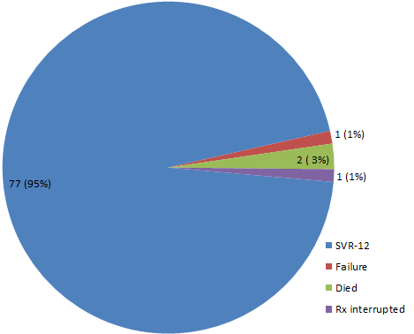
Opiate addiction and hepatitis C in Nairobi: good treatment outcomes despite fragmented care
W Kizito¹, A Thiongo¹, Y Nzomukunda1, A Maina¹, K Khaballa¹, A Lukhwaro², M Murage², A Loarec³, D Donchuk⁴, T Ellman⁴.
¹Médecins Sans Frontières (MSF), Nairobi, Kenya; ²Médecins Du Monde, Nairobi, Kenya; ³Epicentre, Paris, France; ⁴MSF, Cape Town, South Africa.
Background
Results
Injecting drug use is a key risk factor for transmission of Hepatitis C virus (HCV) and HIV.
Data on HCV among People who inject drugs (PWID) in sub-Saharan Africa (SSA) are limited and care programs for PWID are almost non-existent.
We describe outcomes from HCV treatment program for former and current PWID in a primary care setting in Nairobi, Kenya.
Demographic and Clinical Characteristics for those who initiated treatment
  Male gender 72 (89%)
  Median Age 37 years (IQR 32-42)
  Current injectors 16 (21%)
  HIV infection 35 (43%)
  On Methadone therapy 56 (72%)
Methods
Of the current injectors, 5 (31%) were on MAT.
Design
Retrospective analysis of routine operational data.
Study population
All PWID screened for HCV infection between 2014 and 2018 in MSF and MDM supported facilities.
Description of model of care [Fragmented Care]
MSF offered HCV treatment to PWID in Kibera health centre, Nairobi and later at a Drop in Centre (DIC) west of the city. PWID also travelled to clinics in eastern Nairobi for medically assisted therapy (MAT) for Opioid dependence using Methadone, for mental health, HIV and TB care. After screening, HCV patients with confirmed chronic hepatitis C (CHC) received Sofosbuvir and either Daclatasvir or Ledipasvir for 12 weeks. MAT and CHC treatment were administered under daily supervision but the facilities did not share patients medical information for continuity of care.
Efforts were made to encourage adherence including reimbursement of transport and tracing for missed appointments using peer educators.
DAA Outcomes
Of the patients who achieved sustained virological response 12 weeks after completion of treatment (SVR-12), 53 (69%) were on MAT.
Results
Conclusion
124 PWIDs tested positive for Hepatitis C antibodies.
95 (77%) Confirmed chronic Hepatitis C (PCR positive).
81 (85%) initiated for HCV treatment with direct acting antivirals (DAA).
Despite fragmented care the project managed to achieve good treatment outcomes highlighting the fact that:
Excellent outcomes can be achieved from HCV treatment delivery at primary care among both current and former drug injectors.
Fragmented care is a major challenge to care delivery among this high risk but neglected group.
Hepatitis C treatment and MAT remains unavailable in most resource limited settings.
Urgent need to have a full package of harm reduction services and treatment delivery at a single point.
Screening
Predominant Hepatitis C genotypes
  1a ( 41, 51%)
  4 (23, 28%)
Acknowledgements
PWIDs in Nairobi, MDM and MSF staff in Nairobi, National AIDS & STI Control Programme , all partners and collaborators

