Slide 1
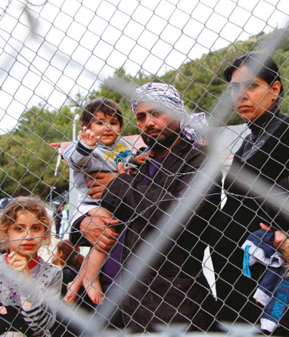
Social support systems among asylum seekers in a mental health care programme, Lesvos Island, Greece
Maria Episkopou¹, Emilie Venables^{2,3}, Katie Whitehouse², Christos Eleftherakos¹, Federica Zamatto⁴, Francisco de Bartolome Gisbert⁴, Nathalie Severy⁵, Declan Barry¹, Rafael Van den Bergh²
¹Médecins Sans Frontières-Operational Centre Brussels, Athens, Greece, ²Médecins Sans Frontières-Operational Centre Brussels, Luxembourg Operational Research Unit, Luxembourg, Luxembourg, ³Division of Social and Behavioural Sciences, School of Public Health and Family Medicine, University of Cape Town, Cape Town, South Africa, ⁴Medical Department, Médecins Sans Frontières-Operational Centre Brussels, Rome, Italy, ⁵Medical Department, Médecins Sans Frontières-Operational Centre Brussels, Brussels, Belgium.
Contact: episkopoumaria@msn.com
Social support helps you endure or overcome difficult situations in your life. What people understand as social support is different because of their varying experiences.
Introduction
Introduction
Results
MSF has provided medical and mental health services to migrants and asylum seekers on Lesvos Island, Greece since 2015.
Following the EU-Turkey statement, new arrivals on Lesvos are held on the island, most of them in Moria camp, until their legal or administrative processes have
been completed.
MSF has been overwhelmed by the challenges of delivering mental health care, which has been exacerbated by compromised social support.
We conducted this study to explore how migrants and asylum seekers understood and defined social support, and how they perceived their needs to be met.
Free-listing interviews defined social support as practical, informational, emotional support, meaning-making and informational support. The importance of actors such as NGOs, friends, family and community were underlined as sources of social support.
Conclusions
The multidimensional challenges that participants face on Lesvos include poor service provision, lack of community and challenges with personal relationships. These lead to and amplify isolation, discrimination and tensions.
Migrants and asylum seekers in the camp have varied needs which often remain unmet. Increasing the capacity of services could reduce tensions and competition for
scarce resources.
Actors involved in providing social support, including MSF, are strongly encouraged to engage in activities that work towards building and strengthening peer support networks, creating community support rather than top down support.
Methods
This qualitative study with migrants and asylum seekers incorporated sequentially conducted free-listing interviews (n=31) and in-depth interviews (n=17) with participants enrolled in MSF’s mental health programme on Lesvos Island, Greece.
Convenience sampling was used to recruit participants. All interviews were conducted in English, French, Farsi and Arabic and were analysed using a thematic approach. Free-listing involved asking study participants to define ‘social support’ in their
own words.
Table 2: Categorization of the responses from the free-listing interviews in terms of forms of social support
Theme 1: availability and accessibility of services
Participants stressed how poor quality services and the barriers to accessing certain types of formal social support within and outside the camp had a negative influence on their lives. Discussions involved the problems created by the lack of formal information and orientation about available services (including medical and legal assistance), their rights and the procedures. Language was also a challenge for those trying to access services.
At the beginning I didn’t know who to speak to. I didn’t know that I needed a lawyer. Some people told me that there are lawyers here and I visited one of them, it was very difficult. I contacted five lawyers but it was still difficult to have an appointment. Male, 18, Afghanistan
Country of Origin | Male | Female
Cameroon | 4 | 2
DRC | 3 | 2
Syria | 1 | 3
Afghanistan | 3 | 1
Iraq | 2 | 2
Iran | 2 | -
Nigeria | 2 | -
Cote d‘ Ivoire | 1 | -
Ghana | 1 | -
Senegal | 1 | -
Mali | 1 | -
Togo | 1 | -
The social assistant is polite but the problem is that we don’t understand each other. She speaks and I don’t understand, I speak and she doesn’t understand.
Female, 20, Cameroon
Theme 2: personal relationships and informal networks
Feelings of isolation, exclusion and stigmatisation were described. Sometimes this was linked to their mental health problems, with others described spending time on their own. Differences between nationalities and heterogeneity amongst people from the same country of origin caused tensions that did not foster a sense of cohesion.
©Mohammad Ghannam, 2017, MSF Source: msf.gr
Acknowledgements
We thank our colleagues from MSF Lesvos Project, especially Ms Giovanna Bonvini, Mental Health Activity Manager, and the translators including Mr Ahmed Al-Humadi and Ms Evi Papakonstantinou who assisted with the interviews. We thank the study participants for sharing their experiences and stories with us. This research was conducted through the Structured Operational Research and Training Initiative (SORT-IT).
Table 1: Participant demographic characteristics
I don’t know people there. They tell me that I often wet the bed, I often scream during the night, that’s what they say. They also say that I’m crazy, that I’m out of
my mind. Male, 42, DRC
During the free-listing exercise, participants created lists of the forms of social support that were most important
to them.
Every day we have problems with each other. We are very different from each other. We are not like [other nationalities] who are similar to each other. Among [ourselves] here we have people from different economic, cultural and social ranks. Male, 32, Iran

