Slide 1
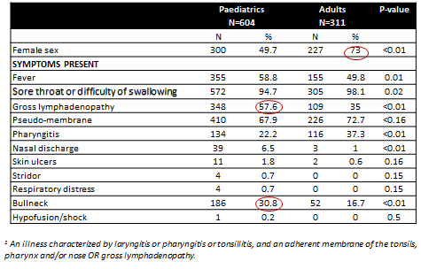
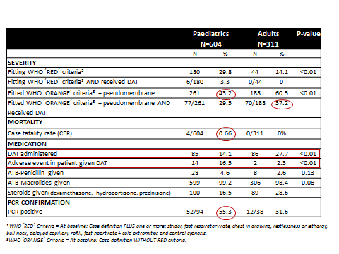
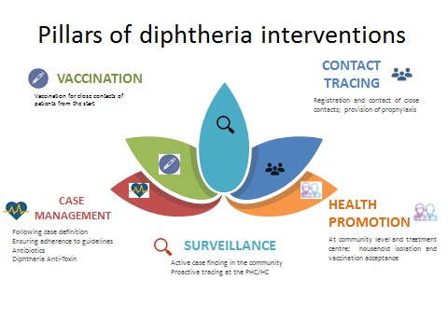
Diphtheria in an emergency outbreak setting: a clinical and epidemiological analysis for children and adults, Bangladesh
¹Enam Sikder, ¹Beatriz Valle del Barrio , ¹Wasim Firuz, ¹Rabeya Khatoon, ¹Astrid Opstrup, ²Mª José Sagrado, ²Miriam Alía Prieto, ²Nadia Lafferty, ¹Raman Mahajan, ¹Rezwanur Rahman Masum, ¹Jessica Patti, ²Sakib Burza
¹Medecins Sans Frontières, Cox Bazar, Bangladesh, ²Medecins Sans Frontières, Barcelona, Spain
Background
Clinical and treatment features of diphtheria cases
Diphtheria outbreaks are rare
Limited evidence on differences in clinic-epidemiological presentation and evolution between children /adults
Patients treated by OCBA between 11th December 2017 and 15th February 2018 in the Rohingya emergency
DTC opened on the 11th December 2017
DAT available in the DTC from 26th December.
Vaccination targeted at only those <15 yrs
Aim
To assess the differences in clinico-epidemiological presentation and evolution between children and adults
Methods
Data source: Indicator based surveillance of diphtheria data of patients presenting at the DTC
Study population: All admitted patients in DTC
Age classification:
  0-14 years of age: Paediatric population
  ≥15 year of age: Adults
Study period: Dec 2017 – Feb 2018
Total number of patients included: 915
Clinico-Epidemiological outcomes were compared using Chi Square
Conclusions
34% of treated patients were aged ≥15 yrs
DAT was available only after 42% of the patients had been treated
Children more likely to be classified as high priority for DAT
However, ↑ proportion of adults were treated with DAT
PCR ↑ positivity in children, but low overall
Limited patients indicated for DAT as per WHO criteria received it
However outcomes were good regardless of DAT administration
DAT adverse events were rare, but more frequent in children
No reported deaths in adults, very few in children
.
Limitations and further questions…
Results: Epidemic curve of diphtheria: paediatric vs adults
Low correlation between patients receiving DAT and WHO guidance reflects various challenges in the outbreak response.
Impact of DAT considering the no difference in CFR or long term outcomes pre and post introduction?
Misdiagnosis/over-diagnosing diphtheria due to lack of expertise?
A higher proportion of adults received DAT treatment in a context where non-protected adults proportions were expected to be high.
Pre-emptive adult vaccination in similar contexts where vaccination rates are very low in children and many non-protected adults?
Ethics
This research fulfilled the exemption criteria set by the MSF ERB for a posterior analyses of clinical data.

