Slide 1


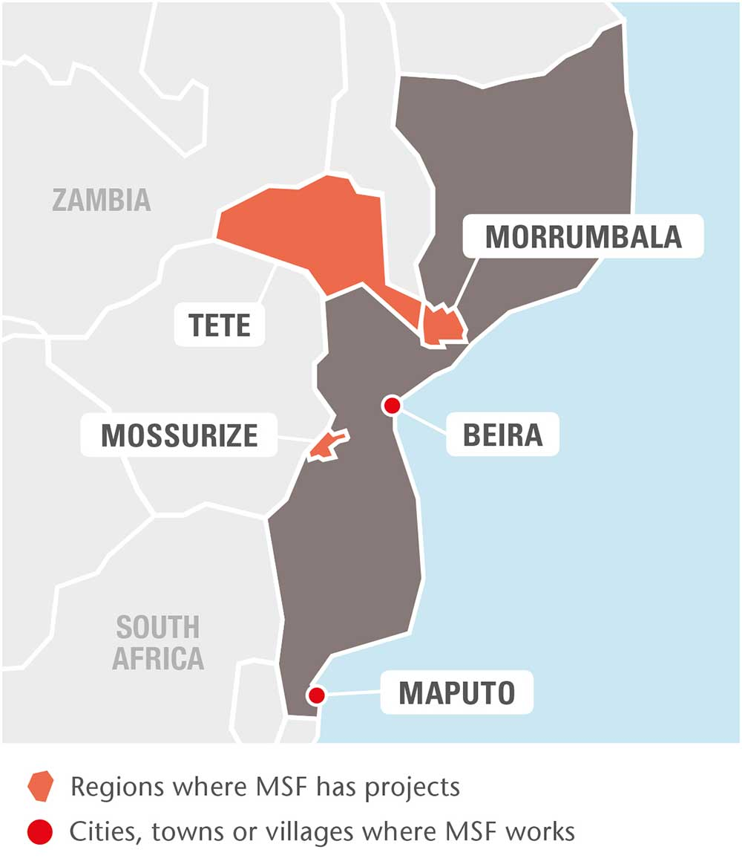
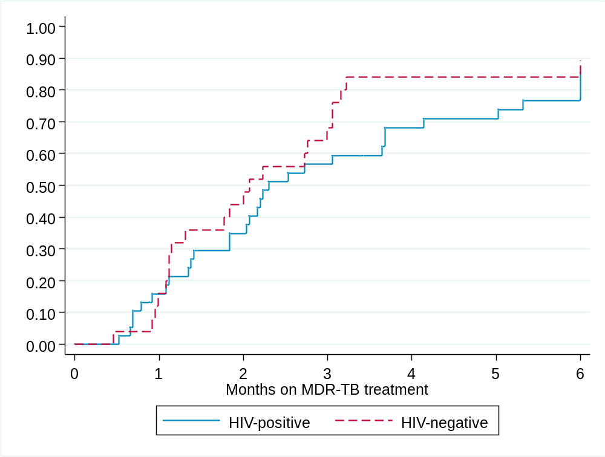
Culture conversion and treatment outcomes of a short standardized regimen for multidrug resistant tuberculosis patients in Mozambique
Mathieu Bastard¹, Elisabeth Poulet¹, Cesar Moreira², Deise Vaz², Ivan Mahinça³, Barbara Rusch⁴, Lucas Molfino², Alex Telnov⁴
¹ Epicentre, Paris, France, ² Médecins Sans Frontières, Maputo, Mozambique, ³ Ministry of Health, Maputo, Mozambique,
⁴ Médecins Sans Frontières, Geneva, Switzerland
Background
Results
Mozambique is a country with a high prevalence of both HIV and TB (WHO 2016):
  HIV prevalence among adults: 12.3% [10.6% - 13.9%]
  TB incidence: 551/100000 (356-787)
Estimated % of TB cases with MDR/RR-TB
  3.7% (2.4 – 5.0) among new cases
  20% (2.1–37) among previously treated
Patients characteristics (N=150 patients included)
 | HIV-negative (N=55) | HIV-positive (N=95) |  | p-value |  | Total N(%)
Gender Male Female | 37 (67.3) 18 (32.7) | 49 (51.6) 46 (48.4) |  | 0.061 |  | 86 (57.3) 64 (42.7)
Age Median [IQR] <35 ≥35 | 26 [22 – 35] 41 (74.5) 14 (25.5) | 33 [30 – 42] 49 (52.1) 45 (47.9) |  | <0.001 |  | 32 [25 – 40] 90 (60.4) 59 (39.6)
BMI Median [IQR] <18 kg/m2 ≥18 kg/m2 | 18.4 [16.4 – 19.6] 25 (45.4) 30 (54.6) | 17.6 [16.4– 19.9] 50 (53.2) 44 (46.8) |  | 0.756 |  | 17.9 [16.4 – 19.8] 75 (50.3) 74 (49.7)
DST at initiation
Z resistant (N=78) | 17 (54.8) |  | 25 (53.2) |  | 0.886 | 42 (53.8)
Km resistant (N=74) Cm resistant (N=74) | 0 0 |  | 1 (2.2) 0 |  | - | 1 0
Ofx resistant (N=74) | 3 (10.3) |  | 4 (8.9) |  | 0.835 | 7 (9.5)
Short standardized course (DR-SSC) for the treatment of MDR-TB
Based on observational cohorts in Bangladesh, and Western Africa, WHO made a recommendation to use short standardized regimen as a treatment option for patients resistant to R and H but still sensitive to all other drugs of the regimen, also mentioning that role of the SSR in treatment of HIV-positive patients is unclear
Recent results of the Stage 1 STREAM trial shows very comparable success rates between shortened regimen and individualised 24 months regimen, although failed to demonstrate formally non-inferiority
A SSC MDR-TB treatment regimen was prescribed under routine program conditions in this context of high TB prevalence and high HIV co-infection rates, and consisted of:
  Intensive phase: Pyrazinamide + Ethambutol + Isoniazid + Moxifloxacin + Kanamycin + Prothionamide + Clofazimine for at least 4 months and until one negative culture documented with a maximum of 6 months duration
  Continuation phase: Pyrazinamide + Ethambutol + Moxifloxacin + Prothionamide + Clofazimine for 5 months
51 (53.7%) of HIV-positive were already on ART at MDR-TB treatment initiation
Median time of ART: 7.8 months [IQR 1.2-52.7]
Median CD4 count: 226 cells/μL [IQR 115-348]
Culture conversion: 63 patients eligible for this analysis
 | Culture conversion at month 6, n(%)
Overall (N=63) | 49 (77.8)
HIV Negative (N=25) Positive (N=38) | 21 (84.0) 28 (73.7)
Ofx resistance Susceptible (N=46) Resistant (N=4) | 36 (78.3) 2 (50.0)
Z resistance Susceptible (N=26) Resistant (N=25) | 22 (84.6) 16 (64.0)
p=0.454
Methods
Design and population
METHODS
Culture conversion according to HIV status
Design
  A prospective interventional non-controlled cohort study in Maputo
Population
  Patients with active pulmonary tuberculosis or case of PTB and EPTB disease diagnosed as rifampicin resistant by Xpert MTB/RIF and phenotypical DST, or children suspected of MDR-TB without bacteriological confirmation but documented as a close contact of a patient with confirmed MDR-TB
Treatment outcomes: 63 patients eligible for this analysis
 | Success n (%) | Death n (%) | Failure n (%) | LFU n (%)
Overall (N=63) | 45 (71.4) | 6 (9.5) | 7 (11.1) | 5 (7.9)
HIV Negative (N=22) Positive (N=41) | 18 (81.8) 27 (65.9) | 0 6 (14.6) | 2 (9.1) 5 (12.2) | 2 (9.1) 3 (7.3)
Ofx resistance Susceptible (N=39) Resistant (N=4) | 28 (71.8) 1 (25.0) | 4 (10.3) 0 | 4 (10.3) 3 (75.0) | 3 (7.7) 0
Z resistance Susceptible (N=23) Resistant (N=21) | 16 (69.6) 14 (66.7) | 3 (13.0) 1 (4.8) | 2 (8.7) 5 (23.8) | 2 (8.7) 1 (4.8)
Exclusion criteria
  History of prior anti-TB treatment with second line drugs for one month or more
  Patients with probable or proven involvement of meninges or bones
  Baseline contraindications to any medications
  Patient in an advanced stage of a concomitant disease not suitable for anti -TB treatment
  Pregnancy or breastfeeding
Among HIV-positive patients, 6 died:
• 3 died < 1 month of treatment: 1 not on ART and 1 received ART < 1 month
• 3 died after 6 months of MDR-TB treatment
• Median BMI: 19.1 kg/m2 [IQR 17.0-22.0]
Secondary exclusion
  Phenotypic DST doesn't confirm the initial rifampicin resistance result
  Patient harbour strains resistant to injectable agents and fluoroquinolones (XDR-TB)
  Patients resistant to fluoroquinolones and patients who harbour strains resistant to both injectable agents (Km and Cm) will continue the DR-SSC regimen if, once the DST results are available, their clinical condition has improved compared to baseline, otherwise withdrawn
Discussion
High rate of culture conversion and higher success rate than the conventional MDR-TB treatment are reported
HIV-positive patients seem to have a lower success rate mainly due to a higher death rate and a slightly higher failure rate
High proportion of treatment failure among fluoroquinolone-resistant patients stresses the need to use rapid molecular testing in order to adapt their treatment and exclude them from the shortened regimen
Analysis
Culture conversion (two consecutive negative cultures) at 6 months of treatment stratified by HIV-status and baseline resistance profile
Treatment outcomes of the first patients enrolled in the study stratified by HIV-status and baseline resistance profile
Acknowledgments
Nadia Safar: TB doctor in Maputo
Michael Rich, Philipp du Cros and Elisabeth Nunes: Scientific committee
Natercia Madeira: data manager

