Slide 1
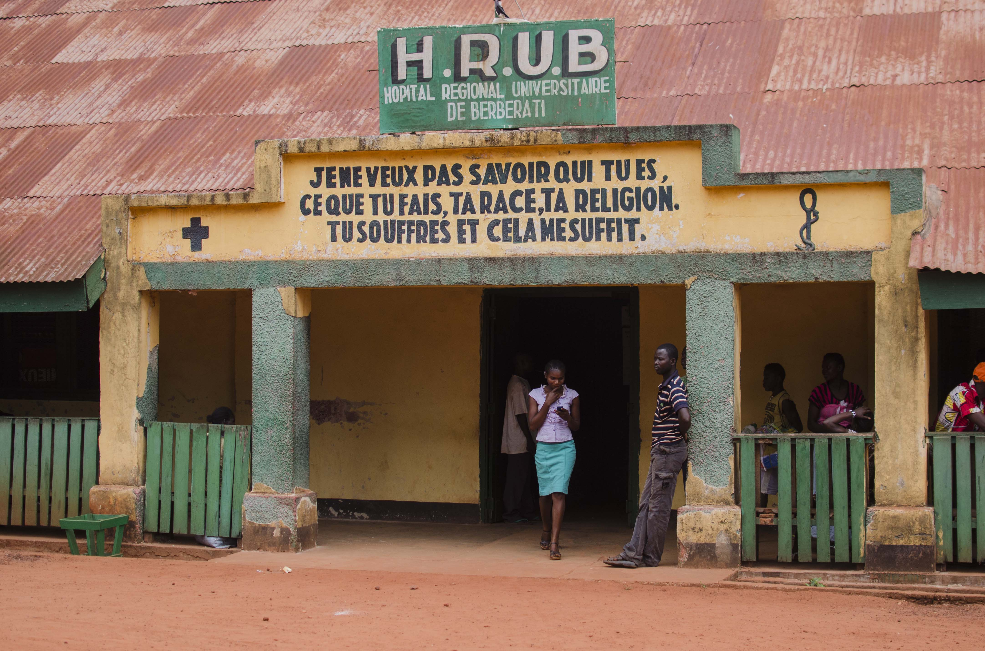
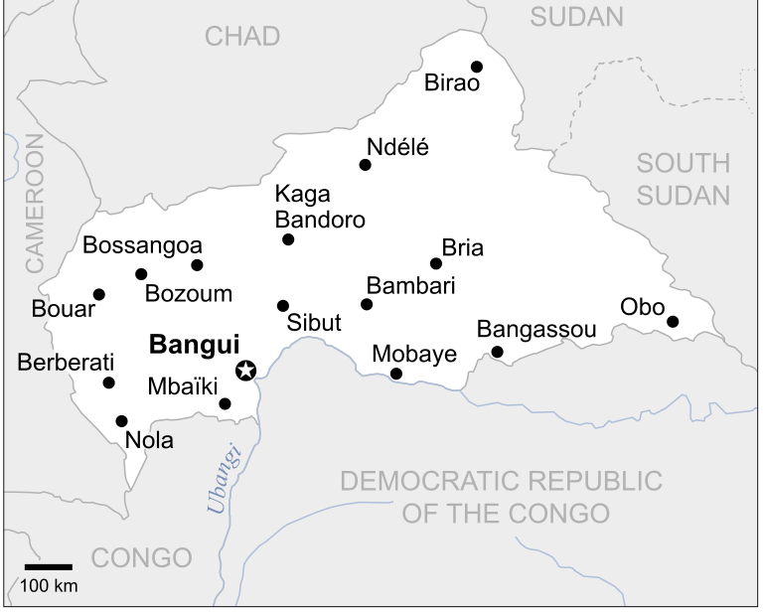
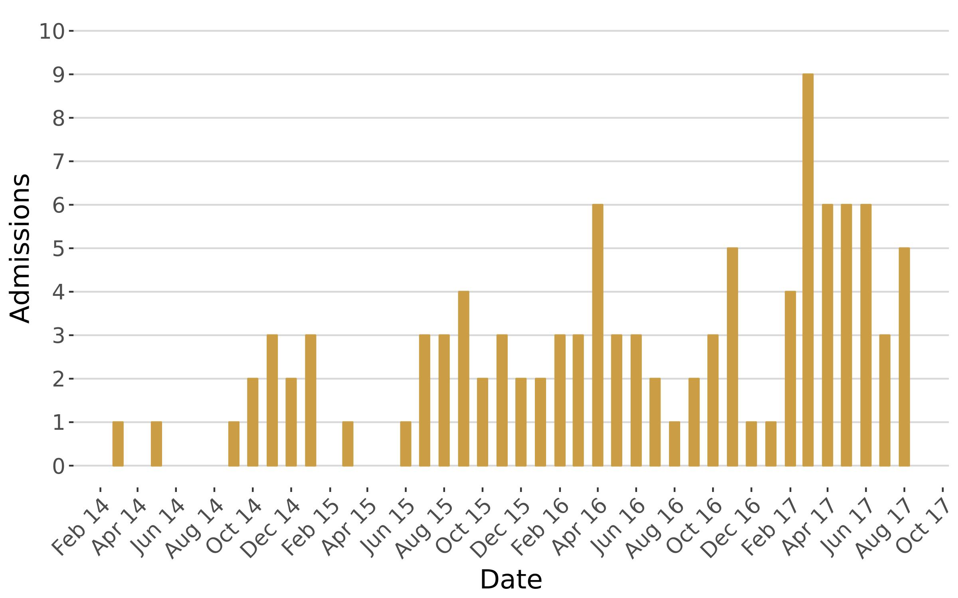
Neonatal Tetanus in Central African Republic: A neglected tragedy
Papadimitriou V^{1,2}, Ciglenecki I¹, González A¹, Macher E¹, Martínez García D¹, Albela Miranda M¹.
¹ Médecins Sans Frontières (OCG), Geneva, Swizerland, ² Hôpitaux Universitaires Genève, Geneva, Switzerland
Background
Neonatal tetanus is a life threatening condition caused by contamination of the umbilical cord in infants born to mothers with inadequate immunization against tetanus.
In 1999 UNICEF, WHO and UNFPA launched the Maternal and Neonatal Tetanus Elimination (MNTE) Initiative. Since then, Maternal and Neonatal Tetanus has been eliminated in 44 countries. Unfortunately, by December 2017, 15 countries still reported neonatal tetanus cases. Central African Republic (CAR) is among them.
Case fatality rate can be up to 90% without treatment
Aurelie Lachant/MSF
CAR is one of the poorest countries in the world and it has been suffering a violent conflict since 2012, displacing more than 1,1 million people. No numbers or estimations have been published regarding the fatalities.
Médecins Sans Frontières (MSF) has been supporting the Pediatrics and Neonatology services of the Hôpital Universitaire de Berberati (HRUB), in the west part of the country, since 2014.
Main entrance to the Hôpital Regional Universitaire de Berberati (HRUB). The text reads: “I do not need to know who you are, what do you do, your race, your religion. You suffer, that is enough to me”
This analysis is based on the neonatal tetanus cases that we have managed in the Neonatology ward from the start of our activities until the closure of the project.
UNOCHA. Creative Commons (CC BY 3.0)
Results
Methods
Design: Retrospective review of the individual patient files
Population: All suspected cases of neonatal tetanus admitted to the HRUB
Site: MSF supported hospital – HRUB
Period: Between March 2014 and August 2017.
Procedure: Severity was graded according to Dakar score , which includes factors such as incubation period, period of onset, entry site, spasms, fever and tachycardia for its calculation. The descriptive analysis was followed by a logistic regression analysis used to assess potential associations between the risk factors and mortality.
106 cases were included in the analysis
62 patients died (58.5%)
Incubation period (time from infection to first symptom) of less than 7 days increased the mortality
Dakar Score works as a good predictor mortality
The presence of trismus was associated with a increase on survival
Increased weight at admission showed a protective effect for patients
This is one of the biggest cohort of neonatal tetanus patients that has been reported. And this is still happening today
Number of admissions per month of neonatal cases in the HRUB
What has MSF done
MSF conducted a 3-round mass tetanus vaccination campaign targetting women in reproductive age.
Conclusions
Acknowledgements
We would like to thank the MSF teams in Berberati as well as all the health authorities who are doing their best to manage this situation among many other problems that the country is facing
Tip of the iceberg: Hospital based analysis. There may be more cases that don’t make it to the hospital
Raise awareness: We described one of the largest cohorts of neonatal tetanus cases from a single hospital found in the literature
Call for action:
        Increase rates of maternal tetanus immunization
        Neonatal tetanus cases should trigger reactive vaccination campaigns
        Improve the access to safe deliveries and clean cord practices
        Increase awareness about this life-threatening condition and how to prevent it

