Slide 1



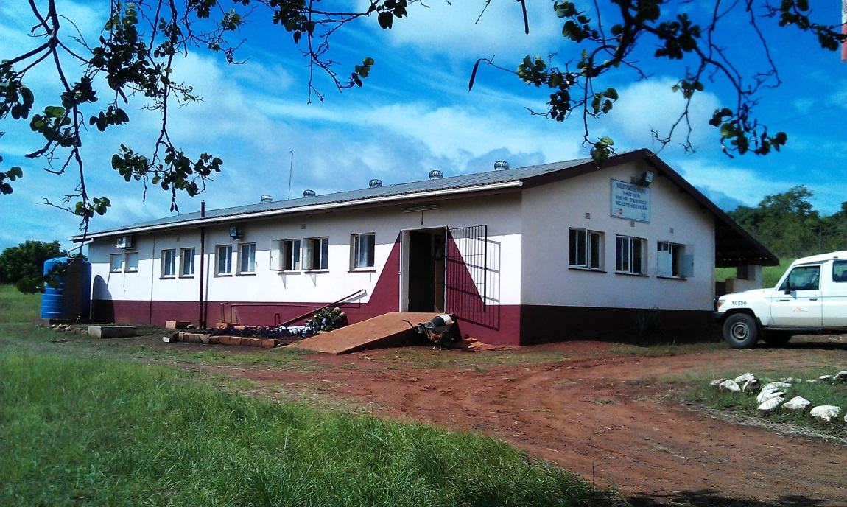
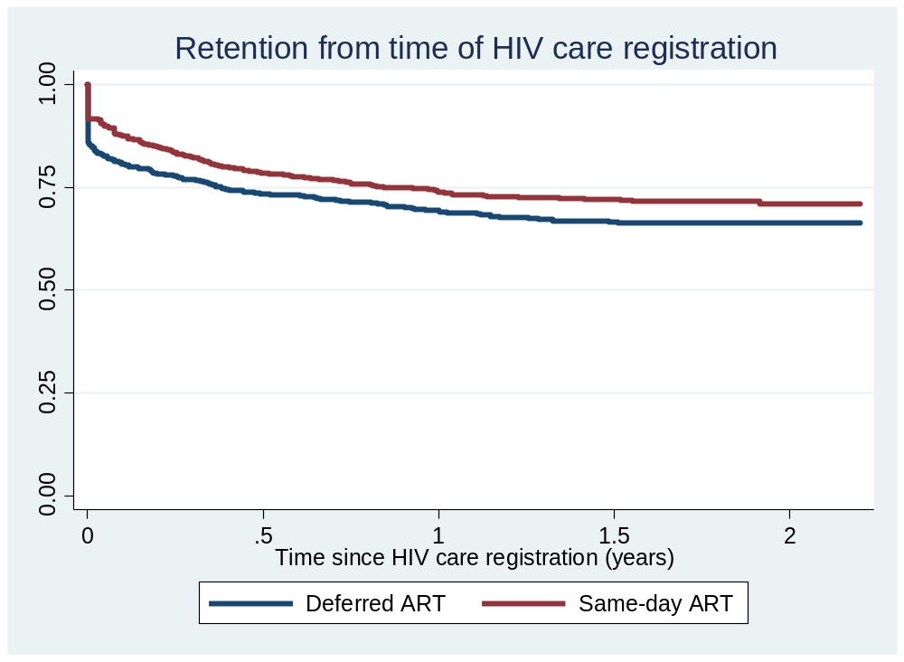
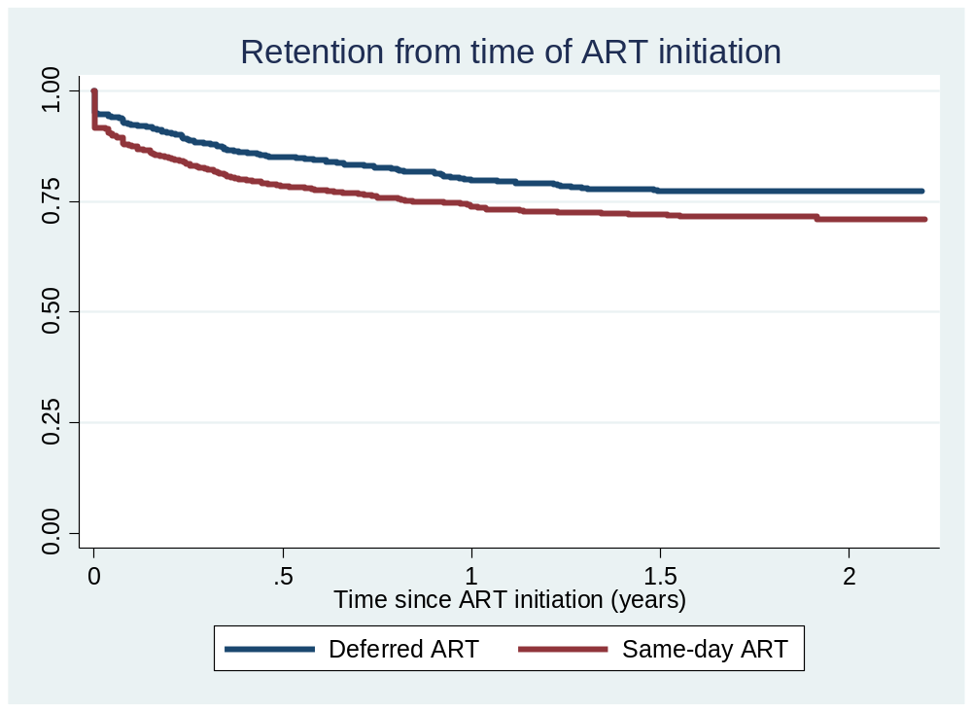
Feasibility of same-day ART initiation
under the WHO treat-all approach
in the public sector of Swaziland
Bernhard Kerschberger¹, Robin Nesbitt¹, Qhubekani Mpala¹, Charlie Mamba¹, Edwin Mabhena¹, Serge Mathurin Kabore¹,
Munyaradzi Pasipamire², Alex Telnov³, Barbara Rusch³, Iza Ciglenecki³
¹Medecins Sans Frontieres (OCG), Mbabane, Swaziland. ²Swaziland National AIDS Program (SNAP), Ministry of Health, Mbabane, Swaziland.
³Medecins Sans Frontieres (OCG), Geneva, Switzerland
Corresponding author: Bernhard Kerschberger; bernhard.kerschberger@gmail.com
Presented at MSF Scientific Day 2018 in London & Mbabane Swaziland.
Background
Results
  Since 2017 WHO recommends rapid antiretroviral therapy (ART) initiation, with the possibility of prompt ART initiation on the day of HIV diagnosis.
  Yet, feasibility in resource constrained settings is unclear.
  Swaziland has the highest HIV prevalence globally (27% for ≥15 years old; SHIMS-2).
  The Ministry of Health and Médecins Sans Frontières (MSF) have scaled up HIV-TB care at primary and secondary care level in the predominantly rural Shiselweni region in southern Swaziland since 2008.
  In Nhlangano health zone, the WHO Treat-All approach has been implemented in 8 rural primary care clinics and one secondary care facility since 2014.
  In addition, health workers offered ART initiation on the day of facility-based HIV care registration for patients ready for immediate treatment, or deferred ART for patients requiring more time.
  A prospective cohort of adults (≥16 years) newly enrolled into facility- based HIV care and eligible for ART irrespective of CD4 cell count (WHO treat-all approach) at 9 health facilities in Nhlangano heath zone between 10/2014 and 3/2016.
  Definitions: ART was offered either on the day of facility-based HIV care registration (same-day ART), or deferred for up to 3 months (deferred ART). Of note, HIV diagnosis could have happened on the day of HIV care registration or before (e.g. at community-based HIV testing points)
  Follow-up time was until 12/2016.
  We identified predictors of same-day ART initiation using multivariate logistic regression analysis.
  Multivariate confounder adjusted flexible parametric survival models were built to estimate crude and adjusted hazard ratios (aHR) for time from facility-based HIV-care registration and for time from ART initiation (for patients initiated on ART) to the composite endpoint loss to follow-up and death.
 Baseline characteristics
Of 1726 patients registered in HIV-care, the median age was 30 (IQR 25-36) years, 23.9% were pregnant; 32.2% had CD4 cell counts ≤200 and 19.2% had CD4 cell counts >500 cells/microliter.
Overall, 48.8% (n= 842) patients initiated same-day ART. In deferred ART (n=884), 84.5% initiated treatment at a median of 10 (IQR 7-22) days and 15.5% did not start ART.
 Predictors of same-day ART initiation
The probability of same-day ART initiation was increased for pregnant women (vs men) (aOR 3.55, 95%CI 2.46-5.11), HIV diagnosis ≥15 days before facility-based HIV care registration (vs diagnosis on day of registration) (aOR 2.14, 1.64-2.81) and recent study period (11/2015-03/2016) (aOR 1.93, 1.49-2.50) (vs study period 10/2014-10/2015).
It was decreased for secondary (vs primary) care facility (aOR 0.24, 0.19-0.30), and (presumptive) TB cases (aOR 0.47, 0.30-0.74).
 Outcomes of same-day ART initiation
For same-day ART (vs deferred ART):
  Crude 2-year HIV-care attrition (measured from time of HIV care registration) was lower (27.6% vs 32.5%; p=0.009)
  Crude ART-attrition (measured from time of ART initiation) was higher (27.6% vs 21.3%; p=0.003).
Confounder adjusted analyses also showed a tendency of decreased risk of HIV-care attrition (aHR 0.85; 95%CI 0.69-1.05) for same-day ART while the risk of ART-attrition was increased (aHR 1.65; 1.30-2.10).
Figure 1: Nurse-led and mobile doctor supported primary care facility in the Shiselweni region. HIV and TB services were integrated into routine general outpatient consultations.
Copy right: MSF Vienna Evaluation Unit & MSF Swaziland, Mbabane.
We describe predictors and outcomes of rapid ART in a well-established routine public sector HIV programme.
Methods
Risk of attrition for same-day ART: aHR 0.85; 95% CI: 0.69-1.05
Risk of attrition for same-day ART: aHR 1.65; 95% CI:1.30-2.10
Figure 2: Kaplan-Meier curves of 2 year retention since the time of HIV care registration, and since the time of ART initiation. The denominator for HIV care attrition analysis was all HIV+ people registered for HIV care. The denominator for ART attrition analysis was all patients initiated on ART.
Conclusions
Although same-day ART retained more patients in HIV-care, attrition was increased in patients on ART.
Better understanding of patient readiness is required to reduce adverse outcomes of same-day ART and inform its scale-up.
Although a limitation was the use of routine data, findings can inform other HIV programmes in similar settings.
English Charity Reg. No. 1026588

