Slide 1

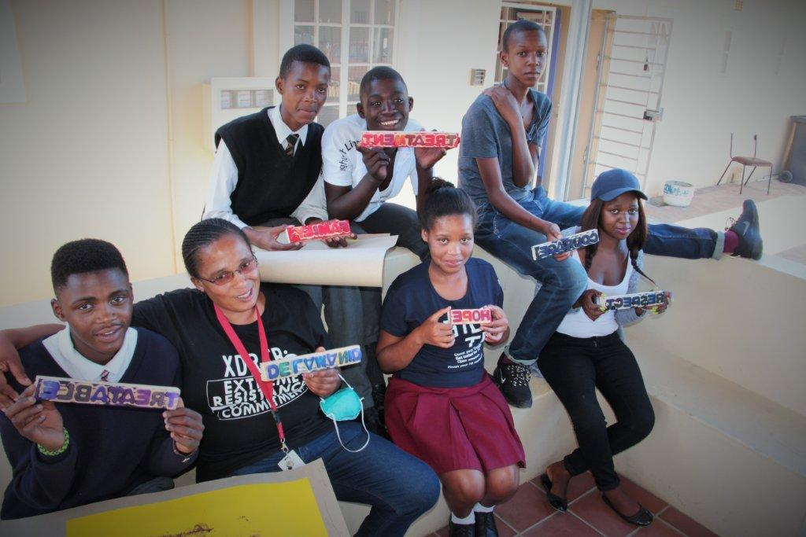
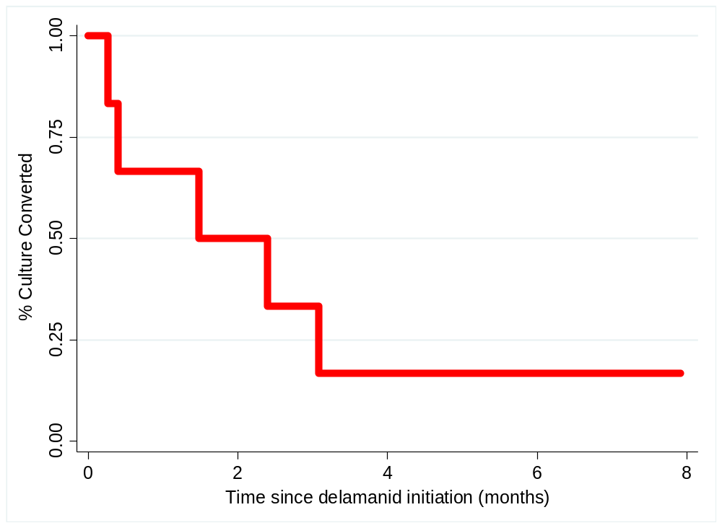
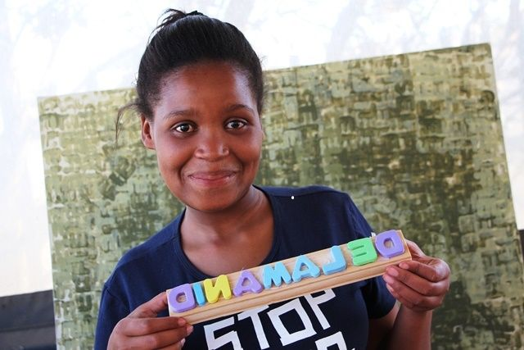
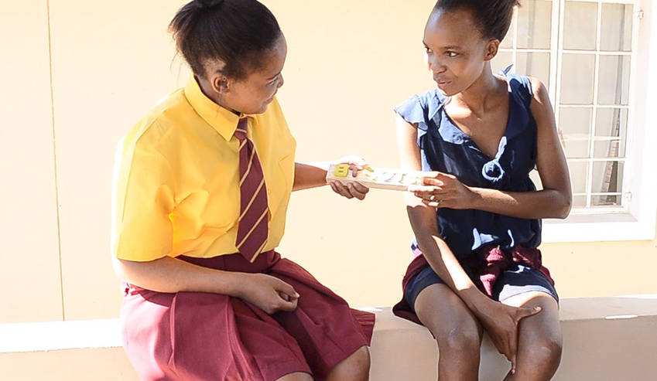



Delamanid with and without bedaquiline, for adolescents and children with Rifampicin-resistant tuberculosis
Corresponding author: Ánja Reuter
msfocb-khayelitsha-tbdoc@brussels.msf.org
Reuter A¹, Mohr E¹, Hughes J², Fargher J¹, De Azevedo V³, Ngambu N³, Harmans X¹, Ferlazzo G⁴, Shroufi A⁵, Trivino Duran L¹
¹Médecins Sans Frontières, Khayelitsha, South Africa; ²Desmond Tutu TB Centre, Stellenbosch University, Stellenbosch, South Africa; ³City of Cape Town Health Department, Cape Town, South Africa, ⁴Médecins Sans Frontières South African Medical Unit, Cape Town, South Africa; ⁵Médecins Sans Frontières, Khayelitsha, South Africa
Background
Results, continued
  Data on the use of delamanid for the treatment of rifampicin-resistant tuberculosis (RR-TB) in patients <19 years is extremely limited.
  We describe early efficacy and safety of the use of delamanid with and without bedaquiline in RR-TB patients <19 years of age from a high HIV-prevalence programmatic setting in Khayelitsha, South Africa.
Table 1. Summary of clinical, demographic, and outcome data for the rifampicin-resistant tuberculosis patients <19 treated with delamanid-containing regimens
 | Age | Sex | HIV-Status | CD4 count and ART status at Dlm initiation | Receiving Bdq | Baseline Culture | Time to culture conversion | Outcome (DEC 1 2017)
1 | 16 | Female | Positive | 183 On ART | No | Positive | 1.5 months | Favorable- Treatment Success
2 | 16 | Male | Negative |  | No | Negative | N/A | Favorable- Still on treatment culture negative
3 | 13 | Male | Negative |  | No | Negative | N/A | Favorable- Still on treatment culture negative
4 | 15 | Male | Negative |  | Yes | Positive | 0.4 months | Unfavorable- still on treatment culture reconverted to positive
5 | 14 | Male | Negative |  | No | Positive | 3.1 months | Favorable- still on treatment culture negative
6 | 14 | Male | Negative |  | Yes | Negative | N/A | Favorable- still on treatment culture negative
7 | 10 | Female | Positive | 157 On ART | No | Positive | 0.3 months | Favorable- still on treatment culture negative
8 | 15 | Male | Positive | 362 On ART | No | Positive | 2.4 months | Favorable- still on treatment culture negative
9 | 18 | Male | Positive | 204 Not on ART | Yes | Positive | Never converted | Unfavorable- still on treatment and culture positive (treatment failure)
Abbreviations: ART, antiretroviral therapy; Dlm, delamanid; Bdq, bedaquiline
Figure 1. Adolescents and children treated with delamanid containing rifampicin-resistant tuberculosis regimens, with and without bedaquiline in Khayelitsha, South Africa, ©MSF
Methods
Retrospective cohort study
Study inclusion:
    <19 years
    initiating delamanid-containing RR-TB treatment regimens with or without bedaquiline, between November 2016 and July 2017.
We report on sputum culture conversion (SCC), interim treatment outcomes and safety at 6-months after delamanid initiation.
% Culture Converted
Time since delamanid initiation (months)
Figure 3. Time to culture conversion among culture positive RR-TB patients <19 years of age at delamanid initiation
Overall, six (66%) had delamanid extended ≥24-weeks. None of the patients experienced serious adverse events; there was no QtcF prolongation >500ms; one patient experienced QTcF >60 ms from baseline at month-6.
Figure 2. Adolescent treated with a delamanid containing rifampicin-resistant tuberculosis regimen, with and without bedaquiline in Khayelitsha, South Africa, ©MSF
Conclusions
Early efficacy and safety of delamanid in this small cohort of children and adolescents is promising; expanded access is urgently needed.
Results
Nine patients initiated delamanid for RR-TB; two (22%) had confirmed or presumed rifampicin-monoresistant-TB, three (33%) had multi-drug resistant TB, and four (44%) had RR-TB with additional fluoroquinolone resistance. The indication for delamanid in six patients (75%) was drug substitution for the injectable agent; the remaining three (25%) patients received delamanid due to limited therapeutic options. The clinical, demographic, and outcome data for the enrolled patients can be seen in Table 1. Of the four (44%) HIV co-infected patients; three (75%) had started antiretrovirals at the time of delamanid initiation. Of the 6 (66%) patients with a positive culture at baseline, 5 (83%) converted to negative by month 6.
Figure 4. Adolescents treated with a delamanid containing rifampicin-resistant tuberculosis regimen, with and without bedaquiline in Khayelitsha, South Africa, © MSF
Consent
We confirm that we have obtained voluntary written permission to use the images from the patients included in this poster.
Acknowledgements
Western Cape Government Health & City of Cape Town Health Department
National Department of Health
TB/HIV care
People suffering from RR-TB in Khayelitsha
Khayelitsha clinic staff

