Slide 1
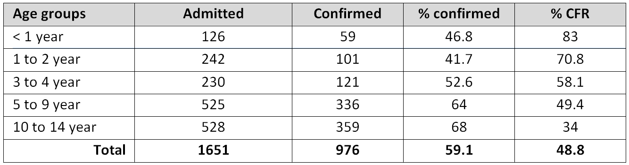
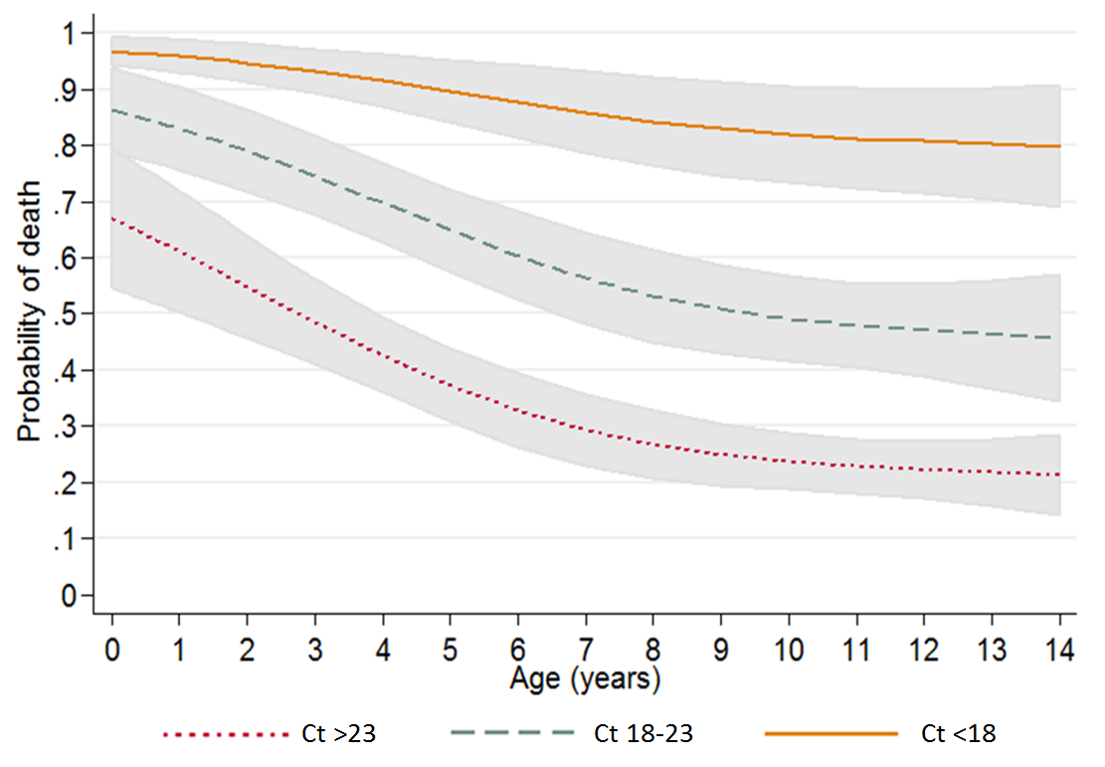
Characteristics of children aged 0-15 years with Ebola virus disease: multicentre retrospective analysis, West Africa
Roberta Petrucci¹, Etienne Gignoux², Mathieu Bastard², Patricia Kahn³, Jay Achar⁴, Iza Ciglenecki¹, Micaela Serafini¹
1 Médecins Sans Frontières (OCG), Geneva, Switzerland, 2 Epicentre, Geneva, Switzerland, 3 Médecins Sans Frontières, New York, United States, 4 Manson Unit, Médecins Sans Frontières , London, United Kingdom.
Introduction
Data on paediatric cases with Ebola Virus Disease (EVD) are scarce.
Here we describe a multicentre retrospective study on a cohort of children under 15 years old admitted in 9 MSF Ebola treatment centres (ETC).
Young age and high viral load are independently associated to mortality in the paediatric population.
Discussion
Children are less represented among the cases compared to general population.
Young children are more likely to be considered suspect once they arrive in an ETC, with a lower proportion among them that are eventually confirmed.
Results
From 24 March 2014 to 10 May 2015, 8541 patients were admitted and 4976 (58.3%) confirmed as EVD cases, of whom 976 (19.6%) were below 15 years old.
The proportion of confirmed cases among admitted children was 59.2% and differed among age groups. Children below 2 years were less likely to test positive (160/368, 43.5%); the proportion of positivity increased with age.
944 EVD-confirmed children were included in the analysis, of whom 461 (48.8%) died. Case fatality rate (CFR) decreased significantly from 83.0% (44/53) among children < 1 year to 34.0% (119/350) in 10-14 year olds (p< 0.001).
CFR was higher for cases with lower Ct values: 87.5% among children with Ct < 18 (98/112), decreasing to 58.2% among children with Ct between 18-22.9 (128/220) and to 32.3% for those with Ct ≥ 23 (122/378) (p < 0.001).
After adjustment for gender, ETC, time since onset of symptoms and calendar time, low Ct value and younger age remained strongly associated with mortality.
Methodology
Suspected cases according to WHO case definition were admitted. Laboratory diagnosis was performed. Results were reported as either EVD-negative or EVD-confirmed with the corresponding cycle threshold (Ct), an inverse measure of viral load.
Patient data were collected at admission. Risk factors for mortality were assessed through multivariate mixed-effect Poisson regression.
Young children were more likely to test negative when hospitalised as suspect cases, showing the limited specificity of the case definition in this age group
Younger age is a significant risk of fatality for children with EVD.
Viral load at admission is an independent predictor of chance of survival in all age groups and our findings suggest that viral load is equally distributed in different age groups.
The vital prognostic of a patient should be evaluated taking into account independently age and viral load at admission.
Specific policies and guidelines should be defined for children under 15 years focusing on a dedicated, child-friendly setup of the ETC, considering the limitation of care in the high risk area.
Table1 : Number of admitted and confirmed patients < 15 years, proportion of confirmed and CFR by age groups
This study describes
the largest
paediatric EVD cohort
with a known outcome
Figure 1 : Relationship between probability of death, CT value and age
during the West Africa
Conclusions
Children were relatively spared by EVD infection. However, young children were more likely to test negative when hospitalised as suspects, showing the limited specificity of the case definition in this age group. Current data do not support that a more accurate clinical assessment will be able to improve suspect case definition; while a key role could be played by a point-of-care test that could speed up the confirmation process, allowing prompt isolation and management.
This study reports younger age and high viral load as independently associated to mortality in the paediatric population.
There is a need of specific guidelines for clinical management of EVD in children, including associated conditions, considering the limitation of care in the high risk area.
outbreak

