Slide 1
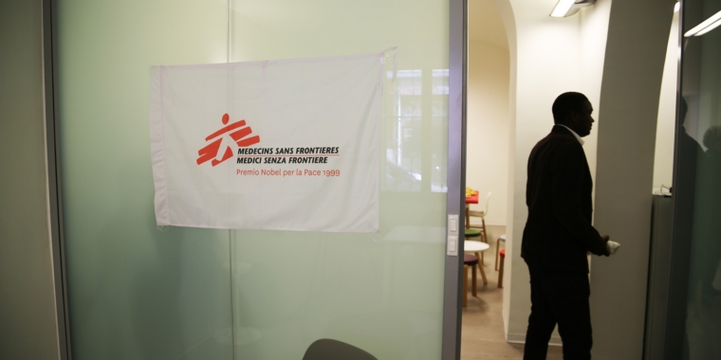
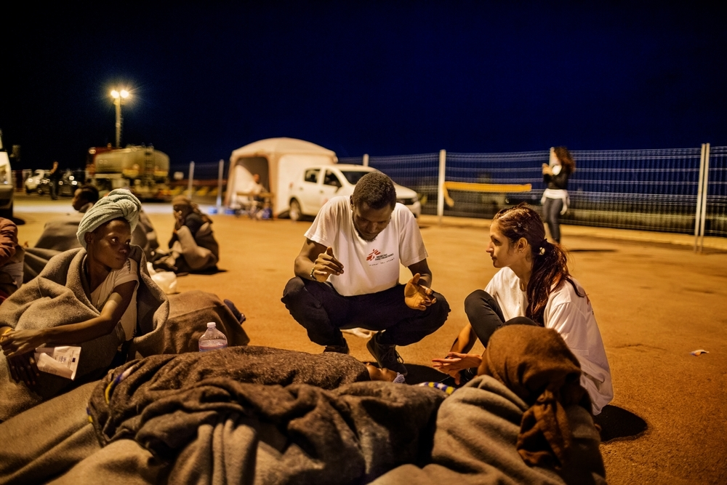
“It never happened to me, so I don’t know if there are procedures”
Identification and case management of torture survivors in the reception and public health system of Rome, Italy
Caterina Spissu^{1,}*, Gianfranco De Maio¹, Rafael Van den Bergh², Engy Ali², Emilie Venables^{2,3}, Doris Burtscher⁴, Aurelie Ponthieu⁵, Mario Ronchetti⁶, Narciso Mostarda⁶, Federica Zamatto⁷
¹Médecins Sans Frontières-Operational Centre Brussels, Italy Mission, Rome, Italy; ²Médecins Sans Frontières-Operational Centre Brussels, Operational Research Unit (LuxOR), Luxembourg, Luxembourg; ³University of Cape Town, School of Public Health and Family Medicine, Division of Social and Behavioural Sciences, Cape Town, South Africa; ⁴Médecins Sans Frontières, Vienna Evaluation Unit, Vienna, Austria; ⁵Médecins Sans Frontières-Operational Centre Brussels, Analysis Unit, Brussels, Belgium; ⁶Azienda Sanitaria Locale Rome 6, Rome, Italy; ⁷Médecins Sans Frontières-Operational Centre Brussels, Operations Department, Rome, Italy
Background
Torture is highly prevalent among migrant and refugee
populations (estimated 5 to 35%). In recent years, Italy
experienced a growing influx of mixed migration flows.
In 2015, MSF opened a clinic for the rehabilitation of
survivors of torture in Rome, where a range of
rehabilitative care (including physiotherapy, psychological
support, and socio-legal services) is provided.
Clinic data show that many cases referred through the
Italian reception system are not truly torture survivors. At
the same time, the number of self-referrals keeps
increasing, suggesting a gap in the identification and
referral processes.
Understanding the challenges in identification and referral
is essential for enhancing survivors’ access to
rehabilitation services.
Results
The main themes identified included 1) participants’
knowledge on the definition of torture and
(identification) procedures; 2) practices and challenges
in identification/detection, and 3) case management.
Professionals reported a lack of awareness or an absence of standardised procedures to correctly identify torture survivors
Participants showed different degrees of knowledge and understanding when asked to define torture and degrading treatment: interviewees often identified violence and trafficking as torture
Obstacles encountered in the identification of torture survivors include difficulty in reading/interpreting signs and symptoms, language barriers and refugees’ refusal to talk, lack of trust towards reception officers
The ability to provide services was limited by human resources and the unpreparedness of the public health system
Reception officers acknowledged their reliance on specialized actors for the provision of specialized services and care
Training on the identification and management of torture survivors case was requested
Public services professionals stressed the need to have additional internal resources to improve the response
I can intuit something because I’ve heard someone talk, I’ve seen reports on TV. I’ve read books, articles… I’ve read magazines and so on. But first-hand experience, I’ve never had.”
Health practitioner
The MSF clinic for survivors of torture in Rome receives referrals from reception centers and provides a range of rehabilitative services. Photo credit Giorgia Girometti. MSF copyright .
A training to enable us to face such delicate topics (…) If one doesn’t know how to manage them, one can create further problems for the person who suffered. So it’s a very, very, very delicate terrain.”
Psychologist
Migrants and refugees arriving in Italy via the Mediterranean sea . Among them potential survivors of torture in need of rehabilitative services.
Photo credit: Alessandro Penso. MSF copyright.
Conclusion
A considerable number of unidentified cases may exist within the migrant and refugee population in Italy
Detection and linkage to care of torture survivors occurs at the hands of non-trained and inexperienced health practitioners and reception officers
Legislative tools ensuring the right of torture survivors to access rehabilitative care exist, but their dissemination and implementation urgently need to be reinforced
Training and additional resources are needed for reception and health/social practitioners
The Italian government should allocate funds to support the existing expertise and employ dedicated multidisciplinary teams of experienced medical and non-medical personnel
Methods
A qualitative study was conducted between July and September 2017
Reception centres and sub-district teams in the ASL-6 district of Rome were purposively selected
28 in-depth interviews with staff (medical doctors, nurses, psychologists, socio-legal workers and cultural mediators) from six reception centres and three Ministry of Health teams were carried out
Data were coded and analysed manually
Thematic analysis was conducted
Strengths and limitations
The study was conducted in one
specific geographical region of Italy
and with a small sample size and
solely focusing on SPRAR and CAS
centres, while other types of reception
centres were excluded
The strength of the study was that it
was conducted with frontline staff,
capturing the situation “on the
ground”
Acknowledgements
The general practitioners and the personnel of the selected reception centres and the sub-districts in the Rome ASL 6 for participating in the study
The Direction of the ASL Rome 6 for the collaboration and for allowing Médecins Sans Frontières, Italy Mission, to conduct this study in its territory
MSF colleagues from the clinic for Victims of Torture in Rome for their inputs, suggestions and reflections on the topic

