Slide 1
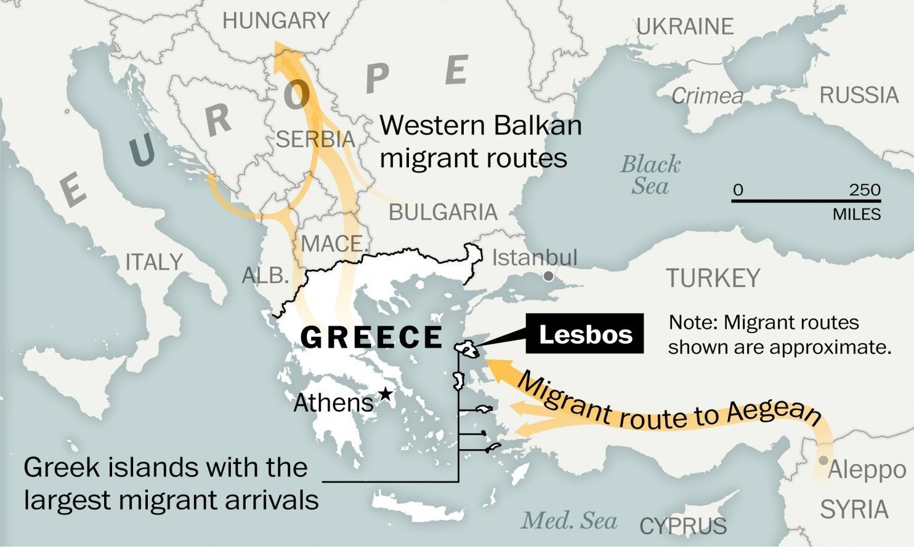
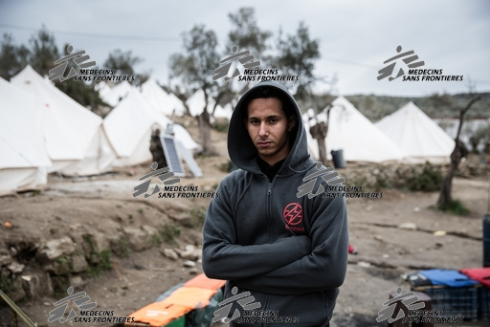
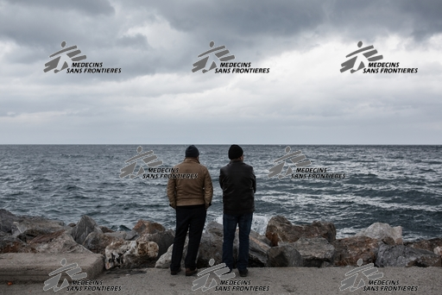
«I prefer dying fast than dying slowly» - How institutional abuse worsens the mental health of stranded Syrian, Afghan and Congolese migrants on Lesbos Island.
Christos Eleftherakos¹, Wilma van den Boogaard², Declan Barry¹, Nathalie Severy³, Ioanna Kotsioni¹, Louise Roland-Gosseli¹
¹Médecins Sans Frontières, Athens, Greece
²Médecins Sans Frontières, Luxembourg Operational Research Unit, Luxembourg City, Luxembourg
³Médecins Sans Frontières, Medical Department, Operational Centre Brussels, Belgium
.
Background
Results
Conclusion
In 2015, Greece had experienced a very high influx of asylum seekers, with close to a million people arriving on its shores. The closure of the “Balkan-route” and the EU/Turkey-deal on the 18th of March 2016, led to a drastic reduction in the flow of migrants arriving in Greece, with periodic increases.
migrants arriving in Greece.
Following the deal, asylum seekers are trapped on the Aegean Islands, and face the risk of return to Turkey. In the reception/detention centers set up on the islands, included Moria camp, people now spend months or years battling for their right to stay in Europe and receive its protection.
Médecins Sans Frontières (MSF) has been providing medical and mental health (MH) services to migrants on Lesbos Island since 2015. This has been challenging since needs have regularly changed depending on the influx of asylum seekers and service provision from other actors. In 2017, MSF considered Lesbos Island to be in a state of mental health emergency.
This study explored factors impacting the MH of Syrian, Afghan and Congolese migrants stranded on Lesbos Island in order to be able to adopt more appropriate MH services.
Three main themes were generated through the FGDs and KIIs.
Those were: 1) Systemic or institutional abuse, 2) Continuous traumatic stress (CTS), and 3) Lack or inefficiency of MH service provision.
Systemic or institutional abuse (which is the destruction of a person’s self-esteem and his sense of safety through installing fear whilst not providing safety), was expressed by: a) inhumane living conditions, b) deprivation of information in order to make future decisions and c) systematic insults, humiliation, and de-personalization by the ‘aiding’ authorities being in power.
“We got very scared. We lock ourselves in the containers but with the fires we were
scared that we will burn in here, we thought we will die in here”. (CWM1)
‘’Even to the toilet (…) we go all together. I am afraid for my daughters, there are
many young men, the camp is not as safe as it was in the beginning”. (SWKT)
“…and they put me in a tent with other 200 people to register me, now for more
than 8 months…”(SMM)
“I see people, they arrive and they are moved, but we are the ones staying here,
while we are the ones that arrived many months ago’’ (SMKT).
“…when I see people on the barbed wire waiting for food what is the difference with
me and sheep? When I see the police beating people in order to wait in line….”
(AMM1)
2 Continuous Traumatic Stress (CTS) (provides a way to describe the consequences of current conditions in which there is an ongoing danger in the present or future instead of the traumatic experience of the past).
Main characteristics of CTS can be indicated by, and were as such described: a) a state of permanent emergency, b) preoccupation with threats on present and future, and c) absence of protective measures.
3 - Lack or inefficiency of mental health service provision: Effective provision of MH in terms of quantity and quality were recurrently discussed and being expressed by: a) delays in appointments, b) lack of psychiatric care, c) different perceptions about mental health.
The EU/Turkey-deal reduced migrant flows from Turkey to Europe at a very high price. Systematic institutional abuse leading to CTS with dramatic consequences on the MH status of the migrants.
The provision of MH services for this unique migrant population is inadequate and insufficient.
Policy and practice
In order to avoid future repetition (including other such similar deals made with Libya, Afghanistan and West Africa) institutional abuse needs to be urgently addressed while living conditions needs to be dramatically improved which allows reduction of CTS, and consequently the mental health status of migrants.
Clear asylum procedures need to be continuously provided for every migrant entering Europe.
MH services need to adopt a more diverse and flexible way of provision for this diverse population.
Map of Aegean and Balkan route before the implementation of the EU/Turkey - deal (source: Frontex and UNHCR)
Limitations
Limitations
Two main limitations were :
1) The transitory nature of the context made it difficult to find the initial desired migrant population at the expected sites.
2) A serious security incidence in Moria which occurred at the same time as the FGDs were taking place, may have influenced some participant’s responses.
Method
This was a prospective qualitative study which included:
8 key informant interviews (KIIs) → health-and social care providers,
12 focus group discussions (FGD) → Syrian, Afghan and Congolese male and female migrants > 18 years residing in Kara Tepe camp (vulnerable families) and Moria camp (reception and identification) on Lesbos Island
Period of data collection: July - August 2017
“Every night fires broke out in Moria and we were running in the woods with our
packs to save ourselves. We didn’t have a single day of calmness. My clothes, they
are still in the bags since 1 year’’ (AWKT1).
“So, this despair, many try to manipulate you to get documents, anything that can
help their case (…), they want to hold on to something” (KI2)
“If I go back to Turkey the Turks don’t like me, if they take me back to Lebanon is
worse, if I stay here they will take me in prison for sure” (SMM2).
“They harm themselves by cutting to show their pain that they are desperate and
can’t take it anymore; in fact it gives relief to the “pain” in the head” (CWM1).
“….he does not want to be social anymore, he just sits and thinks…” (AMKT).
Source: MSF OCB (https://media.msf.org/media/MSF161315.html)
Acknowledgements
We are very grateful to the whole MSF team working on Lesbos Island. In particular the Health Promoters and Cultural Mediators who made this research possible. Special thanks go to Liza Papadimitriou the MSF Humanitarian Affairs Officer (HAO) for intellectual input. Last but not least, our main gratitude goes to the participants who with their generous, lively and emotive accounts gave us the insight of their daily suffering.
This research was conducted through the Structured Operational Research and Training Initiative (SORT IT), a joint initiative by ‘The Union’ and MSF-LuxOR.
“…things are getting worse, suicidal attempts, self-harm. The past three weeks we
have had like 15 people on that list [psychiatric care], (….) when usually it’s about
5’’ (KI3).
“In Afghanistan you have a problem the doctor gives you medication and you go,
they don’t have this idea of psychotherapy, they take the pills” (KI1)
“They give me an appointment 4 months later. I will become crazy after that long”
(AWKT2).
Consent
All photos were retrieved from MSF website msf.media.org. People in the photos have signed agreements allowing images featuring them to be used based on MSF Media Database Terms and Conditions.
Source: MSF OCB (https://media.msf.org/media/MSF161348.html)

