Slide 1
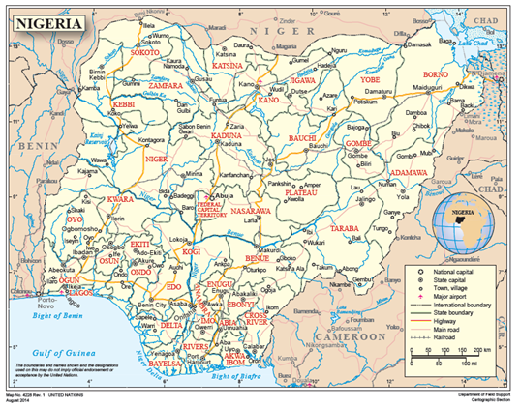
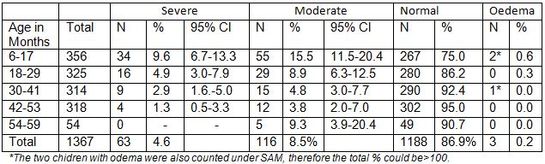
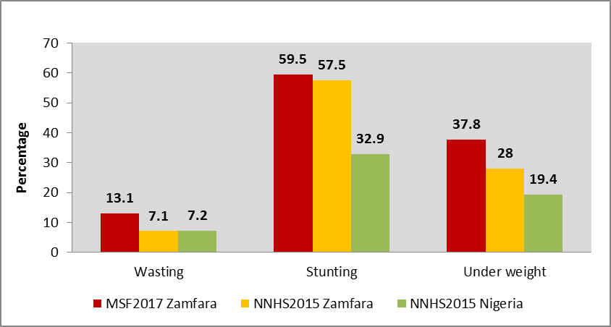
Evidence of acute food crises in children 6-59 months from malnutrition survey in Zamfara state, northwest Nigeria, 2017
Weldeabezgi AH¹, Huisman G², Kaur G³, Oluyide B², Lenglet A⁴, Trienekens , SCM¹, Greig J⁵, van der Kam S⁴, Roggeveen H⁴, Bil K⁴
1 Médecins sans Frontières (MSF), Sokoto, Nigeria, 2 MSF, Abuja, Nigeria, 3 MSF, Anka, Nigeria, 4 MSF, London, United Kingdom, 5 MSF, Amsterdam, Netherlands
Introduction and Objective
Map of Nigeria indicating Zamfara State
Results
Zamfara is one of the states in north east Nigeria; (Figure1).
Since 2016, Médecins Sans Frontières (MSF) observed a worrying increase in the number of pediatric admissions to the inpatient therapeutic feeding centre (ITFC) in Anka Hospital, Zamfara;
No information to better understand this increase;
To understand the extent and severity of malnutrition and inform an appropriate response, we conducted a nutrition and retrospective mortality survey in three selected local government areas (LGAs) of Zamfara state in November 2017.
969 households with 5,676 people;
Mean household size: 6.0;
1,495 children (26.3%) were 6-59 months old;
The prevalence of GAM in the 6-59 months age group was 13.1% (CI:10.7-15.9) by weight-for-height-Z-scores (WHZ) and 12.0% (CI: 9.9-14.5) using MUAC;
The prevalence of SAM by the two methods was 4.6% (CI:3.5-5.9) and 4.2% (CI:3.1-5.6) respectively.
Highest proportion of SAM by WHZ was identified in children 6-17 months of age (9.6%; CI: 6.7-13.3) (Table I);
No difference between male and female children;
The U5MR= 0.42 deaths per 10,000 persons per day;;
Among the 428 non-breastfed children only 4.4% of them were receiving the accepted diversified diets composed of 4 food groups or more.
The current prevalence estimates of wasting, stunting and underweight children <5 years of age are high than a nattional and Zamfara specific malnutrition survey in 2015 (Figure II).
©United Nations 2014
Methods
Two-stage cluster sampling method according to the Standardized Monitoring and Assessment of Relief and Transitions (SMART) methodology on child anthropometry, mortality, morbidity, and food security;
Sample size: 977 household across 35 clusters;
Household selected randomly at village level;
All children aged 6-59 months in selected households were included in the survey
Anthropometric measurements included weight, height and Mid-Upper-Arm-Circumference (MUAC),
Recall period for reported deaths = 365 days;
We estimated the prevalence of global and severe acute malnutrition (GAM and SAM) in children 6-59 months, and under-five-mortality-rate (U5MR).
We calculated a diet diversity score (DDS) based on reported food consumption in the last 24 hours. A DDS<4 was considered low diversity.
I- Prevalence of wasting by age based on Weight-for-height z-scores
II- Overall child malnutrition MSF 2017 Vs Nigerian nutrition and health survey 2015
Limitations
Conclusion
The last national census in Nigeria was conducted in 2006, thus the sampling frame and cluster selection were based on extrapolated population data from this census;
Five districts could not be included in the survey due to security constraints
This survey only included 3 LGAs in Zamfara state, hence results can’t be extrapolated to Zamfara state.
In November 2017, the prevalence of acute malnutrition were equivalent to those you would find in ‘acute food crises’ ;
The nutrition situation in the three included LGAs in Zamfara state is therefore concerning;
We recommend activities to improve early detection of malnutrition (health promotion and outreach), and scaling up support to ambulatory TFCs to tackle this growing problem.
Acknowledgements
The authors would like to thank survey participants and enumerators.
Significant contributions made by Zamfara MSF project team, starting from designing the protocol up to implementation.
We are also grateful to Zamfara sate and district health directors.
Last but not least special thanks goes to Titi Osamika and NERU team.

