Slide 1

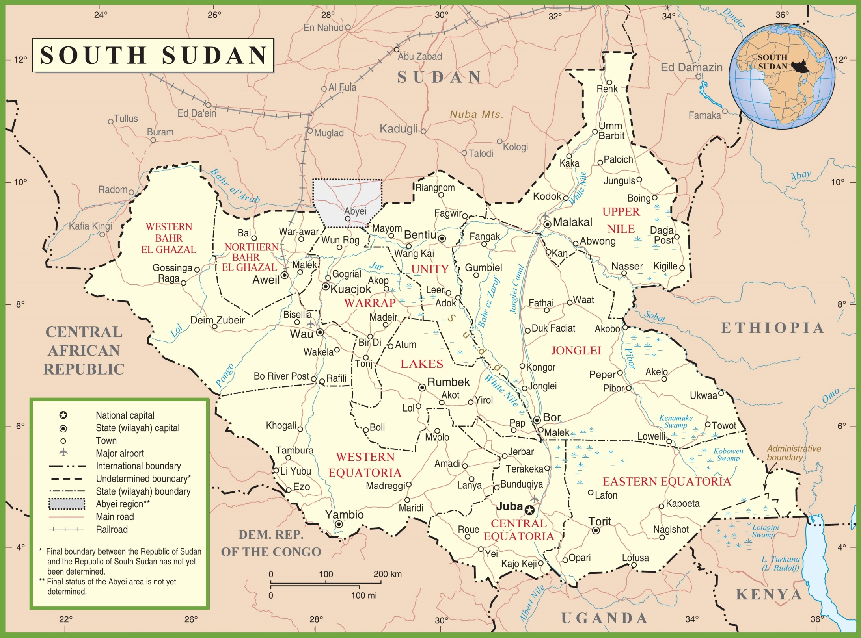
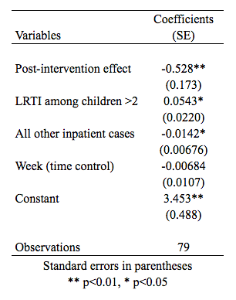
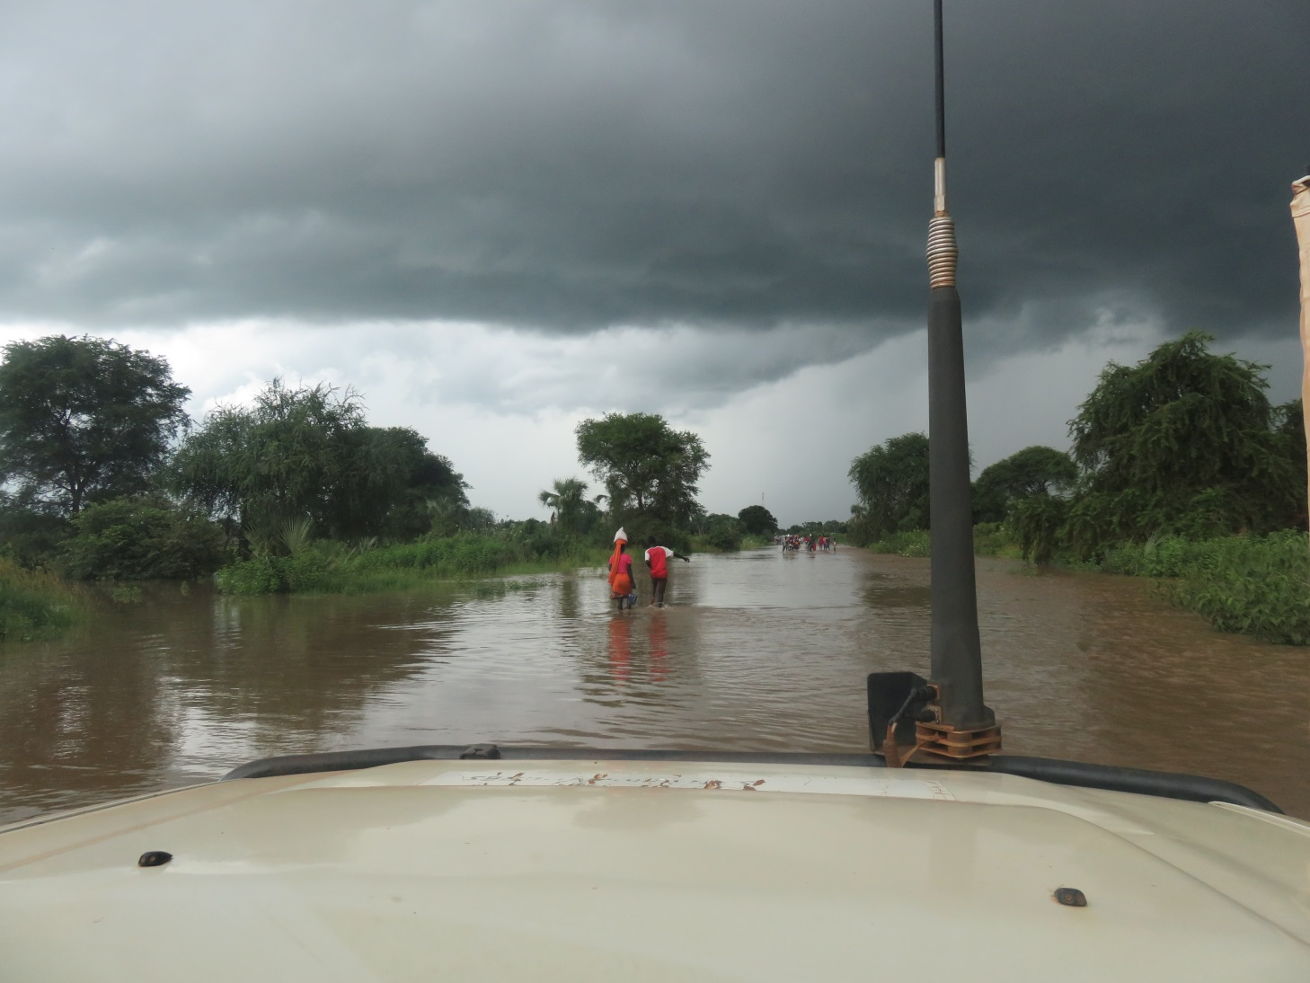
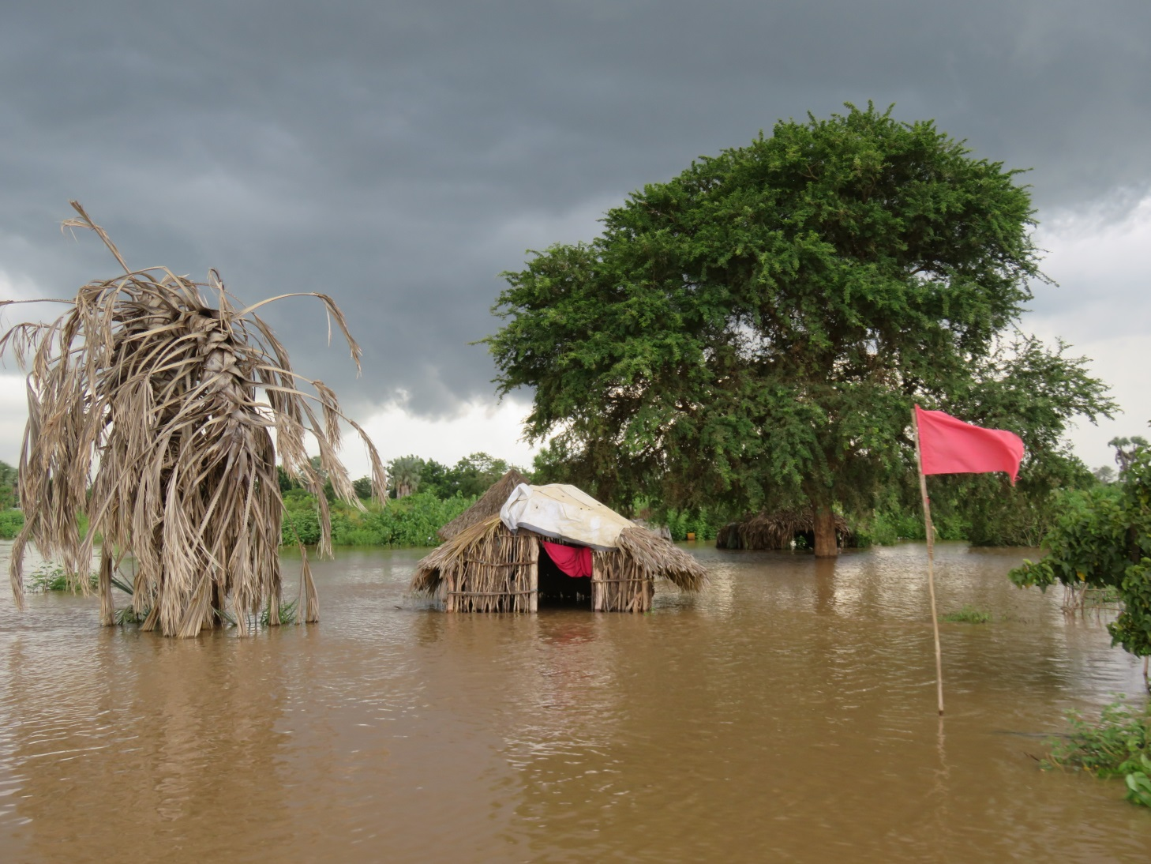

Coverage of a pneumococcal conjugate vaccine campaign in Doro refugee camp, South Sudan and trends in inpatient lower respiratory tract infections over time
Ruben Conner, Alain Ngoko, Husni Mubarak Zainal, Gama David Joseph, Rafael Van den Bergh,
Jai Defranciscis, Patrick Rollinson, Isabella Panunzi, Catherine Bachy, Silvia Pineda
MSF-Operational Centre Brussels, South Sudan
Introduction
Pneumonia is a leading cause of death (estimated 15% of childhood deaths), and likely an even larger share in refugee camps where communicable disease risk is greater [1]
Lower respiratory tract infections (LRTI) are frequently caused by Streptococcus pneumoniae, which can be prevented through the use of pneumococcal conjugate vaccines (PCV)
PCV has been recommended for use in humanitarian settings since 2013 [2] but has been prohibitively expensive. Impact studies of PCV in such settings have been very limited [3]
In June and August 2017, MSF introduced PCV-10 in a two-round multi-antigen catch-up vaccination campaign for children 6 weeks-23 months living in Doro refugee camp
We set out to document the vaccination coverage and trends in lower respiratory tract infections (LRTI) cases in children <2 years pre- and post-campaign
Results
Two-dose PCV coverage = 72.4% [95% C.I. 67.3% – 77.5%]
One-dose PCV coverage = 91.7% [95% C.I. 89.2% – 94.3%]
Average of 22.5 [17.3 – 27.7] LRTI cases per week in 2015/2016
Average of 13.2 [10.1 – 16.3] LRTI cases per week in 2017 (p=0.02)
Figure 2. LRTI cases per week, pre- and post-intervention
Using a regression analysis (Table 2) to control for changes in general inpatient volume and for seasonal variation, we identified a 47% reduction of LRTI admissions (p<0.01) among children <2 years.
Table 2. Regression analysis of inpatient LRTI trends
Figure 3. Flooding during fieldwork [5]
Strengths and limitations
The two-dose PCV-10 coverage reached (72.4%), lower than the set objective of 90%, probably due to heavy rainfalls and floods during the second round of the campaign (Figure 3)
Although at least 2 doses of PCV are required to induce protection, the large proportion of children (91.7%) that have received at least one dose of PCV may greatly contribute to herd immunity against pneumococcal infections in children and the rest of the community [6], though impact among all ages was not measured
The definition used for LRTI does not allow for differentiation between pneumonia and LRTI due to other pathogens. It was not feasible to confirm Streptococcus pneumoniae as the etiologic agent. Any exogenous trends in LRTI induced by other pathogens could have influenced our results
Changes in general risk factors for pneumococcal diseases such as prevalence of malnutrition or population density could have contributed to the reduction in LRTI cases, but no significant change in these other factors was recorded during the analysis period
The case definition for LRTI was consistent and the surveillance system was stable during the entire period
Geography
Doro Refugee Camp, Maban County, South Sudan
Fig 1. Location of Doro refugee camp (red dot) [4]
Conclusions
Following the introduction of PCV in Doro camp, a large reduction in LRTI weekly incidence was observed, suggesting that PCV could have had a notable protective effect for children in the camp, despite the sub-optimal vaccination coverage reached by the campaign.
Continuous vaccination activities are necessary in order to maintain the achieved reduction in LRTI and enhanced epidemiological surveillance would increase our confidence in the results over time. However, our results offer more evidence that preventive vaccination of vulnerable populations against pneumococcal infections should be a priority in all humanitarian contexts.
Ethics
This study met the Médecins Sans Frontières’ Ethics Review Board-approved criteria for analysis of routinely collected programme data.
Conflict of interest
All authors reported that they have no conflicts of interest to declare.
Methods
Cross-sectional vaccination coverage survey among children aged 6 weeks-23 months:
      Two-stage cluster methodology with camp sectors as clusters in the first stage, and households in the second stage
      Sample of 554 households and 739 children
      Based on vaccination cards and recall
Analysis of LRTI trends:
      Based on three years of routine passive surveillance of severe LRTI registered in the IPD of Doro PHCC (sole provider of inpatient care in the camp)
      Data aggregated at weekly level and restricted to periods of high LRTI incidence (weeks 26-52)
      Effect estimation using negative binomial regression, with LRTI cases as the dependent variable and prior years used as comparison group
Citations
[1] Walker, Christa L Fischer et al. "Global burden of childhood pneumonia and diarrhoea". The Lancet, Volume 381 , Issue 9875 , 1405-1416
[2] “Vaccination in Acute Humanitarian Emergencies: A Framework for Decision Making” Department of Immunization, Vaccines and Biologicals, World Health Organization, May 2017
[3] Rinta-Kokko, Hanna, et al. "Long-term impact of 10-valent pneumococcal conjugate vaccination on invasive pneumococcal disease among children in Finland." Vaccine 36.15 (2018)
[4] DeFeo, Michael. "The Effects of Institutional and Political Instability on Civil War in South Sudan." Inquiries Journal 9.11 (2017). <http://www.inquiriesjournal.com/a?id=1692>
[5] Personal photographs courtesy of Silvia Pineda, September 2017, Maban County, South Sudan
[6] Miller, Elizabeth, et al. "Herd immunity and serotype replacement 4 years after seven-valent pneumococcal conjugate vaccination in England and Wales: an observational cohort study." The Lancet infectious diseases 11.10 (2011): 760-768

