Slide 1
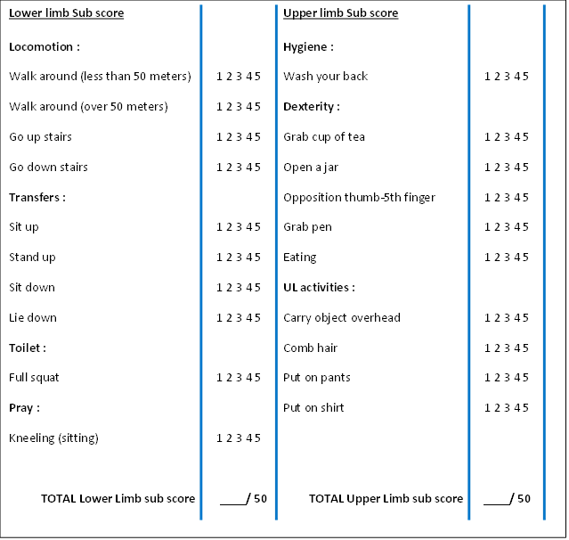

Early physical and functional rehabilitation of trauma patients in the MSF Trauma Center, Kunduz Afghanistan : luxury or necessity?
B Gohy¹, E Ali², R Van den Bergh², E Schillberg², M Nasim³, M Mahmood Naimi³,
S Cheréstal⁴, P Falipou¹, E Weerts¹, P Skelton¹, C Van Overloop², M Trelles².
¹Humanity & Inclusion, Brussels, Belgium; ²Médecins Sans Frontières (MSF), Brussels, Belgium; ³MSF, Kabul, Afghanistan; ⁴MSF, Port-au-Prince, Haiti
Contact : b.gohy@hi.org
Introduction
Methods
© Bérangère Gohy
The increased quality of care has led to a higher survival rate of severely injured patients, leaving more individuals with long term disabilities.
-Scarce and not systematic physiotherapy services in LMICs
-No outcome tools has been adapted to humanitarian context to monitor functional recovery of trauma patients.
MSF integrated early rehabilitation services in its Kunduz Trauma Center (KTC) in collaboration with Handicap International (HI). Besides, an adapted functional score was developed in that context .
A patient with an external fixation of the femoral shaft, performing a knee flexion posture in KTC
  -Descriptive cohort study
  -Trauma patients admitted for inpatient (IPD) care between January and June 2015
  -Data collected at 4 points in time: admission and discharge from both inpatient and outpatient department (OPD)
  -Functional independence assessed through a functional score (see box 1 below) adapted to humanitarian context and to the culture, composed of 2 subscores for upper limb (UL) and lower limb (LL).
Box 1. Adapted Functional Independence Measure used with acute trauma patients, in the Médecins sans Frontières Kunduz Trauma Center
Functional score adapted to context through:
-Simplification of scoring system
-Addition of items important to Afghan daily life (e.g. squatting)
-Addition of upper limb and lower limb items (e.g. grab cup) to increase sensitivity
Objectives
  -Describe characteristics of trauma patients as well as feasibility of integration of physiotherapy services
  -Describe the adapted functional score and the evolution of functional recovery using this tool
Results
  Out of 1528 patients admitted to KTC between January and June 2015:
Conclusions
  Lower limb fracture (30%), Upper limb fracture (22%), Multiple Injuries (12%), Traumatic brain injury (8%) , Others (28%)
  92% received at least one physiotherapy session (n=1410)
  1346 patients (88%) received physiotherapy in IPD and 819 (53%) in OPD.
  62% received IPD sessions within two days of admission.
  Average of 6.6 IPD sessions, with a median length of stay of 5 days (IQR 3–10)
  Average 2.5 OPD sessions, at a median of one every 3.1 weeks (IQR 1.9–4.9).
  Risk factors for not attending OPD physiotherapy:
  Being a severe case (according to SATS)
  Aged 18-45
  TBI or internal organ injury
  Victim of violent trauma
  High functional score at IPD exit
The integration of physiotherapists within any trauma medical team should be a necessity.
The use of the adapted functional score was shown to be feasible for complex trauma patients with different types of injury in a humanitarian setting.
Figure 1. Adapted Functional Independence Measure used with acute trauma patients, in the Médecins sans Frontières Kunduz Trauma Center
Patients with accidental trauma (p=0.0006), lower limb fractures (p<0.0001), and multiple surgeries (p<0.0001) were more likely to receive physiotherapy.
Acknowledgements
This research is dedicated to our colleagues, patients and caregivers who lost their lives the 3rd of October, as well as those who have been injured or anyhow affected by this bombing.
The authors would also like to thank the MSF physiotherapy team, for their dedication and quality work throughout the project, when the situation was already challenging.
This research was supported through an operational research course, developed by the Centre for Operational Research, International Union Against Tuberculosis and Lung Disease, and the Operational Research Unit, Medecins sans Frontieres, Brussels.
  Functional independence improved during stay:
  Among patients with both IPD scores (n=535): at IDP discharge, 32% were functionally independent (score > 80),
  Among patients with both OPD scores (n=95): at OPD discharge, 79% were independent.
Figure 1. Functional independence of four subgroups of trauma patients admitted to MSF Kunduz Trauma Centre between January and June 2015, at admission and discharge from IPD and OPD physiotherapy, using the adapted functional score. n is the number of patients with both admission and discharge functional scores. LLF: lower limb fracture; MI: multiple injury; TBI: traumatic brain injury; ULF: upper limb fracture.

