Slide 1

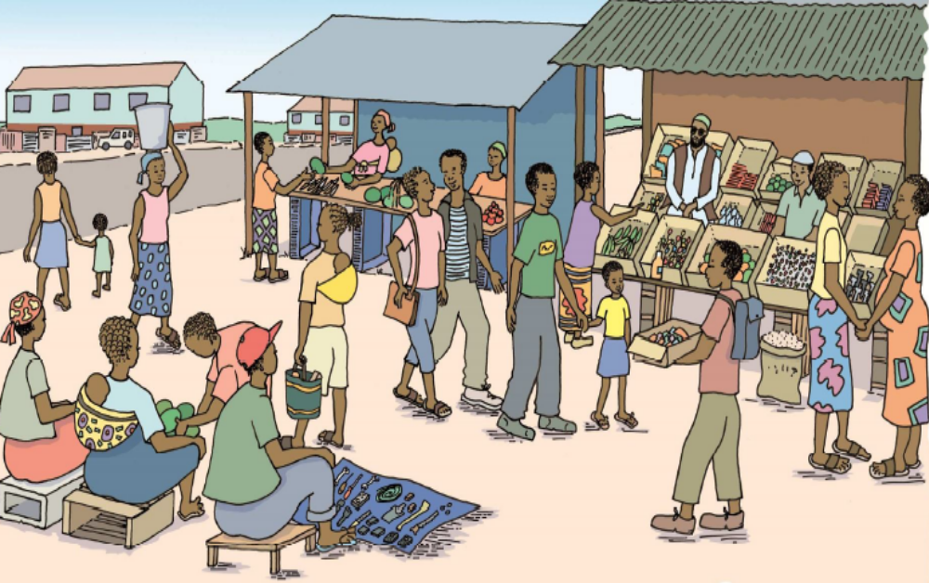
“It´s a secret between us”:
Childrens’ and care-givers’ experiences of HIV disclosure in Kinshasa, Democratic Republic of Congo
E Manziasi Sumbi¹, R Harrison¹, E Kanumay¹, M Garcia², K Iakovidi², JL Chalachala³, E Venables^{2,4}
¹Médecins Sans Frontières, Kinshasa, Democratic Republic of Congo ²Southern Africa Medical Unit, Médecins Sans Frontières, Cape Town, South Africa
³University of North Carolina, Carolina Population Centre, USA ⁴Division of Social and Behavioural Sciences, School of Public Health and Family Medicine, University of Cape Town, South Africa
Contact: emilie.venables@brussels.msf.org
Background
Results
UNAIDS estimates 42,000 children <15 are living with HIV in DRC.
WHO recommends disclosure for HIV-positive children of school-going age, but the process remains challenging for health-care workers and care-givers.
Children in DRC can only be informed of their HIV status with the approval of their care-giver, which, along with the age of consent for HIV testing being 18, can cause delays in disclosure.
Non-disclosure is probably associated with poor outcomes during adolescence including increased risk of poor adherence and retention, and treatment failure.
MSF has provided free medical and psycho-social support to people living with HIV in Kinshasa, including children and their care-givers, since 2002.
Disclosure is a very emotional and challenging time for care-givers and HIV positive children and adolescents
Interviewees had differing experiences of disclosure, including disclosure at a health-care facility, planned disclosure at home and unplanned disclosure
The age at which care-givers and adolescents thought disclosure should happen varied based on their own experiences
Several children suspected they had HIV before disclosure, asking why they had to take daily medication or were 'always ill'.
86% of care-givers were female. Care-givers included biological parents, grandparents, older siblings and local volunteers.
Items and images can span one column or they can span two columns
At the time of interview the average age of adolescents was 17 (15-19), and care-givers 47 (21-70) years old.
Methods
They tested her and she came back in tears with a paper in her hand. [The nurse] shouldn’t have told her like that. The result should be managed between the medical team and the mother of the child, who should be the one to disclose. And they knew that I was HIV positive too! I was very angry .
I was scared for her when they told her: I was scared because I have the HIV virus, and I didn’t think it could happen to my child.
48 year old mother of 17 year old girl, both living with HIV
Perceived benefits of disclosure | Reasons for non-disclosure
The child would be able to protect their future sexual partners | Fear of stigmatisation and gossip because the ‘child talks too much’
Improved communication and relationships within the family | Non-primary care-giver not knowing the status of the child, or not having ‘permission’ from biological parents to disclose
Can help child to be more autonomous and independent in taking treatment | Not wanting to cause distress to the child, including believing there could be a risk of suicide
Better for child to be told their HIV status than to find out accidentally | Mothers not wanting to be blamed in the case of vertical transmission
The child needs to understand why they are taking daily treatment | Wanting to avoid the child ‘seeking revenge’ by infecting others
Could lead to improvements in health through improved adherence | Care-givers struggling with own HIV status and experience of disclosure can create delays in dislcosing
A qualitative study was conducted in 2017 in one health-care facility in Kinshasa
Purposive sampling was used
Interviews were conducted in Lingala, and transcribed and translated into French
Transcripts were manually coded
Thematic analysis was used
34 in-depth interviews were carried out:
Adolescents who knew their HIV status (n=12)
Care-givers who had disclosed to their children (n=11)
Care-givers who had not disclosed to their children (n=11)
→ 11 care-giver/adolescent pairs were included in the sample
Table 1: Care-giver and adolescent perspectives on disclosure
If he asks me questions, I say ‘you’re sick, no? Take your medication!’ It’s painful for someone to have to take medication every day and when I give them to him I do it in secret because I don’t want other people to find out. I tried to disclose to him but I saw how worried he was and I stopped. I want to wait until he’s older…15 or 16.
70 year old grandmother caring for her 12 year old grandson
Conclusions
Finding the right time and way to disclose to a child is essential to reduce possible negative consequences for the child and care-giver
Disclosure programmes need to consider involving and supporting secondary care-givers, who also play a role in caring for the child
Additional psycho-social support is required for care-givers, particularly those living with HIV, to enable them to understand and cope with their child’s diagnosis
Acknowledgements
Do not forget to add these
Acknowledgements
The care-givers and adolescents at the Centre Hospitalier de Kabinda in Kinshasa who took part in this study, and the staff who supported the implementation.
Image 1: Community scene from MSF PMTCT guidelines

