Slide 1
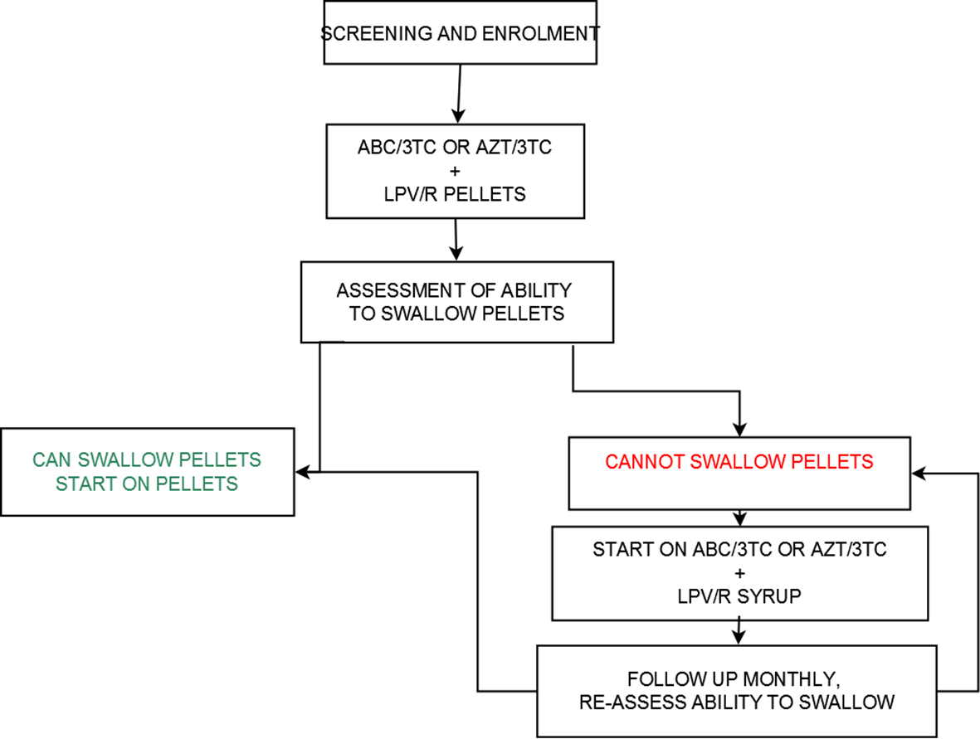
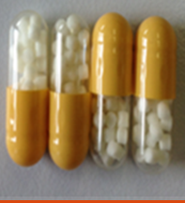
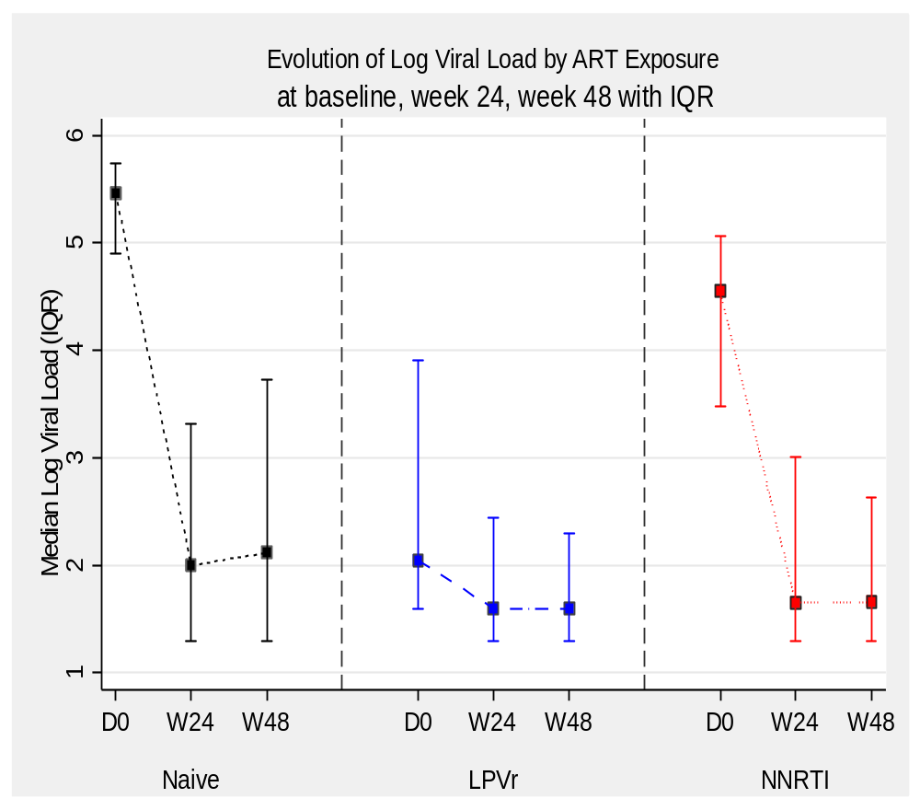



Virological Outcomes, Safety and Acceptability of LPV/r Pellets-Based ART in Young Children: 48-Week Interim Analysis of the LIVING Study.
Andrieux-Meyer I¹, Salami O², Wamalwa D³, Musiime V⁴, Oyaro P⁵, Musoke R⁶, Mbuthia J⁷, Nyandiko W⁸, Omollo R², Obimbo E³, Bukusi E⁵, Mwanga-Amumpaire J⁹, Egondi T², Simon F¹, Odhiambo S², Kyomuhendo F², Waweru M², Lee J¹, Kekitiinwa A¹⁰, Lallemant M¹
¹Drugs for Neglected diseases initiative, Geneva, Switzerland, ²Drugs for Neglected diseases initiative, Nairobi, Kenya,³University of Nairobi, Nairobi, Kenya, ⁴Makerere University, Kampala, Uganda, ⁵Kenya Medical research institute, Nairobi, Kenya, 6COGRI/Lea -Toto, Nairobi, Kenya, ⁷Gertrude's Children's Hospital, Nairobi, Kenya, ⁸AMPATH/ Moi University, Eldoret, Kenya, ⁹Epicentre, Mbarara, Uganda, ¹⁰Baylor university centre of excellence in pediatric HIV, Kampala, Uganda
Background
Study Objectives
There are limited options for first line ARVs in infants and young children.
The current tablet and syrup formulations of LPV/r are not suitable for use for very young children and their caregivers.
DNDi has worked with CIPLA to develop a new pellet formulation of LPV/r which is palatable, heat-stable, taste-masked and easy-to-administer.
The pellets formulation has been approved for use in infants and young children. However, there is limited clinical data on its effectiveness and safety in routine care.
The LIVING study aims to evaluate the effectiveness, safety, PK and acceptability of LPV/r pellets + standard NRTIs in HIV+ children unable to swallow tablets.
Inclusion criteria
HIV infected children
ARV naïve, or already on first line liquid lopinavir-based treatment, or failing first line, NNRTI based therapy
weight ≥3 and <25 kg at the time of enrolment (age is not an inclusion criterion)
Unable to swallow tablets
Methods
Study Design
Single-arm phase IIIb implementation study
open-label
prospective
non-randomized
non-comparative
multicentre, multi-country
Exclusion criteria
  Treatment failure with the presence or strong suspicion of a PI resistance mutation
  Current treatment with a drug that interacts significantly with LPV/r
  Clinically significant disease in the investigator’s opinion, which would compromise participation in the study
  Treatment with experimental drugs for any indication within 30 days prior to study entry
  Anticipated transfer to non study treatment site.
Dosing of LPV/r pellets followed WHO weight bands
Observation of pellets administration performed at clinic
Enrolment completed across 12 sites in Kenya, Uganda and Tanzania
Pic 1:LPV/r Pellets ( DNDi 2016)
Fig 1: patient flow
1. Patient disposition
Table 1: baseline characteristics
Results
2. Baseline characteristics
 | n | %
Sex
Male | 130 | 48.9
Female | 136 | 51.1
Treatment exposure
ART naïve | 25 | 9.4
Lopinavir | 229 | 86.1
NNRTI | 12 | 4.5
 | ART naive |  |  | NNRTI+LPV/rr |  |  | NNRTI |  |  | Total
 | median | 95% CI |  | median | 95% CI |  | median | 95% CI |  | median | 95% CI
ART duration (mths) | 0.0 | 0.0 | 0.0 | 26.8 | 10.6 | 45.8 | 32.6 | 14.2 | 39.5 | 27.1 | 11.4 | 45.7
Age (mths) | 20.0 | 11.0 | 38.0 | 44.0 | 28.0 | 63.0 | 52.5 | 43.5 | 62.5 | 43.0 | 25.0 | 62.0
Weight (kg) | 9.0 | 6.2 | 11.7 | 14.0 | 11.0 | 16.0 | 14.8 | 11.6 | 16.8 | 13.8 | 10.7 | 16.0
VL log10 copies/ml | 5.5 | 4.9 | 5.7 | 2.0 | 1.6 | 3.8 | 4.6 | 3.5 | 5.1 | 2.4 | 1.6 | 4.6
Enrolled (n=715)
ARV experienced = 641
NNRTI = 42
NNRTI+LPV/r = 599
ARV naïve = 74
3. Virological outcome
Table 2: baseline characteristics
 |  | n | Median Log 10 cp/ml | IQR |  | ≤50 copies | ≤*400 cp/ml | ≤’1000 cp/ml | >1000 cp/ml
 | ART naïve | 25 | 5.5 | 4.9 | 5.7 | 1(4.0%) | 1(4.0%) | 1(4.0%) | 24(96.0%)
Baseline | NNRTI+Lopinavir | 229 | 2.0 | 1.6 | 3.9 | 77(33.6%) | 138 (60.3%) | 153 (66.8%) | 76(33.2%)
 | NNRTI | 12 | 4.6 | 3.5 | 5.1 | 1(8.3%) | 2 (16.7%) | 2(16.7%) | 10(83.3%)
 | Overall | 266 | 2.4 | 1.6 | 4.7 | 79(29.7%) | 141(53.0%) | 156(58.7%) | 110(41.4%)
 | ART naïve | 25 | 2.0 | 1.3 | 3.3 | 9(36.0%) | 15(60.0%) | 16(64.0%) | 9(36.0%)
Month 6 | NNRTI+Lopinavir | 229 | 1.6 | 1.3 | 2.4 | 121(52.8%) | 177(77.3%) | 186(81.2%) | 43(18.8%)
 | NNRTI | 12 | 1.7 | 1.3 | 3.0 | 6(50.0%) | 8(66.7%) | 9(75.0%) | 3(25.0%)
 | Overall | 266 | 1.7 | 1.3 | 2.6 | 136(51.1%) | 200(75.2%) | 211(79.3%) | 55(20.7%)
 | ART naïve | 25 | 2.1 | 1.3 | 3.7 | 12(48.0%) | 16(64.0%) | 17(68.0%) | 8(32.0%)
Month 12 | NNRTI+Lopinavir | 229 | 1.6 | 1.3 | 2.3 | 127(55.5%) | 182(79.5%) | 187(81.7%) | 42(18.3%)
 | NNRTI | 12 | 1.7 | 1.3 | 2.6 | 6(50.0%) | 9(75.0%) | 10(83.3%) | 2(16.7%)
 | Overall | 266 | 1.6 | 1.3 | 2.5 | 145(54.5%) | 207(77.8%) | 214(80.5) | 52(19.6%)
Visit M-6 (n = 459)
Visit M-12 (n = 303)
Fig 2: patient disposition
Complete VL results available for n=266, data as of 31/10/2017
4. Ease of administration of pellets
Fig 3: Median log VL at baseline, M6 and M12 stratified by prior ART exposure
Response from caregiver | Month 3, n=548* | Month 6, n=454* | Month 12, n=297*
Very easy, n (%) | 246 (44.9%) | 216 (47.6%) | 154 (51.9%)
Easy, n (%) | 194 (35.4%) | 149 (32.8%) | 94 (31.6%)
Average, n (%) | 63 (11.5%) | 48 (10.6%) | 29 (9.8%)
Difficult, n (%) | 21 (3.8%) | 24 (5.3%) | 11 (3.7%)
Most difficult, n (%) | 5 (0.9%) | 4 (0.9%) | 0%
Pending, n (%) | 19 (3.5%) | 13 (2.9%) | 9 (3%)
Table 3: viral suppression
* Includes patients<50 cp/ml, ‘ includes <50 and <400 cp/ml
5. Adverse events
    Acknowledgements
This project has been made possible thanks to the support of Unitaid, the French Development Agency (AFD), and Médecins Sans Frontières. We also acknowledge here all study participants, site teams, DNDi staff, and partners.
36 children had 74 grade 3/4 AEs.
2 AEs led to treatment discontinuation.
Naïve children failing NVP, as well as those switching from LPV/r syrup were well suppressed at week 48.
LPV/r pellets were well accepted with minimal safety concerns.
Conclusion
Table 4: acceptability
* Acceptability questionnaires administered to mothers at scheduled study visits

