Slide 1
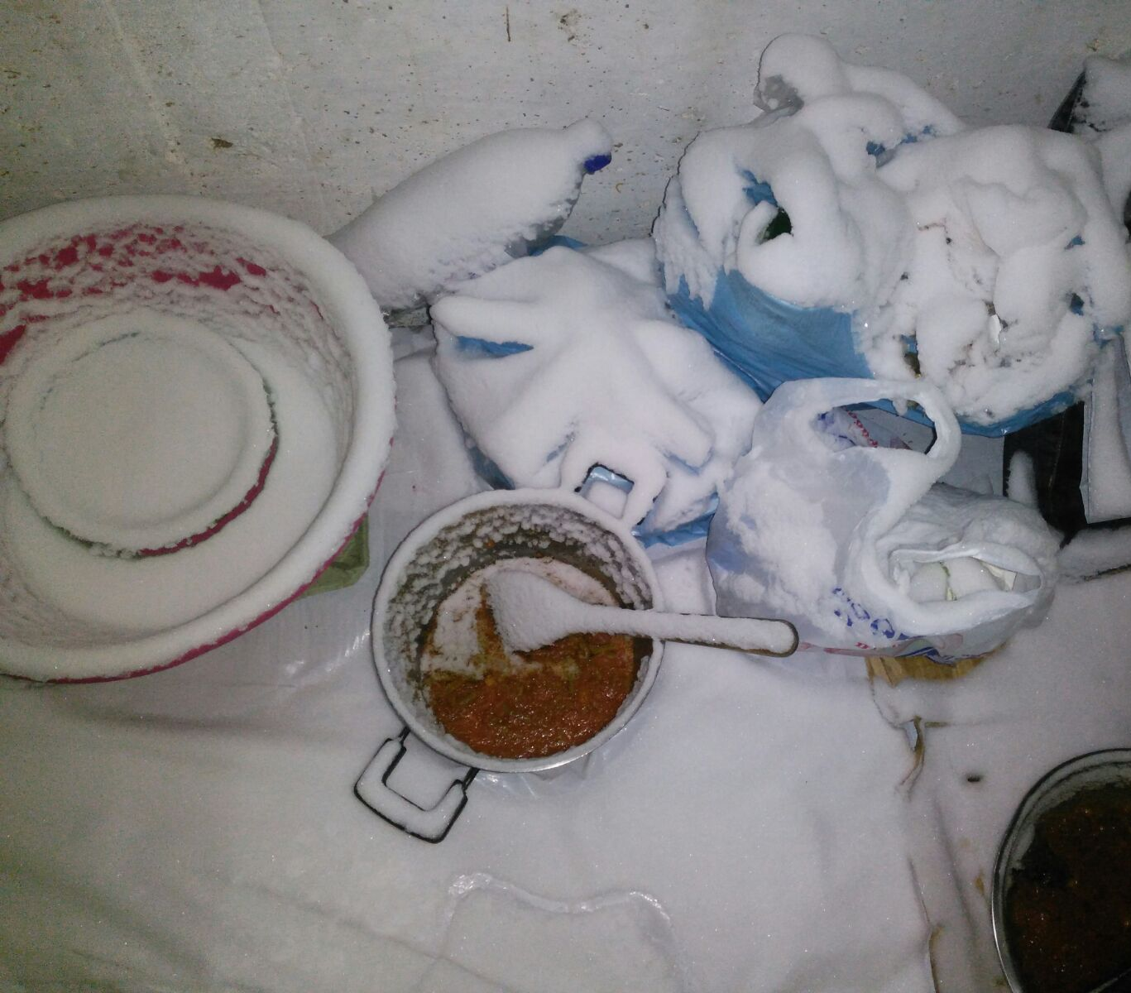
Mental health of refugees and migrants stranded in Thessaloniki, Greece, 2016-17
I Evlampidou¹, A Meimaridou¹, R Moisidou¹, G Toskidis¹, Z Marmouri¹, O Al Massri¹, S Boufidis¹, D Barry², F Zamatto³, N Severy⁴
1 Médecins Sans Frontières, Thessaloniki, Greece 2 Médecins Sans Frontières, Athens, Greece, 3 Médecins Sans Frontières, Rome, Italy, 4 Médecins Sans Frontières, Brussels, Belgium
Context
Results
219/377 (58%) single psychological assessments took place in Idomeni camp (people on the move)
Stricter EU immigration policies since 2016 EU-Turkey deal
~50,000 refugees & migrants stranded in Greece in 2016-17
Inappropriate living conditions, violence, increased mental health (MH) burden
MSF psychologists: 659 patients, 2937 sessions (mean: 4, IQR: 1-35) (Fig. 1)
MSF psychiatrist: 105 patients, 476 sessions (mean: 5, IQR: 1-16) (Fig. 1)
Socio-demographic characteristics: Table 1
 | Psychologists (N=659) |  | Psychiatrist (N=105)
Characteristic | n | % | n | %
Female | 290 | 44 | 40 | 38
Child (<18 years) | 97 | 15 | 6 | 6
Syria, Afghanistan, Iraq | 545 | 83 | 69 | 66
Vulnerable | 364 | 26 | 24 | 23
History of MH problem | 192 | 53 | 14 | 58
Single parent with minor child | 53 | 15 | 2 | 8
Physical illness | 48 | 13 | 11 | 46
Figure 1. Number of sessions per patient and professional, MSF, Thessaloniki, 2016-17
MSF Project
Psychological and psychiatric support to refugees & migrants stranded in Thessaloniki region, Greece
Four MSF psychologists & one psychiatrist with cultural mediators
Sessions in camps, hotels, shelters, open air, MSF/psychiatrist practice, gas/train/police stations
Patient identification via health promotion sessions, self/peer/NGO referral or MSF staff (psychologist to psychiatrist and vice versa)
Psychiatric medication provided when needed
Table 1. Socio-demographic characteristics and vulnerabilities during first psychological and psychiatric assessment, Thessaloniki, 2016-17
MSF psychologists (1st assessment):
Migration journey: median 2.5 months (IQR: 0.2-16.3);
Stranded in Greece: median 4.6 months (IQR: 2.4-7.1)
91% (N= 597) experienced traumatic life-events & difficulties during migration or while stranded in Greece (Fig. 2)
Figure 3. Presenting category of symptoms, 1st psychological assessment, MSF, Thessaloniki, 2016-17
Aim
To describe the mental health status and traumatic experiences of people accessing MSF mental health services in Thessaloniki, Greece in 2016-2017, to guide programmatic decisions.
Most common presenting symptoms at 1st psychologist session: Depression, adjustment, anxiety (Fig. 3)
More females suffered from depression and anxiety & more males from behavioural symptoms
Figure 2. Self-reported traumatic life experiences, 1st psychological assessment, MSF, Thessaloniki, 2016-17
Methods
Data collection - analysis
Inclusion period:
    Psychologist assessments: April 2016-August 2017
    Psychiatrist assessments: August 2016-August 2017
Retrospective analysis of anonymous, standardised routine patient data
Study definitions
Vulnerability: history of MH problem, under 5 years, unaccompanied minor, pregnant, elderly, single parent with minor children, disabled, chronic physical illness
Traumatic life events/difficulties: situations experienced that affected the patient physically or emotionally, experienced before, during or after the migration trip (self-reported, non-probed)
Limitations
Non-stable population, unreliable denominators
Misclassification of diagnosis during 1st assessment
MSF psychiatrist (1st assessment)
Conclusion
75 (71%) referred by MSF psychologist
69 (66%) living in camps, 36 (34%) in hotels, apartments or shelters
Common diagnostic categories (ICD-10): PTSD (48%), Depression (42%) (Fig. 4)
Most common symptoms (of): depression, adjustment, anxiety & PTSD
Torture, violence, and other traumatic life-events, being stranded, vulnerable, inappropriate living conditions, financial hardships and an unknown future may have caused or aggravated MH symptoms
@MSF/Tamim Elnaggar
Recommendations
Figure 4. Psychiatric diagnoses (ICD-10), 1st assessment, MSF, Thessaloniki, 2016-17
National and European authorities, NGOs:
Review restrictive policies
Ensure safety, appropriate living conditions
Provide MH screening
Scale up full, free access to culturally adapted MH services, including psychiatry
Establish/expand child and adolescent psychiatric care
No difference in morbidity between females & males
Comorbidity:
  130 disorders diagnosed among 104 individuals
  20 (19%) patients with depression and PTSD
Outcome:
  45 (67%) stable, 16 (24%) improved, 6 (9%) deteriorated
  18 (17%) referred to other actor for investigation or follow-up
Acknowledgements
The patients, volunteers, field, coordination & headquarter teams. Contact: iro.evlampidou@gmail.com

