Slide 1
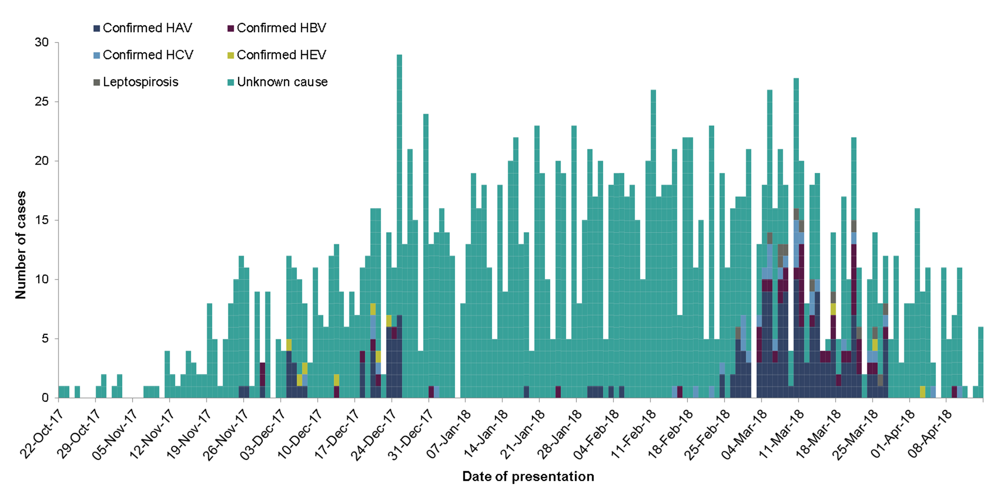
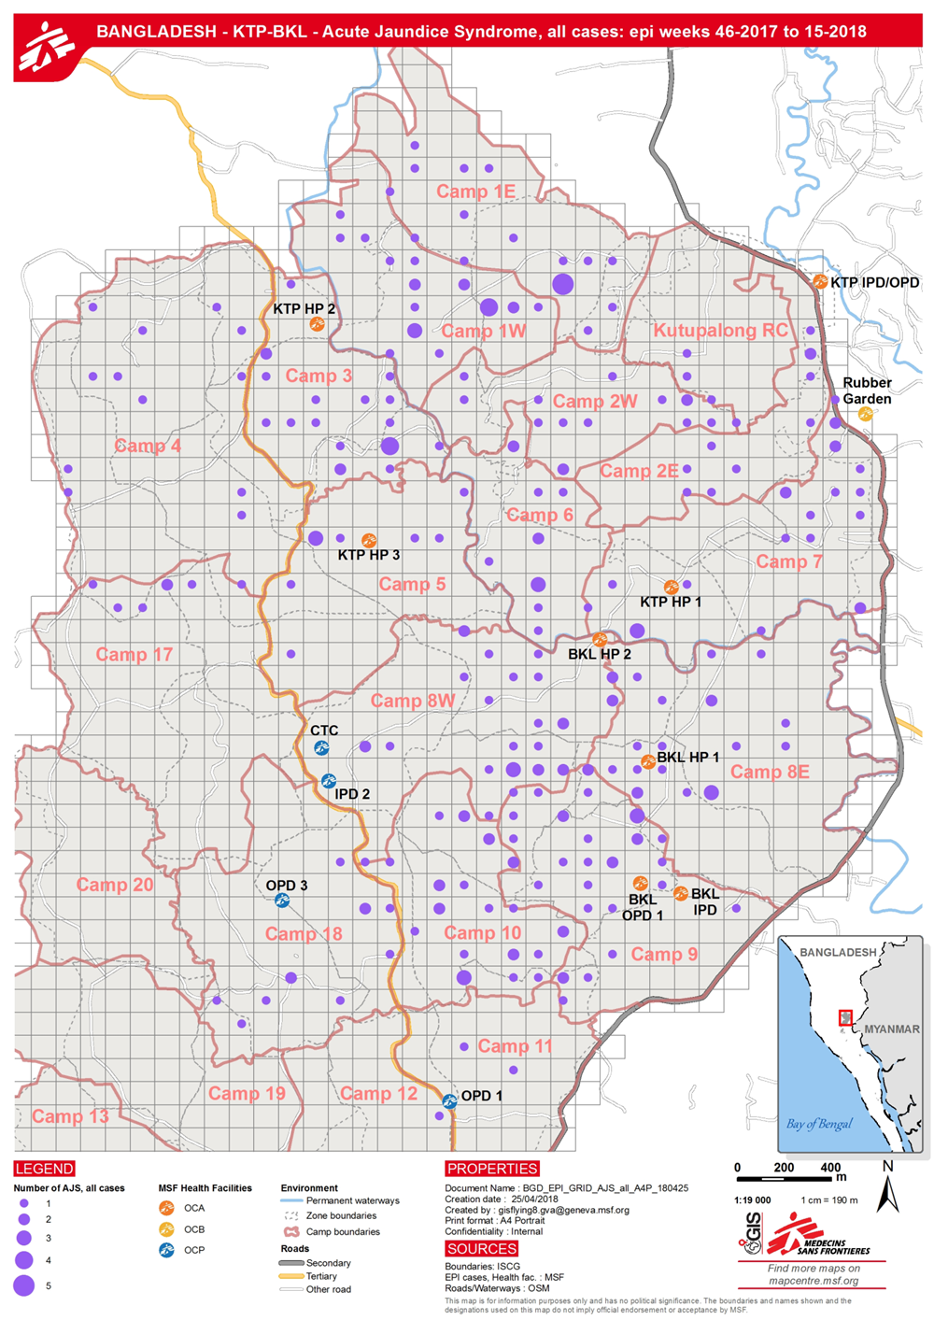
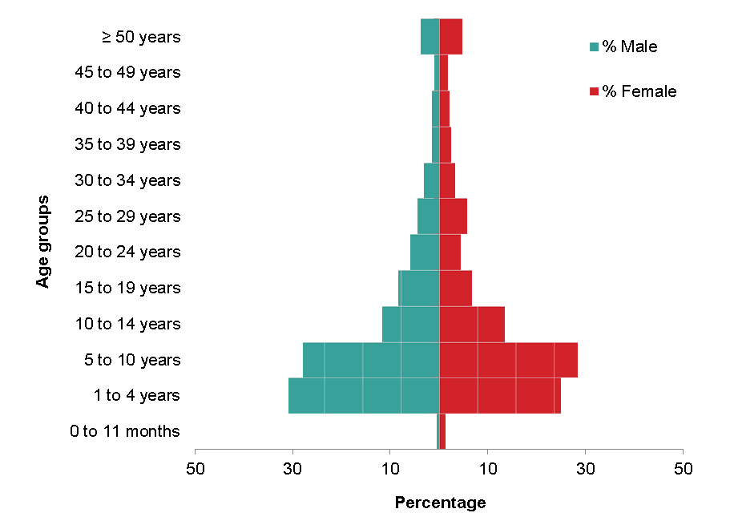
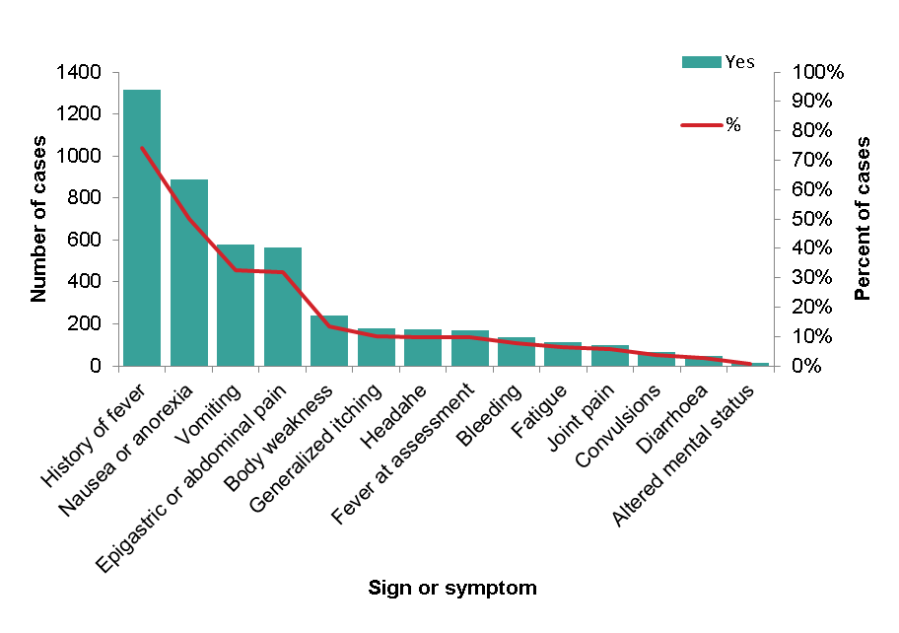
Outbreak of Acute Jaundice Syndrome (AJS) in Cox’s Bazar, Bangladesh
Monique Pereboom¹, Melissa Ivey², John Guzek², Crystal van Leeuwen², Kate White², Ruby Siddiqui³
¹Field Epidemiology Training Programme (FETP), Public Health England, UK; ² Médecins Sans Frontières (MSF), Amsterdam, Netherlands; ³ Médecins Sans Frontières (MSF), London, UK
BACKGROUND
Since August 2017, approximately 621,000 Rohingya have fled Myanmar into Bangladesh. The majority live in settlements in Cox’s Bazar.
The settlements have a high population density with poor water and sanitation conditions. An increase in cases of AJS has been noted since mid-October.
Health-facility based line-listing of AJS cases commenced in MSF health facilities in epidemiological week 46, 2017.
Objective
Describe the current ongoing AJS outbreak in terms of time, person and place in the settlements in which MSF operates
RESULTS
1,775 AJS cases reported between 22 October 2017 and 14 April 2018
Steady increase of AJS cases between November 2017 and March 2018, followed by a decline in the number of cases presenting to MSF health facilities (Figure 1)
Overall, serologic testing was performed on 293 blood samples (16.5%), with the majority being infected with hepatitis A infection (9.7%) (Table 1).
Fifty-five samples (3.1%) tested negative for hepatitis A, B, C, E and leptospirosis (Table 1)
The majority of cases (86.1%) were not tested for hepatitis A, B, C, E and leptospirosis (Table 1)
Table 1. Serology and RDT testing results of AJS cases
METHODS
MSF health-facility based AJS line-list data analysed from 23 October 2017 to 14 April 2018
Weekly epidemic trend (epidemic curve), age and sex distribution of cases, and geographical spread were analysed
Serologic confirmation of AJS cases was conducted for a sample of cases in Dhaka at the beginning of the outbreak between November and December 2017. Exhaustive serological testing of AJS cases presenting at health facilities was organised by the WHO to identify the etiology of ongoing transmission between 25 February and 31 March 2018
Priority cases only (e.g. pregnant women, cases with others being ill in the same household, inpatients, host population) were tested for hepatitis B, C, and E using Rapid Diagnostic Tests (RDTs)
Case definition
Acute jaundice syndrome of unknown etiology was defined as any person presenting with jaundice of less than 8 weeks duration and any of the following symptoms: nausea or anorexia, vomiting, abdominal pain, fever, itching, joint pain, fatigue, headache, diarrhoea, bleeding or convulsions.
A confirmed case of viral hepatitis A, B, C, or E or leptospirosis was defined as any person meeting the above case definition and testing positive on either a rapid diagnostic test or serologic antibody testing for a particular virus causing hepatitis or the Leptospira bacteria.
* Some cases tested positive for more than one infectious agent. Therefore, adding the number of confirmed cases and cases with unknown etiology exceeds the recorded total of 1,775 cases.
** Negative for hepatitis A, B, C, and E, and leptospirosis
Figure 1. Epidemiological curve of AJS cases by date of presentation and etiology, 22 October 2017 to 14 April 2018
Median age of AJS cases was 8 years (range: 1 month to 90 years), with 55.8% of AJS cases being male (Figure 2)
The majority of cases suffered from fever (74.1%), nausea (50.1%), and vomiting (32.6%) (Figure 3)
Among female AJS cases, 1.8% were pregnant; 12 pregnant women were not tested, none tested positive for hepatitis E infection, and one tested positive for hepatitis C infection
Geographical mapping of 297 (27.4%) households in Balukhali and Kutupalong settlements showed cases were distributed throughout the settlement (Figure 4)
Figure 2. Age and sex distribution of AJS cases
Figure 3. Number and proportion of AJS cases reporting signs and symptoms
Figure 4. Cases of AJS in Balukhali and Kutupalong settlements, week 46-2017 to week 15-2018
CONCLUSION
There is a mixed etiology among AJS cases with the majority of cases infected with hepatitis A
AJS cases are ubiquitously spread throughout the settlements
Improvements in water, sanitation and hygiene conditions throughout the camps is necessary
A small proportion of AJS cases were caused by hepatitis E or leptospirosis, however with the upcoming monsoon season, these diseases may become a concern
LIMITATIONS
Due to limited availability of reagents in the laboratory in Dhaka, testing was only conducted at the beginning of the outbreak, and in March 2018.
Due to the limited supply of RDTs for hepatitis B, C, and E, only priority cases were tested in health facilities
Positive laboratory results were well documented, but negative results were not consistently recorded
Only a small proportion of the households with AJS cases were mapped
Ethical considerations
This research fulfilled the exemption criteria set by the MSF-ERB for a posteriori analyses of clinical data and thus does not require MSF-ERB review. It was conducted with permission from Sidney Wong, Medical Director, MSF-OCA.

