Slide 1
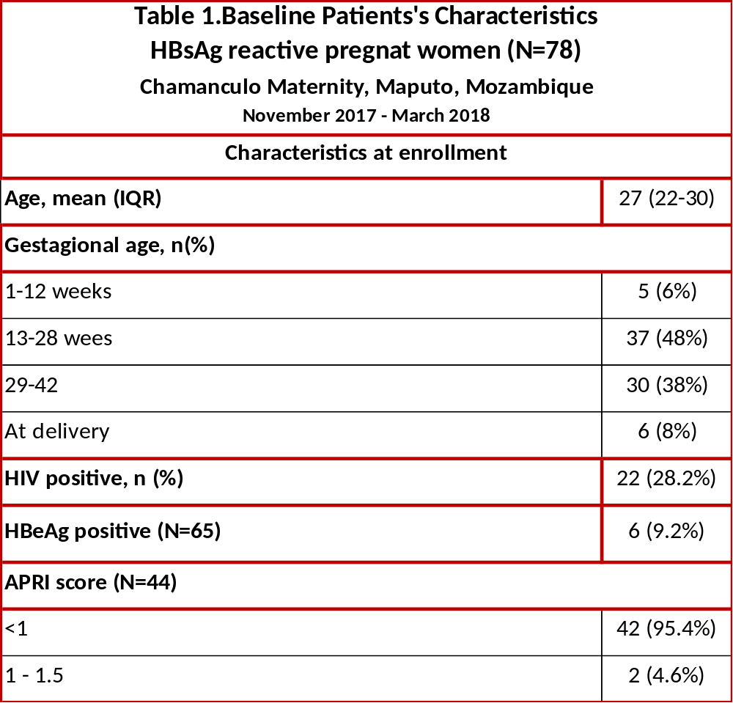
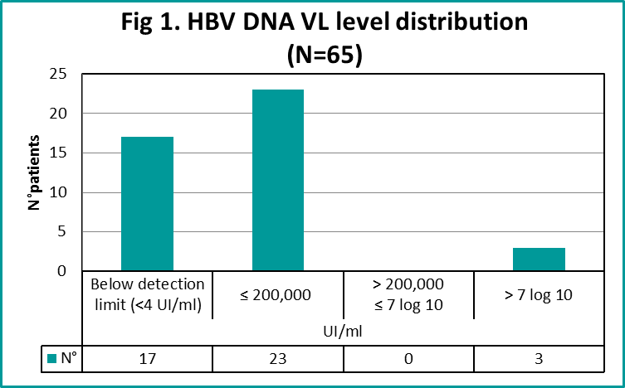
Integrated Hepatitis B prevention in PMTCT program in Chamanculo maternity, Maputo, Mozambique
Natalia Tamayo Antabak¹, Anne Loarec², Aude Nguyen³, Námita Da Conceição Milicinho Eliseo⁴, Lucas Molfino¹,
Javier Goiri³, Iza Ciglenecki³, Ana Mafalda Chissano¹.
¹Médecins Sans Frontières, Maputo, Mozambique, ²Epicentre, Paris, France, ³Médecins Sans Frontières, Geneva, Switzerland.
⁴HIV Programme, Maputo Ministry of Health (MoH), Mozambique.
Introduction
Results
Hepatitis B infection (HBV) in endemic areas is most commonly spread from mother-to-child at birth or from person-to-person in early childhood.
When HBV prevalence is above 2% in general population, WHO recommends routine antenatal HBsAg screening, with linkage to prevention, treatment and care services which includes
*identification of pregnant women
with high HBV viremia,
*assessment for need of prophylactic
antiviral therapy in the 3rd trimester,
* birth-dose (BD) HBV vaccine into
the universal vaccination schedule
*implementation of full HBV vaccine
coverage (to complete 3 doses)
According to the WHO, in 2017, the HBV prevalence estimate in African region was 6.1%. In Mozambique, reported prevalence is as high as in African region or higher.
Neither screening not BD vaccine and HBV treatment are available for PMTCT in Mozambique public health system.
Since November 2017, Médecins sans Frontieres (MSF) supports MOH in piloting the integration of HBV diagnosis, care and prevention into existing HIV PMTCT in Chamanculo maternity, Maputo, Mozambique. We present the first results of HBV screening.
From November 2017 until March 2018
2,197 pregnant women were screened for HBsAg as part of routine ANC follow up
Out of them , 78 were diagnosed with Hepatitis B - positive HBsAg (3.5%) (See Table 1)
HBeAg pos.rate was 9.2%
HBV DNA VL level >200,000 UI/ml is considered for TDF peripertum, which corresponds just to 3 patients (4.6%) in our cohort (Figure 1)
In HBsAg+, HIV coinfection was detected in 28.2% %) patients
No patient had abnormal ALT level, and no one patient fulfilling treatment criteria
Integration of HBV care into ANC and Maternity routine activities is feasible, with HBV testing and vaccination done by MoH staff
Methods
Conclusion
As part of routine antenatal care and delivery services, all pregnant women are offered:
screening with HBsAg rapid diagnostic test (RDT)(Alere Determine™ HBsAg);
if HBsAg RDT is positive, blood is collected for HBeAg, HBV Viral Load (VL) and AST/Platelets ratio (APRI), non-invasive liver fibrosis assessment;
HBV treatment if WHO criteria
HBV birth dose (BD) vaccine for all HBV exposed newborns
We documented an HBV prevalence of 3.5% in a cohort of pregnant women in Maputo, highlighting the need of
implementation for
** routine HBsAg screening in ANC and maternity services
** HBV birth dose vaccination inclusion in national immunization schedule
** access to HBV treatment.
Integration of HBV care into current MoH ANC and Maternity activities was successfully implemented, supporting
the possibility of being a sustainable intervention for public health system in long term.
Acknowledgements
We would like to thank all the staff involved in these activities, the communities and patients, the Ministries of Health and partners of different sites
For questions or comments
Natalia Tamayo Antabak
Email: msfch-chamanculo-hepatitis@geneva.msf.org

