Slide 1
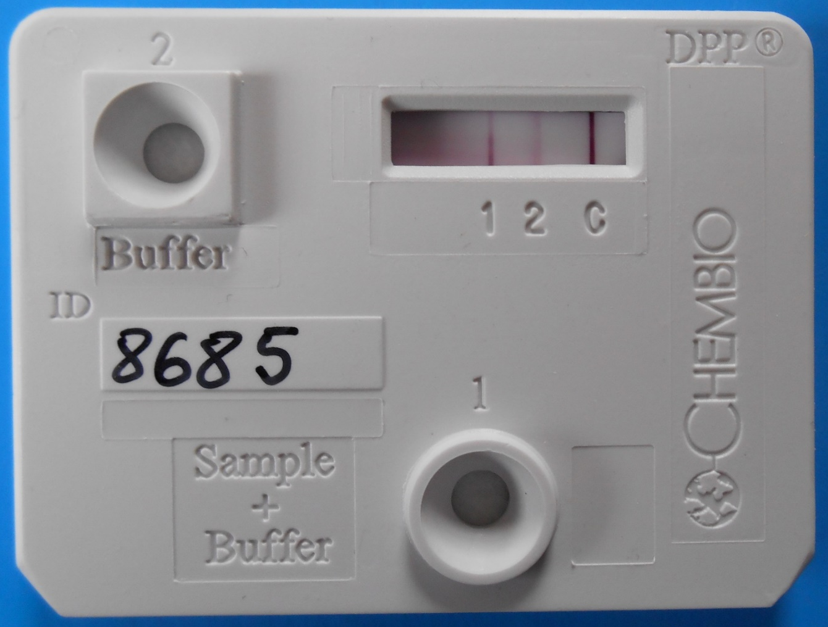
No Reduction in Over-treatment for Syphilis Using a Novel Dual Rapid Diagnostic Test in Pregnant Women
C Langendorf¹, C Lastrucci², I Sanou-Bicaba³, K Blackburn⁴, M-H Koudika², R F Grais¹, T Crucitti⁵
¹Epicentre, Paris, France; ²Médecins Sans Frontières (MSF), Paris, France; ³Ministère de la Santé du Mali, Bamako, Mali; ⁴MSF, Sydney, Australia; ⁵Institute of Tropical Medicine, Antwerp, Belgium
Introduction
Results
Screening pregnant women for syphilis using rapid diagnostic tests (RDTs) is a key tool in the prevention of congenital syphilis. However, most syphilis RDTs detect only treponemal antibodies
(T-RDT), meaning antibiotics may be provided unnecessarily to previously treated pregnant women.
A new immunochromatographic RDT, Dual Path Platform Syphilis Screen and Confirm assay (DPP test, CHEMBIO Diagnostic System, Inc, USA) combines simultaneous detection of treponemal (T) and non-treponemal (NT) antibodies.
In countries affected by increasingly common shortages of Benzathine penicillin, medication for preventing congenital syphilis must be prioritized for those who do really need it.
242 pregnant women were included from May to August 2014.
  Median age = 25y
  No history of syphilis or current clinical symptoms of syphilis
Prevalence of presumptive active syphilis: 37.6% (51% with RPR titre≥1:8)
DPP inter-user agreement : T-line = 0.95; NT-line = 0.75.
DPP testing did not reduce the number of incorrectly treated cases
(over-treatment) compared to T-RDT (p=0.2) (Figure 3).
DPP testing had a higher proportion of under-diagnosis compared to T-RDT (p<0.001). Therefore, 48.4% (44) of women needing treatment (including 16% with high RPR titres) would not have received it if only DPP testing had been used, versus 2.2% (2) cases that would have been missed using T-RDT testing (Figure 3).
We estimated the potential reduction in overtreatment when comparing T-RDT (SD Bioline Syphilis Test) to the DPP test.
Methods
Figure 2. DPP test, CHEMBIO Diagnostic system. © Céline Langendorf, 2014.
Study design: Prospective study
Study area: Maternity of Deou, Burkina Faso
Inclusion criteria:
  Pregnant woman
  Attending antenatal consultations in study site
  Eligible for routine syphilis screening according to routine practices in the maternity
  Consent to participate to the study
  No exclusion criteria
Interventions
Participants N = 242
Presumptive active syphilis NEED TREATMENT
n=91 (37.6%)
NO active syphilis
NO NEED TREATMENT
n=151 (62.4%)
Enrolment of pregnant women
Finger prick blood collection
Consultation room
Midwives
Venous blood collection
No treatment
using DPP
n=44 (48.4%)
No treatment
using T-RDT
n=2 (2.2%)
Over-treatment using DPP
n=0 (0.0%)
Over-treatment using T-RDT
n=6 (4.0%)
Field laboratory – Lab technician
DPP test
1st user
Whole blood
Plasma extraction
P<0.001
P=0.2
SD Bioline Syphilis test
DPP test
2nd user
Plasma storage for shipment to ITM reference lab
Figure 3. Proportions of potential underdiagnosis and overtreatment using T-RDT or DPP tests
Negative
Positive
Picture : 3rd reading
Conclusion
RPR qualitative
In this first evaluation comparing DPP to traditional screening methods in pregnant women, we saw no reduction in unnecessarily treated syphilis and an underestimation of those needing treatment.
High prevalence of presumptive active syphilis in the population may indicate the presence of non-venereal treponematoses in the area as previously shown in the 80’s.
The sensitivity of the DPP test was lower compared to other studies performed in behavioral high risk groups or symptomatic patients. However, this test cannot be used in screening for syphilis unless further study in other contexts shows better performance.
Negative
Positive
Reference tests
TPPA/RPR quantitative
No treatment
No treatment
Treatment
Figure 1: Description of study activities
Analysis:
  Primary endpoints: DPP results by midwives and laboratory technician; SD Bioline results by laboratory technician; reference tests results (TPPA and RPR) done at the Institute of Tropical Medicine (ITM), Antwerp, Belgium.
  Presumptive active syphilis: detection of T and NT antibodies.
  McNemar test for paired samples: compare proportions of falsely treated cases or falsely non treated cases between different algorithms (significance level p = 0.05).
Ethical considerations: Ethics approval was granted by the National Ethical Committee of Burkina Faso, ITM-Ethical Review Board and the Comité de Protection des Personnes in France.
Acknowledgements
We are grateful to the pregnant women who participated in this study. We also wish to thank the Ministry of Health in Burkina Faso and the staff working in Deou health centre.

