Slide 1
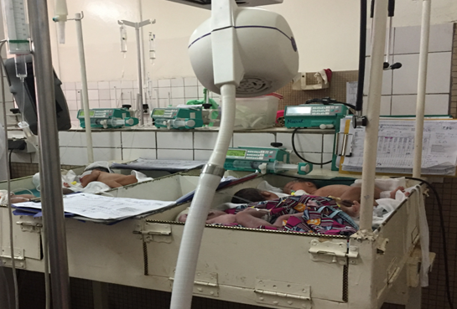
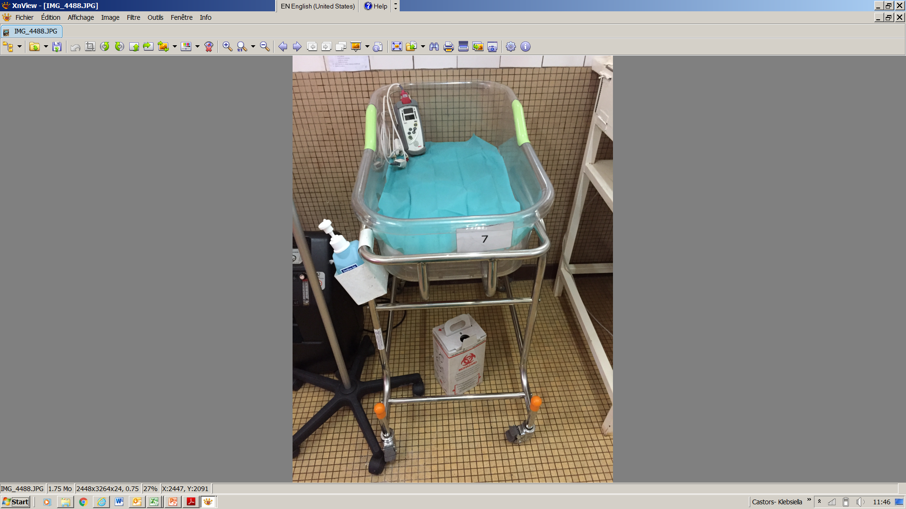
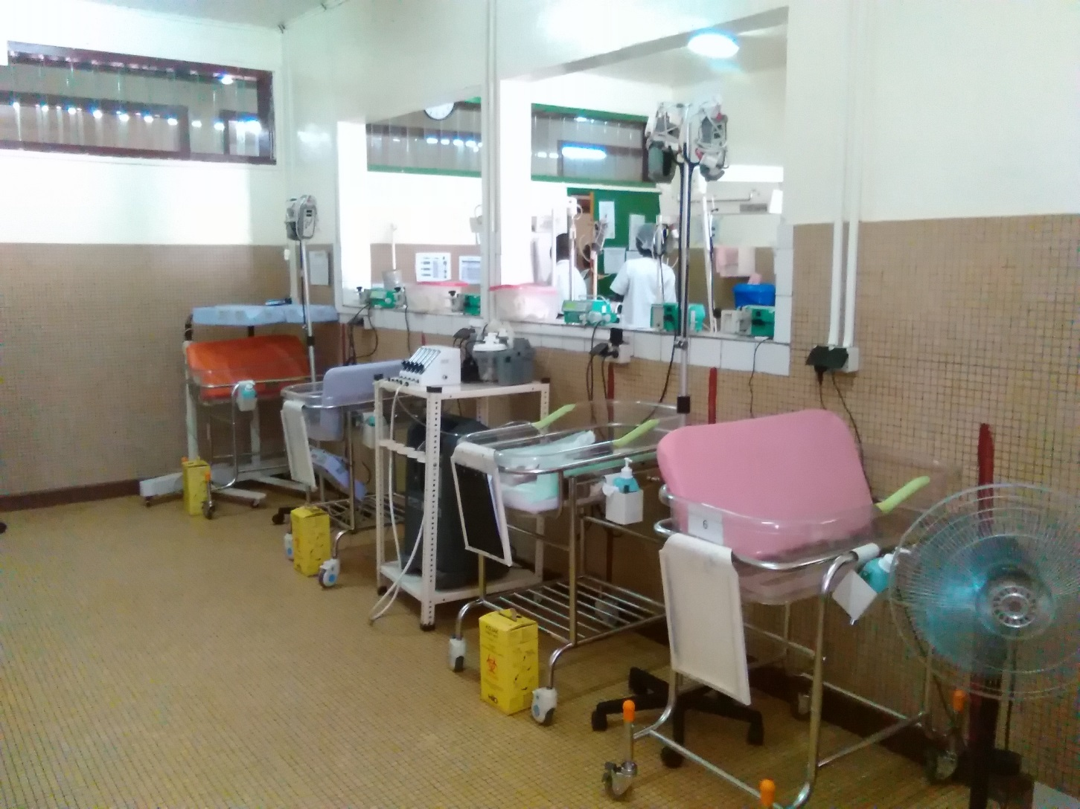
Outbreak of ESBL Klebsiella pneumoniae in a maternity unit in Central African Republic
Gil Cuesta J¹, Thallinger M², Antierens A¹, Caluwaerts A¹, Chaillet P¹, De Clerck H¹, D’Hondt R¹,
Di Stefano L², Lambert V¹, Mabvouna Biguioh R², Mazzeo V², Ogundipe O¹, Tremblay N¹, Yabingui JB², Zuniga I¹, Van den Bergh R¹, Van Herp M¹
¹ MSF Brussels, Belgium, Operational Centre Brussels
² MSF Central African Republic, Bangui project, Operational Centre Brussels
Corresponding author: julita.gil@luxembourg.msf.org
RESULTS
By December 30th, 25 confirmed cases of ESBL-KP were reported, with a 28% case fatality rate (n=7):
Main symptoms were fever, jaundice and respiratory distress. 52% showed an onset of symptoms within 72 hours after birth (n=13).
Antibiotic susceptibility testing showed 100% resistance to Ampicillin, Gentamicin, Cefotaxime and Ceftriaxone
The second line treatment changed from Ampicillin and Cefotaxime to Imipenem/Meropenem with or without Amikacin with subsequent de-escalation to the standard protocol.
Being resuscitated immediately after birth was the only risk factor significantly associated with being a ESBL-KP case (Table 1)
ESBL-KP was isolated from sinks, but was not found in water samples
BACKGROUND
In March 2017, an outbreak of Klebsiella pneumoniae ESBL (ESBL-KP) was reported at the neonatal unit of the MSF-supported maternity in Bangui, CAR (Figure 1).
A comprehensive outbreak response was implemented to identify and control the potential sources:
  Clinical case identification and management
  Epidemiological investigation to assess risk factors associated with ESBL-KP cases
  Environmental investigation
  Infection Prevention and Control (IPC)
Table 1. Logistic regression comparing the risk factors for ESBL-KP neonates
with the rest of admitted neonates over this period
Risk factor | Odds Ratio | 95% CI
Male | 1.8 | 0.5-6.9
Low birth weight | 3.3 | 0.8-11.4
Prematurity | 4.3 | 0.8-23
Being resuscitated | 4.9* | 1.2-19.6
Mother with infection risk | 1.1 | 0.3-3.9
Figure 1. Castors neonatal unit before IPC interventions, March 2017 (Thallinger M)
CASE DEFINITION
Suspected ESBL-KP case is a neonate born at the maternity and admitted to the neonatal unit with suspected sepsis not responding to first line antibiotics.
*P value < 0.05
OUTBREAK RESPONSE MEASURES
IPC interventions focused on:
  Strengthening standard precautions
  Implementation of “water free” care with wet wipes for hygiene
  Reorganization (Figure 2 and 3)
  Infection prevention in the care
Admission criteria revised and number of beds in neonatal unit reduced
Continuous surveillance including hemocultures to rapidly identify suspect cases
METHODS*
Case confirmation by identification of ESBL-KP from hemoculture result and antimicrobial susceptibility testing
Logistic regression to compare the risk factors sex, low birth weight, prematurity, resuscitation at birth (bag-mask ventilation and/or Oxygen) and mother’s infectious risk (rupture of membranes > 18 hours, fever eclampsia, malaria, syphilis rapid-test positive) in confirmed ESBL-KP versus the rest of neonates
Environmental investigation including identifying potential transmission sources and sampling for microbiology analysis
*The study was exempted from MSF ERB review
CONCLUSIONS
Outbreak of multi-resistant ESBL-KP detected at the maternity due to strengthened surveillance
Nosocomial transmission likely occurred
Improvement of IPC standards, staff sensitization and training implemented to avoid new outbreaks
Surveillance maintained to rapidly identify new peaks
ACKNOWLEDGEMENTS
To the mothers and babies attending Castors and the maternity staff responding to the outbreak
Figure 2 and 3. Castors neonatal unit after IPC interventions, April 2017 (Tremblay N)

