Slide 1

Perspectives from a short-course regimen for multi-drug-resistant TB in Karakalpakstan, Uzbekistan: A qualitative study
Conflict of Interest
The author has declared no conflict of interest.
Person-centred Care in Practice
Shona Horter, Médecins Sans Frontières UK
Beverley Stringer, Nell Gray, Nargiza Parpieva, Khasan Safaev, Zinaida Tigay, Jatinder Singh, Jay Achar
¹ Médecins Sans Frontières UK; ²Ministry of Health of the Republic of Uzbekistan, ³ Republican Phtiziology Hospital #2, Karakalpakstan, ⁴ Médecins Sans Frontières Uzbekistan

Slide 2
Person-centred care: A definition
Providing care according to individual patients’ preferences, needs, values
Shared decision-making
Patient self-management
WHO End TB Strategy
Pillar 1:
Integrated, patient-centred TB care and prevention
Pillar 2:
Bold policies and supportive systems
Pillar 3:
Intensified research and innovation
Notes:
What do we mean by person-centred care… can be defined as…
Internationally recognised priority – pillar 1 of the WHO strategy to eliminate TB in the next decade, included within MSF operational strategic plan
This presentation focusing on how to implement PCC and what it can look like in reality (rather than why do PCC)
Broad concept… what does this mean in reality of our programmes
Include aim – why undertaken this analysis, what hoped to find out

Slide 3
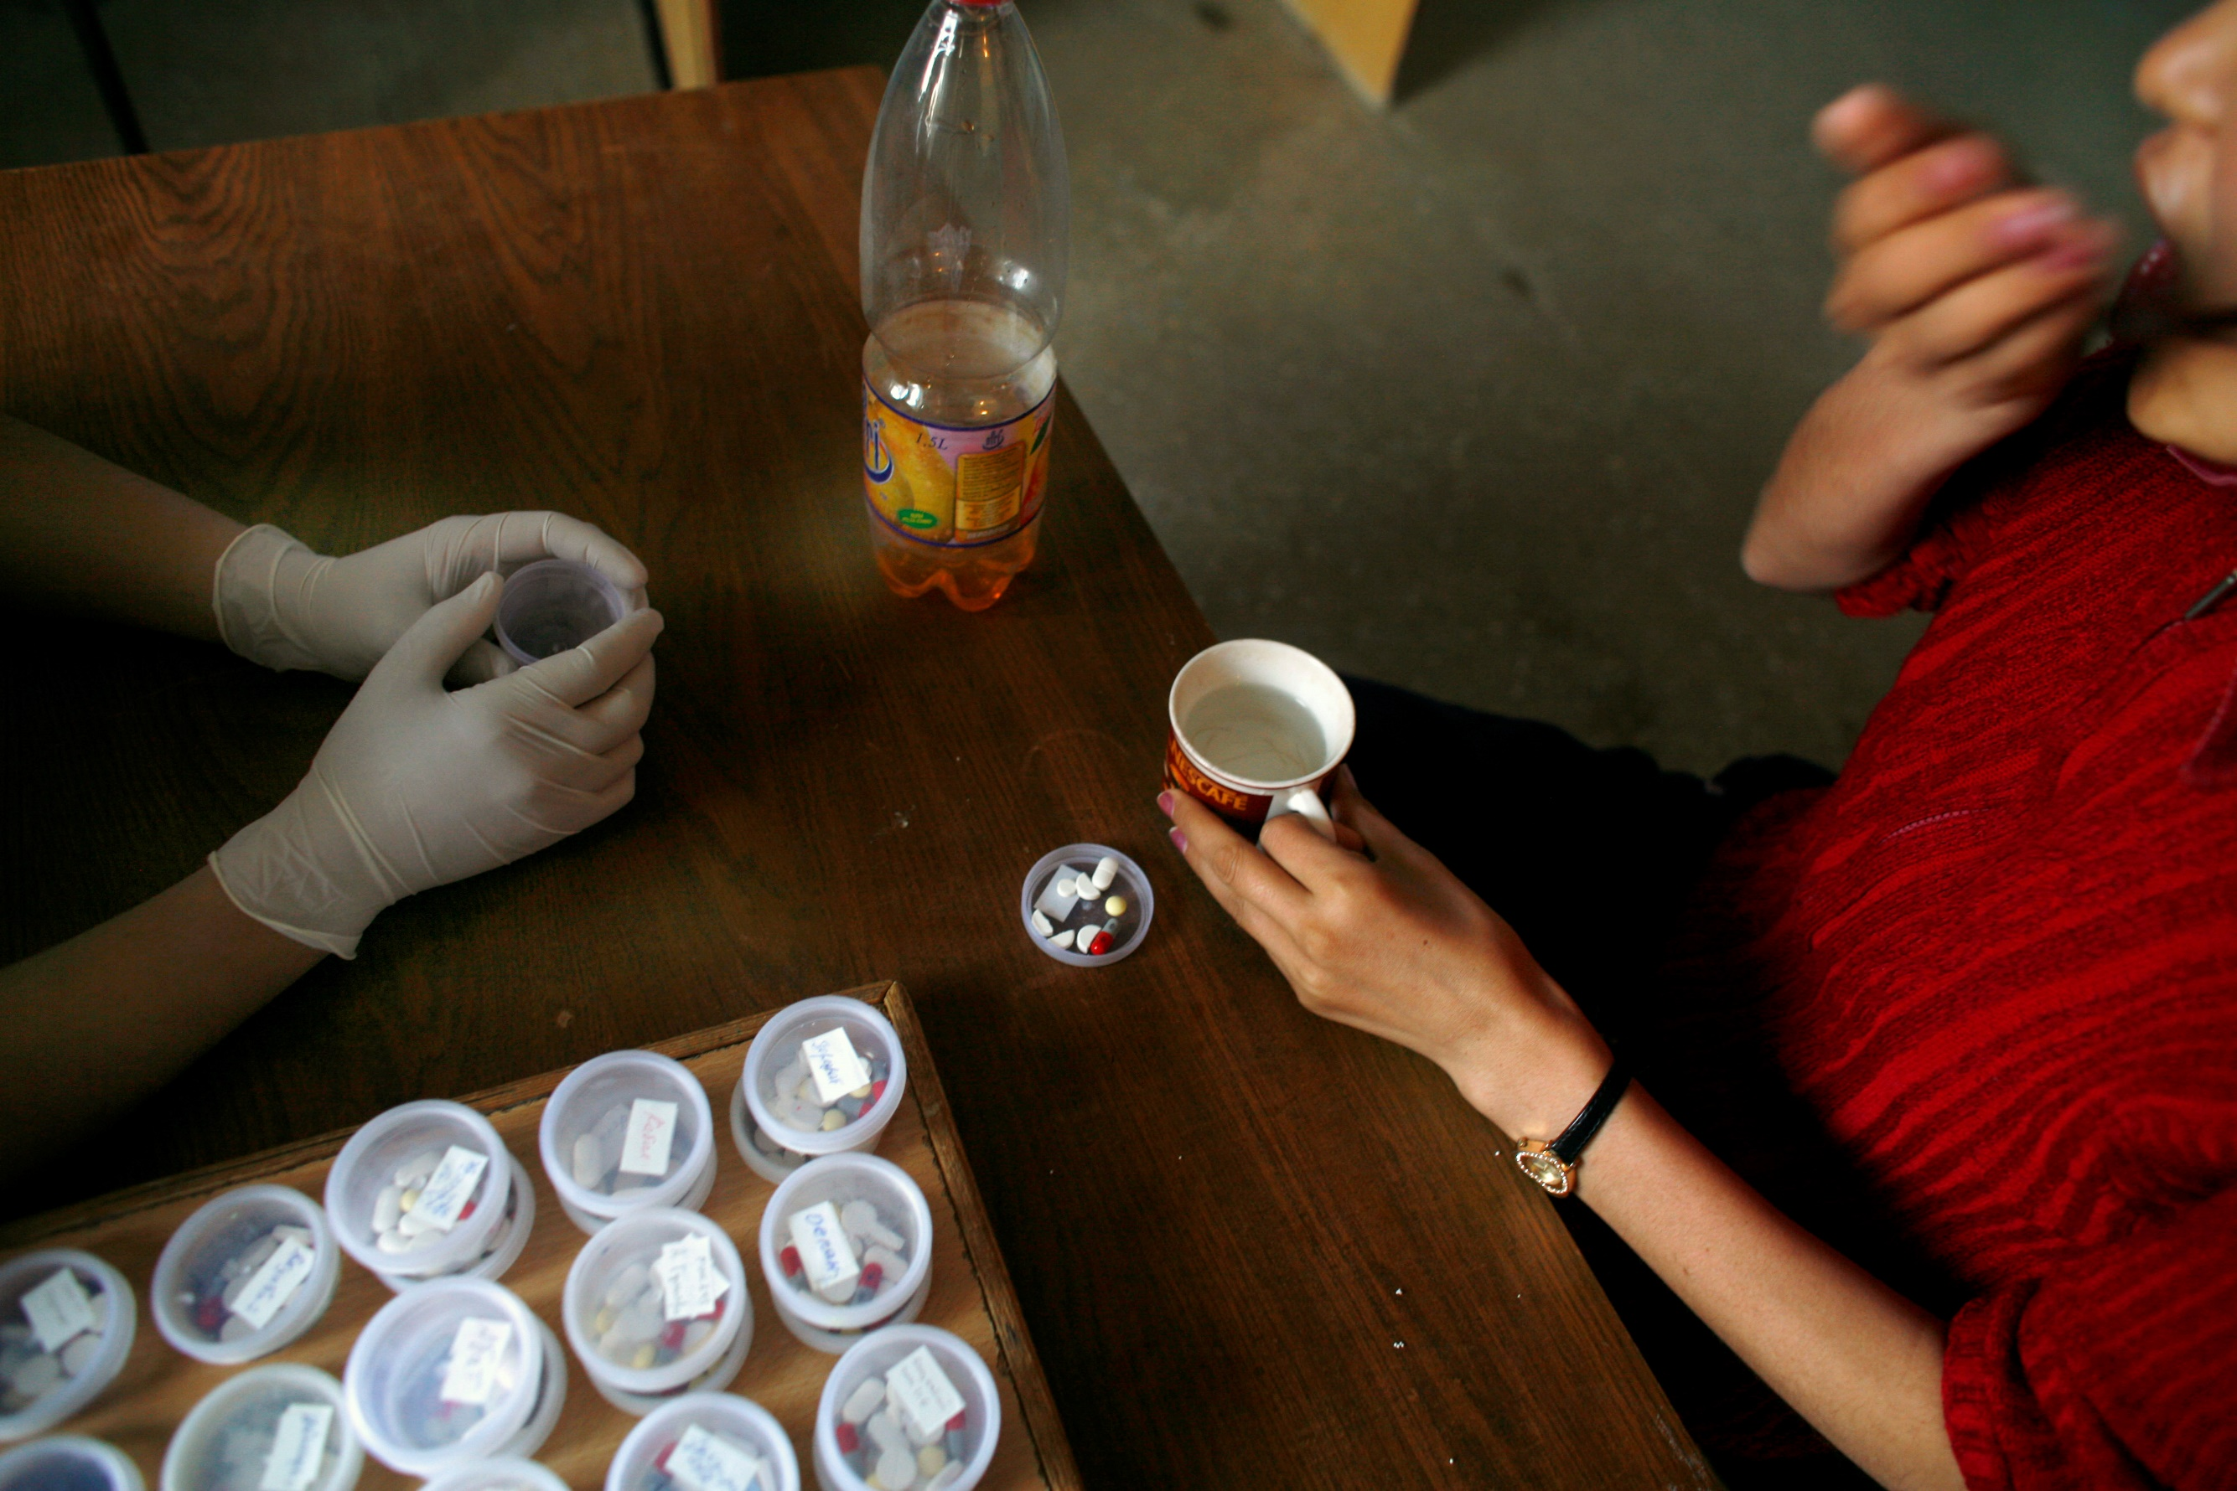
Study Aim
To examine perceptions and experiences relating to person-centred care, including shared decision-making for treatment options, to consider how the concept may be realised in practice.

Slide 4
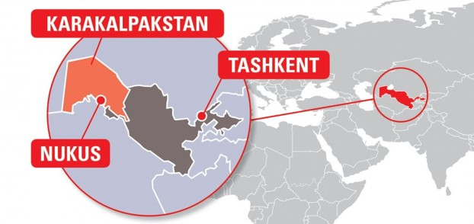
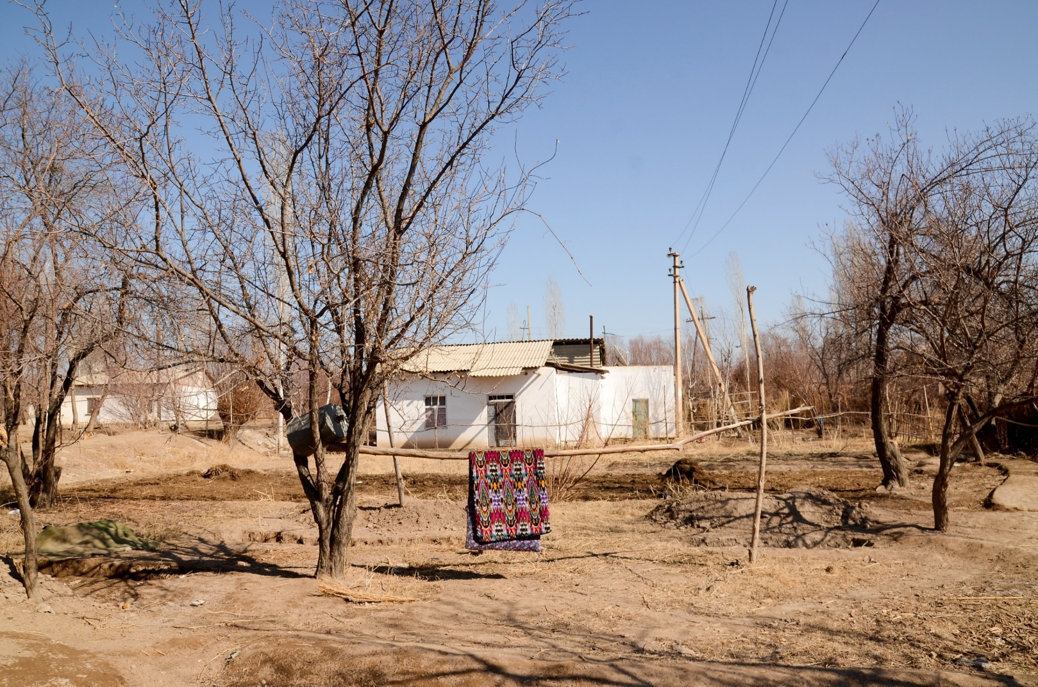
Study context: Karakalpakstan
Uzbekistan: high MDR-TB burden
MSF/Ministry of Health (MoH) comprehensive TB care project in Karakalpakstan since 1998
2019 treatment guidelines including person-centred care and shared decision-making
Changing TB treatment landscape
Notes:
Central Asia
MSF supporting the MoH response to TB and MDR-TB since 1998/2003 – reflecting high burden MDR-TB and also (why MSF is there?)
Why MSF needed this RQ answered?
2019 treatment guidelines including PCC/shared decision-making, when historically approach has been more paternalistic (doctor-led decisions)
Also changing TB treatment landscape – increasing options for treatment including short course regimen (9-11 months) and new drugs for ~20 months
Don’t know how patients and HCW feel about being involved in choice for tx and other ways in which to implement PCC in practice – what do people want/need?

Slide 5
Qualitative Study Methods
48 in-depth interviews
Purposive sampling – patients and health-care workers (HCW)
Thematic data analysis
Reflexivity
Ethics approval granted by MSF and Uzbekistan ERB
HCW participant information | Number
Total HCW Women/men | 20 15/5
Role Doctor Nurse Counsellor | 11 5 4
Employer Ministry of Health Médecins Sans Frontières | 12 8
Patient participant information | Number
Total patients Women/men Age 18-34 Age 35-58 | 24* 12/12 17 7
Treatment category On SCR treatment Completed/cured Treatment failure Relapse Transferred/on standard regimen | 15 5 3 1 4
*3 patients participated in repeat interviews
Notes:
Reduce tables

Slide 6
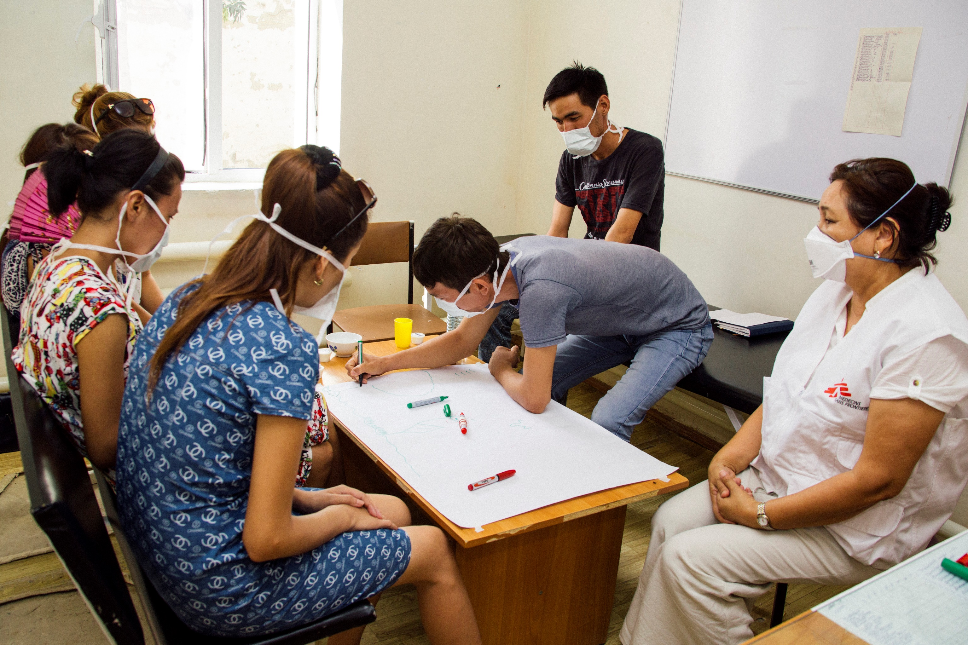
Study Findings
Shared decision-making
Involvement in care

Slide 7
Shared decision-making for treatment option
Unfamiliarity with concept of shared treatment choice
Preference for doctor to decide
Knowledge and experience imbalance – patient deferring to doctor’s authority and expertise
Trust within practitioner-patient relationships
Patient discomfort with responsibility for choice (and potential blame)
Patients enacting choice in other areas
“The doctors never think anything bad for you and they will give whichever one is best; it is better that doctors give treatment. Choosing it myself, I might make a mistake.” P24
“Here people are brought up like this; the patient comes, the doctor checks them and gives out a prescription… If you tell them that they have two options and to choose one, then the patient questions whether the doctor is going to treat them.” HCW14
Notes:
Choice for tx location – sometimes even going against HCW advice in asserting preference

Slide 8

Dissonance in Treatment Preferences
Patient versus HCW priorities:
    Patients wanting shorter treatment
    HCW concerns about insufficient treatment duration
International changes versus patient preferences:
    International move to oral-only regimens
    Patient priority for reduced pill burden: swallowing pills perceived most difficult to tolerate
“We are not including patients into SCR, that is it!... Our doctors do not want to prescribe SCR.” HCW13
“I think it would be nicer if there were no tablets, and there would be only injections… with the injection, they just inject and that’s all, but tablets… you need to swallow and then suffer.” P02
Notes:
Dissonance between pt and HCW perspective
e.g. Pts wanting shorter tx, doctors not trusting reg so not prescribing
e.g. international priority for oral-only regimen??

Slide 9
Involvement in Care
Importance of information and understanding
  Treatment expectations
  Readiness
  “My body, my right”
Experiential conceptions of treatment need and effect
  Through symptoms improving, sputum/culture results, peer-to-peer information
  Instilling belief in treatment and hope for cure
“It is my life, that is why I should know what is happening, what are they doing?... It is hidden, but I want it to be told openly” P14
Notes:
Info and understanding – limited, e.gs of asking qs and not getting answers, my body my right
Experiential conceptions of tx necessity and effectiveness – e.g. many describing long period of time with symptoms prior to seeking dx and care, evidence of tx working through results / symptoms improving
Treatment readiness, expectations
However, Misinformation undermining trust and engagement
- Changes in results and tx length not always communicated
Results not always communicated – especially when change in tx length is required – can undermine trust and motivation
Being involved, believing in need for tx, understanding purpose, expectations, readiness --? Ownership and self-responsibility – determination, motivation, prioritisation

Slide 10

Involvement → Ownership
Ownership and self-responsibility for health and treatment
Supporting sustained treatment-taking through:
    Determination
    Prioritisation of treatment
Regulated approaches to treatment delivery, e.g. Directly Observed Therapy (DOT) may undermine
“The doctors were making us take the drugs… they were controlling it.” P05

Slide 11
Conclusions
Person-centred care in context:
  Involving patients in discussions
  Supporting understanding and belief in treatment
  Seeking patients’ preferences
  Preference for doctor to decide on treatment
Consider community/family DOT
Need for contextually tailored person-centred approaches
Notes:
Strengths and limitations?
PCC delivery – moving away from regulated approaches where locus of control for treatment intake lies with HCW towards more PCC ones e.g. community/family DOT.

Slide 12
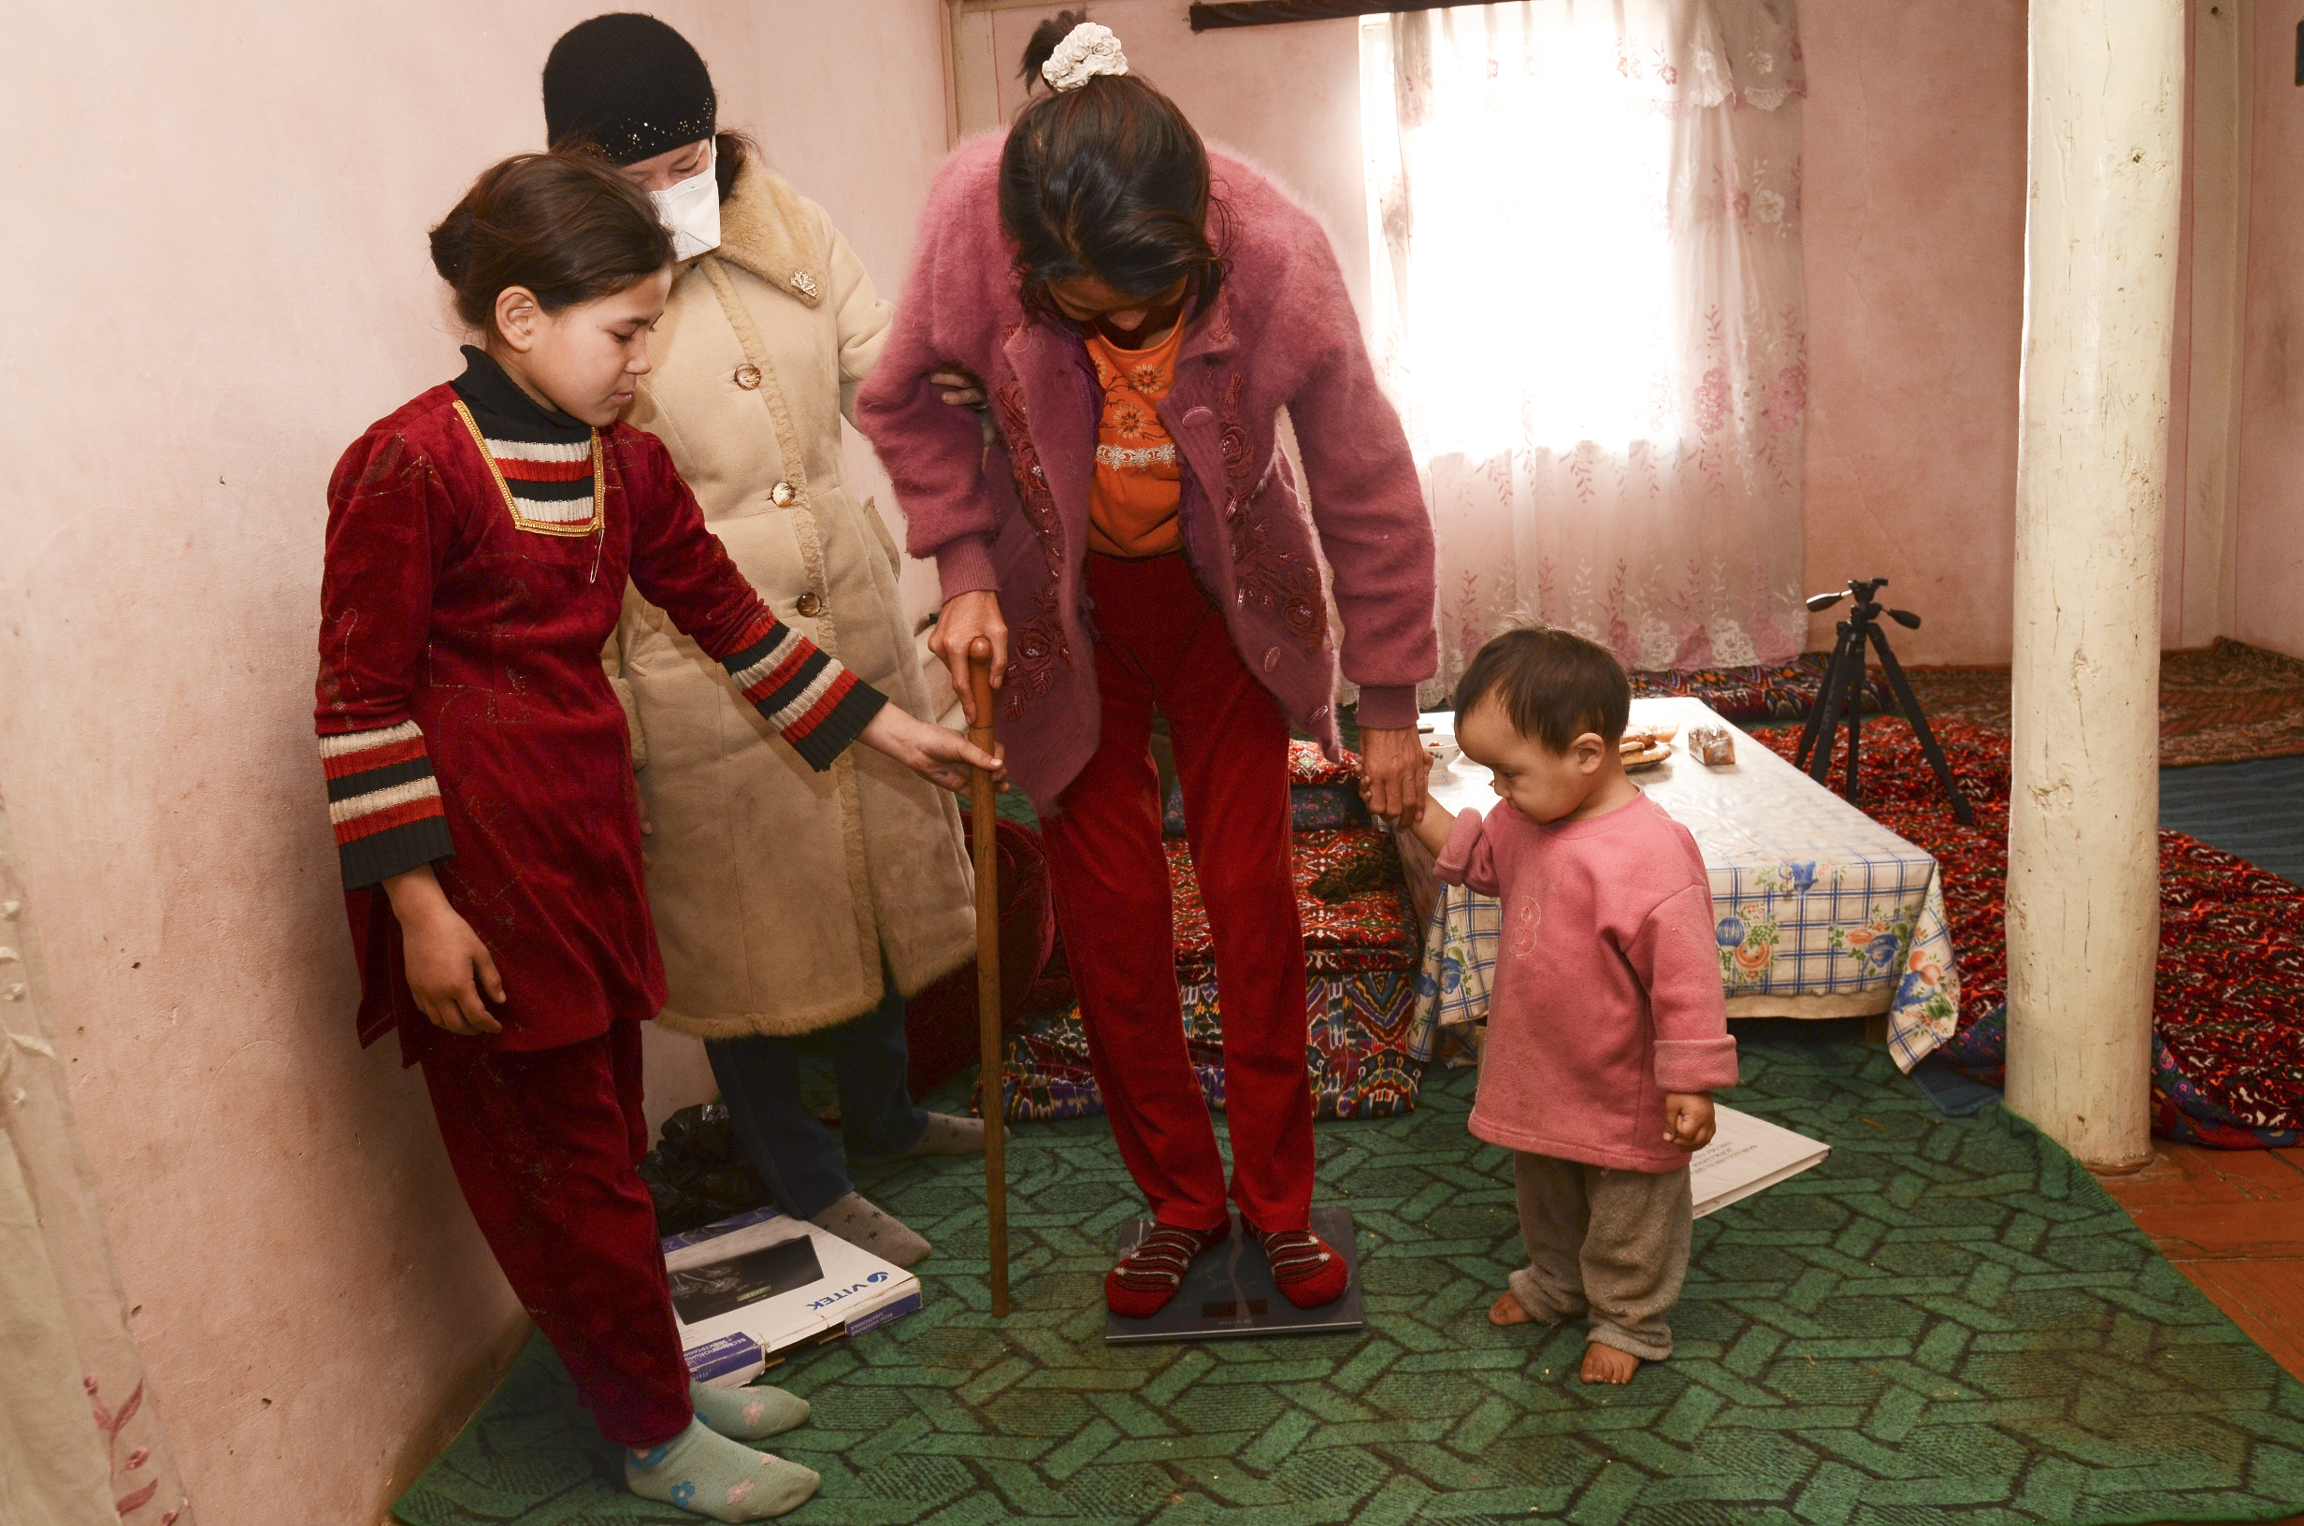
Acknowledgements
MSF and MoH staff
Patients
For further information contact:
shona.horter@london.msf.org
N.B. All images taken from MSF Media database
Notes:
Acknowledgements

