Slide 1

Protective effectiveness of
Seasonal Malaria Chemoprevention (SMC):
A prospective case-control study in Magaria, Niger
Bachir Assao, Epicentre
May 24, 2018

Slide 2
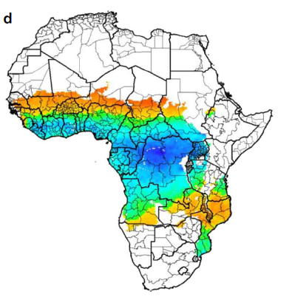
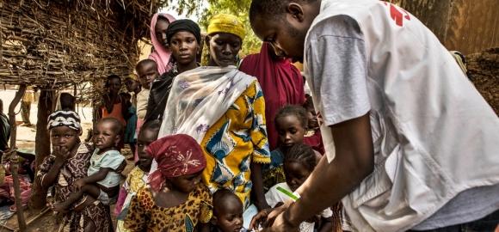
Seasonal malaria chemoprevention
Targets children aged 3-59 months in the Sahel
Monthly treatment courses
  Day 1: Sulfadoxine-pyrimethamine (SP) + Amodiaquine (AQ)
  Day 2: AQ
  Day 3: AQ
3-4 months a year
Cairns, et al. Nature Communications (2012) 3:881.
Photo : Juan Carlos Tomasi/MSF

Slide 3
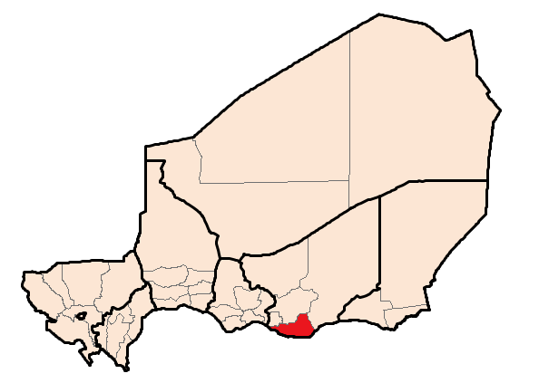
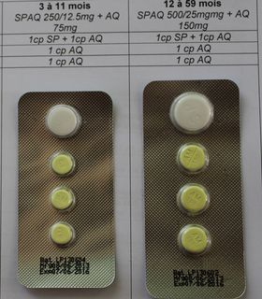
Context
MSF supports SMC in Niger since 2013
2014-2015: malaria continued to overwhelm clinics in Magaria
  Why?? Children coming from Nigeria? Poor adherence? “Bad malaria year”? Resistance? Better access to care?
In 2016, SMC given with two strategies:
  first dose directly-observed (DOT)
  first dose not directly-observed (non-DOT)
Photo : Bachir Assao

Slide 4
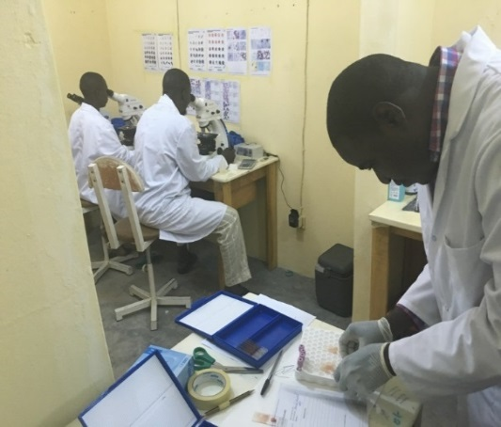
Objective and methods
Objective: estimate the protective effectiveness of SMC (PE_{SMC}) against developing clinical malaria in each of the two different delivery strategy zones
Matched case-control study in 2 Health Centers and 4 Health Posts
Case: Child aged 3-59 months with fever (37.5°C axillary) or history of fever and a positive malaria rapid diagnostic test (pLDH-based)
Control: healthy, age-matched child (+/- 6 months) from same village of origin, enrolled on same day as case (3 controls per case)
All participants:
  Detailed questionnaire
  Thick and thin smear
  500 µl blood in EDTA-microtube for plasma AQ levels
Conditional logistic regression to estimate PE_{SMC}
Comité Consultatif National d’Ethique of Niger (014/2016/CCNE)
and MSF-ERB (1624).
Photo : Matthew Coldiron

Slide 5
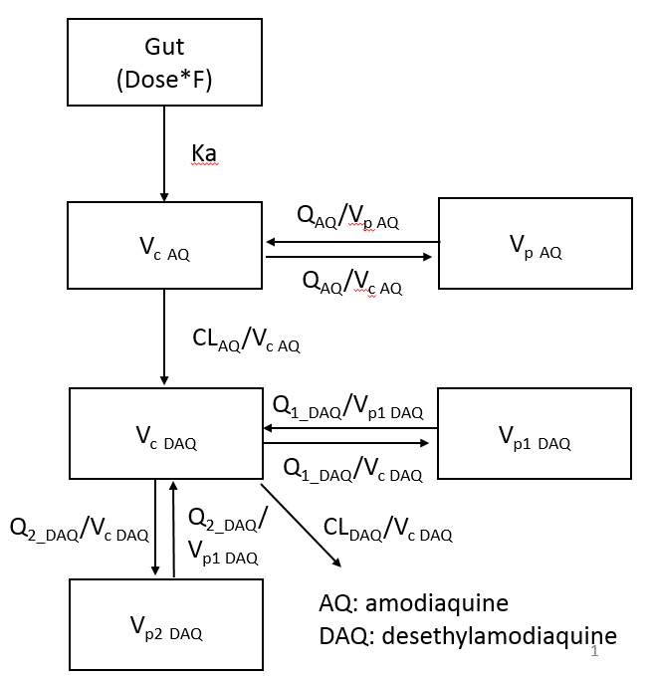
Objective and methods (2)
Population pharmacokinetics sub study
Objective: model ideal AQ / desethylAQ curves
  And then compare case-control samples against it to see if adherence is good
165 children given SMC under ideal conditions with 3-dose DOT from study nurses at home
3 blood draws at home at specific time points over 6 weeks
Joel Tarning lab, Mahidol-Oxford Tropical Medicine Research Unit
Model structure
2-compartment model for AQ
3-compartment model for DAQ
Absorption model: First order absorption
Bioavailability fixed to 100%
NONMEM 7.4 software

Slide 6
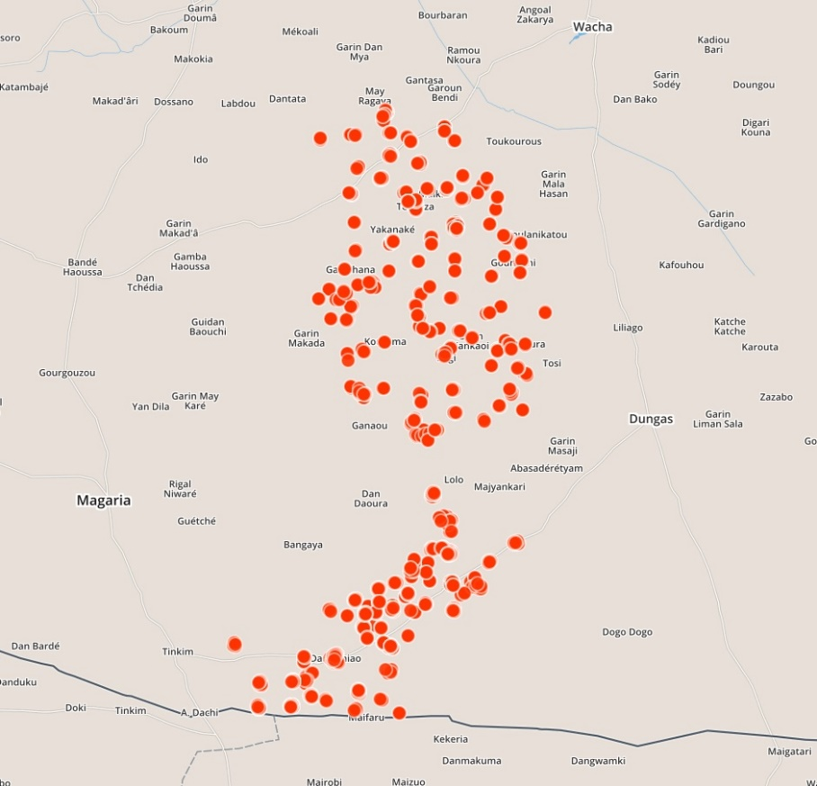
Inclusions
10 km
One dot = one case

Slide 7
Baseline characteristics DOT Zone
 | Cases (N=264) | Controls (N=765) | P
Male | 58% | 50% | 0.04
SMC with card | 36% | 72% | <0.0001
SMC by card or report | 74% | 86% | <0.0001
Currently enrolled in nutritional program | 14% | 4% | <0.0001
≥ 6 food groups in last week | 19% | 30% | 0.001
Among all groups:
High (>97%) reported LLIN use
2-4% had taken an antimalarial in the week prior to enrolment
5% with teen mothers, almost no formal education among parents
36% own mobile phone
18-20% have animal wealth >US$ 750
65% Hausa, 25% Peulh, 10% Tuareg

Slide 8
Baseline characteristics non-DOT Zone
 | Cases (N=313) | Controls (N=935) | P
Male | 54% | 53% | 0.83
SMC with card | 67% | 76% | <0.001
SMC by card or report | 77% | 80% | 0.20
Currently enrolled in nutritional program | 4% | 5% | 0.67
≥ 6 food groups in last week | 28% | 34% | 0.001
Taken any curative antimalarial in week prior to enrolment | 8% | 3% | <0.001
Among all groups:
Lower reported LLIN use (93-96%)
5% with teen mothers, almost no formal education among parents
35% own mobile phone
13-19% have animal wealth >US$ 750
85% Hausa, 15% Peulh

Slide 9
PE_{SMC} against clinical malaria
Overall study area | Protective effectiveness (%) | 95%CI
By card | 85 | 78-90
By card or report | 50 | 27-66
DOT Zone: 97 (93-99)
Non-DOT Zone: 60 (35-74)
DOT Zone: 89 (77-94)
Non-DOT Zone: 21 (-31-52)
No differences seen in PE_{SMC} by
  Age
  Sex
  Nutritional status

Slide 10
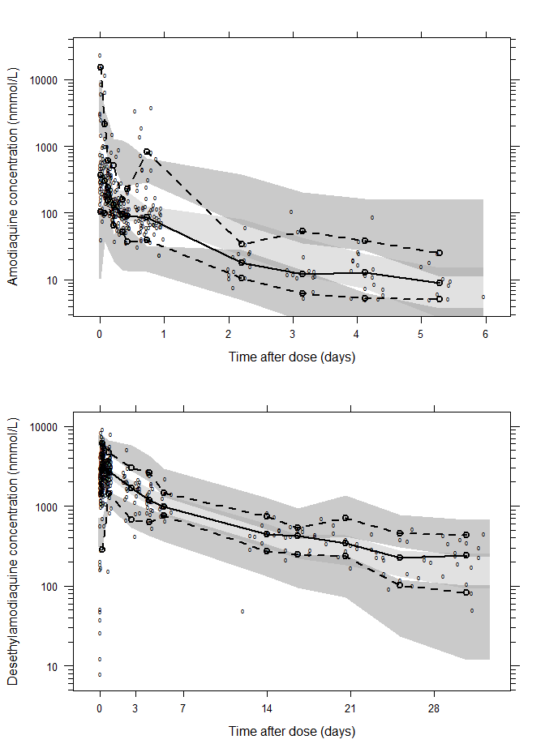
Population pharmacokinetics and adherence
Population pharmacokinetic models fit very well
Preliminary analysis suggests adherence to days 2-3 of AQ at home is poor in all children
  Over 80% of children who self-reported correct adherence at home have plasma desAQ levels below the 5th percentile of the population pharmacokinetic curve for the given day since SMC
Credit: Junjie Ding, Joel Tarning

Slide 11
Conclusion
SMC works, but effectiveness is better when first dose is directly-observed
Serious questions about correct adherence at home
  Is observed effectiveness of SMC coming from SP alone?
Using the correct operational strategy likely has an impact on SMC effectiveness
  These results took place in a setting where MSF provided a large amount of support, what happens in areas with less support?
Photo : Juan Carlos Tomasi/MSF

Slide 12



Acknowlegdements

