Slide 1
Using medical data to provoke political and social change
Case study: Rohingya people in Bangladesh
Sidney Wong, Kate White, Corinne Grant, Ruby Siddiqui

Slide 2
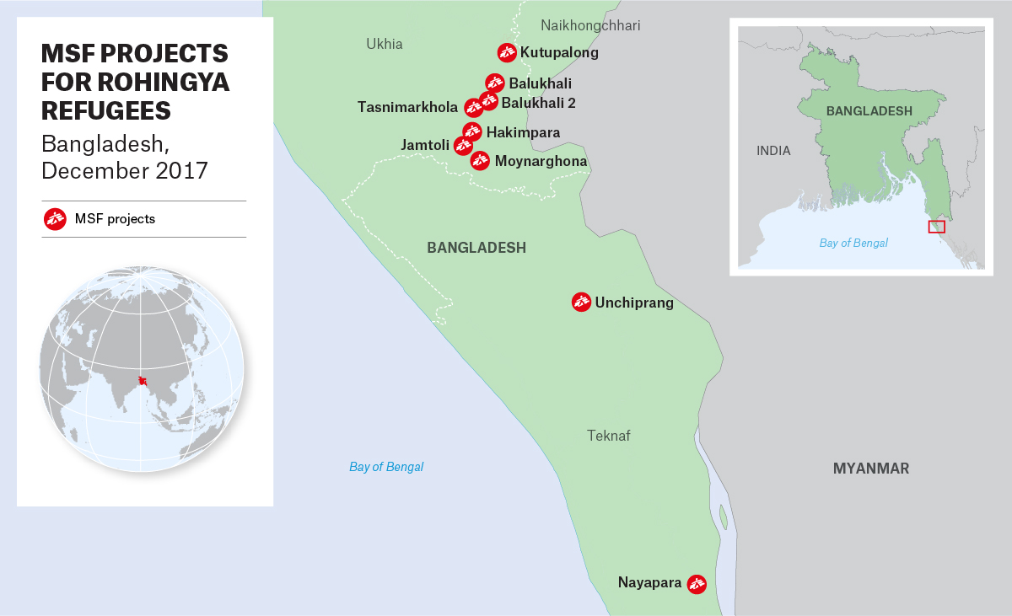

Slide 3
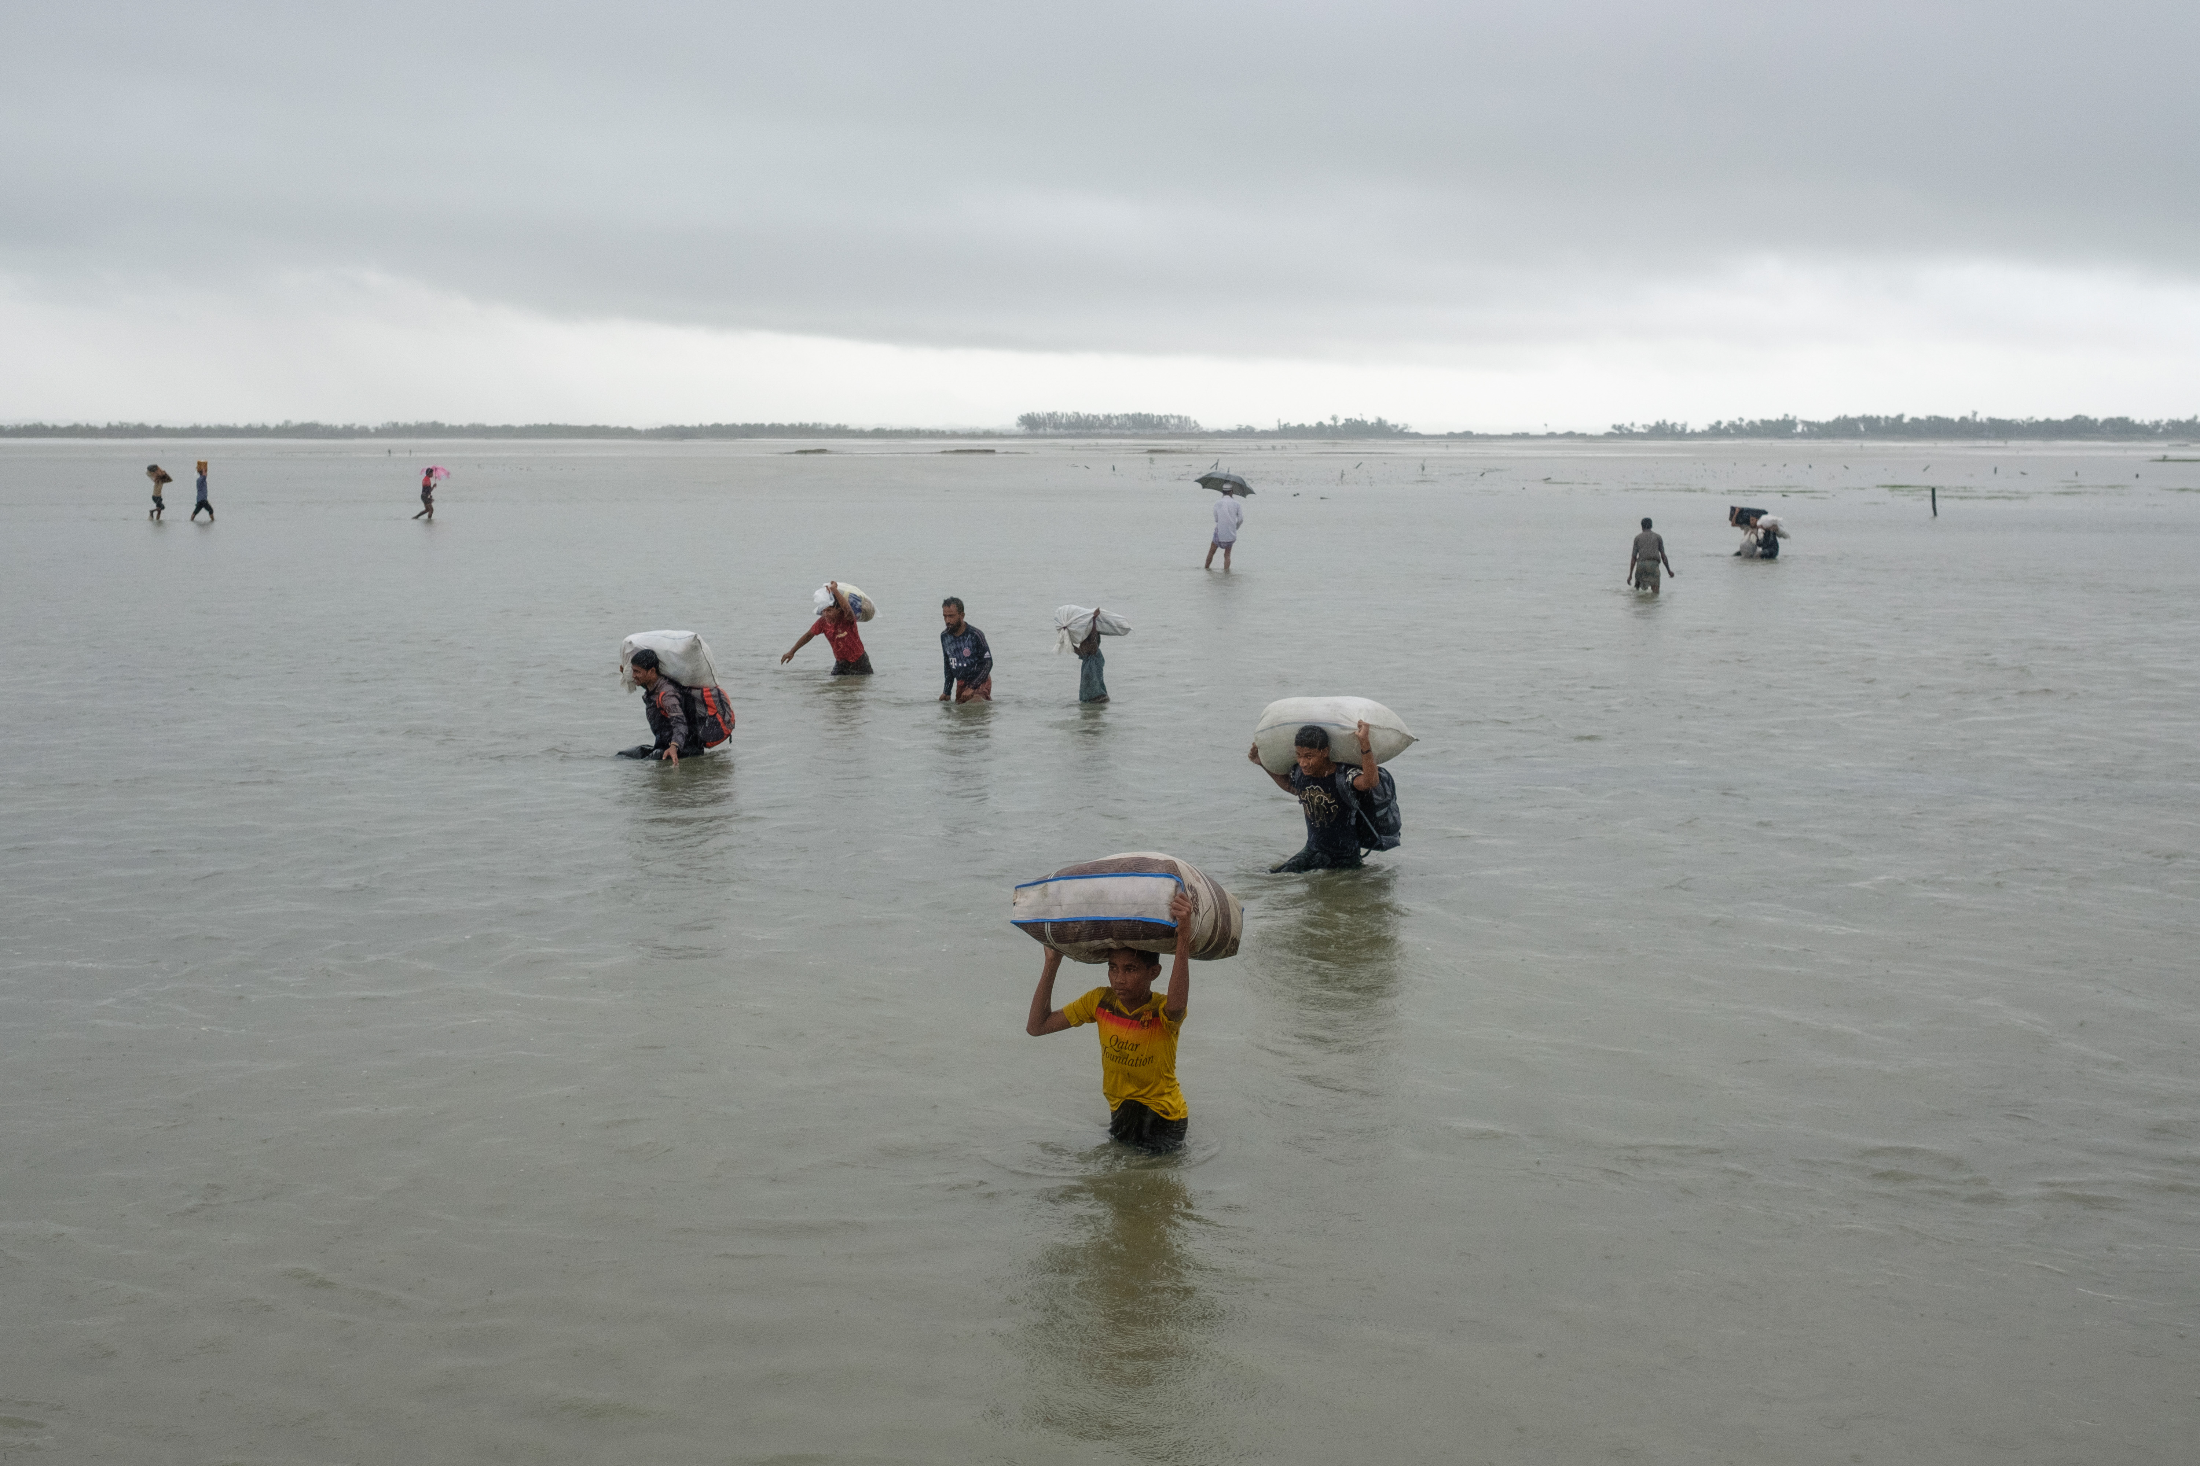
photographer: Antonio Faccilongo

Slide 4
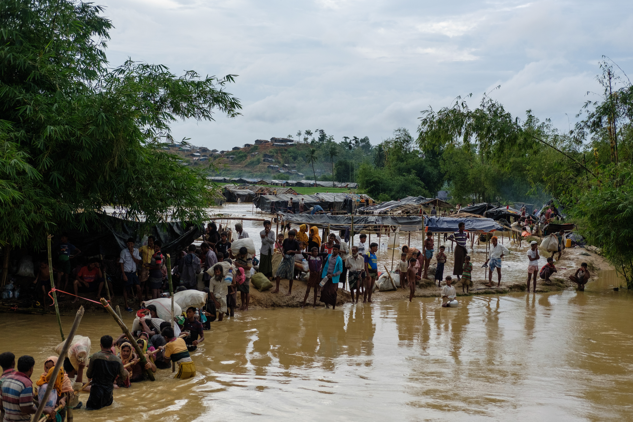
photographer: Antonio Faccilongo

Slide 5
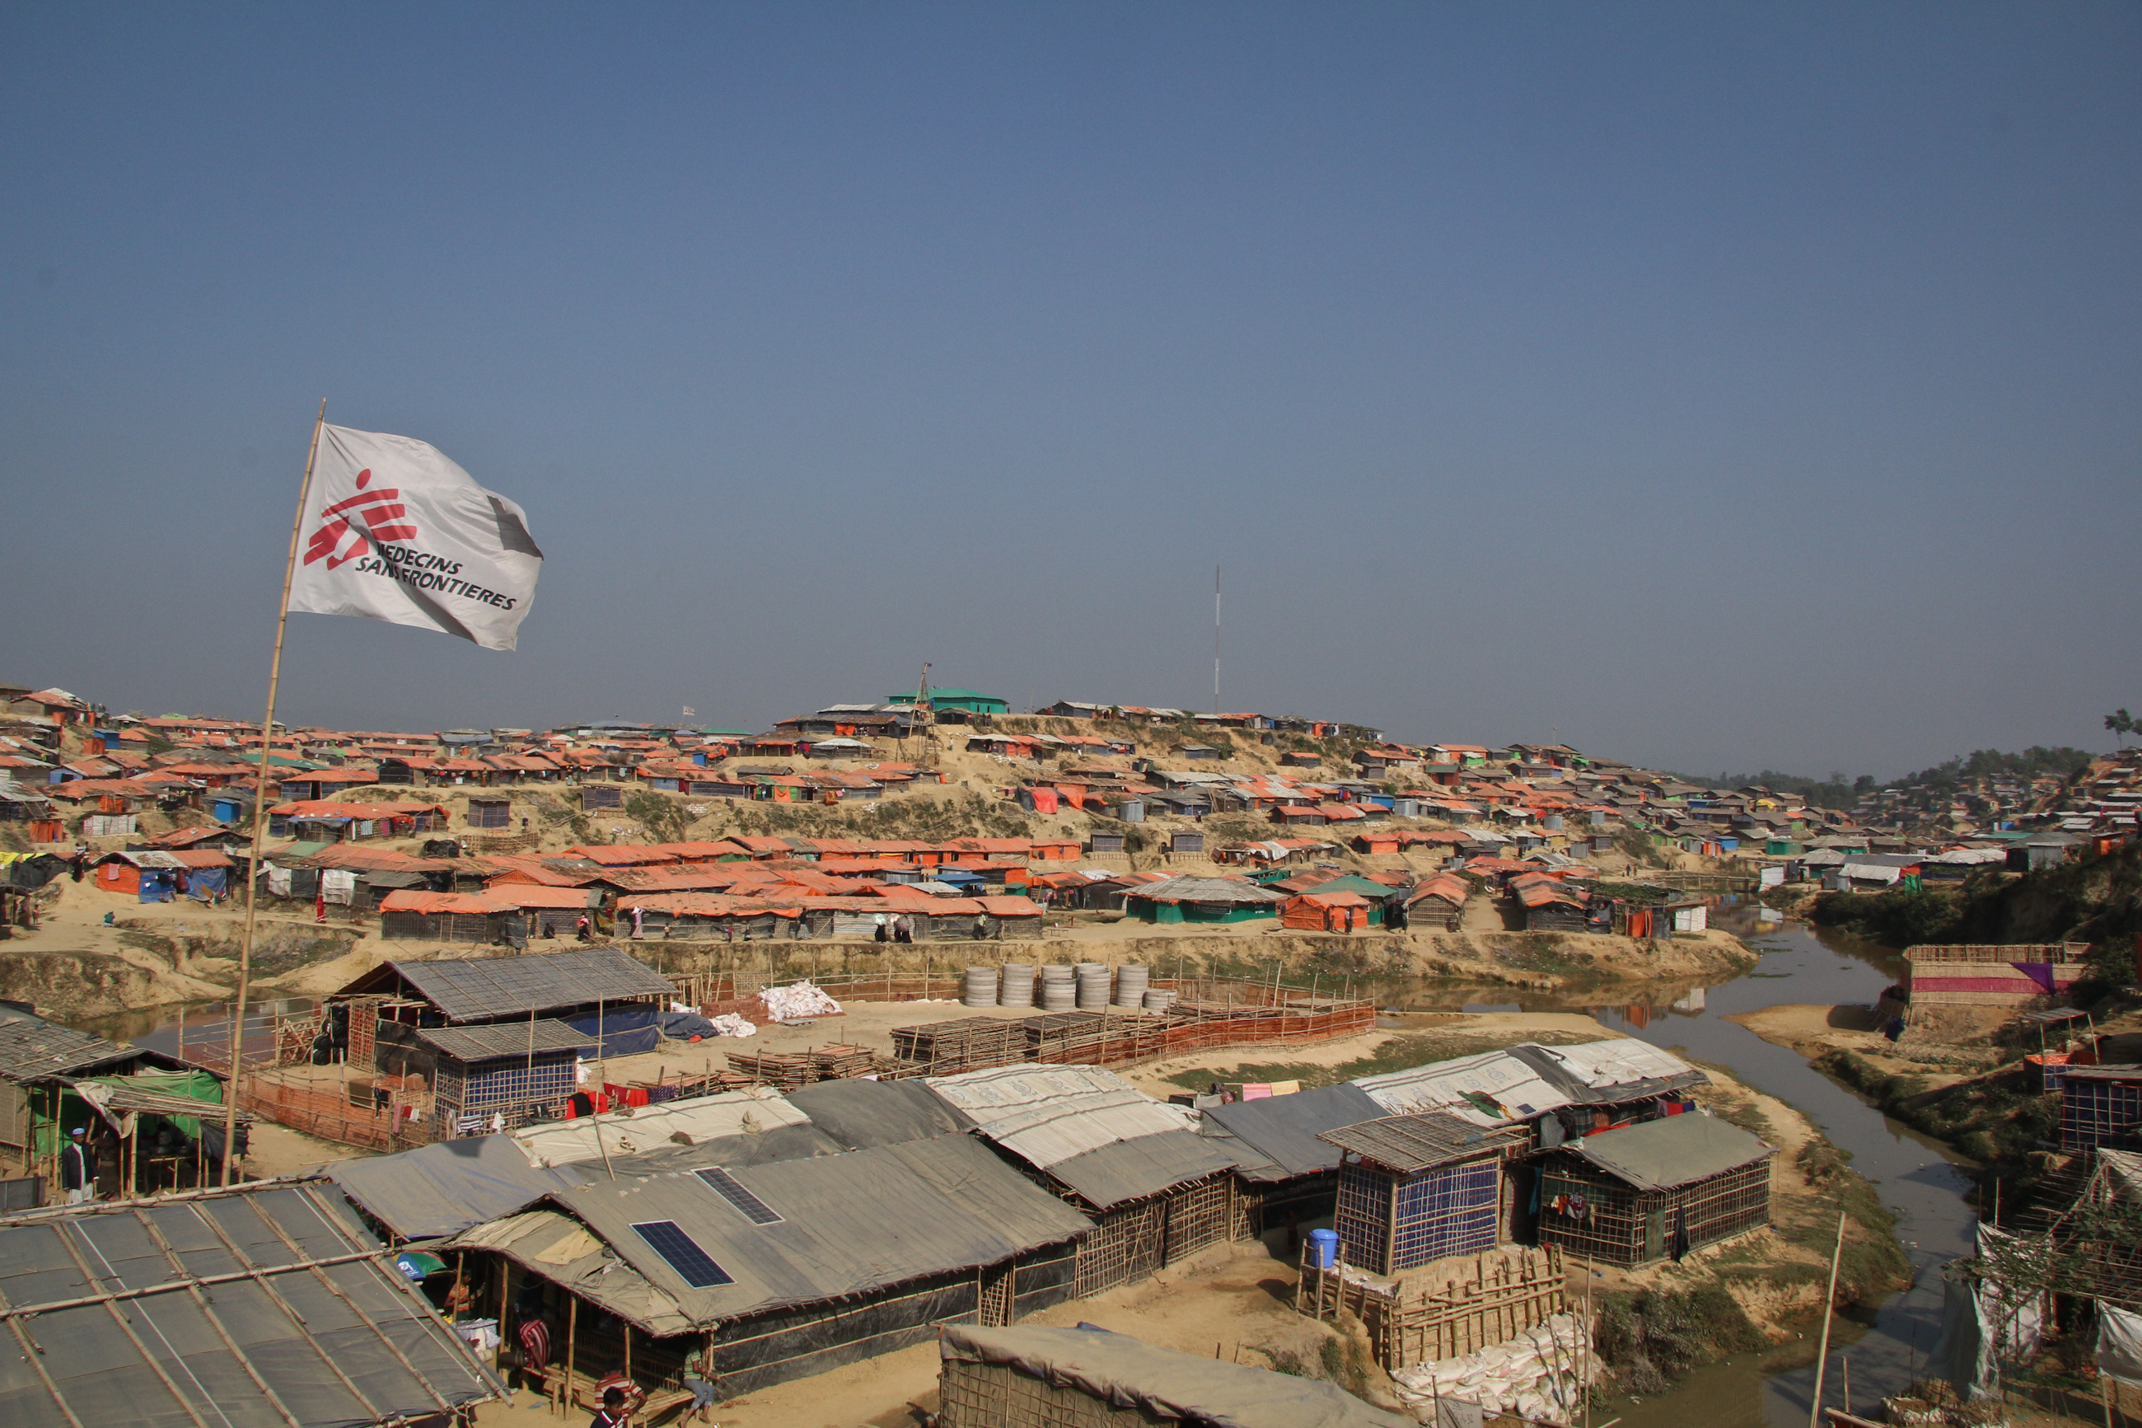
photographer: Sara Creta

Slide 6
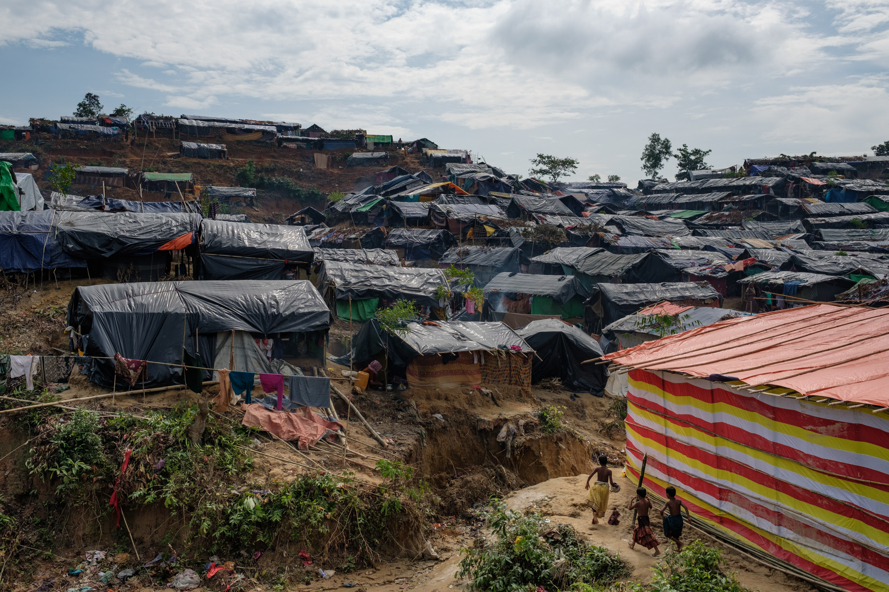
photographer: Antonio Faccilongo

Slide 7
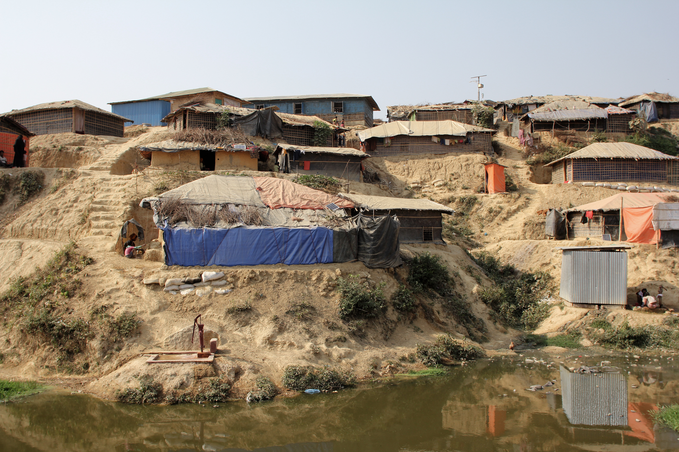
photographer: Sara Creta

Slide 8
“We speak not into the wind, but with a clear intent to assist, to provoke change, or to reveal injustice. Our action and our voice is an act of indignation, a refusal to accept an active or passive assault on the other. We are not sure that words can always save lives, but we know that silence can certainly kill.”
Nobel Lecture by James Orbinski, Médecins Sans Frontières, Oslo, December 10, 1999

