Slide 1


Single-dose oral ciprofloxacin prophylaxis in response to a meningococcal meningitis epidemic in the African meningitis belt: a three-arm cluster-randomized trial d
Matthew Coldiron, Epicentre

Slide 2
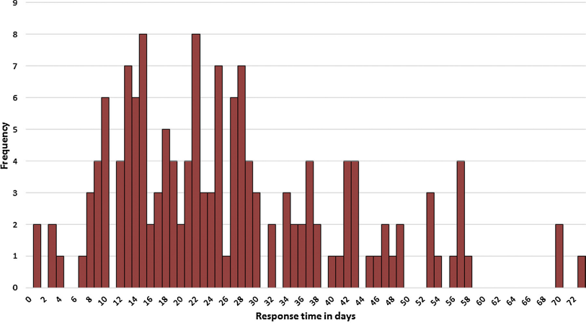

Outbreak response in the meningitis belt
Reactive vaccination often late
  As a result, impact is mitigated¹
  More cases averted if vaccination happens faster²
  Limited vaccine supply (2.4M doses for 2018 season)
Antibiotic prophylaxis for contacts of cases not recommended during epidemics
  No evidence; also concerns about logistics / resources
  Trial recommended by WHO panel after emergence of Serogroup C epidemics in Africa in 2015
Days from crossing the epidemic threshold to vaccine implementation among 151 vaccine requests to the International Coordination Group (ICG) between 2006 and 2013.
¹M.J. Ferrari et al. Int. Health 2014;6:282-290
²C.L. Trotter et al. Vaccine 2015;33:6212–6217

Slide 3
Study design and primary objective
3-arm, open-label, cluster-randomized trial to assess the impact of prophylaxis with single-dose oral ciprofloxacin
(to household contacts and to entire villages) on the overall meningitis attack rate during an epidemic.
Full methods: Coldiron et al. Trials 2017;18:294
Trial registry: clinicaltrials.gov NCT02724046

Slide 4
Interventions
Arm 1: standard care
Arm 2: ciprofloxacin to household contacts
  Given by nurse at home <24h of case notification
Arm 3: ciprofloxacin to entire village
  Village-wide distribution of ciprofloxacin <72h after declaration of first case from a village
Directly-observed, age-based dosing of ciprofloxacin, including children and pregnant women

Slide 5
Randomization and surveillance
Study Launch: 2 Health Areas of a Health District cross epidemic threshold in same week
Villages randomized after first case notified from that village
  Household ppx arm: only one distribution per household
  Village-wide ppx arm: only one distribution per village
Dedicated surveillance nurse in each Health Area in study
  WHO case definitions of suspect and confirmed meningitis used
  Standard MOH procedures and sample flow from periphery to District Hospital and then national reference laboratory for PCR confirmation
Door-to-door exhaustive census after inclusion to have accurate denominators

Slide 6
Statistical analysis
Primary outcome: attack rates in 3 arms
  Cluster-level t-test of log-transformed post-randomization attack rates
  Inverse variance weights to account for heterogeniety among clusters
Poisson regression to adjust for potential confounders
  Age structure of villages
  Time between randomization and start of epidemic
  Time between randomization and reactive vaccination
  Inclusion before/after rains
ICC calculated using ANOVA

Slide 7
Resistance sub-study methods
Sample size: 10 villages / 200 individuals in control/village-wide arms
  = 20 individuals randomly selected in each of 20 villages, individual written consent
Stool collection at days 0, 7 and 28
Detection of the carriage of enterobacteriae resistant to cipro and/or cefotaxime by plating on selective media
  Simplification of identification / confirmation methods after 5 villages showing very high prevalence of resistant bacteria
Quality control at IAME laboratory, Inserm, Paris, France

Slide 8
Ethics and funding
Village chiefs provided permission for randomization of their villages
Risks and benefits of ciprofloxacin explained prior to administration
  No individual written consent (Ottawa Statement on cluster-randomized trials)¹
Protocol approved by CCNE of Niger (003/2016/CCNE) and MSF-ERB (Ref: 1603)
Funding: Médecins Sans Frontières
¹Weijer C et al. PLOS Medicine 2012;9:11. doi:10.1371/journal.pmed.1001346

Slide 9
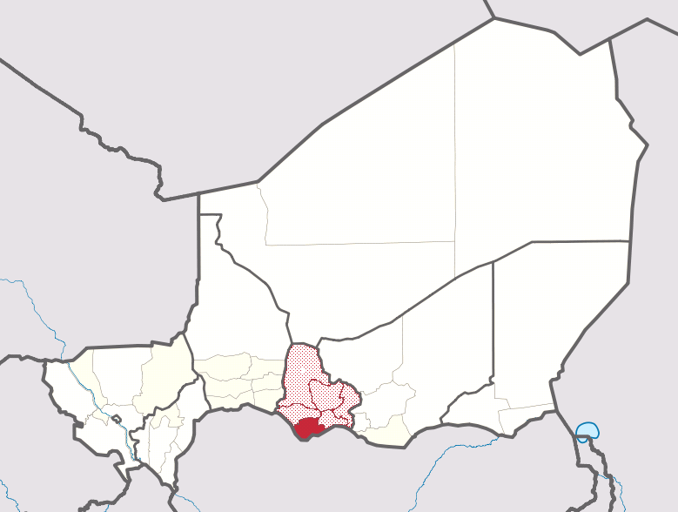
Timeline
20 April: Trial start criteria met in Madarounfa District, Niger
22 April: First villages included
10 May: First rains
12 May: First vaccination began
18 May: Last village included
23 May: Last case notified

Slide 10
Baseline characteristics of villages
 | Standard care | Household cipro | Village-wide cipro
Number of villages | 17 | 17 | 15
Total population | 25 510 | 23 621 | 22 177
Age of cases, mean±SD | 18±13 | 17±15 | 18±17
Female population (%) | 51 | 51 | 51
Proportion <30y (%) | 78 | 77 | 76
Days between inclusion and reactive vaccination, mean±SD | 11.1±7.8 | 10.8±9.5 | 12.2±8.8
Days between inclusion and first rains, mean±SD | 7.2±7.1 | 6.4±8.1 | 7.1±6.5
Coldiron et al. PLOS Medicine, in press

Slide 11
Primary results
 | Standard care | Household ciprofloxacin | Village-wide ciprofloxacin
Post-randomization cases | 115 | 91 | 42
Attack rate (95%CI), cases/100 000 people | 451 (262-776) | 386 (225-662) p=0.68 | 190 (99-364) p=0.03
Adjusted attack rate ratio versus standard care (95% CI)* | Ref | 0.94 (0.52-1.73) p=0.85 | 0.40 (0.19-0.87) p=0.02
* Adjusted for whether village included after the first day of rainfall
Coldiron et al. PLOS Medicine, in press

Slide 12
Laboratory results
52 samples sent from 248 post-randomization cases
  21 NmC, 31 negative
    Standard care: 16 NmC from 28 tested
    Household ppx: 5 NmC from 16 tested
    Village-wide ppx: 0 NmC from 8 tested
Coldiron et al. PLOS Medicine, in press

Slide 13
Standard care
Household
prophylaxis
Village-wide
prophylaxis
Coldiron et al. PLOS Medicine, in press
Notes:
These histograms show the timing of the cases in each arm, it seems like the bulk of the difference between the village-wide prophylaxis arm occurs here, during the first week after randomization, in line with what we know about the short, highly-localized nature of epidemics in a village.

Slide 14
Coverage of ciprofloxacin
In household prophylaxis arm, a total of 1245 people in 87 households were treated (4% of population)
In village-wide prophylaxis arm, a total of 16792 people
were treated (76% of population)
  Median coverage by village (IQR): 77% (75%-80%)
Coldiron et al. PLOS Medicine, in press

Slide 15
Resistance sub-study - Results
 | No cipro | Village-wide cipro
Cipro-R (%)
D0 | 95 | 95
D7 | 93 | 97
D28 | 95 | 99
ESBL (%)
D0 | 91 | 94
D7 | 87 | 93
D28 | 93 | 93
Baseline carriage of resistant enterobacteriae was very high
Trend for increased prevalence of carriage of Cipro-R enterobacteriae after village-wide distribution
  Non-significant difference in change between D7/D0 and D28/D0 between arms (p=0.12)
Coldiron et al. PLOS Medicine, in press

Slide 16
Conclusions
Village-wide prophylaxis with single-dose oral ciprofloxacin <72h after meningitis case notification significantly reduced attack rates
  Could be an attractive new epidemic response strategy (faster, cheaper…)
  Would have preferred more confirmed cases, but trends are the same
Very high prevalence of carriage of CiproR and ESBL bacteria at baseline
  Hopefully not representative of all regions in the meningitis belt
  Clinical significance of carriage is unknown
  Need more information about potential impact of strategy on antibiotic resistance (both of meningococcus and gut flora)

Slide 17
Next steps
WHO expert panel received the results favorably¹
  More evidence needed before changing recommendations
Ciprofloxacin pre-positioned in Niger and Nigeria, research protocols approved
Contingency plans for “documentation” in areas where trial not logistically possible
¹ WHO. Weekly Epidemiological record. 2017:92;205-228.

Slide 18





Acknowledgements

