Slide 1


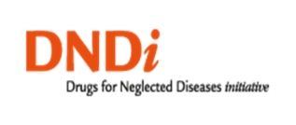

Effectiveness of combination therapy with liposomal amphotericin B and miltefosine for visceral leishmaniasis in HIV coinfection: DNDi/MSF strategy for policy change in East Africa
MSF Scientific Days 2018
Charles Abongomera^{1,2}, Séverine Blesson³, Ermias Diro⁴, Jorge Alvar³, Alan de Lima Pereira¹, Jozefien Buyze², Kolja Stille¹, Fareed Ahmed⁵, Johan van Griensven², Fabiana Alves³, Koert Ritmeijer⁶
¹MSF, Abdurafi, Ethiopia; ²Institute of Tropical Medicine, Antwerp, Belgium; ³DNDi, Geneva, Switzerland; ⁴University of Gondar, Gondar, Ethiopia; ⁵MSF, Addis Ababa, Ethiopia; ⁶MSF, Amsterdam, The Netherlands

Slide 2
Presentation outline
Background
Methods
Results
Discussion
Conclusions/recommendations
Acknowledgments

Slide 3
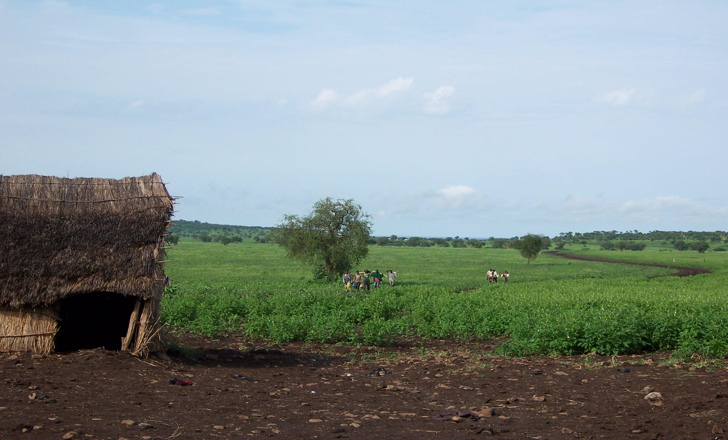
Context
Ethiopia is one of the top six countries with high burden of visceral leishmaniasis (VL). 3400–5000 VL cases/year.
NW Ethiopia: 20% of VL patients are HIV co-infected.
Migrant workers are most at risk.
©Rachel ter horst

Slide 4
VL and HIV coinfection
HIV increases VL severity and worsens treatment outcomes.
  ↑ case fatality rates.
  ↑ initial parasitological failure rates.
  ↑ relapse rates.
VL in turn promotes the progression of HIV infection.

Slide 5
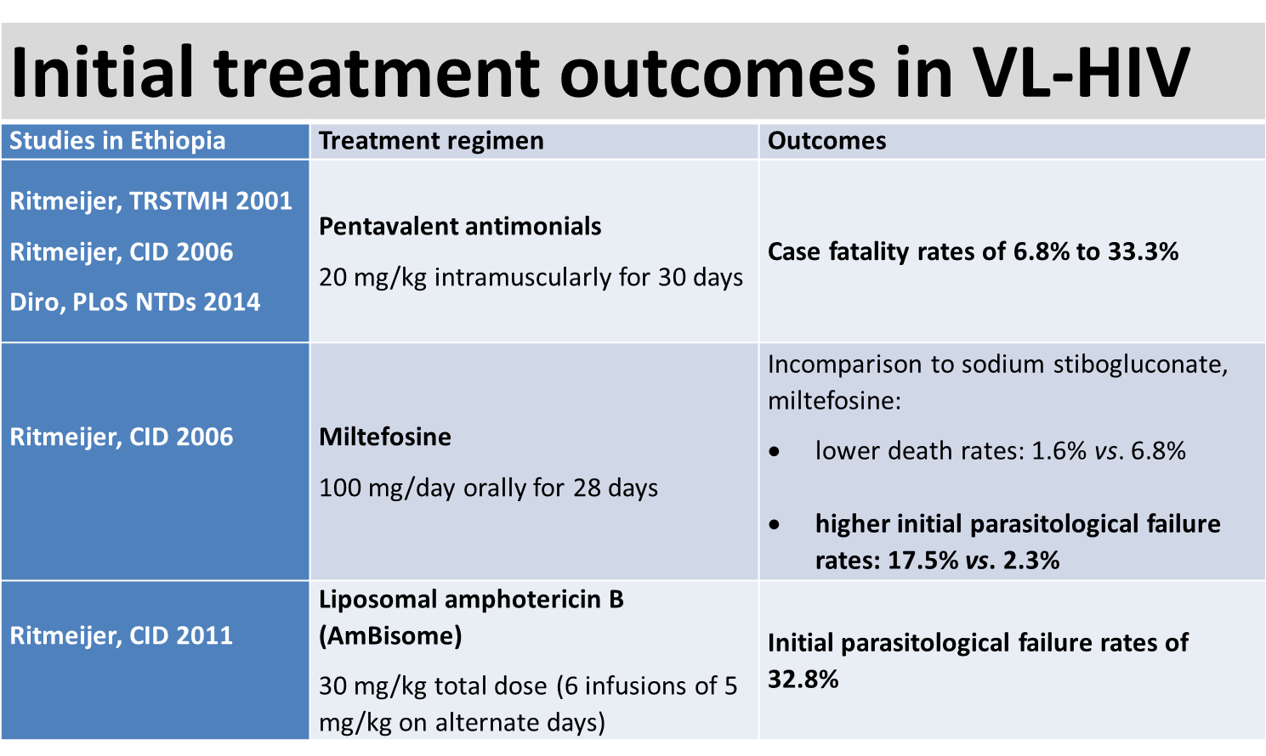

Slide 6
Combination therapy for VL
Combination therapy: ↑ efficacy & tolerance; ↓treatment duration & cost; limits emergence of resistance.
In 2011, MSF => combination treatment: AmBisome infusion (30 mg/kg total dose over 12 days, as 6 infusions of 5 mg/kg on alternate days) and miltefosine orally for 28 days (100 mg/day) as first line treatment for VL in HIV patients.

Slide 7
Cohort study followed by randomized clinical trial
Retrospective cohort study in Abdurafi HC.
Open-label randomized clinical trial in Abdurafi and Gondar University hospital:
  AmBisome monotherapy (40 mg/kg total dose; IV infusion of 5
  mg/kg on day 1-5, 10, 17, 24). (WHO recommended treatment for VL/HIV)
  AmBisome infusion (30 mg/kg total dose) and miltefosine orally for 28 days (100 mg/day). (MSF protocol)
We aimed to determine the initial effectiveness (cure, death and parasitological failure rates) of this combination regimen.

Slide 8
Methods 1: Retrospective cohort study
Setting: Abdurafi health center (MSF).
Ethics approval: ITM-Antwerp, IPH-Gondar University ERB’s and permission of OCA medical director.
Inclusion criteria: All adult VL-HIV patients; primary and relapse VL; Jan. 2011 - Aug. 2014; initial treatment (AmBisome and miltefosine).
Exclusion criteria: Discontinued treatment; defaulted; transferred-out; missing VL treatment outcome.

Slide 9
Methods 2: Retrospective cohort study
Proportions of initial treatment outcome categories.
Predictors (initial parasitological failure, death): multivariable logistic regression.
Missing baseline CD4 count (advanced HIV disease = additional WHO stage IV disease or a CD4 count <50 cells/µL).
Sensitivity analysis (intention to treat analysis).

Slide 10
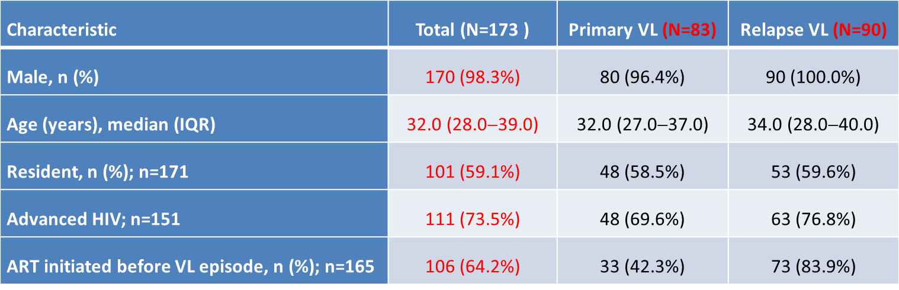
Selected patient characteristics in cohort study

Slide 11
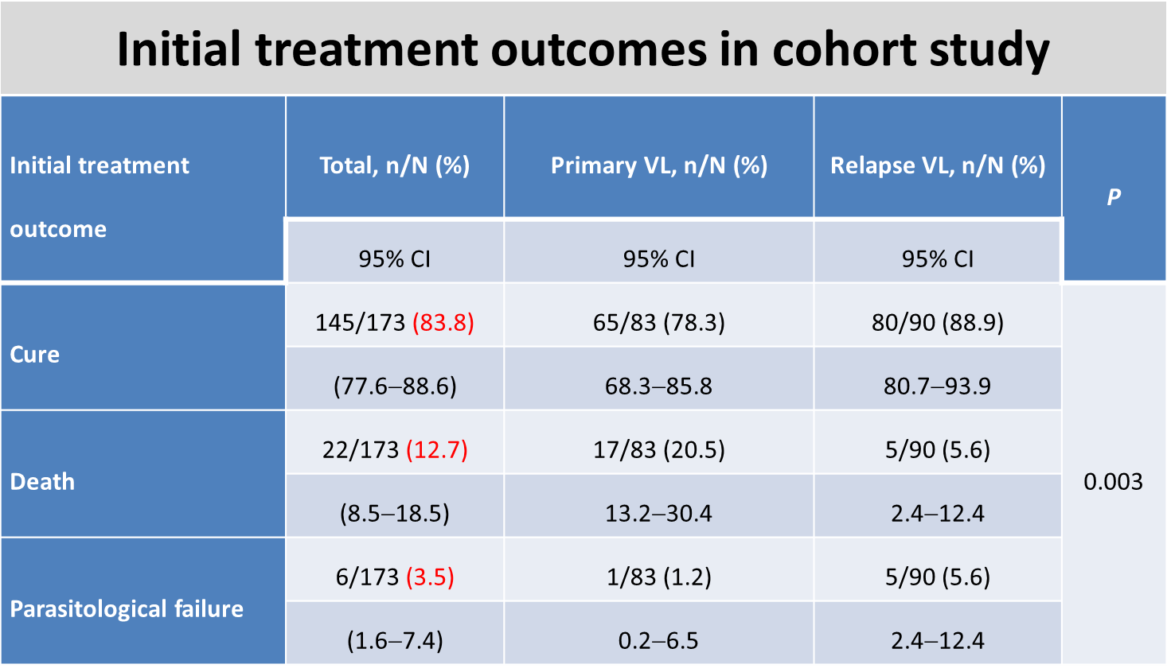

Slide 12
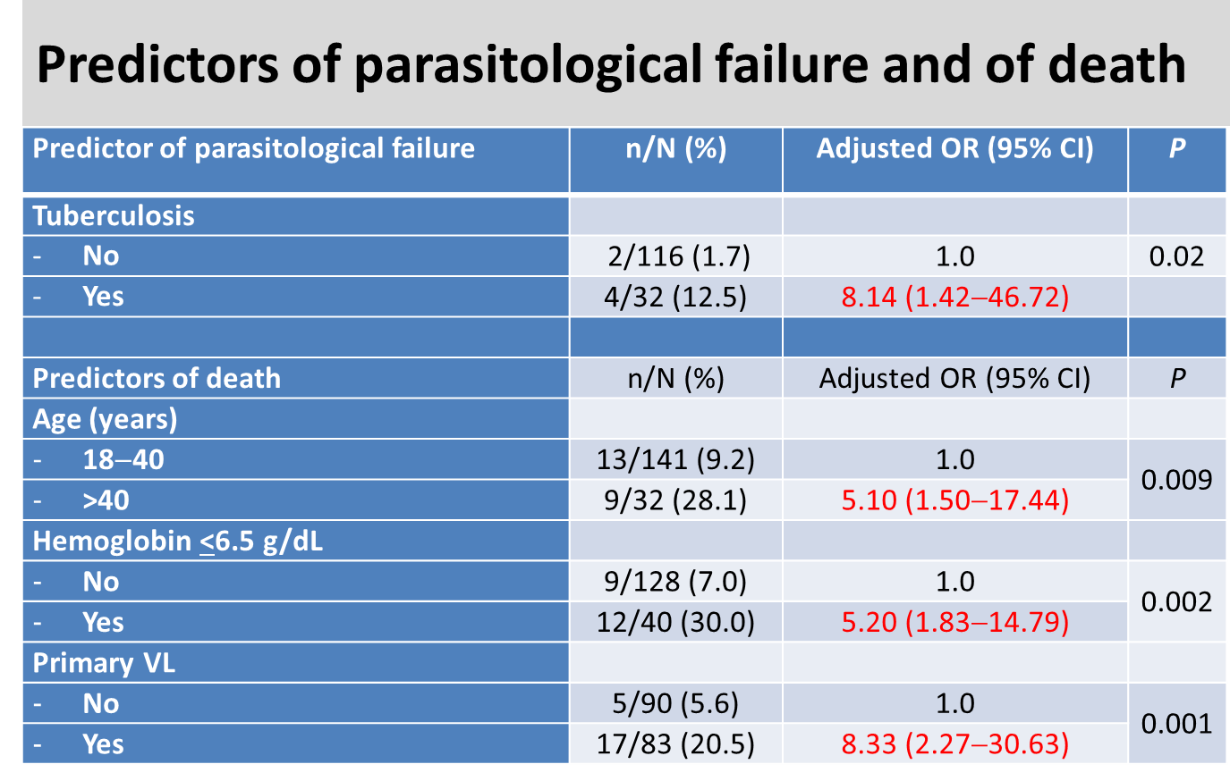
Charles Abongomera, MSF, AmBisome and Miltefosine Combination Treatment of Visceral Leishmaniasis in HIV patients

Slide 13
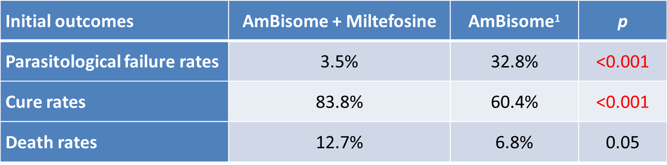
Comparison of initial outcomes in cohort studies
¹ Historical cohort from Abdurafi (2007-2009) in same patient population (Ritmeijer, CID 2011)
Charles Abongomera, MSF, AmBisome and Miltefosine Combination Treatment of Visceral Leishmaniasis in HIV patients

Slide 14
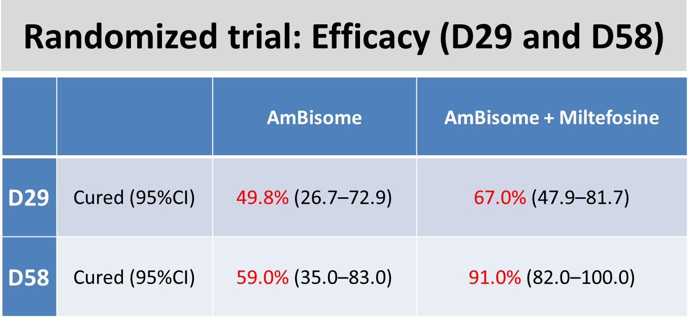

Slide 15
Limitations: Retrospective cohort study
Retrospective study.
Diagnosis and cure not systematically confirmed by parasitological tests.
CD4 counts: many missing.
No long term follow up (pentamidine trial).
No capacity to preform autopsies.

Slide 16
Conclusions/recommendations
Parasitological failure rates with combination therapy were low.
Knowledge of predictors of poor outcome may facilitate better management.
WHO, MSF, and DNDi have agreed with the Ethiopian Ministry of Health to review national treatment guidelines.
Meanwhile implementing compassionate use of combination therapy.
Meta-analysis of the two studies.
Once both studies are published, WHO will launch a Consultative Meeting to eventually endorse the change in VL-HIV case management.

Slide 17
Acknowledgments
Staff of Abdurafi health center and LRTC at the University of Gondar, Ethiopia.
MSF, DNDi, ITM-Antwerp, UoG-Ethiopia, WHO and Ethiopian Ministry of Health.
AfriCoLeish project has supported this work.

