Slide 1

Pregnancy and Ebola : survival of pregnant women admitted to MSF Ebola treatment centres in the 2014-2016 outbreak
*Severine Caluwaerts ^{1,2}, Michel Van Herp¹, Julita Gil Cuesta¹, Rosa Crestani¹, Axelle Ronsse¹, Daphne Lagrou¹, Patricia Lledo Weber³, Jean-François Saint-Sauveur³, Benjamin Black⁴, Grazia Caleo⁴, Carissa Guild⁵, Furaha Walumpumpu⁶, Iza Ciglenecki⁶, James Sylvester Squire⁷, Mosoka Fallah⁸, Mamadou Saliou Sow⁹, Annick Antierens¹

Slide 2
Introduction
Pregnancy and Ebola: historically 90% mortality (Mupata et al. 1999; Johnson 1978)
Fœtal/neonatal mortality: 100%
Unsure if being pregnant carries a worse prognosis
Live neonates born to mothers with Ebola virus disease: a review of the literature
J M Nelson, S E Griese, A B Goodman, G Peacock and for the CDC 2014 Ebola Response Children’s Health Team Journal of Perinatology 36, 411-414 (June 2016)
Ebola Hemorraghic Fever and Pregnancy
J Infect Dis. 1999 Feb;179 Suppl 1:S11-2.
Mupapa K, Mukundu W, Bwaka MA, Kipasa M, De Roo A, Kuvula K, Kibadi K, Massamba M, Ndaberey D, Colebunders R, Muyembe-Tamfum JJ.

Slide 3

Research questions
1. What is the maternal and neonatal survival of EVD in the 2014-2016 outbreak?
2. Does pregnancy worsen prognosis?
3. What is the potential infectiousness of amniotic fluid/products of conception(POC) after birth?
Kailahun, 2014, Aminata going home
BBC, 2014

Slide 4
Methods
All 9 study sites (ETCs) reported (Guéckédou, Donka/Nongo, Freetown, Kissy, Bo, Magburaka, Kailahun, Foya, Monrovia) between March 23rd 2014 to October 23rd 2015
Manual retrospective patients’ file search done (search term ‘pregnancy’) after the epidemic
Comparison of survival in EVD confirmed pregnant women versus EVD confirmed clinically/anamnestically non-pregnant women of reproductive age (WRA; 15-49 years old)
2014 Exemption of full ethics review (MSF ERB) and local ERBs contacted afterwards; we also confirm that we have obtained permission to use images from the patients included in this presentation

Slide 5
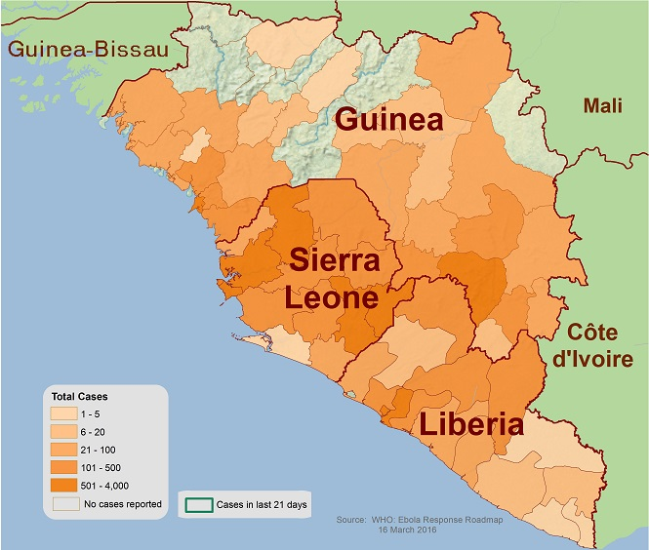
Results : 2014-2016 Ebola outbreak in West Africa
The 2014-2016 outbreak:
15 227 laboratory confirmed cases
MSF treated 4 967 (32%) confirmed patients, 3959 files available for analysis (80%)
77 women were confirmed pregnant (clinically or pregnancy test done) 1204 WRA clinically and anamnestically nonpregnant (WRA with available CT data)
WHO, 2015

Slide 6
Results
77 clinically/anamnestically
pregnant EVD + women
41 died (53.2%)
22/41 died undelivered
18/41 delivered/miscarried before death
1/41 unknown
36 survived (46.8%) (95%CI 35·3-58·5%).
23/36 delivered/miscarried before/during admission
8/36 inductions for IUFD
3/36 terminations of pregnancy in ETC
1/36 home delivery 1/36 unknown
WRA survival in ETC: (607/1204; survival rate of 50·4%, 95%CI 47·5-53·2%).
Survival between pregnant and nonpregnant WRA was not statistically different (p=0.27)

Slide 7
Results
Survival of pregnant patients was associated with
Lower viral load at admission (p < 0.001), similar to WRA
2. Pregnancy trimester (p=0.04):
  higher survival in first trimester (75%) versus third trimester (35%)

Slide 8
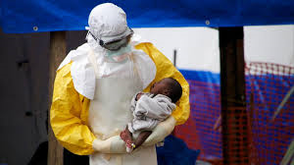
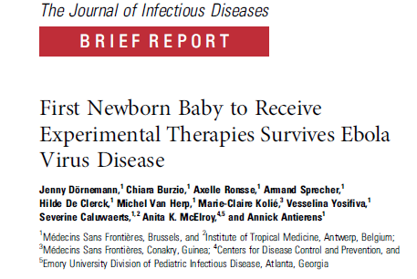
Results
MSF, 2015
RT-PCR testing on amniotic fluid/fetal cord blood, placentas/products of conception/ fetuses done in 22 deliveries/abortions :
  in 100% of cases (22/22) at least one RT-PCR was positive (RT-PCR Ct < 30, ++) (0-32 days after negativation maternal blood PCR)
One neonate lived 2 days, one survivor congenital EVD

Slide 9
Conclusions
Many limitations !
Largest series of confirmed EVD+ pregnant patients
No statistical difference in survival when compared with nonpregnant WRA
Survival better than historical data on EVD and pregnancy
Persistent CT positivity of POCs also after convalescence of the mother (up till 32 days) infectivity unknown (no culture)
Nubia, first documented survivor of transplacental Ebola
Notes:
Limitations:
-20% of files missing (mainly Foya and Guéckédou)
-no systematic pregnancy testing in ETC until december 2014 (and still…)
-According to population figures > 50% more pregnancies expected in 3959 patients
-pregnant women were a heterogenous group (treated over 21 months, in 9 different ETCs, 5 different laboratories,…)

Slide 10
Operational recommendations:
Standard pregnancy testing at admission to ETCs for all WRA
All pregnant EVD-positive/EVD-convalescent patients should deliver inside an ETC awaiting more research on infectivity
A private maternity space in an ETC should be created for mother and for a potentially live neonate
Management of patients with ongoing pregnancies in ETC remains a challenge: no clear guidance possible – careful discussion needed!
Notes:
6 first trimester pregnancies picked up by urinary testing (2 were referred from another centre not sure if was routine testing or if patient knew she was pregnant)

Slide 11
MSF, 2016

Slide 12


Thank you!
Everyone who reported data and cared for the patients (Floribert Lomboto , Furaha Walumpumpu, Maya Vergara, Ruth Kauffman, Benjamin Black, Patricia Lledo, Nelly Staderini, Michel Moreau, Modet Camara, Maud Santantonio, Axelle Ronsse, Aicha Taybi, Jeff Edwards, Lucie, Fernanda Baggi, Gillian Burkhardt, Elin Erland, Gert Verdonck , Catherine Juvyns and many more) and the field teams from Liberia, Guinea and Sierra Leone
Luxor operational research unit
MoH of Guinea, Sierra Leone and Liberia
°MSF, 2014

