Slide 1
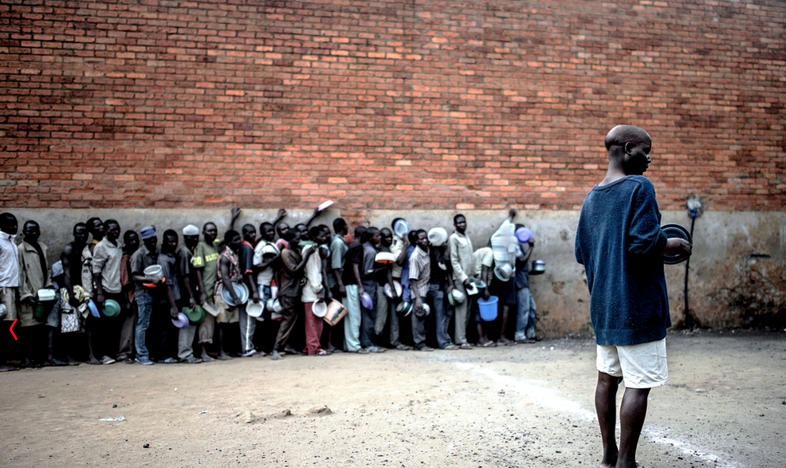

Improving tuberculosis case finding in Malawian prisons: implementation of systematic screening
Courtesy Luca Sola/MSF
A. Shigayeva¹, C. Aluda¹, D. Henderson¹, K. Chawinga¹, *R. Ortuño¹, E. Goemaere², P. Isaakidis²
¹Médecins Sans Frontières (MSF), Blantyre, Malawi; ²MSF, Cape Town, South Africa
*msfocb-blantyre-medco@brussels.msf.org

Slide 2
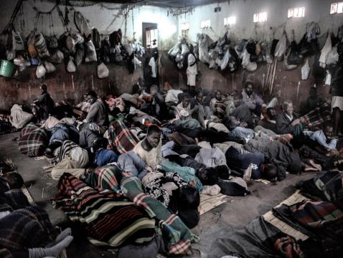
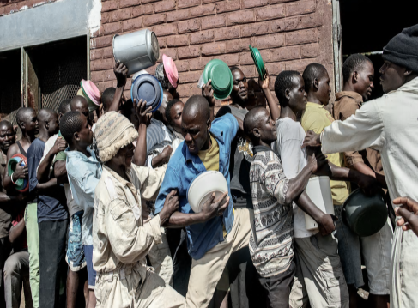
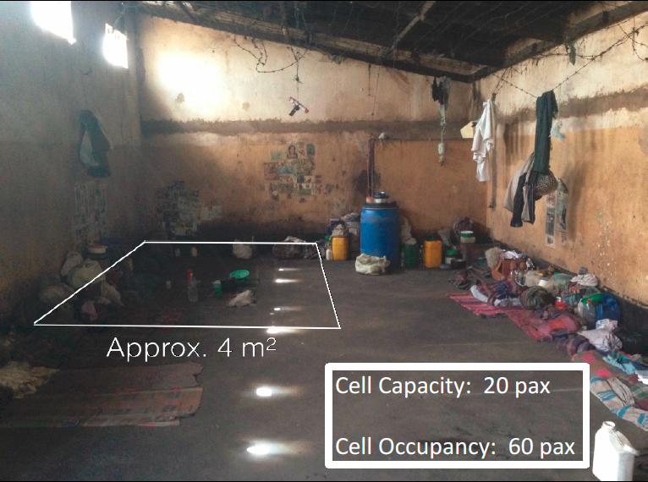
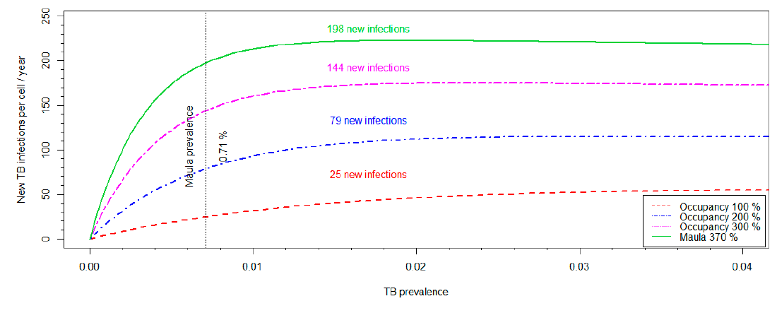
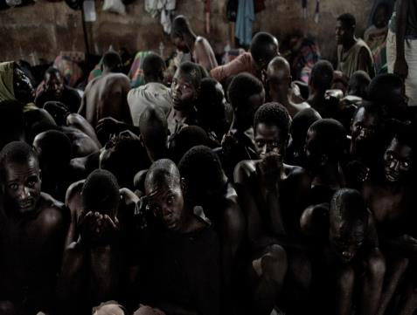
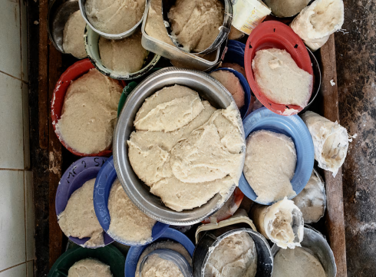
Context
Lack of hygiene, inadequate sanitation → diarrhoeal & skin disease
Degrading treatment, internal dynamics→ violence
Courtesy Luca Sola/MSF
Courtesy Luca Sola/MSF
Overcrowding (>340% capacity), poor ventilation → TB and resp infections
Inadequate nutrition → malnutrition, vit deficiencies (e.g. pellagra, iron def
Courtesy Luca Sola/MSF
Courtesy Luca Sola/MSF
Notes:
Other issues
Overcrowding of over 340% (Maula prison built for 800, housing over 2700, Chichiri built for 570, housing just shy of 2000)
Lack of hygiene, sanitation, inadequate ventilation – communicable disease (diarrhoeal illness, fungal skin, scabies, respiratory illness, opportunistic infections in HIV).
Inadequate nutrition: 1 meal nzima per day (maybe beans once per week). Severe malnutrition rate >10% with several cases of pellagra and other nutrient deficiencies monthly.
A mathematical modelling
The dotted black line represents
the sputum positive pulmonary TB prevalence in Maula Prison (0.71%). The figure demonstrates the effect of
cell occupancy and overcrowding on annual TB transmission, assuming a static population. In reality, the large
monthly influx of susceptible individuals and release of infected individuals means that the figures presented
are lower than is actually the case.
The green line represents the numbers of new TB infections per year with the current prison occupancy of
370%. At this cell occupancy (228 inmates), with a sputum-positive TB prevalence of 0.71%, assuming all noninfected
individuals are susceptible, there will be an estimated 198 new infections of susceptible individuals per
year. As occupancy declines, represented by the pink (300%), blue (200%), and red (100%) lines, the probability
of infection also declines with 144, 79, and 25 new infections annually respectively. This figure illustrates the
impact of decongesting cells on numbers of new TB infections in prisons per year, which may also help to
reduce the TB burden in the surrounding communities.

Slide 3
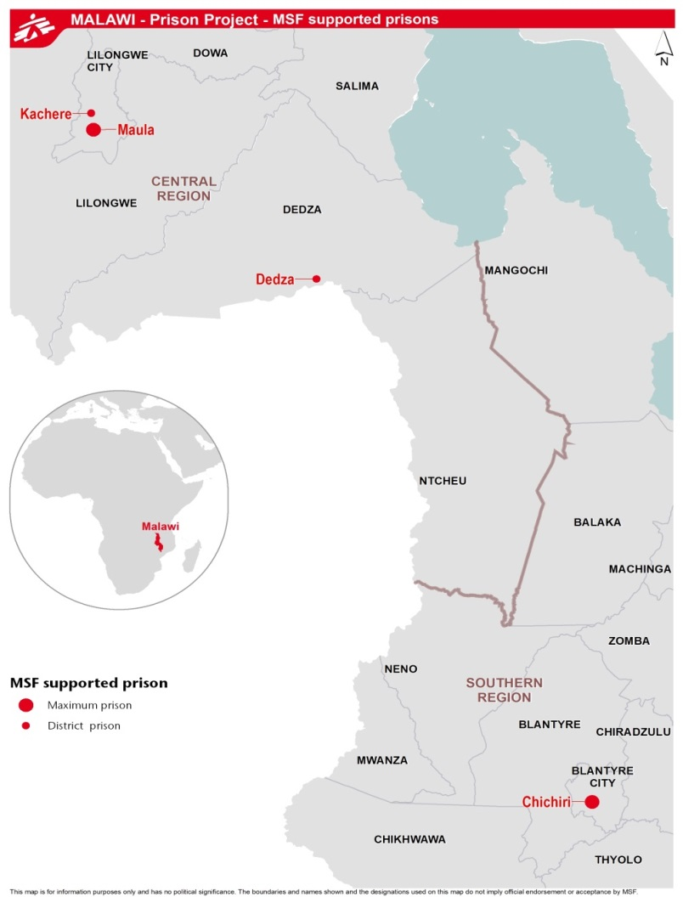
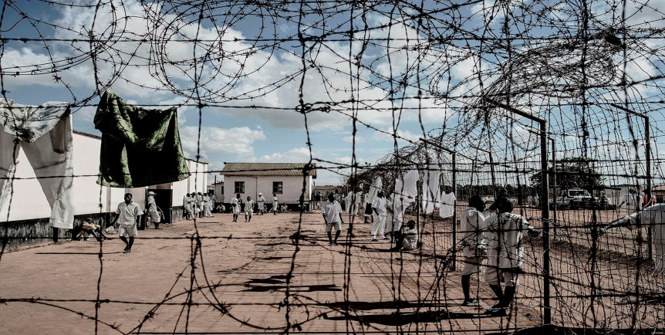

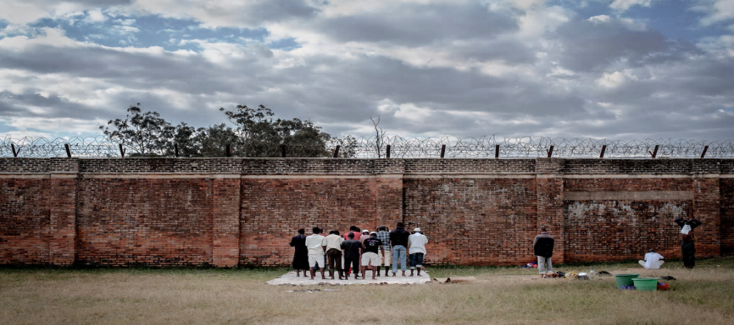
Project setting
Maula Prison
2770 prisoners
HIV prevalence: 14.2% (95% CI: 12.8–15.7%)
vs. 11.8%* in Lilongwe
Courtesy Luca Sola/MSF
Chichiri Prison
1870 prisoners HIV prevalence: 22.5% (95% CI 20.3–24.9%) vs. 18.2%* in Blantyre
Courtesy Luca Sola/MSF
*Malawi PHIA. Ministry of Health. 2015-2016.
Courtesy Luca Sola/MSF

Slide 4
MSF Program = 3 Phase model
ENTRY
Comprehensive Screening
STAY
OPD Care
EXIT
Exit Screening
HTC
TB symptomatic screening and followed by MTB/RIF GeneXpert and/or sputum microscopy
Hep. B Vaccination
STI/Syphilis rapid test
OIs & STIs
Lab services
GXP
Microscopy
VL
RDT
Hep. B Vaccination
PSU/HP
PEP
ART/TB Adherence
EAC
Psycho-social care
HP/IEC
HTC
TB symptomatic screening and followed by MTB/RIF GeneXpert and/or sputum microscopy
STI/Syphilis rapid test
Hep. B Vaccination
Transfer out with adapted drug refill
Medical Assessment
T&T (2016)
Nutritional status assessment
Routine Screening (biannually)

Slide 5
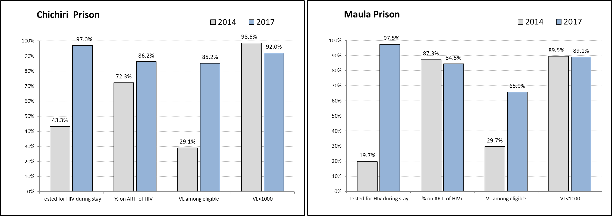
HIV Cascade of care, 2014 & 2017
Notes:
Data on performance from annual report I did (database Feb 2018). In Maula – we had lower VL coverage since 2nd Q of 2017 vs then Maula did before (was there something with lab in 2017, as I recall). All indicators for cascade – status as of end of a period (here – as end Q4 2017).
Maula in particular.

Slide 6
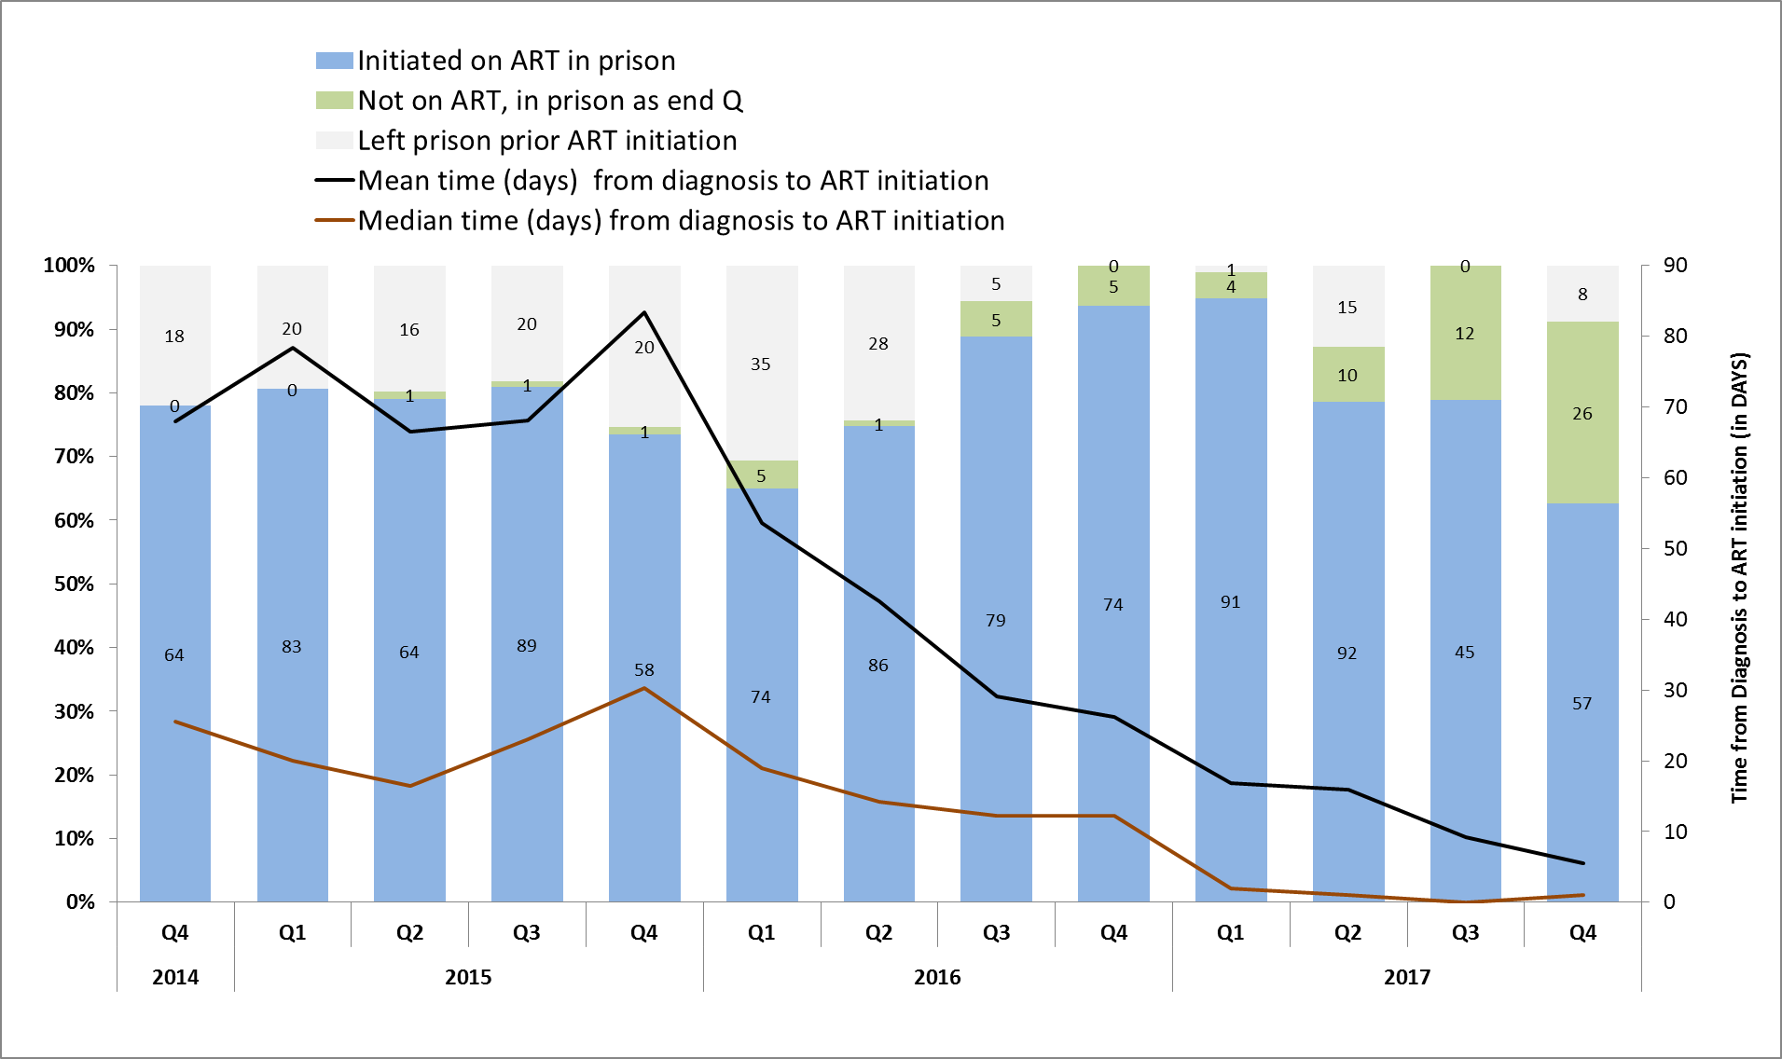
ART Initiation among newly diagnosed

Slide 7
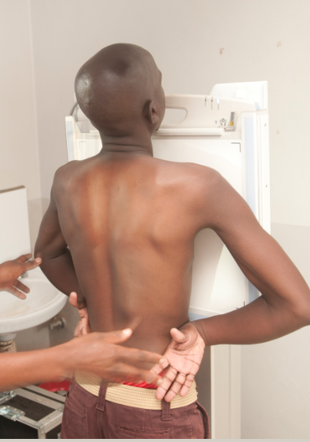
Aim
This study aims to assess how TB case-finding changed between 2014 and 2017, and to determine factors associated with developing TB disease whilst in prison.
2015
+ GeneXpert
2016
2017
+ X-ray
2014
Symptomatic Screening
Reinaldo ORTUNO, MSF, Improving tuberculosis case finding in Malawian prisons
Courtesy Arjen van de Merwe/MSF
Notes:
In 2014 MSF introduced a comprehensive screening package
Since 2015, it included symptomatic screening, followed by MTB/RIF GeneXpert and/or sputum microscopy.
In 2017 MSF, working with Challenge TB, carried out a mass campaign using digital X-ray as an additional screening tool.

Slide 8
Methods
This is a retrospective analysis of routinely collected data from 2014-2017.
Case notification rate was calculated for new cases (self-reported as never previously treated).
To determine the person-time at-risk, we used a sum of monthly inmate count excluding time on TB treatment for incident cases.
We used a 3 month cut-off to separate prevalent cases on entry from incident cases.
We applied multivariate logistic regression to assess factors associated with development of TB.
This analysis met the criteria of the MSF ERB for exemption
Reinaldo ORTUNO, MSF, Improving tuberculosis case finding in Malawian prisons

Slide 9
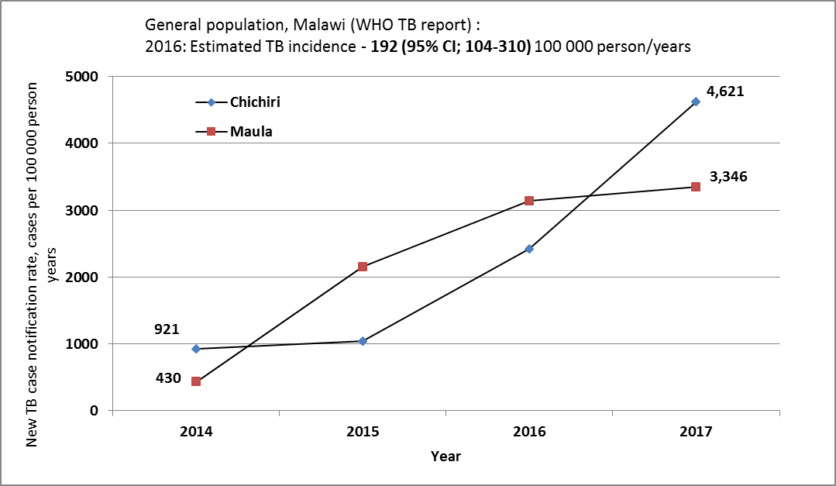
Results – TB case notification
Notes:
Between 2014 and 2017, TB case notification per 100 000 population increased from 921 to 4 621 in Chichiri, and from 430 to 3 346 in Maula prison (review if correct)

Slide 10
Results: Patients characteristics
Between 2014-2017, 468 TB cases notified, 63 (13.5%) had extra pulmonary TB, 464 (99%) were males, median age was 32 years (IQR; 26-38), 213 (46%) were TB/HIV+, and 81/386 (21%) had BMI< 18.5.
 | Total TB cases | New | Retreatment* | Rate per 100000 | EPTB (% of total ) | TB/HIV
Chichiri
2014 | 17 | 16 | 1 | 921 | 0 | 8 (42%)
2015 | 18 | 18 | 0 | 1036 | 4 (18%) | 11 (61%)
2016 | 54 | 46 | 8 | 2416 | 9 (16%) | 36 (67%)
2017 | 109 | 89 | 20 | 4621 | 11 (10%) | 52 (48%)
Maula
2014 | 13 | 11 | 2 | 430 | 4 (31% ) | 6 (43%)
2015 | 58 | 55 | 3 | 2149 | 6 (10%) | 25 (42%)
2016 | 90 | 85 | 5 | 3137 | 8 (9%) | 30 (33%)
2017 | 109 | 95 | 14 | 3346 | 21 (19%) | 45 (41%)
ALL, 2014-2017 | 468 |  |  |  | 63 (13.5%) | 213 (46%)
Notes:
N=468 – those diagnosed in prison; transfer-ins excluded (diagnosed elsewhere but TI into a prison when already on treatment).
Retreatment= relapses +retreatment.
For the 468 TB cases seen, 63 (13.5%) had extrapulmonary TB, 464 (99%) were males, median age was 32 years (IQR; 26-38), 213 (46%) were TB/HIV+, and 81/386 (21%) had BMI< 18.5.

Slide 11
Risk factors for developing TB in prison
Both prisons, N incarcerations = 17.009
N TB disease after >=3 months since entry into prison=376/468
Of the 468 TB cases detected, treatment was provided for all.
 | N | Adjusted Odds Ratio | 95% CI | p-value
HIV status
HIV negative/unknown | 13620 | ref
HIV positive | 3389 | 3.8 | 2.9 - 5.2 | <.0001
BMI
BMI>=18.5 | 15113 | ref
BMI <18.5 | 1896 | 2.0 | 1.4 - 2.8 | <.0001
Time incarcerated
<12 months | 8,731 | ref
>=12 months | 8,270 | 7.1 | 4.7 - 10.6 | <.0001
Notes:
Risk of developing TB was significantly associated with being HIV+ (aOR=3.8, 95%CI 2.9–5.2; p< .0001), BMI < 18.5 (aOR=2.0, 95%CI 1.4–2.8, p< .0001), and being incarcerated for > 1 year (aOR=7.1, 95%CI 4.7–10.6; p< .0001).

Slide 12
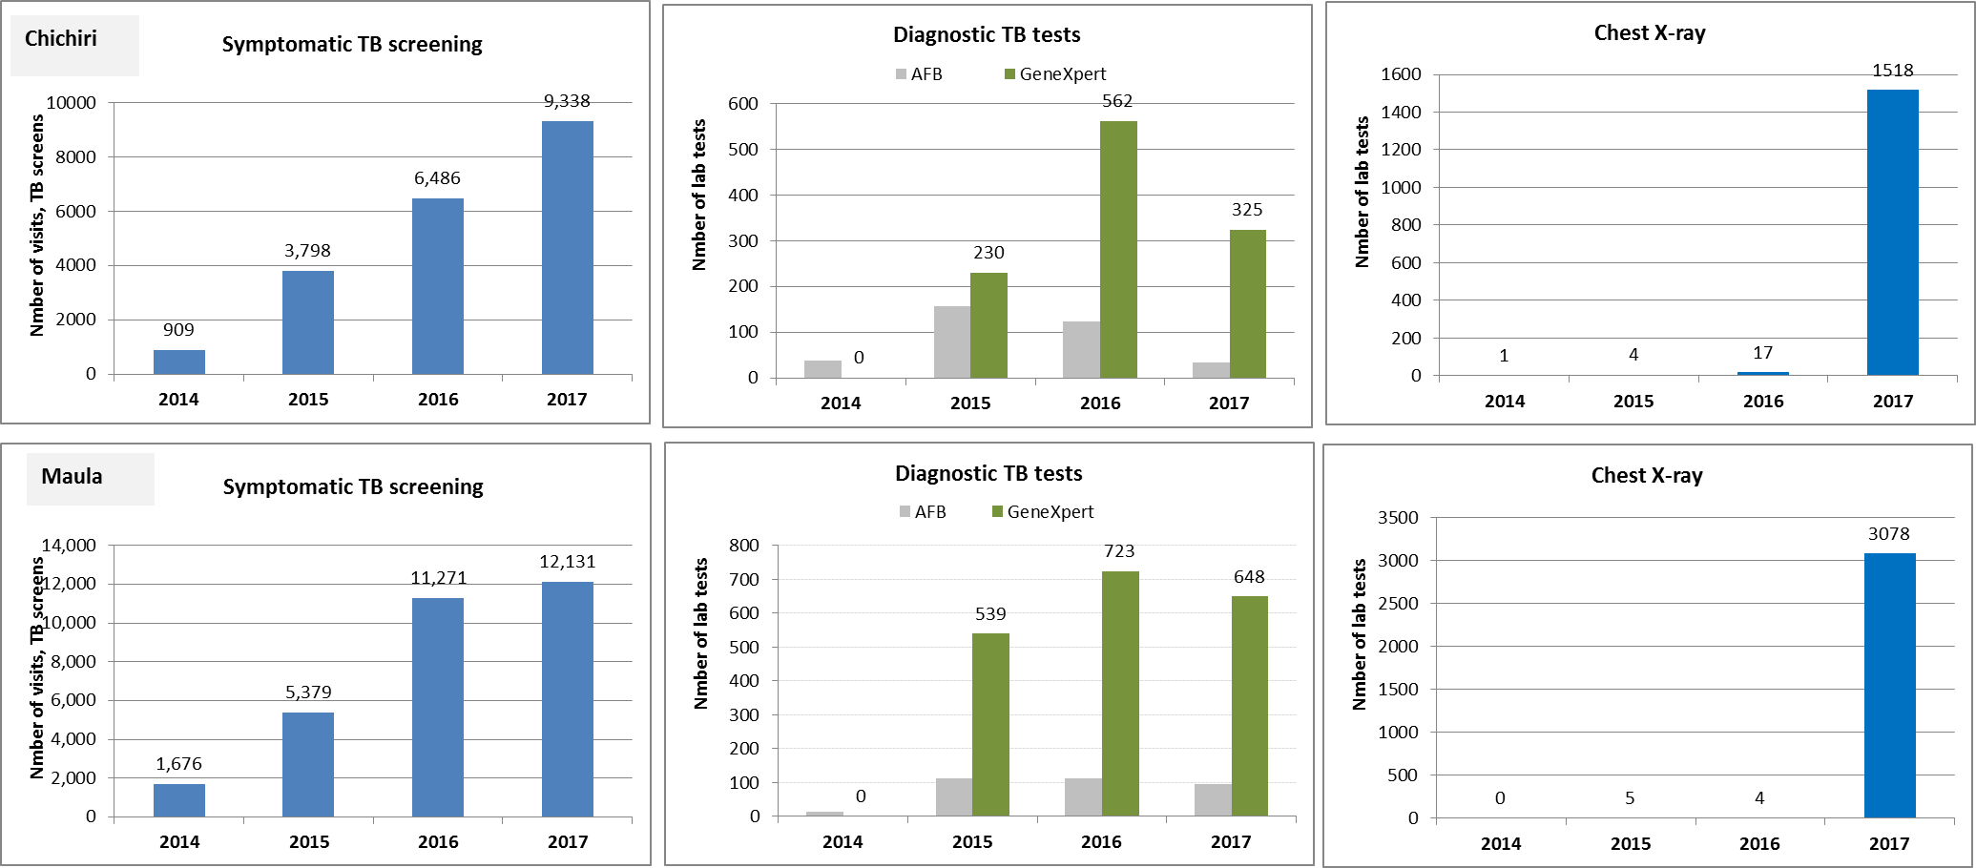
Screening and lab tests for TB

Slide 13
Limitations
Retrospective review with limitations of data at the beginning of the project in 2014/2015.
M&E system improved end 2015 forward.
High turn over of prison population (dynamic population)
Reinaldo ORTUNO, MSF, Improving tuberculosis case finding in Malawian prisons

Slide 14
Conclusions
Malawi prisons remain a high risk setting for acquiring or developing TB disease.
Implementation of systematic TB screening may have significantly improved TB case finding.
This model can be replicated in similar contexts.
Preventive therapy for eligible prisoners should be considered to prevent development of TB among this high-risk population.
Reinaldo ORTUNO, MSF, Improving tuberculosis case finding in Malawian prisons

Slide 15
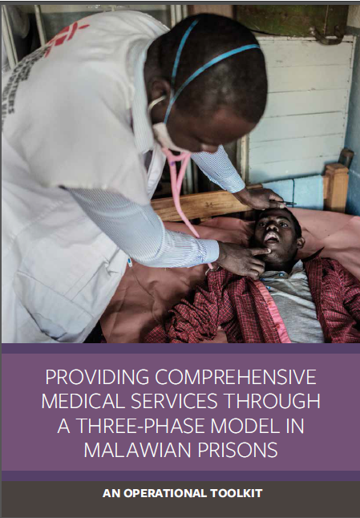
What’s next
https://samumsf.org/en/resources/hiv/key-populations/prisons
Share this experience among other prisons in Malawi and/or similar projects
Continued advocacy about overcrowding, food, living conditions, etc.
“TB free prison proposal” early identification of active TB through comprehensive screening (including X-ray at entry/stay/exit) and new prevention strategies (treatment for LTBI)
Courtesy Arjen van de Merwe/MSF
Reinaldo ORTUNO, MSF, Improving tuberculosis case finding in Malawian prisons

Slide 16
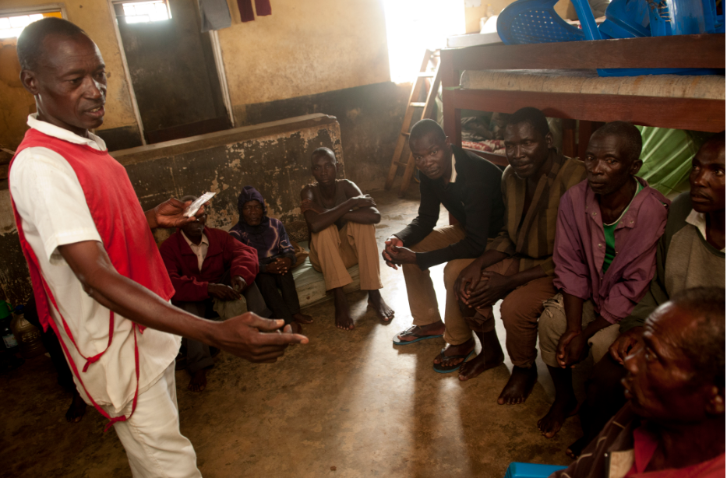
Acknowledgements
To all the medical and non-medical staff working in Malawian prisons
To the prisoners themselves
Malawian Prisons Health services
MSF team in the field and HQ
SAMU
"We confirm that we have permission to use images from the participants / patients / individuals included in this presentation".
Courtesy Arjen van de Merwe/MSF

