Slide 1


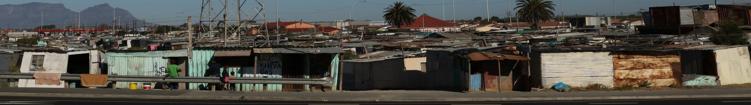

Palliative care for patients with drug-resistant tuberculosis: case description
Cape Town South Africa
By Leigh Snyman

Slide 2

Case Description
Why focus on palliative care?
  DR-TB is a major source of morbidity and mortality
  In South Africa, treatment is successful in only about half of those diagnosed and started on therapy.
Notes:
Notes:
Drug-resistant TB (DR-TB) is a major source of morbidity and mortality
In South Africa, treatment is successful in only about half of those diagnosed and started on therapy

Slide 3
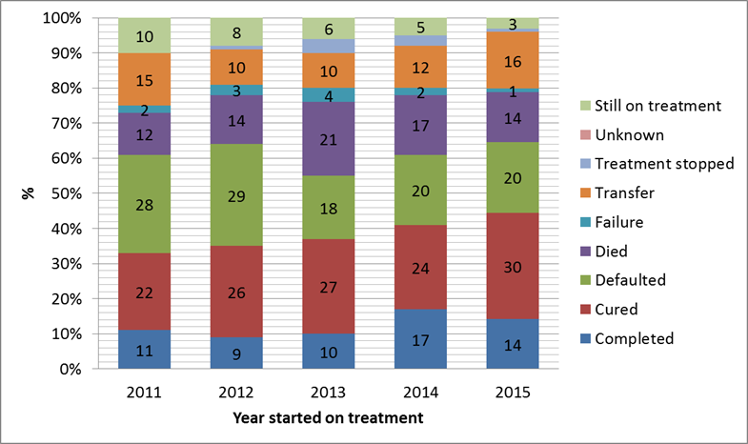
24-month treatment outcomes based on year of treatment initiation

Slide 4
Palliative Care with in DR-TB?
Diagnosis
Clinical Management
Terminal Phase
Curative/ life prolonging therapy
Palliative management
Notes:
Traditional view / understanding
Palliative care only needed when curative care is stopped/ ended
Traditional versus Early Palliative CareIn the traditional care model, palliative care is instituted only after life-prolonging or curative treatment is no longer administered. In the integrated model, both palliative care and life-prolonging care are provided throughout the course of disease. Adapted from the Institute of Medicine

Slide 5
What is Palliative Care?
WHO Definition of Palliative Care:
Palliative care is an approach that improves the quality of life of patients and their families facing the problems associated with life-threatening illness
Methods:
Prevention and relief of suffering
Assessment and treatment of pain and other problems, physical, psychosocial and spiritual
WHO 2010
Notes:
WHO Definition answer the question-

Slide 6
The true place of Palliative care
HOLISTIC CARE
SUPPORTIVE CARE
Diagnosis
Clinical Management
Terminal Phase
Curative/ life prolonging therapy
Palliative management
Notes:
Traditional view / understanding
I would take this part off the slide and talk through it. Too much on slide with it and it allows you to say something different to what is on the slide. Changed format at bit.
Counseling Session focus
Comprehension of the disease progress and possible prognosis
Treatment options for RR-TB but also acute episodes and co-morbid conditions
Psychosocial support options

Slide 7
Father
Full time employed
Mr. N and father has a conflictual relationship
Mother
Unemployed
Mother is concerned about infection control
Poor communication with oldest son
Well spoken
Appear weak and timid, struggling with shortness of breath
Refused further management of DR-TB treatment and shows fair insight regarding consequences
9
7
20
23
Genogram key:
Female
Male
Patient
7
Age
Notes:
Notes:
23 year old male
Fourth DR-TB treatment episode
Has a history of adherence challenges
Has a history of verbal aggression towards HCWs
Positive cultures indicated treatment regimen failure
DR-TB drug advisory and ethics committee decided - further treatment attempts must happen in hospital
Mr. N refused further treatment and clinic care.

Slide 8
Patients Needs assessment
Shortness of Breath
Physical
Coughing
Pain
Financial concerns
Psychosocial
Family Dynamics
Spiritual Pain
Infection control
Contacts at risk

Slide 9
The Four Core Ethics Principles
Autonomy
Patient has the right to choose or refuse treatment
Beneficence
Medical team act in the best interest of the patient
Non Maleficence
First do no harm
Justice
Health resources should be distributed equally
Notes:
Notes
Autonomy – Patient has the right to choose or refuse treatment-
The Health care team partnered with the social work team to manage the families needs
With limited home based care services available to DR-TB patients the MSF medical team offered the service to Mr. N
Assistance given regarding Infection control education, planning & supplies.
Counselling support for the patient & family to prevent family discord because of families lack of insight and acceptance of patient’s choice
Beneficence – Medical team acts in the best interest of the patient
Home visits allowed for patient centered assessment and management of symptoms
Patient centered approach allowed patient to consider the pros and cons of pursuing legal avenues to enforce treatment adherence were discussed with the patient and the family
Non- maleficence – First do no harm
The patient and the family were considered in the planning and implementation of care plans
Justice – Health resource need to be distributed equally
Patients past history with HCWs did not become a barrier to care

Slide 10
Conclusion/ Take away message
Palliative Care is essential with DR-TB treatment management
Palliative care Policies and implementation plans require:
Resources
partnerships with social and legal agencies
home based nursing /counselling services
access to palliative care medicine

