Slide 1


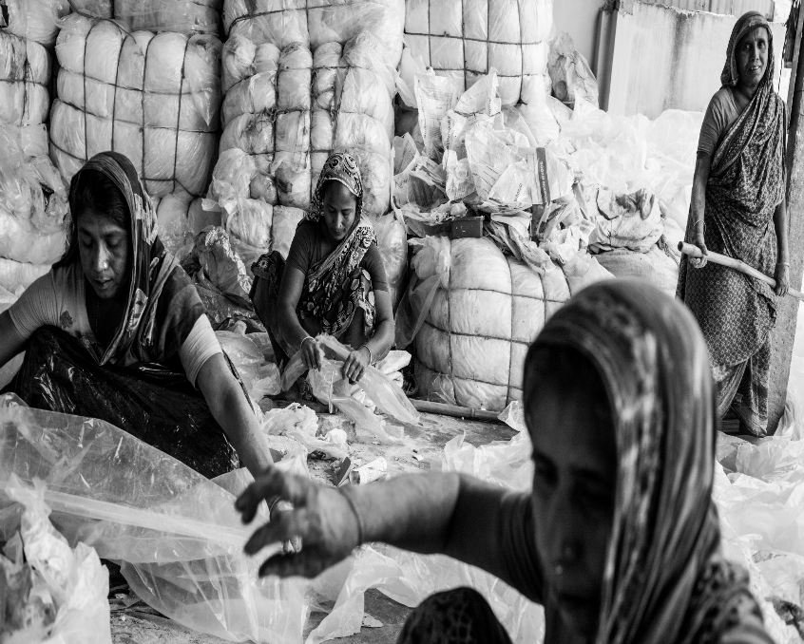
Morbidity and occupational risks among factory workers in an urban slum, Dhaka, Bangladesh: a retrospective analysis
Sofiul Islam, Martins Dada, Gudrun Freidl, Lois O'Connor, Mitchell Sangma,
Rashed Mahfuzullah, Mahmud Imran Talukder, Akke Boere, Gary W. Bangs, Patrick Almeida, Kostas Danis, Grazia Caleo
© BrianScott

Slide 2
What is Occupational Health (OH)?
“Branch of medicine which deals with the maintenance of health in the workplace, including the prevention and treatment of diseases and injuries”
Source: McGraw-Hill Dictionary of Scientific & Technical Terms

Slide 3
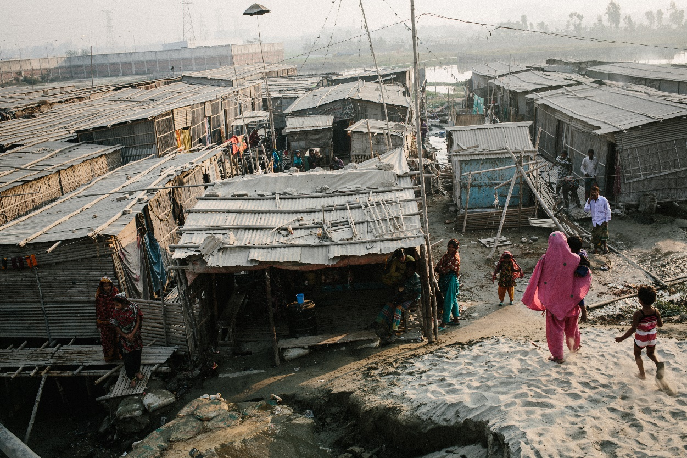
Kamrangirchar slum, Bangladesh
- Most crowded slum in Dhaka: 400,000 inhabitants in 3.68 km²
- Unknown number of small-scale factories:
aluminium, lead, plastic, garment, metal
- Until 2017 tanneries located in neighbouring Hazaribagh
© HanaConnor
Figure 1: Kamrangirchar slum

Slide 4
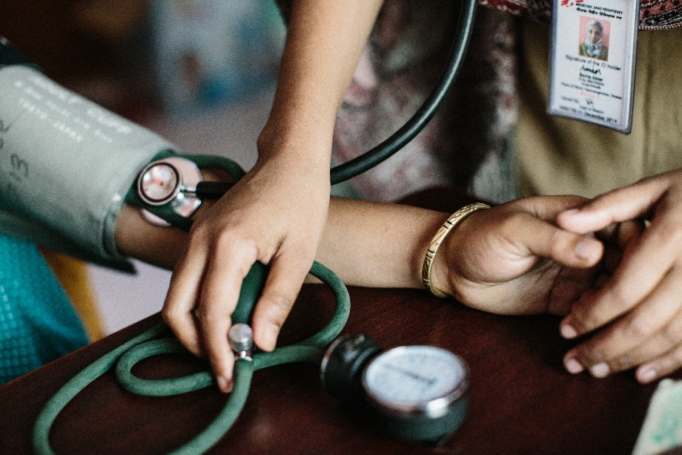
MSF in Kamrangirchar slum
Since 2014 MSF provides 3 main services:
Sexual and reproductive health
Sexual/intimate partner violence
Occupational health:
- OH illness/injury care
- Tetanus vaccination
- Health promotion
- Assess work hazards
© HanaConnor
Figure 2: Clinics

Slide 5
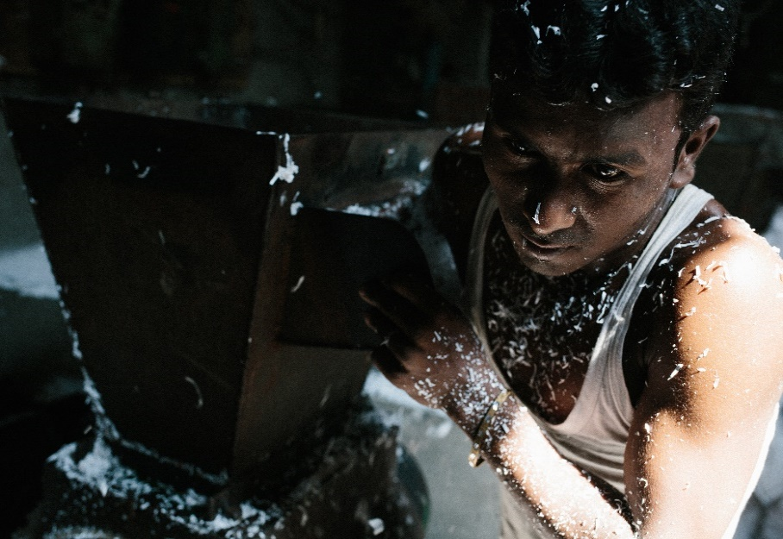
Reasons for OH interventions
  In 2012-13 four major incidents in Bangladesh resulted in 1,261 deaths (Rana Plaza)
  Between 2013-15 MSF surveys showed:
    -Marginalised working populations
    -Poor access to care
    -High injury rate and diseases
    -Lack of tetanus vaccination
    -Safety service very limited
© BrianScott

Slide 6
Objectives
To assess hazards inside the factories with whom MSF has agreed consent
To describe the morbidities for adult (≥ 18 years) and minor (< 18 years) workers consulted at MSF OH clinics

Slide 7
Methods 1/2
Factory hazard assessment, conducted in 2017 by industrial hygienist and outreach team
Check list to assess hazards:
1. General physical safety
-e.g. safe drinking water
2. Control measures
-e.g. chemicals stored in closed labelled containers
3. Protective equipment
-e.g. hand protection
4. Ergonomics
-e.g. workers holding the same position for prolonged time

Slide 8
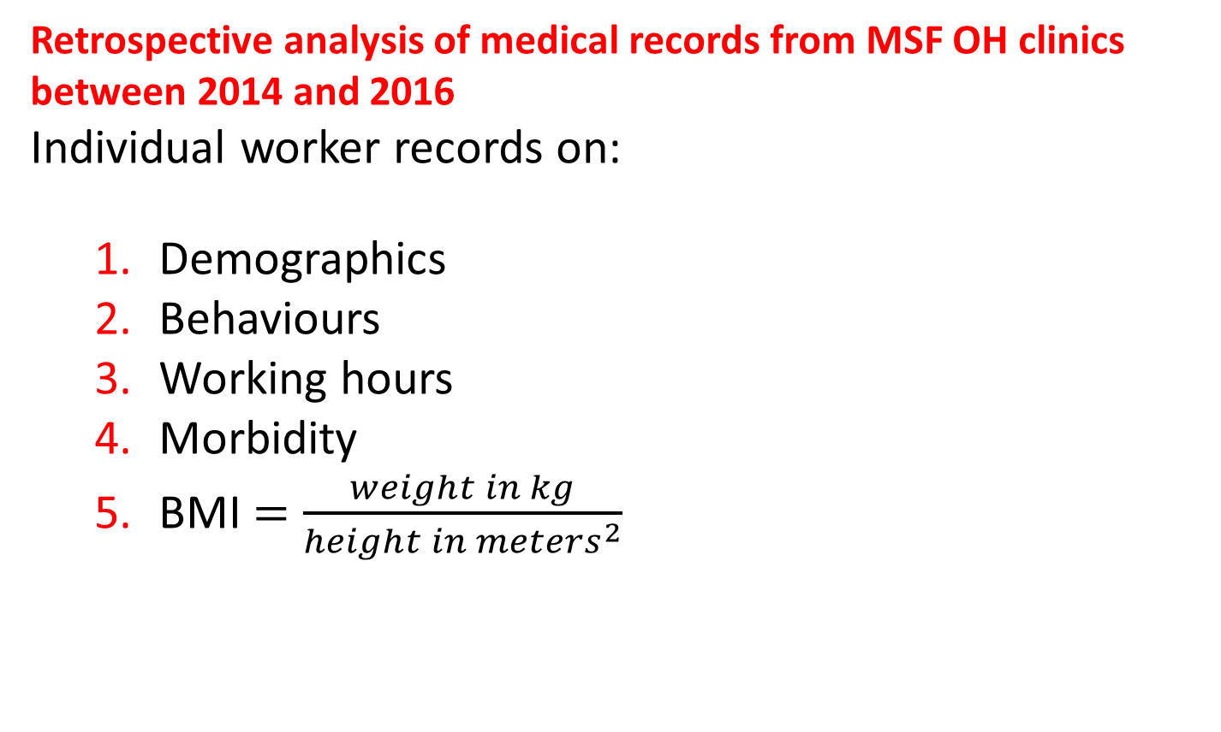
Methods 2/2
Retrospective analysis of medical records from MSF OH clinics between 2014 and 2016
Individual worker records on:
  Demographics
  Behaviours
  Working hours
  Morbidity
  BMI $=\frac{weight in kg}{{height in meters}^{2}}$

Slide 9
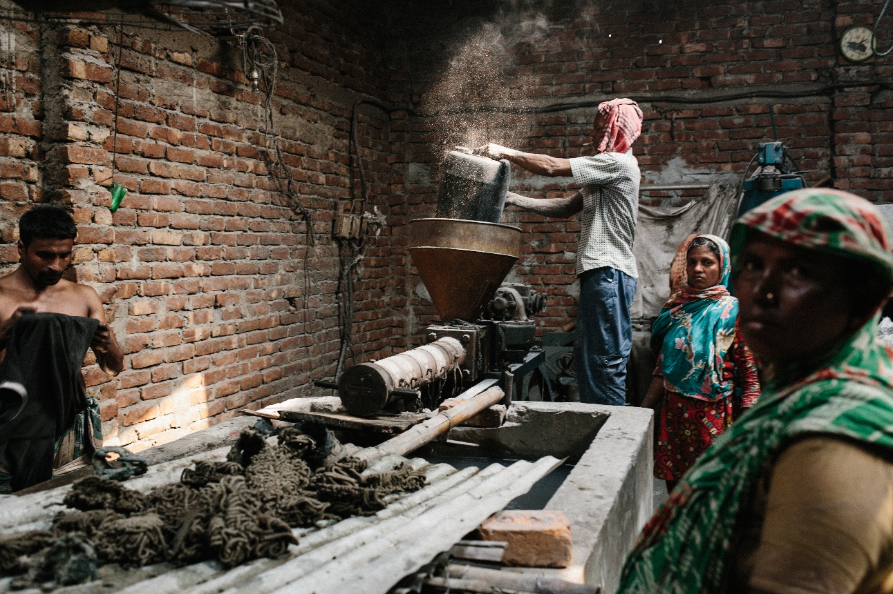
Results
Factory Hazard Assessment
© HanaConnor

Slide 10
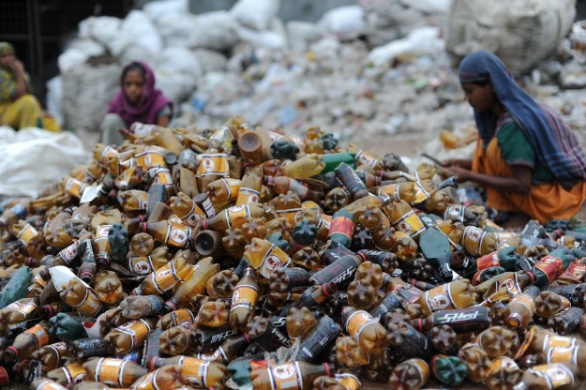
Results
Factory hazard assessment
98% (151/153) factories participated
Representing working condition of 5,084 workers
©Julie Remy
 | Factories |  | Average # of total workers per factory type
Factory type | # | %
Metal | 34 | 22.5 | 18
Plastic | 36 | 23.8 | 32
Garments | 38 | 25.2 | 25
Leather | 2 | 1.3 | 190
Tannery | 39 | 25.8 | 50
Glue | 2 | 1.3 | 25
TOTAL | 151 | 100.0

Slide 11
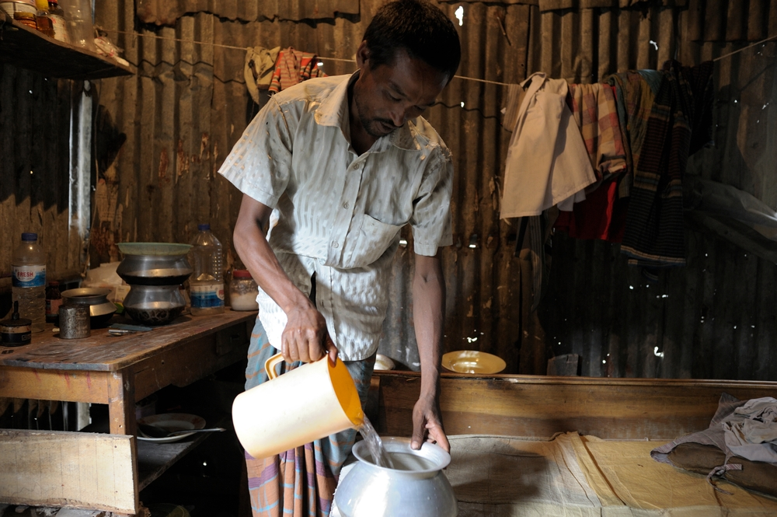
Results
General physical safety
< 10% of factories provide safe drinking water for workers
78% did not have soap
© Stanley Greene

Slide 12
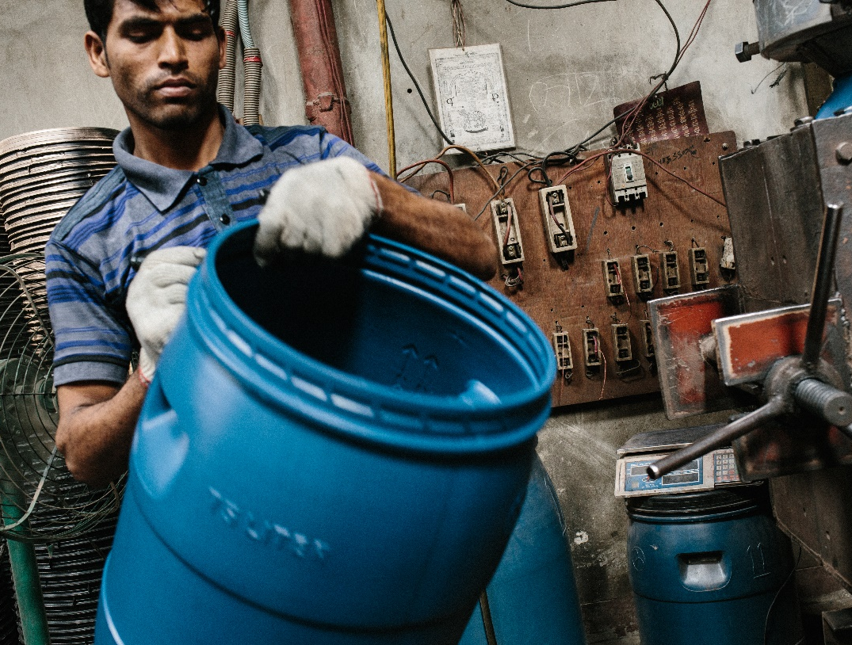
Results
Control measures
94% failed to label and store chemicals safely
95% had moving machine parts uncovered
© HanaConnor

Slide 13
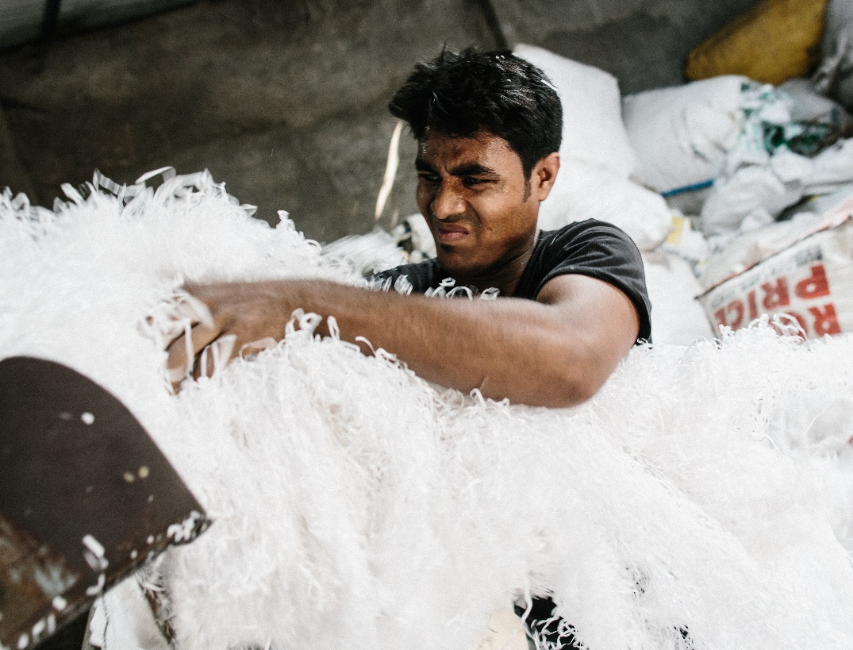
Results
Protective equipment
Almost none (<1%) had adequate personal protective equipment in place
No eye, ear, dust protection observed
© HanaConnor

Slide 14
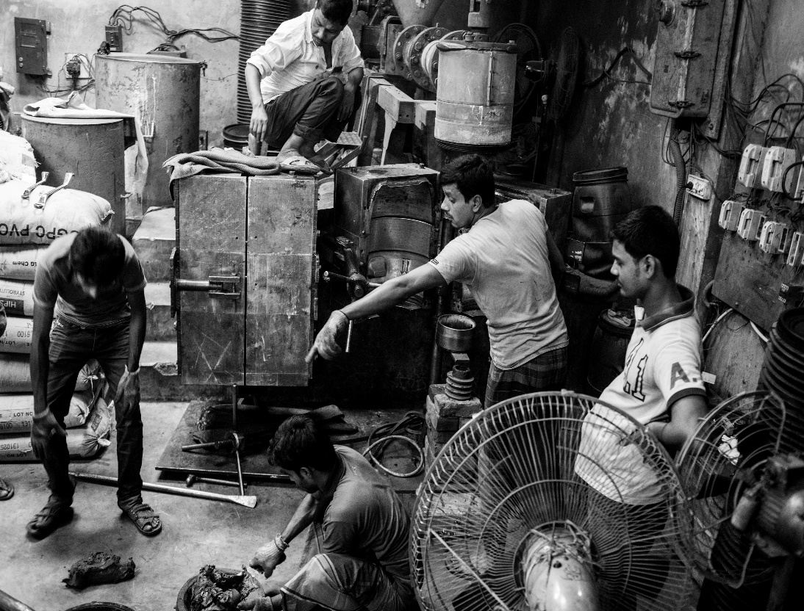
Results
Ergonomics
66% of the metal, plastic and garment factories did not provide an ergonomic working environment
78% of workers performed task above shoulder level
© BrianScott

Slide 15
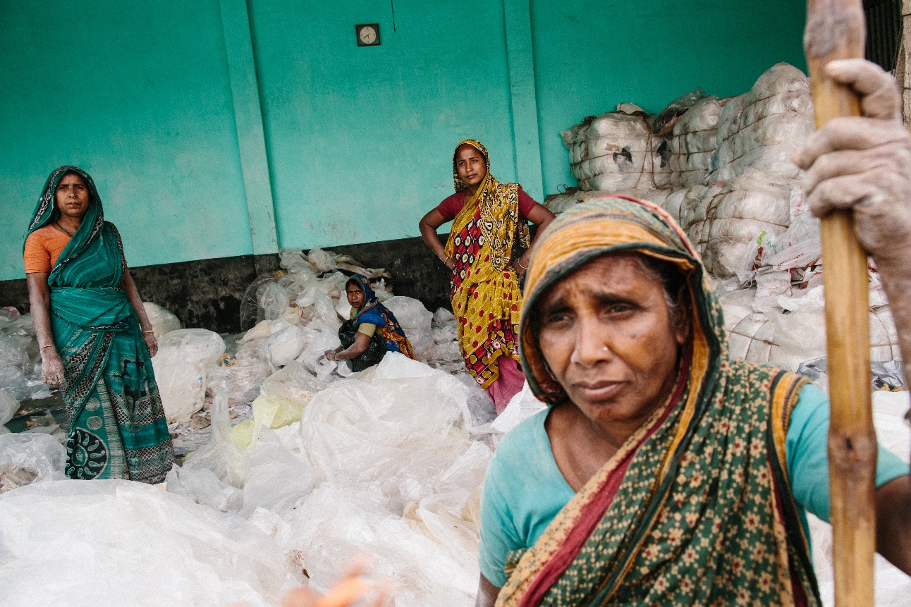
Results
Medical records
© HanaConnor

Slide 16
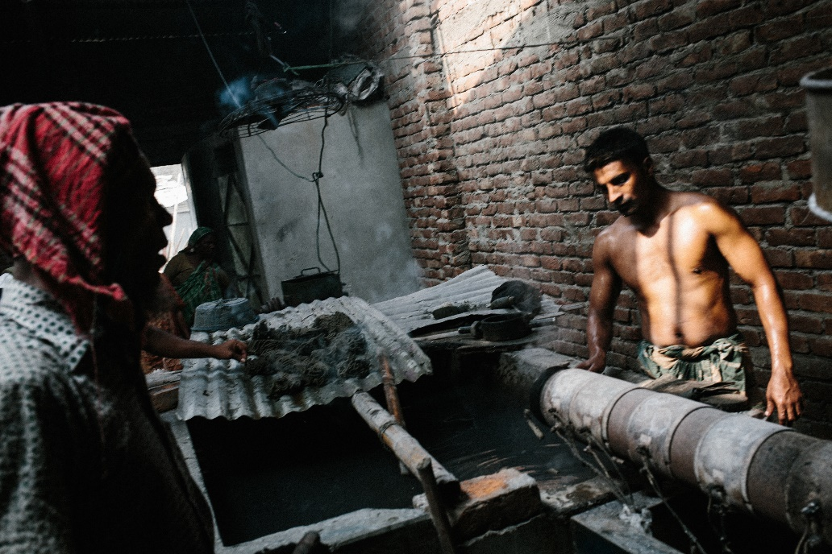
Results
Between 2014 to 2016
5,198 workers consulted:
- 82.6% adults (n=4,291)
- 17.4% minors (n=907)
© HanaConnor

Slide 17
Results
Variables | Adults | Minors
Median Age (IQR) | 27 years (22-35) | 15 years (13-16)
Sex (male %) | 76.2 | 71.3
No education % | 55.1 | 56.9
Living in a factory % | 15.7 | 21.8
Ever chewed betel nut % | 26.2 | 4.5
Factory type %
Metal | 13.4 | 19.2
Plastic | 20.9 | 19.7
Garments | 17.5 | 32.0
Leather | 23.1 | 13.7
Tannery | 24.4 | 14.2
Other | 0.7 | 1.2

Slide 18
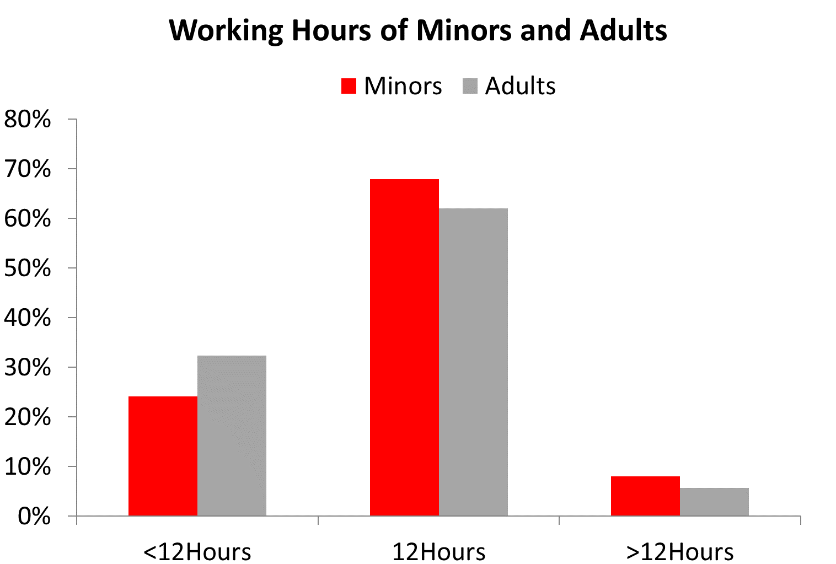
Results

Slide 19
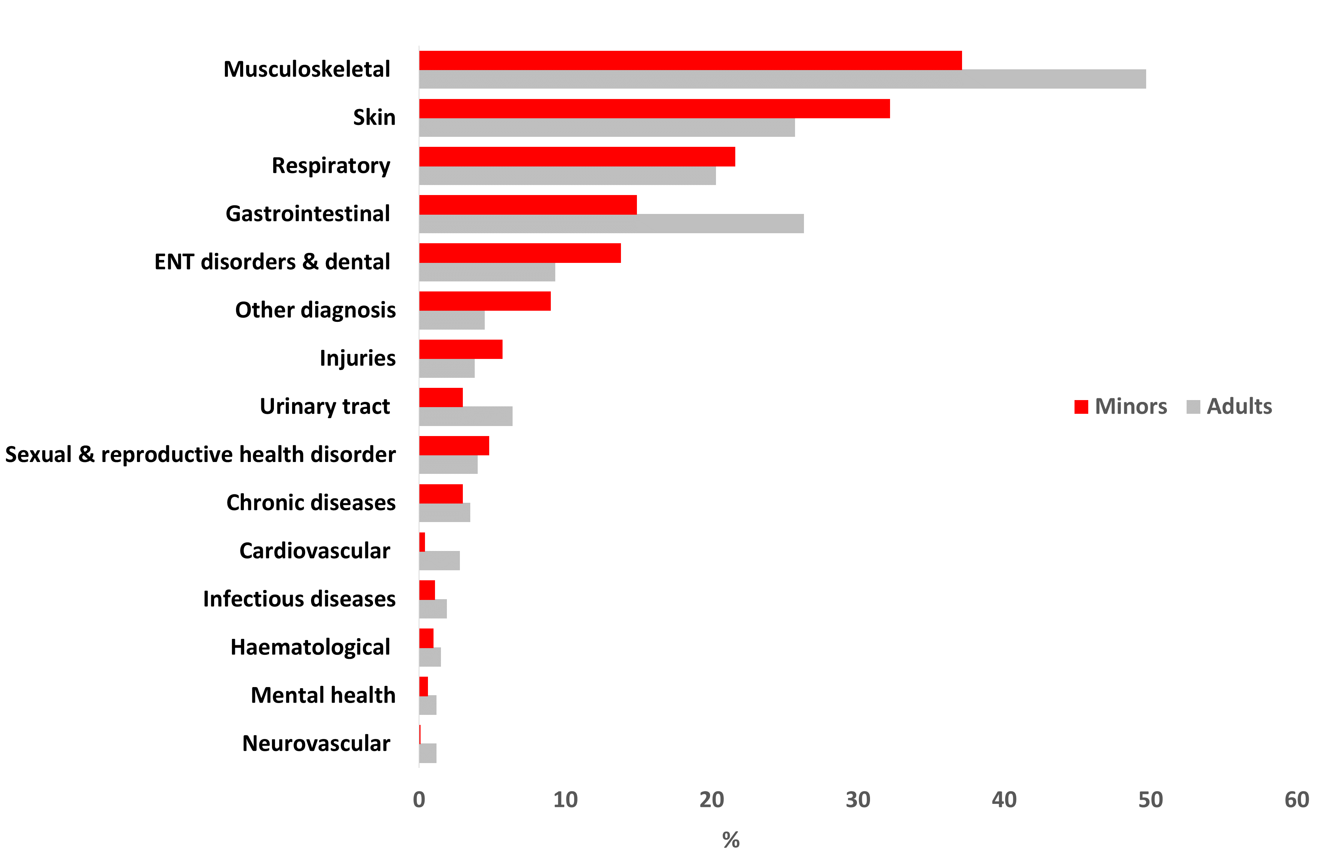
Results
Morbidity

Slide 20
Results
BMI
Body Mass Index | Adults | Minors
Severely underweight (<16.5) | 3.7 | 26.3
Underweight (16.5-18.4) | 21.2 | 46.0
Normal (18.5-23.9) | 56.4 | 25.9
Overweight (>=24) | 18.7 | 1.9

Slide 21
Limitations
Findings may represent pattern of morbidity amongst those accessing care, not amongst worker population generally
Misclassification of conditions may have occurred
Factories agreeing to participate in hazard assessment may have differed from factories generally

Slide 22
Conclusion
New challenging field for MSF (require specific expertise e.g. occupational specialist, industrial hygienist)
Analysis documents lack of hazard protection and poor health in a marginalized population
Patterns of morbidity were potentially illustrative of poor working conditions

Slide 23
Lessons learned
Improve access to health care, including systematic nutritional screening
Include factory hazard assessment as a standard step in our OH interventions
Support implementation of interventions to improve work safety

Slide 24
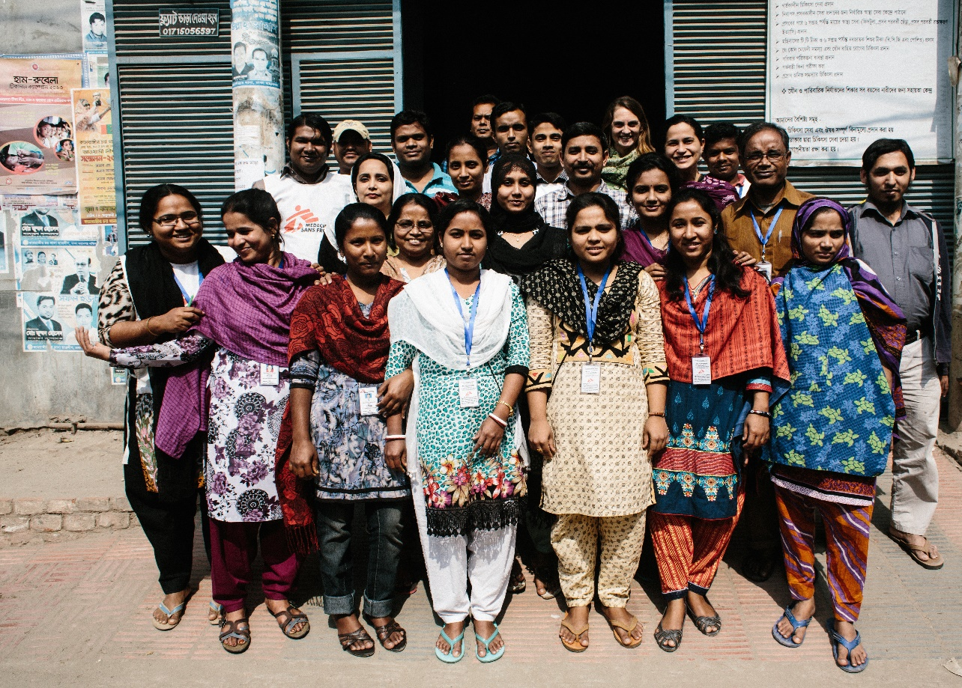
Acknowledgements
MSF Team
Raphael Brechard
MSF Patients
Nell Gray
“We confirm that we have obtained permission to use images from the participants/patients/individuals
included in this presentation”
© HanaConnor

